Slide 1
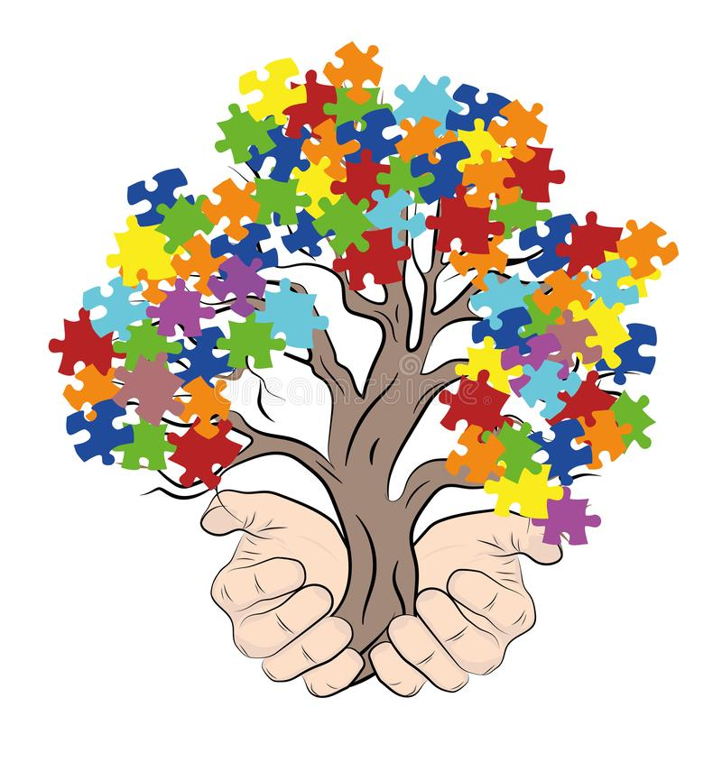
The Effects of Self-Management Training on Individuals with Autism
By: Jolene Fray, Monmouth University Email: s0982123@monmouth.edu
Image:https://www.dreamstime.com/illustration/autism-tree.html
Background
What is Autism? (Xin et al., 2017)
1 in 68 youths are diagnosed with Autism (“The Center for Disease Control and Prevention”, 2012, as cited in Xin et al., 2017)
Barriers for individuals with Autism (Singh et al., 2011)
Barriers of Autism may include, but are not limited to: stereotyped, repetitive, and/or aggressive behavioral characteristics (Singh et al., 2011) .
Deficits in self-management skills and attending skills (Holifield et al., 2010; Wilkinson, 2008, as cited in Xin et al., 2017)
What is self-management training? (Turnball & Turn-ball, 2001, as cited in Xin et al., 2017)
Key Components of Self-Management Training
1. instruct the individual to discern the occurrence of the targeted behavior ( Blood et. al, 2011, as cited in Xin et al., 2017)
2. Educate the individual to record his or her self concerning the occurring behavior ( Blood et. al, 2011, as cited in Xin et al., 2017).
Purpose
The purpose of this presentation is to discuss the the effects of self-management training on individuals with Autism Spectrum Disorder (ASD)
Methods
21 peer-reviewed journal articles were analyzed
Articles dated 2010 or later
5 databases were searched
The criteria for inclusion in my research were that all participants in the study had to have a diagnosis of ASD and exhibit some form of deficits.
Diverse ages and ethnicities.
Ex.: Hispanic, White, and Asian.
Reflects the diversity of exceptional learners with Autism.
Key Words: self-management training, Autism, task acquisition, children, adults, adolescents, increases appropriate social behaviors, decreases inappropriate behaviors, self-monitoring, self-regulation, self-acceptance, autonomy
Findings: Themes
1. Self-management training increases appropriate behaviors.
Increased elaborate responses and question-asking (Koegel et al., 2013)
increased appropriate social behaviors and on-task behaviors (Liu et al., 2015)
Increased on-task behavior and math fluency (Legge et al., 2010)
Increased in classroom participation (Shorgren et al., 2011)
2. Self-management training fosters independence for individuals with Autism
Participant progressively became autonomous during the study (Kontogianni & Nanou, 2020)
Increased the probability of the participants’ engagement to independently make social initiations with others (Deitchman et al., 2010).
Demonstration of proactivity and independence with regards to completing homework tasks (Hampshire et al., 2015)
Increased independence in completing food preparation tasks (Bouck et al., 2014)
Increased independence to complete self-care (May & Heflin, 2013)
3. Self-management training decreases inappropriate behaviors
Decreased aggressive behaviors (Singh et al., 2011).
Decreased scripting behavior (Silla-Zaleski & Vesloski, 2010)
Decreased inappropriate eye gazes (Grynszpan et al., 2011)
Decreased inappropriate social behaviors (Gural et al., 2013)
Decrease regressive behaviors (Henderson et al., 2015)
4. Self-management training increases task acquisition and skills
Increased the writing ability of children with ASD (Asaro-Saddler & Saddler, 2010)
Increased academic accuracy in the subjects of language arts and mathematics (Holifield et al., 2010)
Positive impact on students and increased the participants’ academic engagement (Roberts et al., 2019).
Limitations
Limited journal articles analyzing the effects of self-management training on adults with Autism
Limited data regarding generalization of self-management training
Discussion
These findings are better correlated with children and adolescent age ranges than with Adults
Extensive research supports that self-management training is an effective form of intervention for children and adolescents with Autism
Strength: Diversity of participants
Weakness: limited data regarding adult participants and generalization
Implications
This literature review is relevant to home and academic settings
beneficial to the field of special education and applied behavior analysis
Future research:
Generalization in community settings
Effects of self-management training on adult individuals with Autism
The long-term impact of self-management training

