Slide 1
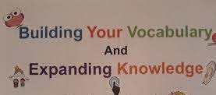
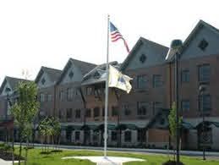
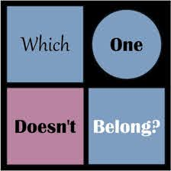
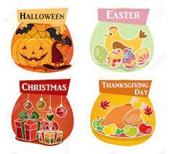
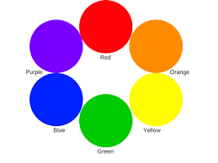
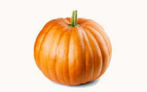
My Experimental Experience and Clinical Practice Reflections This Fall 2020 Semester
Anastasia Elementary School
For the duration of this semester, I spent my time in a Ms.Hochstaedter’s 5th grade class at Anastasia Elementary School. Interestingly enough, I spent time at this elementary school last semester to begin my experience in service learning, my intro to education class. That really helped me get started and lead me to where I am now. Then and now, I was at that school virtually during the time of this pandemic. This was was something I could never predict and something I had to settle in and get used to. It helped me in the end, as I now have experience working with students in a class online and have observed how a classroom can function, including how a class is conducted virtually.
Chris Landry
Monmouth University School of Education
As a service learner in my time of clinical practice, I got the opportunity this semester to observe a functioning classroom with teachers and students. This helped me see what a real life, functioning classroom looked like, and has been a huge part in my growth of working towards becoming a teacher. I was able to see students progress throughout the semester and learn more everyday, as they finish their final year of elementary school before moving on to middle school. Without this, I would not know as much as I do now. I have been able to see the teachers and those assisting the students in this classroom be patient and make accommodations for these students. Students needed time to fully learn and think through what they were learning. This semester, students in this class learned:
Reading
Writing
Vocabulary
Nouns
Past and present tense
Art , and how to express their emotions through art.
How did students learn and progress throughout the course of the semester?
This was no doubt a tough time for students this semester. Especially for these students in their last year of elementary school, it is a rough transition from what they previously have been through in their education and schooling the last several years. These students had to adapt and adjust to an online learning experience. All things considered, with everything this pandemic has thrown at them, these students responded and have done exceptionally well. I saw it first hand. They still were able to pay attention and focus hard on their work, being done virtually and remote from their teachers watching them in a classroom setting. Students were quick to answer questions asked of them and took leap and bounds in their education. I see they gave effort and learned much more about the subjects (i.e. reading and grammar) taught to them over the course of their marking period.
Objectives: What did students learn?
In my time of service learning, I was able to help contribute with a lesson plan over the course of this semester. Students learned under my lesson plan how to categorize a particular group of objects or categories. (Ex: colors, seasons, places to go, ice cream flavors, holidays). Random objects were put in with the groups of categories. Students were able to pick up and identify this, seeing that these objects did not belong with the rest. At the end, students took each of the five objects not did not belong and made it into their own sentence, expressing creativity. They were also asked to draw out the sentence as another way to display their creativity.
My role and what I learned
To note, for this lesson plan I was able to use and improvise with internet and online resources in the current state of the world and education in this pandemic. I was able to use a “google slides” presentation with slides full of pictures, the names of categories, and putting them altogether at the end. This was also done through screen-sharing on Zoom in which all the students were able to view it.
Besides partaking in service learning and observing the classroom of the students and teachers, I also had a role in the classroom as well. I served as a teacher-like figure to the students. The teacher informed students to ask me for help if needed as well. Throughout the semester, I was able to help students with any questions they had on their assignments what they had to do under their assessment of what the teachers asked of them.
I learned much of importance this semester with my time in service learning. I learned how a elementary school classroom functioned. I saw how students at times were unsure of what to do and how on the same assignments and questions at the end of my time there they felt much more comfortable and sure of what they were asked of. I learned that a class previously once planned for in-person could be conducted online. I saw that patience and organization goes a long way in success for students.
What were the results?
As for my lesson plan, upon completing this lesson plan with the students, it was a success. The students gained further knowledge on how to go about categorizing different categories and seeing what did not belong using background and context clues. The students had a lot of fun using their imagination in creating their own sentences out of the categories that did not belong and then in the end drawing it out.

