Slide 1


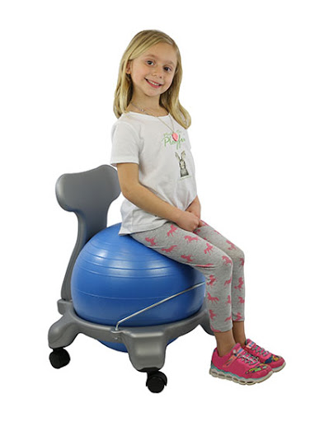
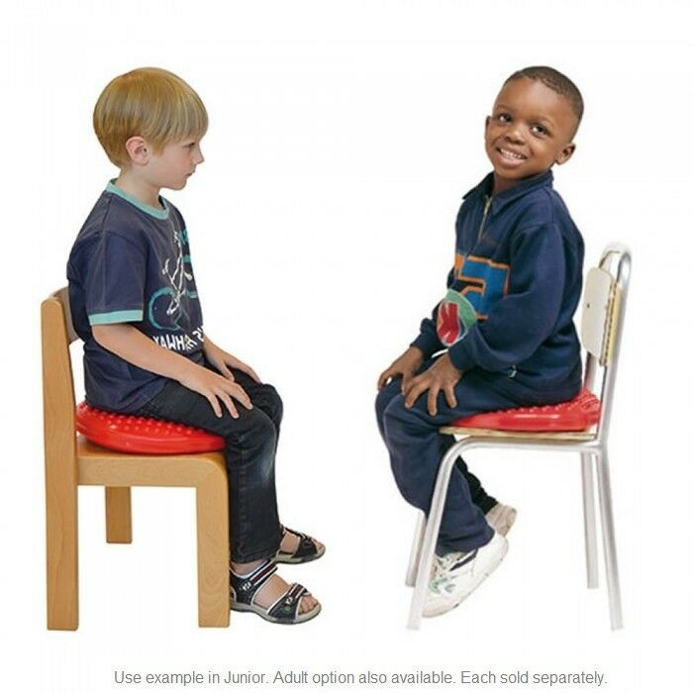
Understanding and Accommodating for Learners with Attention Deficit Hyperactivity Disorder:
Antecedent-Based Classroom Management
Angelica Pellone
Monmouth University, West Long Branch, NJ
  What is Attention Deficit Hyperactivity Disorder (ADHD)?
Definition:
“a neurological condition that involves problems with inattention and hyperactivity-impulsivity that are developmentally inconsistent with the age of the child…[it] is not a disorder of attention...Rather, it is a function of developmental failure in the brain circuitry that monitors inhibition and self-control” (U.S. Department of Education, 2009)
Characteristics:
difficulty paying attention to details
difficulty sustaining attention
more disruptive
more fidgety
sensory processing deficits
Prevalence: Between 7-9% of school-age children are diagnosed with ADHD (CDC, 2019)
  Antecedent-Based Classroom Management Strategies (CMSs)
“What can I do, as an educator, to support learners with ADHD in my classroom?”
Purpose: strategies that focus on proactively modifying the environment to reduce the occurrence of problem behavior
Benefit:
Reduce off-task and disruptive classroom behavior in learners with ADHD
Highly favorable and effective practices that educators should consider using for learners with ADHD symptoms
Strategies:
Altering the Physical Classroom
Strategic Student Placement
  Strategic Student Placement
  Where a student is positioned in the classroom impacts their learning and behavior.
Purpose: reduce stimuli that cause undesirable behavior and overcome ADHD barriers
Results:
Row Seating
    Pro: provide classroom structure and minimize distractions → increase in engagement
    Drawbacks: limit collaborative opportunities
Small Group Seating
    Pro:
        facilitate interaction between students
        Lev Vygotsky’s Social Learning theory
    Drawbacks:
        Undesirable behavior
Implication: Desks and classroom structure should be flexible to provide an easy transition to a variety of instructional approaches.
  Altering the Physical Classroom
Purpose: provide individuals with sensory processing deficits the opportunity to attain and maintain an optimal state of arousal when learning
Results:
↑ ↓
Dynamic
constant and productive activity, change, or progress
Seating
a chair, stool, or bench intended to be sat in or on
Movement while
Sitting
Under-Responsivity
decreased or poor reactions to relevant stimuli
Sensory-Seeking
constant search for intense stimuli
Over-Responsivity increased or exaggerated responses to stimuli
=
Row Seating
Small Group Seating
  Purpose
Problem: How educators can alter the physical classroom/environment (utilizing antecedent-based CMS) to benefit students with ADHD in an inclusive elementary classroom setting?
Research Objective: To understand and provide educational practices to accommodate learners with ADHD; with emphasis on antecedent-based CMSs, including:
        altering and manipulating the physical classroom by utilizing dynamic seating
        strategic student placement
  Conclusion
Problem: How educators can alter the physical classroom/environment (utilizing antecedent-based CMS) to benefit students with ADHD in an inclusive elementary classroom setting?
UTILIZING ANTECEDENTS CMSs
Limitations:
Scarce recent literature in the last 5-10 years
Call to researchers and educators to replicate and expand upon earlier studies to provide more current and up-to-date literature
Implication(s): Antecedent CMSs should be used to manipulate the classroom environment prior to learning taking place and beneficially support learners with ADHD and help them overcome the barriers presented by their disability.
↑ ↓
desirable behavior
in-seat behavior, on-task behavior, work productivity, attentiveness, reaction time
Undesirable behavior
constant fidgeting, disengagement, low work productivity, inattentiveness, and slow response time
  Method
Investigated 20+ research articles analyzing ADHD and antecedent practices to employ to reduce undesirable behavior
Utilizing Monmouth University Library databases searching the keywords: attention deficit hyperactivity disorder, attention, dynamic seating, alternative seating, classroom management, antecedent interventions, seating arrangements, on-task behavior, in-seat behavior, sensory integration, classroom environment, desk placement, row seating
Explored studies that referenced landmark study: Schilling et al. (2003)
desirable behavior
undesirable behavior
Therapy Chair Ball
Seat Cushions: Disc ‘O’ Sit
Please direct all feedback to: Angelica Pellone, s1046655@monmouth.edu
Notes:
WHY:
Children should spend pursuing their passions and interacting with their families
Homework can cause stress and frustration amongst students and parents

