Slide 1
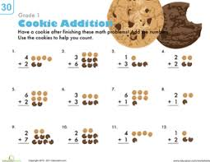
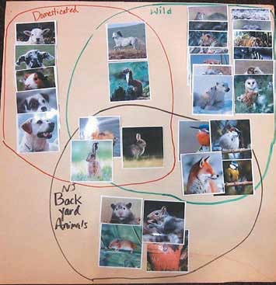
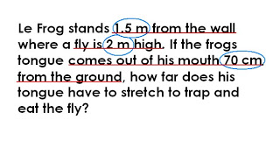
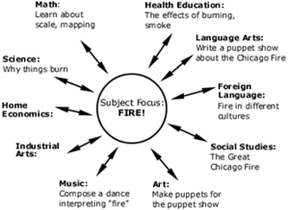
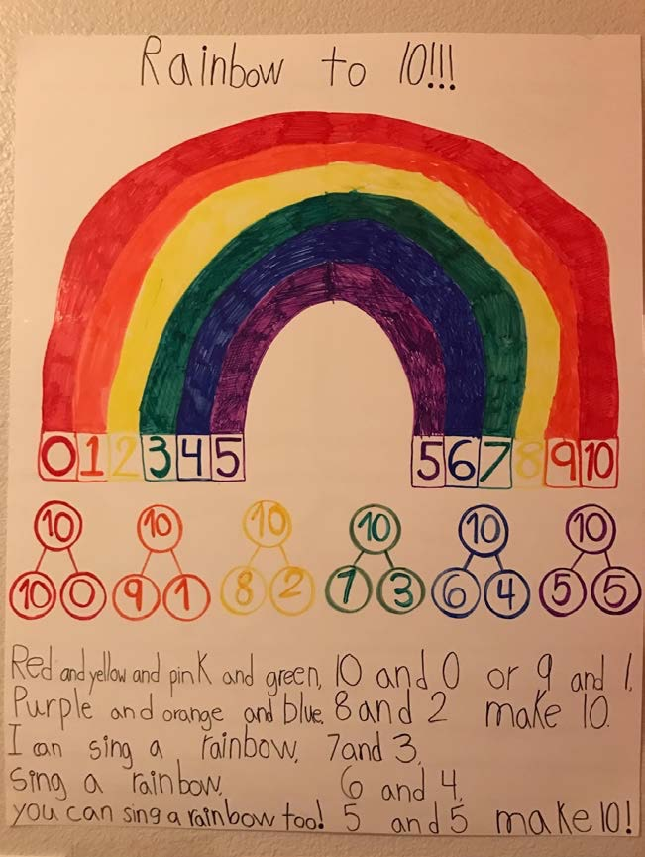
Real World Connections
Interdisciplinary Approach Cures Mathematics Isolation
By: Amanda Balestrieri
Science & Social Studies
4th Common Core Math Practice Standard: “Model with Mathematics”
Reasons why this is not done more often:
1) Teachers may argue that these lessons lack academically
2) The stigma that it is difficult to write lesson plans for mathematical activities
Examples:
Messiness and Math: Kindergarten Teacher teaches class about measurements by having students create their own play-doh from scratch
Integrating Literature in Math: 2nd grade teacher reads students a story about making a batch of cookies and dispersing them to friends to show an application of addition/subtraction
An estimated 50% of K-12 students suffer from math anxiety
Science and Social Studies are less stressful, more hands-on subjects
Examples:
Integrating Math and Science: Ecology and Venn Diagrams: Middle School students categorize animal breeds while using terms like intersection, union and set
Interdisciplinary Instruction: Unit and Lesson Planning Strategies K-8: serves as an alternative for teachers who may not want to merge subjects together
Central Claim
If teachers incorporate more standards within one lesson, ranging from literacy and math to art and math, students can be provided with a more content rich-learning experience. At the same time, doing this combats a main stigma regarding mathematics: that it is an isolated and independent subject.
Literary Supplements
NCTM stresses writing as “an essential part of math education”
Word Problems:
Students are taught to sift through words in a word problem to pull out math details ← this is the problem!
Reading the story conveyed in a word problem helps with reading comprehension and fluency/literacy
Examples:
Integrating Writing and Mathematics: Middle School teacher held writing workshops with students during math for them to write stories with mathematical concepts ie. The Magical Subtracting Frying Pan
Why Literacy Should be Included in an Effective Elementary Math Curriculum: Elementary School teacher uses poetry (Poem: Rainbow to 10) to teach her students basic math facts
Societal Values
What is our goal as a teacher?
Collaboration between staff members
Groupwork/Communication
Procedural Fluency
Personalized Education

