Slide 1

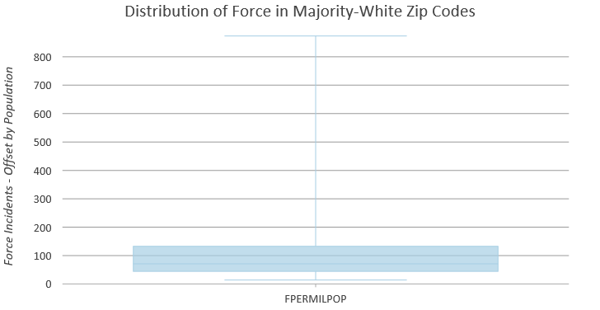
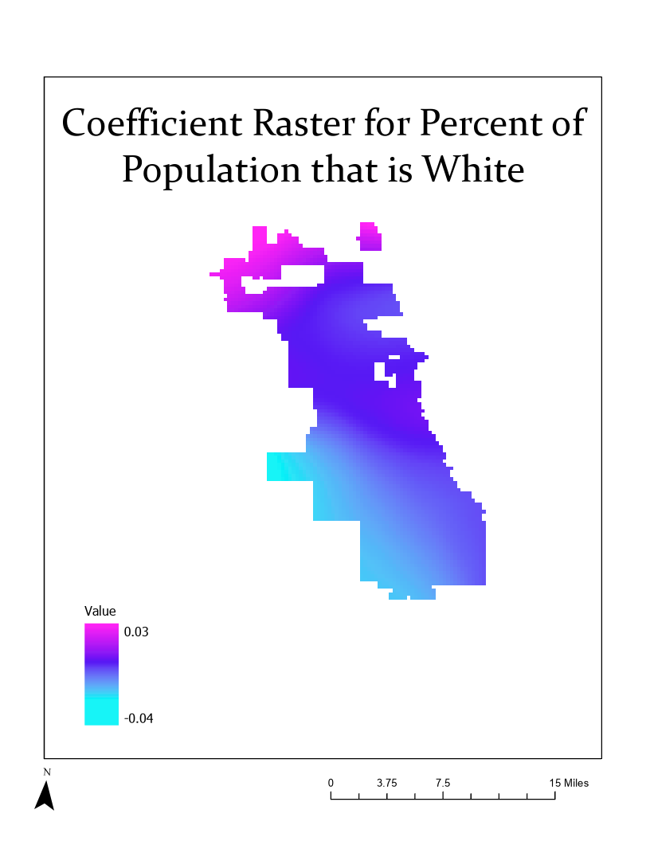
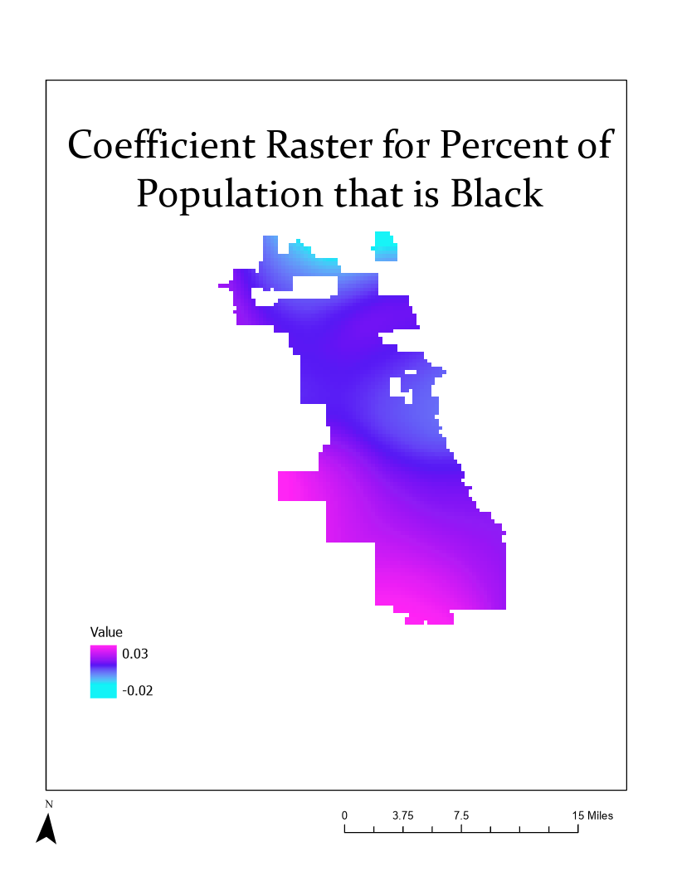
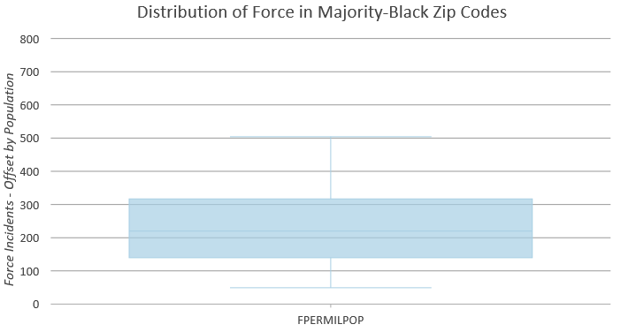
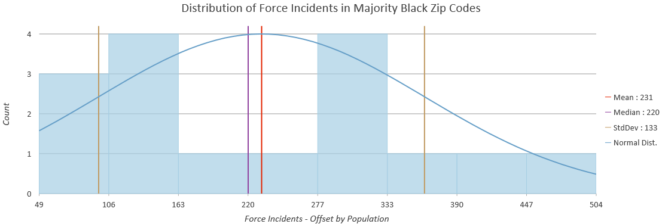
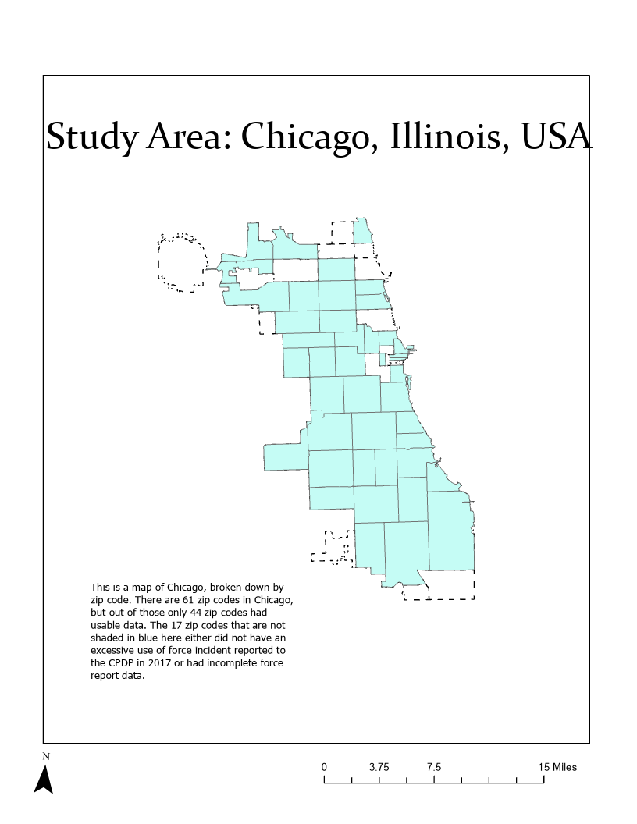
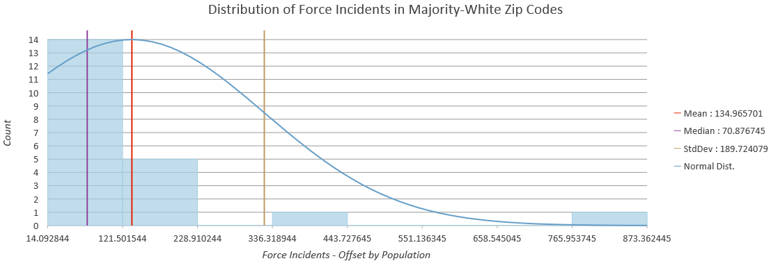
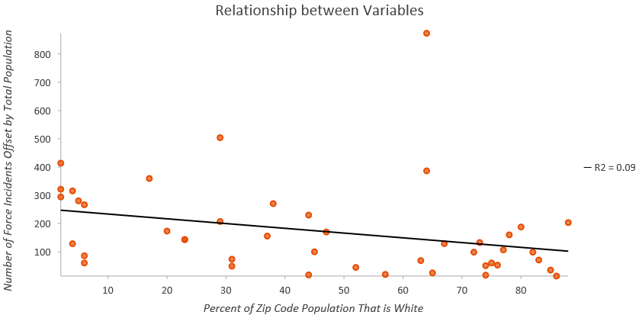
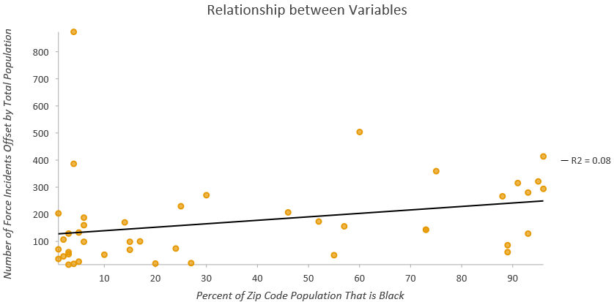
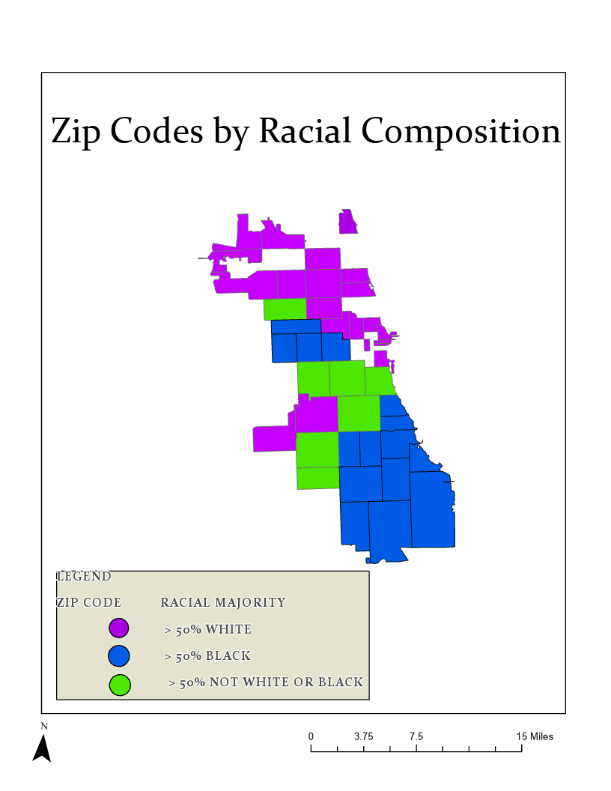
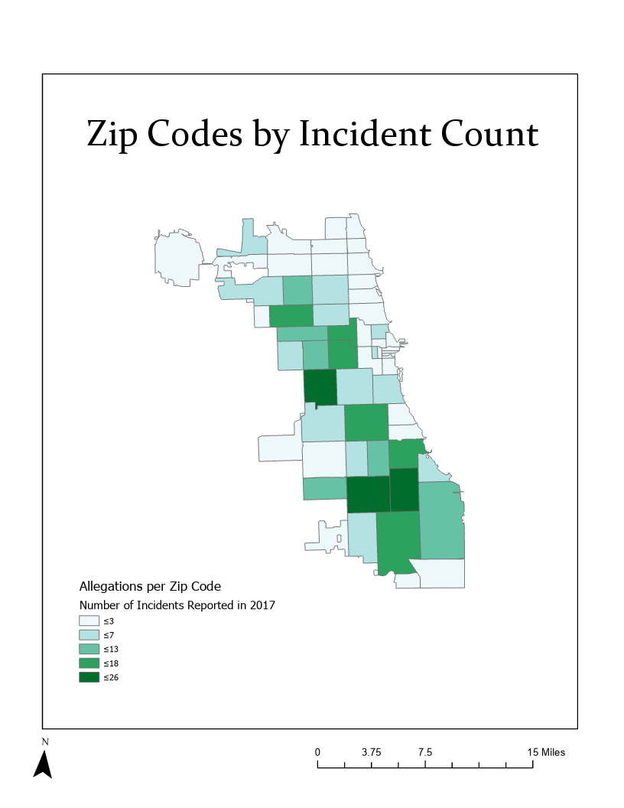
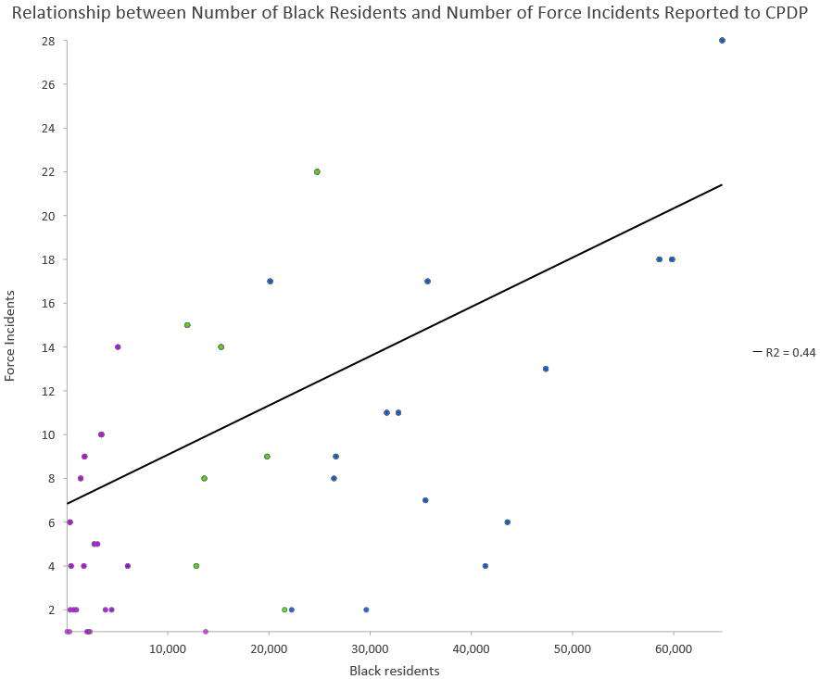
Geographic Analysis of Police Use of Force by Race in Chicago, Illinois, USA
Abigail Carroll, Graduate Certificate Program in G.I.S. , Geoffrey Fouad, Faculty Mentor
Monmouth University
ABSTRACT
DATA
RESULTS
Distribution of police use of force rates in majority-white zip codes (top) and majority-Black zip codes (bottom). Most zip codes that are majority-white had between 44 and 133 force incidents per million people. Most zip codes that are majority-Black had between 139 and 317 force incidents per million people. The maximum value of 873 force incidents per million people in majority-white zip codes is an outlier due to a zip code with a small population.
The histograms below also show distribution of force rates.
Black individuals are significantly more likely to be killed by the police than white individuals in the United States. Historically, data on police use of force in Black communities was unavailable, either because it was not collected or because it was not released to the public. Literature on police brutality therefore often lacked the data necessary to make substantive claims of institutional violence and meaningful change to violent institutions. As the Black Lives Matter Movement has grown in popularity over the past decade, the issue of racialized police violence has been brought to the attention of mainstream media and political discourse. While some police forces have been pressured to provide use of force statistics to the public after misconduct, others have been exposed by extra-governmental data collection efforts. The current study draws on such data from the Invisible Institute’s Citizens Police Data Project (CPDP), which offers a record of police use of force in Chicago that is otherwise not available on government websites. The CPDP data are applied here to map police use of force cases in Chicago and relate that data to percent Black and white population in zip codes. Maps show the rate of police use of force relative to population and race, and a univariate correlation analysis of police use of force and race is conducted in the entire map area. The geographic variation in the correlation between police use of force and race is shown using a geographically weighted regression, which is expected to show that police use of force is more strongly tied to race in majority-Black neighborhoods. Finally, police use of force is compared in majority-Black and majority-white zip codes using a Mann-Whitney U test, with an expectation that the median rate of police use of force is higher in majority-Black zip codes.
A shapefile of the city of Chicago broken down by zip code was downloaded from the City of Chicago’s open data website. Demographic information was downloaded from the United States Census’s data site, data.census.gov.
The Citizens Police Data Project was chosen because it was an extra-governmental source that does credible work. The CPDP collects data that might otherwise be kept from the public, and publishes police conduct reports and discipline proceedings. The CPDP’s website dataset was filtered through to find reports categorized as use of force incidents in 2017.
The Geographically Weighted Regression showed that police use of force varies by race in Chicago as incidents increase at a rate of 0.03 for every 1% increase in Black population in the south. Despite this, the tool found that the White Model fit use of force better than the Black Model perhaps because of low use of force incident rates in white neighborhoods.
METHODS
Preliminary data cleaning was done in Microsoft Excel. The data tables containing demographic information and police use of force reports were joined to the shapefile of Chicago, and the new shapefile was then imported into RStudio. A Kendall correlation of racial composition and use of force rate (incidents per 100,000 people) was run in RStudio.
There is correlation between race and use of force incidents. The next analysis was run in ArcGIS Pro. One model was created using percent of population in a zip code that is Black as the independent variable (“Black Model”) and another was created using the percent of the population in a zip code that is white as the independent variable (“White Model”). The models were created using the Geographically Weighted Regression (GWR) tool. The GWR tool is housed in the Spatial Statistics toolbox. The parameters of the GWR tool were set using Model Type: Count (Poisson), Neighborhood Selection Method: Golden Search, and Local Weighting Scheme: Bisquare.
After reading the output from the GWR tool, a Mann-Whitney U test was performed. The data was extracted from ArcGIS Pro, sorted for ranking in Microsoft Excel, and then calculated manually with the assistance of a critical value table (confidence = 0.05). The process involved creating a table of force incidents (offset by total population) per zip code, with the count for majority-Black zip codes on one side, and the count for majority-white zip codes on the other. All count values were ranked from smallest to largest (irrespective of racial composition of the zip code). Each count value was then multiplied by its rank. The products were added to create a rank sum for each race category. The rank sum of majority-Black zip codes was 395. The rank sum of majority-white zip codes was 308. The following math was done to calculate each race category’s U-value.
U = rank sum – [(n (n + 1)] / 2
U B = 395 – [16(16+1)] / 2 = 257
U W = 308 – [21(21+1)] / 2 = 77
The lower U-value is used to test for significance using a critical values chart. Using a significance of 0.05, a critical value of 103 was found, and because 103 is greater than 77, it was determined that there is difference between the ranks in majority-Black zip codes and majority-white zip codes.
Change in police use of force rate for every 1% increase in white population
Change in police use of force rate for every 1% increase in Black population
A comparison of the coefficient rasters and relationship plots shows that they are nearly inverses of one another. This is likely due to the high level of racial segregation in Chicago; as the map of Zip Codes by Race shows, the city is almost clearly divided into a white northern section, a concentrated Black southern section, and a more diverse center.
Police use of force rate decreases with white population
CONCLUSIONS
The results clearly show that neighborhoods with more Black residents have higher rates of police use of force incidents. Zip codes that were majority-Black as a group exhibited different distributions than zip codes that were majority-white.
The severe racial segregation of communities in Chicago may be a factor that promotes racialized policing.
* A shortcoming of this analysis is that it fails to account for any kind of racial difference except for that between white and Black populations.
This makes the data less useful and ignores the fact that people of color who are not Black still face over-policing and a heightened risk of police brutality.
A full analysis of police brutality and race would need to be far more nuanced. Income, educational attainment, crime, and land-use information could also add depth to the spatial analysis of police use of force.
This is a map of Chicago, broken down by zip code. There are 61 zip codes in Chicago, but out of those only 44 zip codes had usable data. The 17 zip codes that are not colored either did not have an excessive use of force incident or had incomplete data.
Police use of force rate increases with Black population
Police use of force incidents by number of Black residents, with points colored according to majority white (purple), majority Black (blue), and other (green), which shows white zip codes clustered at the low end of force incidents and Black zip codes toward the high end of force incidents
In sum, all analyses confirmed the hypothesis that use of force incidents happen more in zip codes with more Black residents.
The Kendall correlation confirmed that race and force incidents are correlated. The Geographically Weighted Regressions produced models of race coefficients. These models showed how the strength of race’s correlation with force incidents changes through the city of Chicago. Black population is positively correlated with force incidents – meaning force incidents increase as the percent of Black residents in a zip code increases. White population is negatively correlated with force incidents – meaning force incidents decrease as the percent of white residents in a zip code increases. The Mann-Whitney U test and the descriptive statistics in the far-right corner confirm that force incidents are distributed differently in Black neighborhoods than they are in white neighborhoods.
DATA SOURCES
The Citizens Police Data Project - https://beta.cpdp.co/
American Community Survey - https://data.census.gov/cedsci/
Chicago Data Portal - https://data.cityofchicago.org/
ACKNOWLEDGEMENTS
I would like to thank Dr. Fouad for helping me so much with this project and throughout the certificate program this year!
CONTACT INFORMATION
s1316220@monmouth.edu

