Slide 1
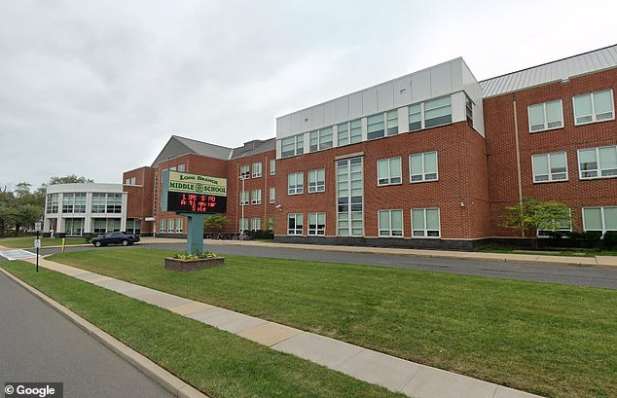
The Impact of Service Learning
Loreanna Caputi
B.S. in Mathematics with an Endorsement in Elementary Education and Teacher of Students with Disabilities
Monmouth University, Honors School '24
What I Learned:
How to construct collaborative interactions to exert within the classroom environment
How to collaborate effectively with multiple professional educators
How to implement and observe purposeful and integrated "play"
How I Impacted the Site:
Fostered and expressed enthusiasm amongst the classroom environment that I had not observed prior to implementing it
Instilled confidence in the students for the mathematical topic (multiplicative and division facts, and implicating such within one step equations) worked upon within this Jeopardy-styled game
Site:
Long Branch Middle School
6th through 8th grade
1,121 students (National Center for Educational Statistics)
Student to teacher ratio is 11:1 (US NEWS)
Classroom and Students:
7th Grade
9 Students in the Class
Male Teacher
Intellectual Disabilities
Desk, Assigned Seating
Whole Class Instruction
Technological Accessibility
(e.g. Chromebooks)
Disabilities include but are not limited to Autism and Communication Impaired
All students are of Hispanic descent
Project:
Math Jeopardy:
Students engage in an educational activity that imitates the game of Jeopardy to enhance math literacy skills they are currently working on in class
Goals included:
Students work together to gain shared confidence through shared responsibility of the tasks
Students reinforce their knowledge on the topic they are learning currently in their curriculum
Students will be put into groups to collaborate in deriving answers to questions
Each group, or team, will compete against one another to see who can accumulate the most points, in a jeopardy style game
Role:
Place students into groups of equal amounts
Manage and guide the classroom in this academic endeavor
Use assistive technology to demonstrate the amount of time the team has to complete the question
(e.g. instructional visual clock timer)
Hand out the materials the students will need to complete the project (e.g. whiteboard, dry-erase markers)

