Slide 1
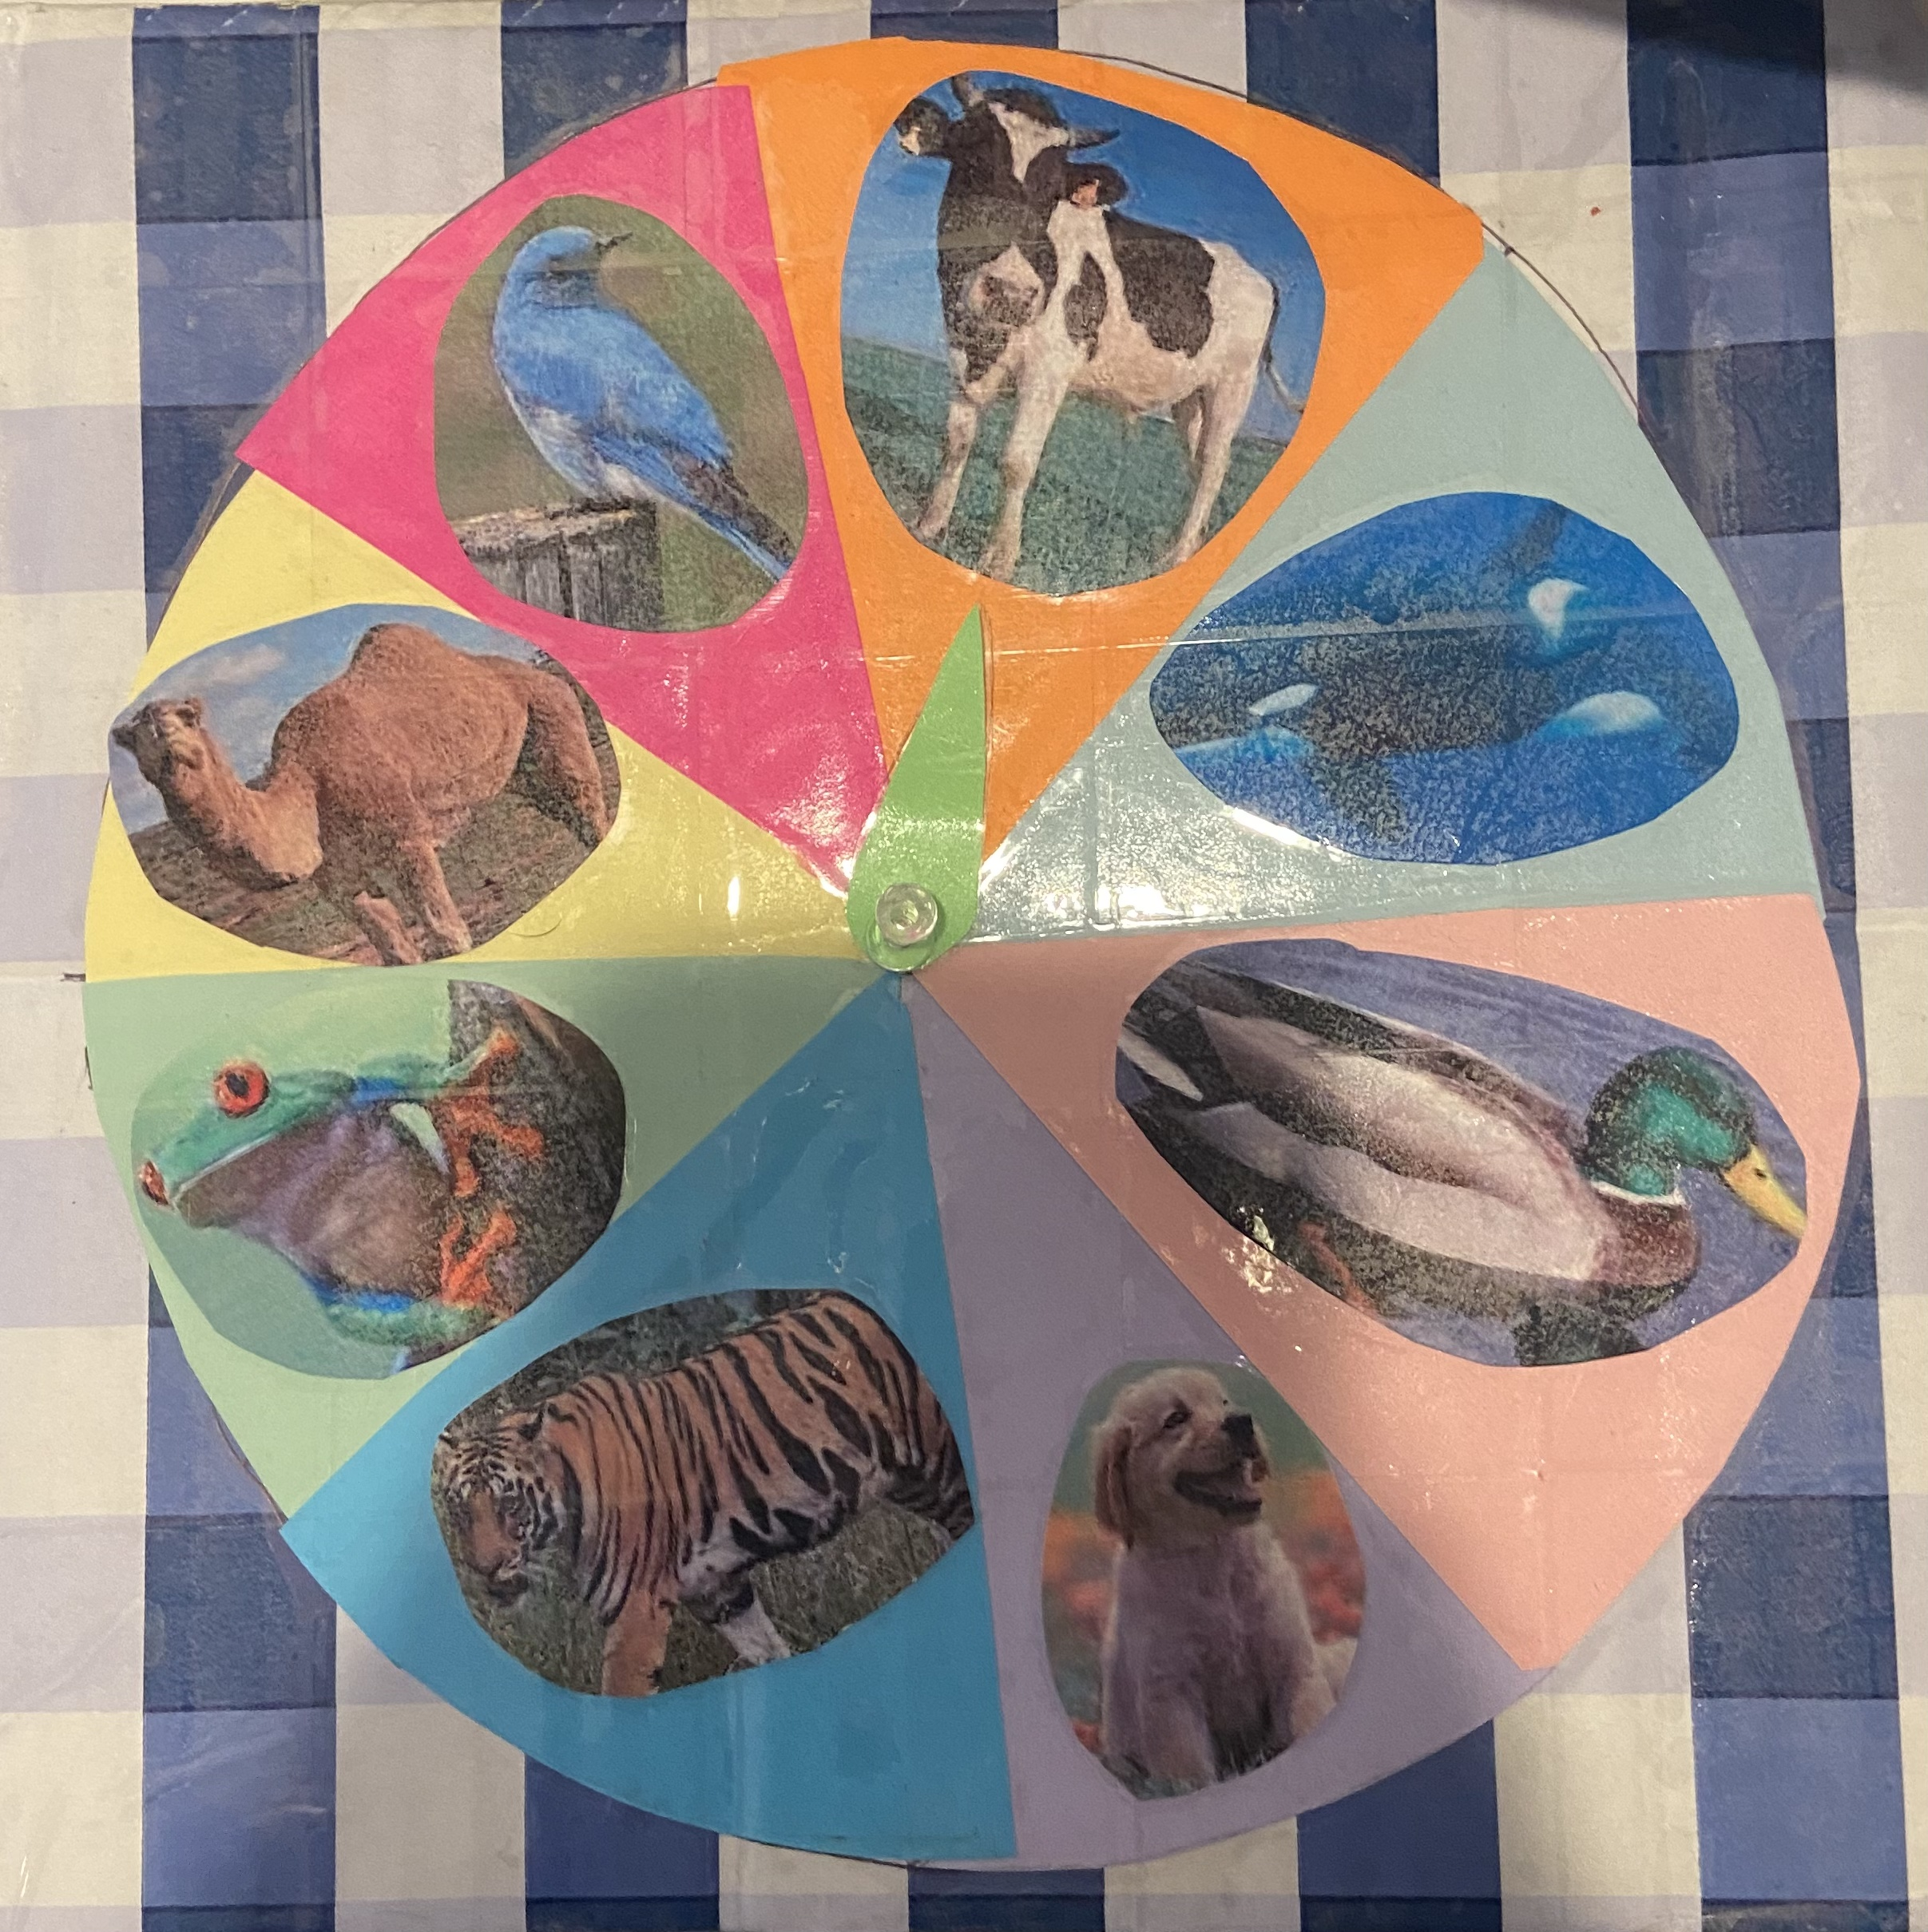
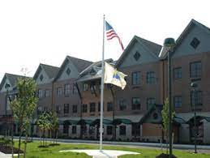
Special Education Service- Learning Participation
Setting
Gina Ciotti
Monmouth University
COMMUNITY
Long Branch, New Jersey
Monmouth County
Population: 30,516 (United States Census)
Poverty: 18.2% (United States Census)
Future Goals
Use what I have learned and further them
Continue working towards developing more ideas to help all students
Course & Project
EDS-330-01
15 hours of field experience
My Action Plan: Spin to Make a Story!
Spin the wheel for characters
Card matching game to establish setting
Write the story you’ve built!
SCHOOL
Amerigo A Anastasia Elementary School
K-5
Student-teacher ratio: 10:1 (US News)
46% female students, 54% male students (US News)
What I learned
Students
2 females, 8 males
All students with learning disabilities
One student with Tourette’s Syndrome
How an ELA classroom runs
Beneficial strategies to use for children’s learning
How to approach students
CLASSROOM
5th grade ELA class
Learning disabilities class
Structured
3 main parts
Do now, full class instruction, centers
Technology
Each student had a computer
Scholastic
Connections to Course
Impacts
Students with disabilities in the classroom
Strategies to help them
Information about what works versus what doesn’t
Do Now and centers help
More comfortable making a story, and one that makes sense

