Slide 1


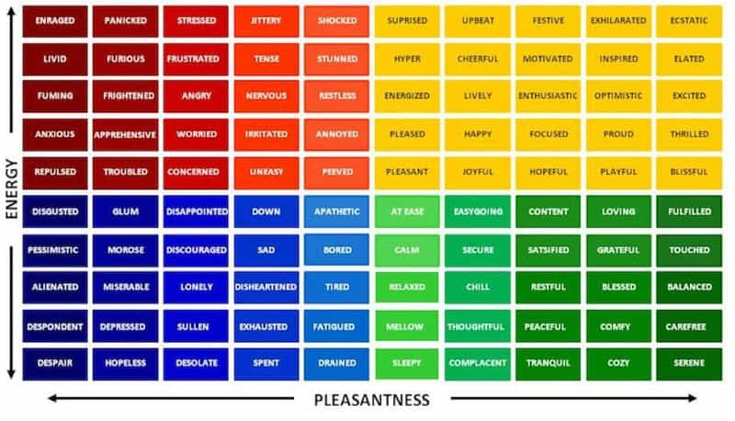

SEL at Long Branch Middle School
School/Community Overlook
Results, Impacts Made
LBMS
  Student/Teacher Ratio (US News) 11:1
  Demographics (US News)
    60.1% Hispanic/Latino
    21.6% White
    15.2% Black
    Free/discounted lunch recipients: 84.7% (School Digger)
Very engaged, interactive and expressive
Learned strategies that will help them in any facet of life
Goals and Intentions
Enhance life skills of students particularly with special needs
Make the community better by building the character of community members
How did I promote this?
  Emotional check in
  Informative videos of SEL
    Stress, pressure, coping mechanisms
    Class discussion
    Kahoot game to reinforce lessons learned
Students
What I Learned
7th Grade
12 students
  Intellectual/learning disabilities
If you give opportunity for students to share their feelings, they will
Teachers are more than just an educator to some of the students

