Slide 1
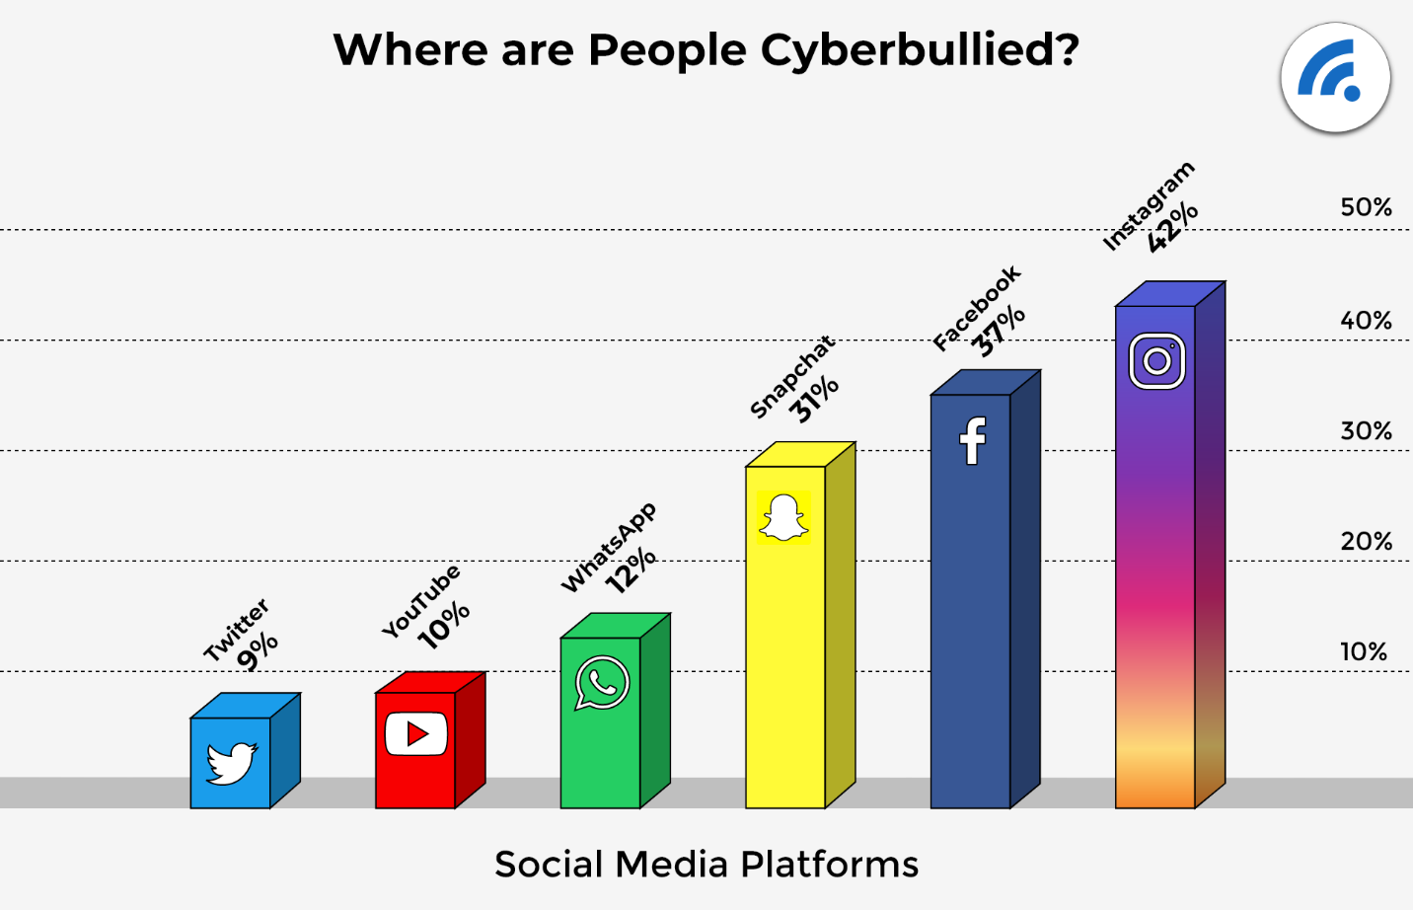
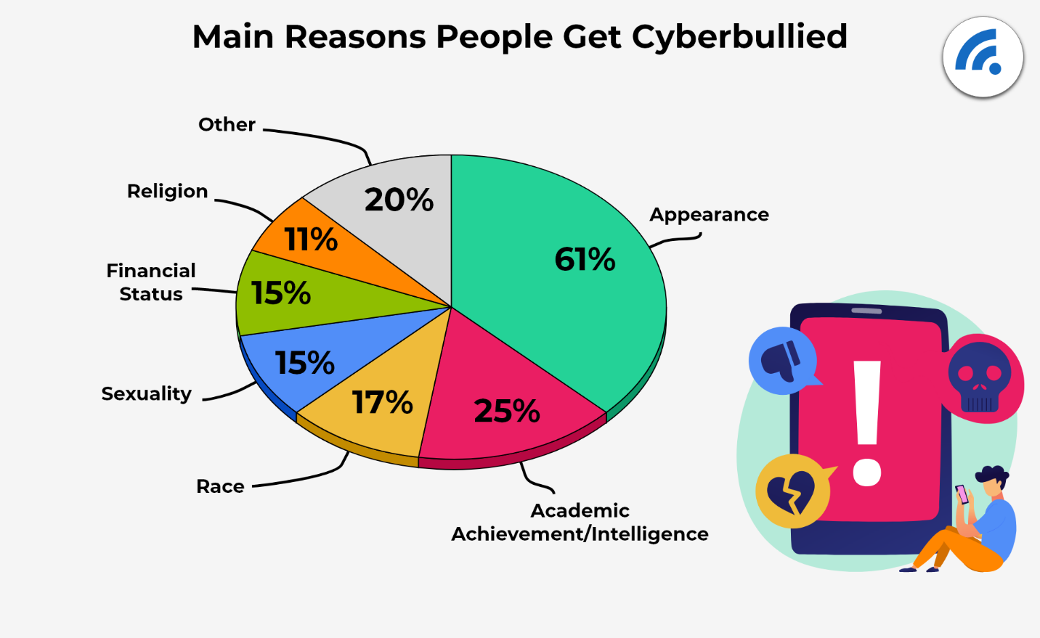
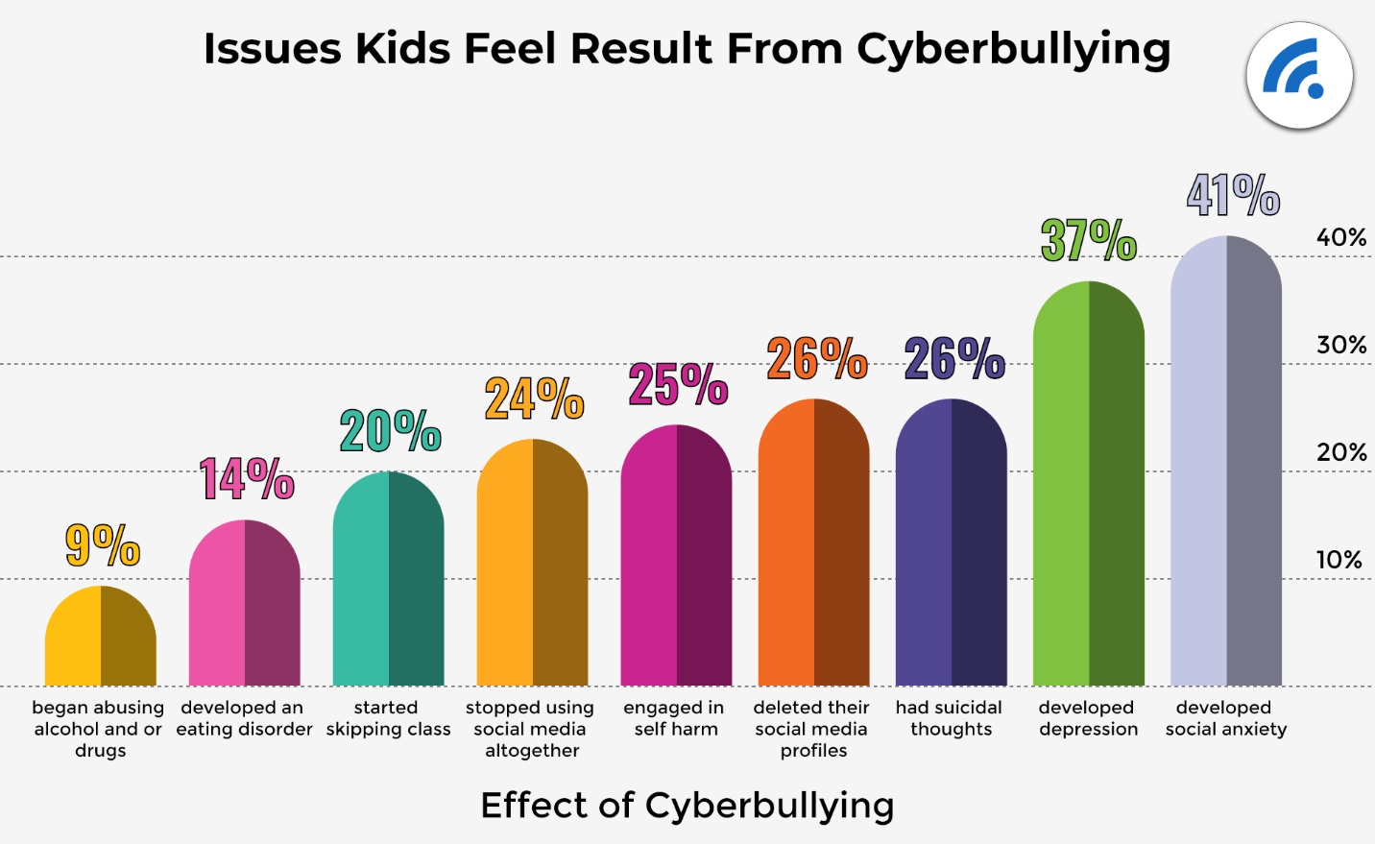
Have We Asked the Parents? What Parents Want and Need to Help Prevent Bullying Proposed Research by Joan McNichol
Background
Students who cyberbullying utilize technology to harass, intimidate or bully thier peers.
Cyberbullying is linked with anxiety, depression and, suicide.
Studies to explore the causes of this behavior have primarily focused upon students.
Additional research has explored parental attitudes and styles of parenting through the use of self report inventories, surveys and written questionnaires.
Less research has been conducted that explores the perceptions, understanding and experiences of parents as articulated in their own words.
An examination of these factors may identify links between these parental perceptions and the behaviors of children.
Conditions within schools indicate a need to strengthen a home-school connection for cyberbullying prevention.
Purpose
The objective of this proposed study is to develop a deeper understanding of how parents’ perspectives may be impacting the behavior of their children.
This research will investigate three questions:
How have parents’ past exposure to bullying influenced their perception of both their children’s behavior and their children’s social and emotional well being?
How do family norms regarding aggression align with the school district’s expectations for student behaviors in regard to cyberbullying?
How do parents’ level of familiarity with technology impact their children’ cyberbullying behavior?
Parental responses may indicate emergent themes.
These themes may inform school decision makers as they work to strengthen the partnership between parents and schools.
Partnerships between parents and schools may strengthen prevention efforts against cyberbullying.
R eferences
https://www.youtube.com/watch?v=QvXtDbcfp-8&t=13s Amanda Todd-Bullying Video
“https://www.youtube.com/watch?v=x11NA63gLDM Eric Clapton Change the World
https://www.broadbandsearch.net/blog/cyber-bullying-statistics
https://doi.org/10.1186/s12889-021-10555-9
Methods
This qualitative research project proposes to develop a richer understanding of how parents’ perceptions influence their children’s involvement in cyberbullying.
Data will be gathered from parents whose children attend school in a small urban school district in New Jersey.
Parents of children who have engaged in cyberbullying will be invited to participate.
Structured interview questions will prompt parents to share their understanding, perceptions and opinions regarding cyberbullying.
Interviews will be recorded and transcribed verbatim. Confidentiality will be ensured.
A grounded theory approach will be used to analyze the data and to identify emergent themes.
Themes will indicate of commonalities found among the participants’ perceptions, experiences and understanding of cyberbullying.
This is a 48”W” x 36”HIGH template. Check your conference requirements and adjust as needed
Click the Design tab, Slide size, custom size.
If your poster is wider than 56”, then make your poster half the size it is supposed to be (both dimensions) and tell the printer to print at 200%

