Slide 1
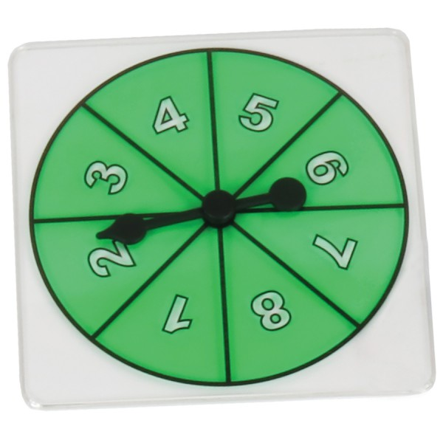
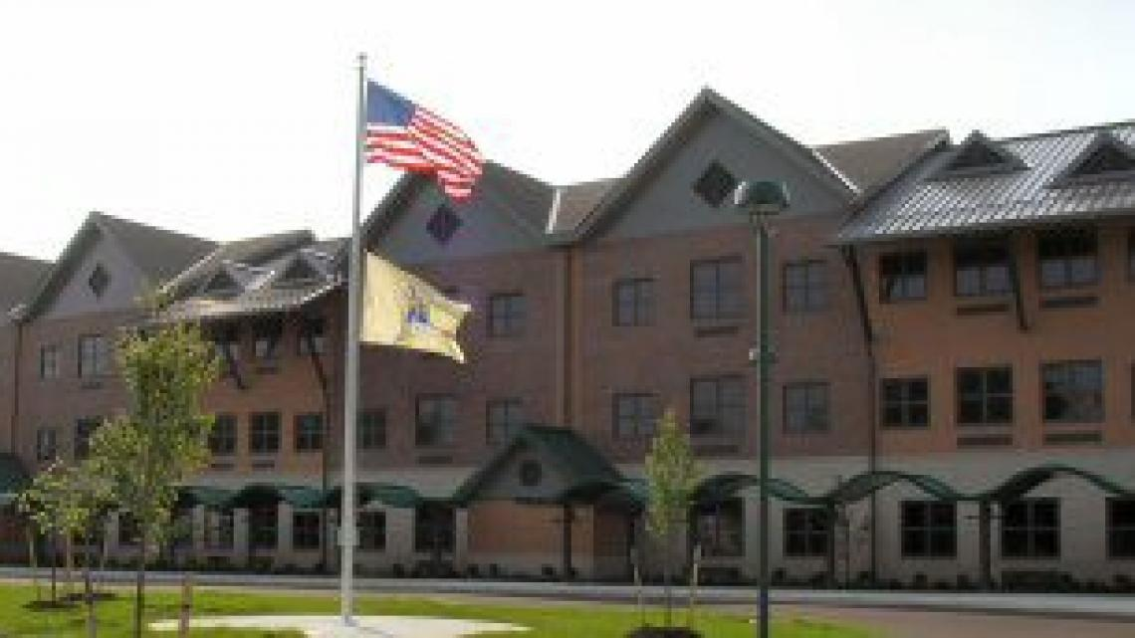
Field Work Poster EDS 330 Monmouth University School of Education - Ryan Brady
Course & Project
EDS 330
St. Patrick’s Day themed activity called “Lucky Spin”
Students were able to spin a wheel with numbers on it two times, multiply the numbers, and see if the result was on their sheet
If the result was on their sheet, they would fill it in with the color green.
Goal was to get five numbers in a row
Students
4th Grade
4 students
Different Disabilities that include dyslexia and ADHD
Math class
Future Goals
To continue to find innovative and creative ways to teach students in an engaging way.
Site
Amerigo A. Anastasia School
Long Branch, NJ- Monmouth County
K-5, about 562 students total
Free/discounted lunch recipients: 83.5%
Racial demographics: Hispanic: 54.4% White: 30.2% African American: 9.8%.
Student/Teacher ratio: 9.5/1
Job Title
Clinical Experience
Work with students both individually and collectively
Help the teacher with small and large tasks
Provide necessary aid to individuals that need it
Role
Field Experience- EDS 330
15 hours in math class
Impacts
Students were able to use tools to complete a task
Students were able to practice their basic multiplication skills
Students were actively engaged with one another
Understandings
Students will match an educators energy
Innovative strategies should be used frequently in a classroom

