Slide 1
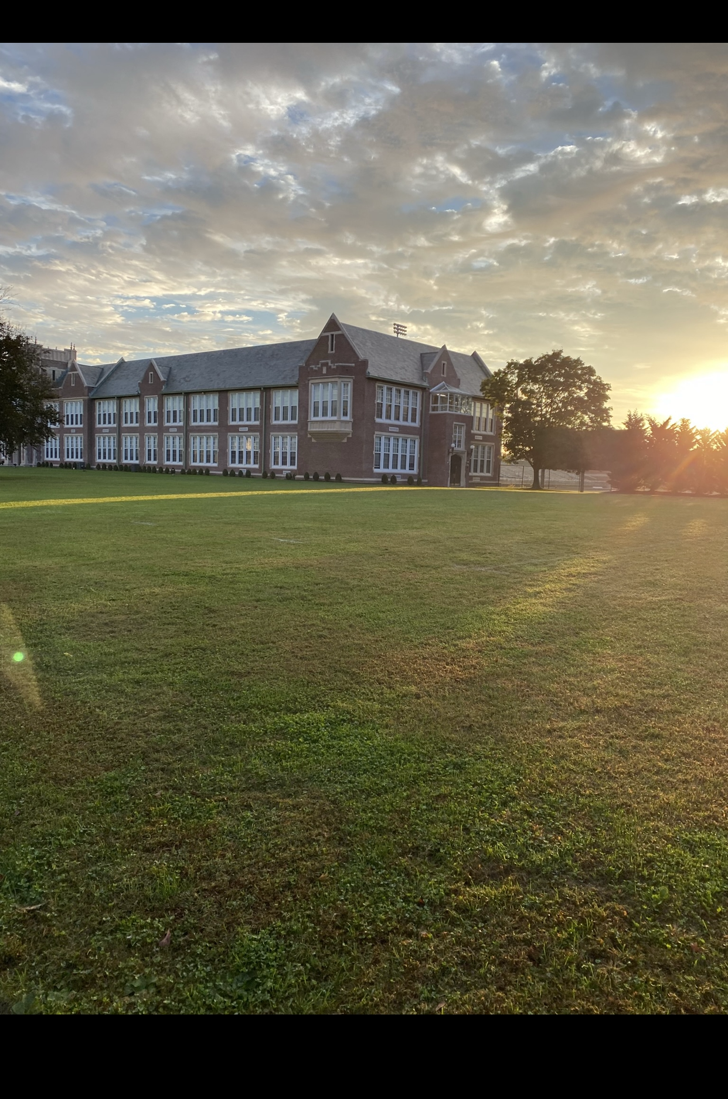



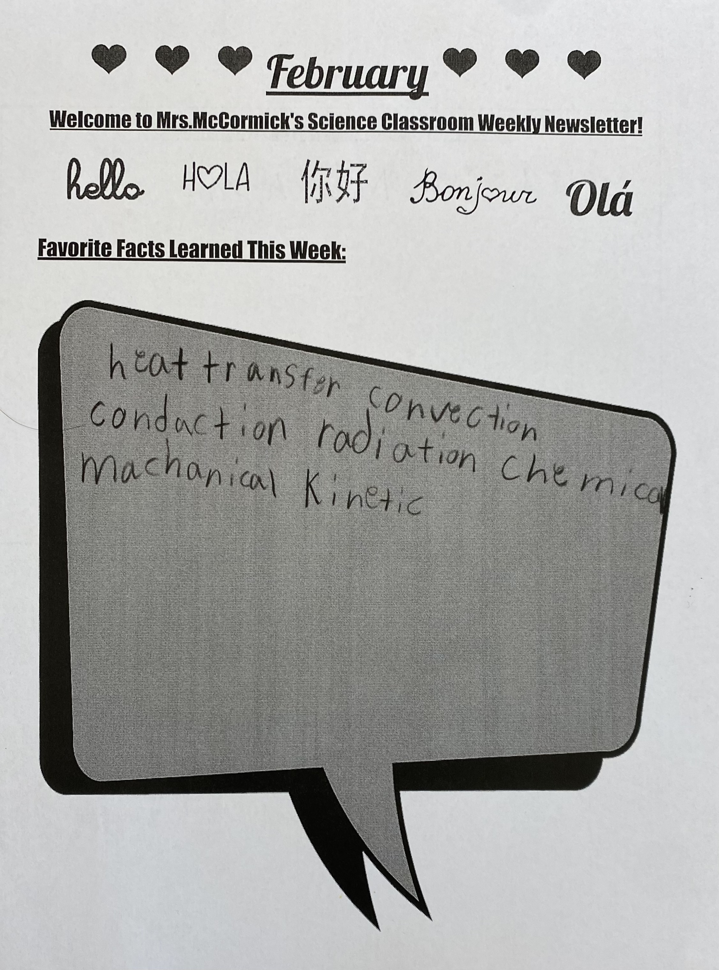
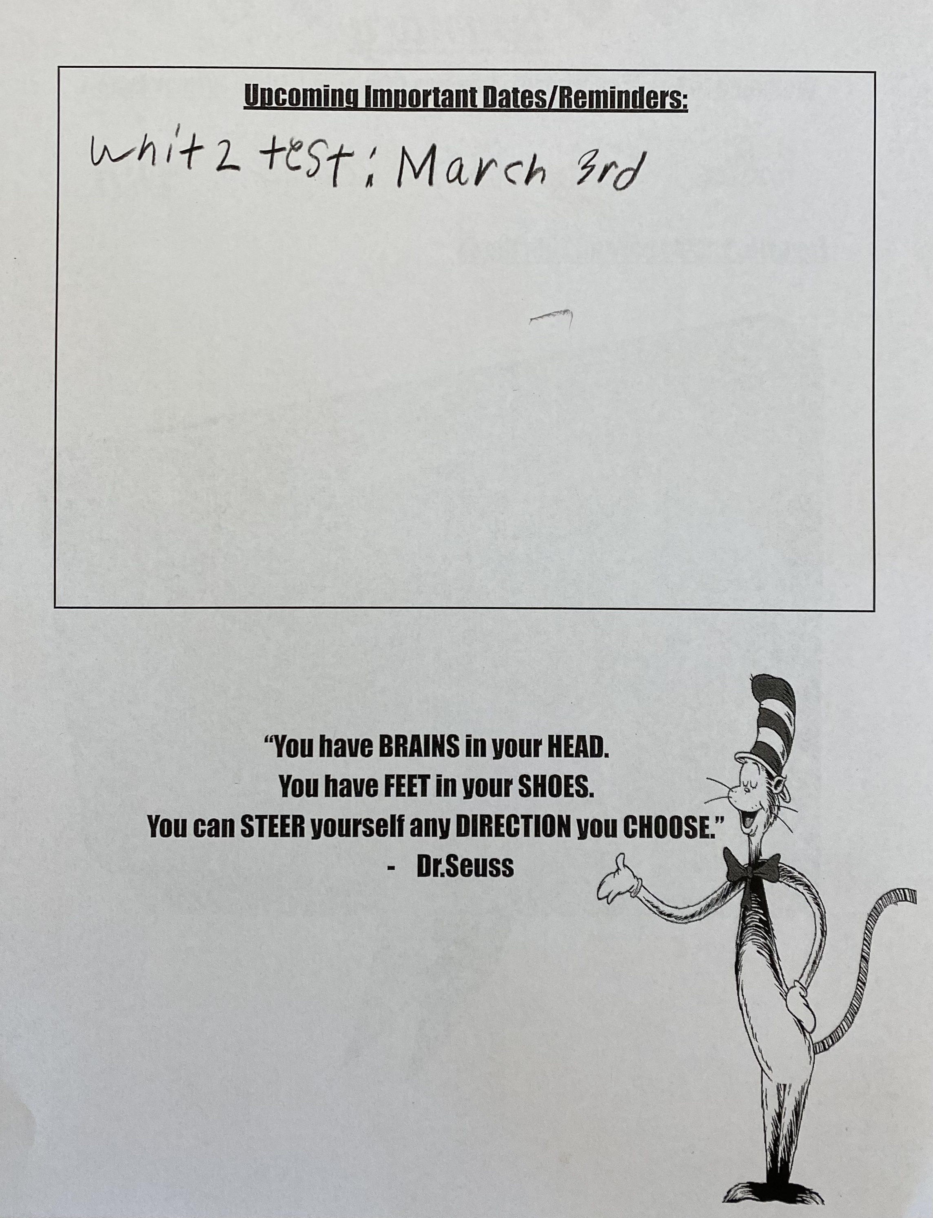



EXPERIENTIAL EDUCATION & CLINICAL PRACTICE- SCHOOL OF EDUCATION EXHIBITION
Job Title:
Future Professional
Observe, Connect, Learn, Collaborate, Guide, and Have Fun !
What Did I Learn?
Every student is unique and learns in their own ways.
Be flexible and allow students to have a voice and choice.
Praise more, punish less.
B.F. Skinner’s rewards system theory is used by my cooperating teacher and works tremendously.
Site:
Long Branch Middle School
Grades 6-8
1,192 students
In-person Attendance
84% receive Reduced Lunch
Assignment:
Monmouth Learning Partners: 15 hrs. field experience (EDS 330)
Service- Learning Project: Bi-Weekly Classroom Newsletter for Family
Students:
7th Grade
Learning Disabilities
ESL
2 Classes: 5-15 Students
Belle Kranbuhl

