Slide 1
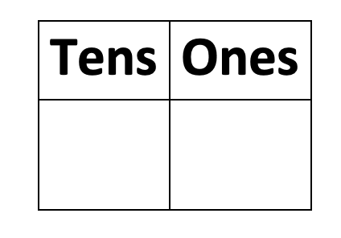
Noelle Kulisz
SCHOOL OVERVIEW:
- Amerigo A Anastasia Elementary School
- Located in Long Branch, New Jersey
GRADES: K-5
581 students
24.8% English Learners
25.1% Students with disabilities
STUDENTS:
- Special Education LD math classroom
consisting of 4 students
- Each student has their own specific IEP
ROLE:
- Observe teaching behaviors
- Collaborate with CT
- Assist students when needed
PURPOSE OF PROJECT & LAYOUT:
- EDS 330
Students will practice their addition, subtraction, and place value skills through a hands-on activity. Students will be given resources such as a number line to help visualize how the answers to such equations become bigger or smaller.
WHAT I LEARNED:
The provided resources helped fit the needs of all leveled students. I was able to easily adjust the problems for those who struggled. I noticed a major increase in student motivation.
MY IMPACT:
This activity helped make learning math fun. I successfully assisted the students in helping to strengthen their addition, subtraction, and place value skills. The students even collaborated with one another to complete the math mats.

