Slide 1
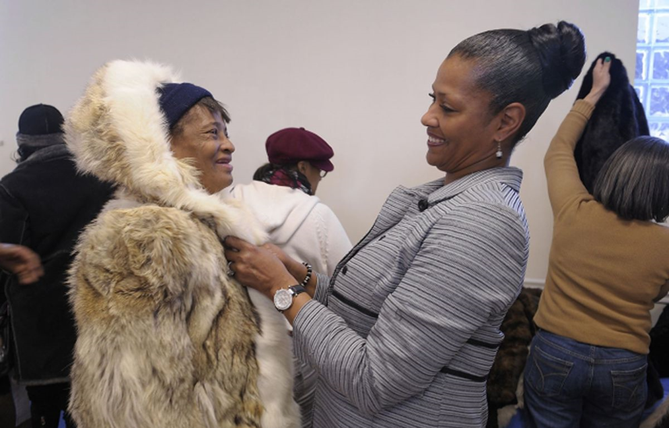



Combating Stigma Through Ethical Donations
By: Suzette D. Lohr
PROBLEM AND POPULATION
INTERVENTION
IMPACT
The project’s population are clients of Shore Haven. who often face mental health stigma from the surrounding community. Male and female adults of all ages attend Shore Haven 3-5x a week and diagnosed with one or multiple mental heath issues. Additionally, most clients are financially challenged. This becomes increasingly significant during the winter months. The agency often receives clothing donations; however, many items are unworthy, do not fit the needs, and are incorrect sizes. People often believe if it is free, individuals should be grateful. According to Showers (2022), “while the need for clothes is essential, people still want to look good and maintain their self-respect.” The homeless are as deserving of clothes that in good condition and nice to wear like everyone else (Showers, 2022).
Community collaboration can transform lives and is crucial to social work practice. It takes dedication and action from community organizations to champion transformation that can promote healthier individuals and communities. It helps locate resources, fosters new relationships, and can satisfy organizational missions that promote positive outcomes (Lanier et al., 2015).
Making a list of all sizes and color of coats needed at Shore Haven. Fulfilling the need, supplying everyone with the size and color coat requested. Providing winter accessories such as hats and gloves.
Educating church leaders about unintentional stigma through clothing donations and reasons why this population may face homelessness.
The members of the church provided 30 brand new winter coats and accessories for the clients at Shore Haven to promote positive well-being and prepare for any possible homelessness.
Shore Haven Clients Response: The gratitude and the joy in being connected to the community, being provided with brand new winter coats and accessories helped to reduce the unintentional stigma that is often found in clothing donations.
Church Leaders Response to Giving: During the presentation, there were tears of joy and heartfelt gratitude, recognizing the impact the church members had on the clients.
Evaluation: The posttest following the presentation reflected an increase in understanding of the importance of client empowerment and unintentional stigma in donations..
CLIENT RESPONSES
One gentleman was handed his coat and began crying. He stated, “this is one of the nicest things someone has ever done for me.
One woman stated, “I will actually be warm this winter.”
One gentleman stated, “geez, this is the nicest winter coat I ever owned, thank you.”
One woman stated, “wow, it is exactly what I asked for.”
ABSTRACT
The purpose of this project was to combat mental health stigma through collecting ethical donations for Shore Haven clients to provide for essential needs. A list was created which included all colors and sizes of coats needed for the 30 clients who regularly attend Shore Haven. The social worker located a local church who became the designated partner. Church members were willing to donate the monies necessary to fulfill the requests. After providing the coats to the clients, they felt respected and thankful. The church members were able to see the impact this had on the clients, equally joyful and grateful for the results, understanding the importance of client empowerment, allowing them to voice their needs.
SITES OF INTERVENTION
Shore Haven of Bright Harbor Healthcare is the highest level of care outside of hospitalization. It is a mental health care organization serving individuals with mental illness in an outpatient setting with structured programming and daily monitoring. Very few clients are voluntary and are more likely to be referred by hospitals, judicial systems, and family members. The agency’s primary focus is to prevent re-hospitalization and increase stabilization.
Calvary Baptist Church is a local church in Ocean County that became the designated partner of Shore Haven of Bright Harbor Healthcare.
REFERENCES
Lanier J., Schumacher., & Calvert, K. (2015). Cultivating community collaboration and community health through community gardens. Journal of Community Practice, 23, 492-507. Doi: 10.1080/10705422.2015.1096316
Showers, J. (2022). Donate Clothes with Dignity: Give used clothing that respects the receiver. Blanchet House. https://blanchethouse.org/donate-clothes-with-dignity-give-used-clothing-that-respects-the-receiver/
United Nations Human Rights. (2012). Committee on the rights of persons with disabilities
SOCIAL JUSTICE & HUMAN RIGHTS
Universal Declaration of Human Rights
Article 8 – Awareness Raising, states “parties undertake to adopt immediate, effective and appropriate measure to raise awareness throughout society, including the family level, regarding persons with disabilities, and to foster respect for the rights and dignity of persons with disabilities.”
Article 25 - All individuals have the right to an adequate standard of life that includes necessities such as clothing, housing, food, healthcare, and social services when needed to sustain personal and family well-being.

