Slide 1
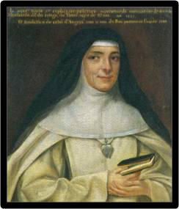
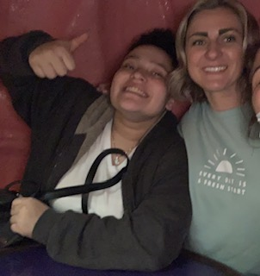
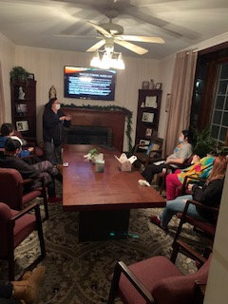
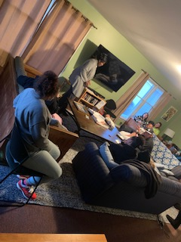
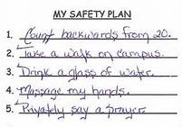
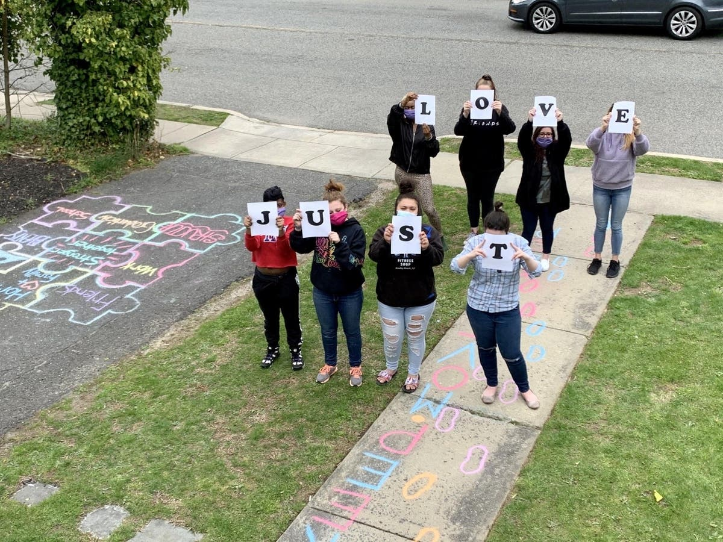
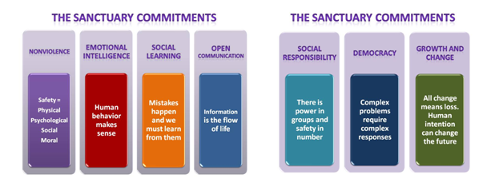
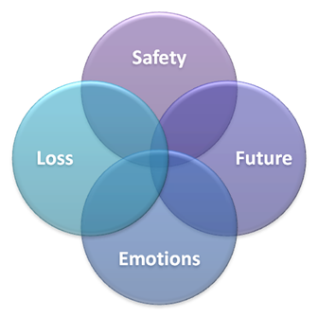
How did I make an impact?
Collier Residential Program
“Kept me grounded and sane. Reminded me to focus on myself and my future” -Youth 18
“Intern was realistic about situations and made me feel like I was not being judged.” –Youth, 17
Collier Group Home
Located in Red Bank, NJ
Social Work Internship
Collier Group Home is a residence for ten teenage girls who are unable to live in their own homes due to significant and longstanding personal or family issues. The girls live together in a warm, attractive setting where they interact with each other and supportive adults. Staffed twenty-four hours a day by professional counselors, the residence provides a stable and affirming environment in which girls prepare to return to their homes or independent living.
Rebecca has made such a strong impact at Collier Group Home in more ways than one. Rebecca brings light to the home and is always looked upon as a powerful influence by the staff and youth. Rebecca demonstrates the mission of Collier in all aspects of her interactions. Rebecca is a true Shephard, and in the words of our foundress, "Meanwhile work hard to grow in love of the mission. Oh, what wonderful things love does! What undertakings brought to fulfillment by the power of love!"
St. Mary Euphrasia, Conferences, Chapter 5
-Supervisor
Collier Youth Services Residential Programs:
Sanctuary Based Programs:
Collier Group Home – serves adolescent young women, currently in middle
school or high school, ranging in age between 13-18.
Collier House- Transitional Home for 16-21 year old aging out
and/or homeless young women.
Mission:
To provide at-risk youth a chance to grow toward their potential in an environment that promotes belonging, dignity and hope.
The mission is based on a philosophy of deep respect for the inherent worth of each individual and the belief in the capacity for personal change that is consistent with the ministry of the Sisters of the Good Shepherd.
Fieldwork Roles/Assignments
Assessment, Development, and Implementation of Casey Life Skills Independent Living Plans
Weekly meetings with youth to go over plans implement different strategies to achieve goals.
Made daily logs/updates of progress
Set up professional speakers to speak to the youth
Actively used Sanctuary Model and Nurtured Heart Approach
Assisted staff with daily tasks
Provided support counseling to youth as needed
Assisted older youth on transition planning for youth aging out of the program
Psychoeducational groups surrounding life skills
Research and implementation of different strategies to achieve independent living goals
Collier Youth Services is proud to be the first residential programs in New Jersey to become certified in Sanctuary through the Andrus Institute. Collier’s 4 year certification process started in February of 2012 and we received certification in February of 2016. Sanctuary has truly provided our organization with the tools and language to process trauma and loss with compassion and hope for a better future for all.
Why Collier is a great place to intern
Great supervision and support
Friendly staff and open-communication
Flexible on implementing your own ideas and knowledge
Developed therapeutic relationships with youth
Took trips outside the home with the youth to places including iPlay America, the beach, skate park, movies, shopping, and so many more.
Took youth on college tours as part of her process of transitioning out of the program
Training in Sanctuary Model and Nurtured Heart Approach
Awareness of the importance of self-care and boundaries
Diagnosis and Medication Training
Training and administration of ATF-A Assessments
Collier Youth Services provides a holistic approach in integrating sanctuary into our programs. Collier provides psycho educational programming to our youth, families and communities in unique and creative ways including our newsletters, family days, open houses and group activities. Collier’s emphasis is to promote trauma informed care to help our staff, youth and families understand the wide range of trauma we experience and work towards helping those heal from trauma and adversity by moving toward the future. Through use of the Sanctuary SELF Model, safety plans, and 7 Commitments the staff and residents embrace this trauma informed culture. This culture promotes a safe environment where each individual can learn about reenactment patterns and move towards positive change. We at Collier believe in the importance of not only practicing Sanctuary in our residential programs but expanding Sanctuary education to our communities, local colleges as well as our social services partners such as NJ Department of Child Protection and Permanency (DCP&P) and New Jersey Case Management Organizations (CMO) through workshops and information sessions. Collier continues to strive to be on the forefront of trauma informed care in New Jersey.
Reframing the key question from “Tell me what’s wrong” –to- ”tell me what happened?
The Sanctuary Model is not just for the clients we serve but for the entire organization:
It creates a shared language for everyone.
Organizes how we talk.
Creates and promotes consistency across the organization
Focuses on the impact of recurrent stress.
Focuses on growth and change.
The SELF Model provides a simple and accessible language for all the people working together toward change
Safety: physical, psychological, social, and moral
Emotional Management: recognizing and handling feelings in non-harmful ways
Loss: acknowledging and grieving past losses or traumas and committing to work against getting stuck in the past while recognizing that all change involves loss
Future: re-establishing the capacity for choice and engaging in new behaviors rather than repeating old patterns

