Slide 1
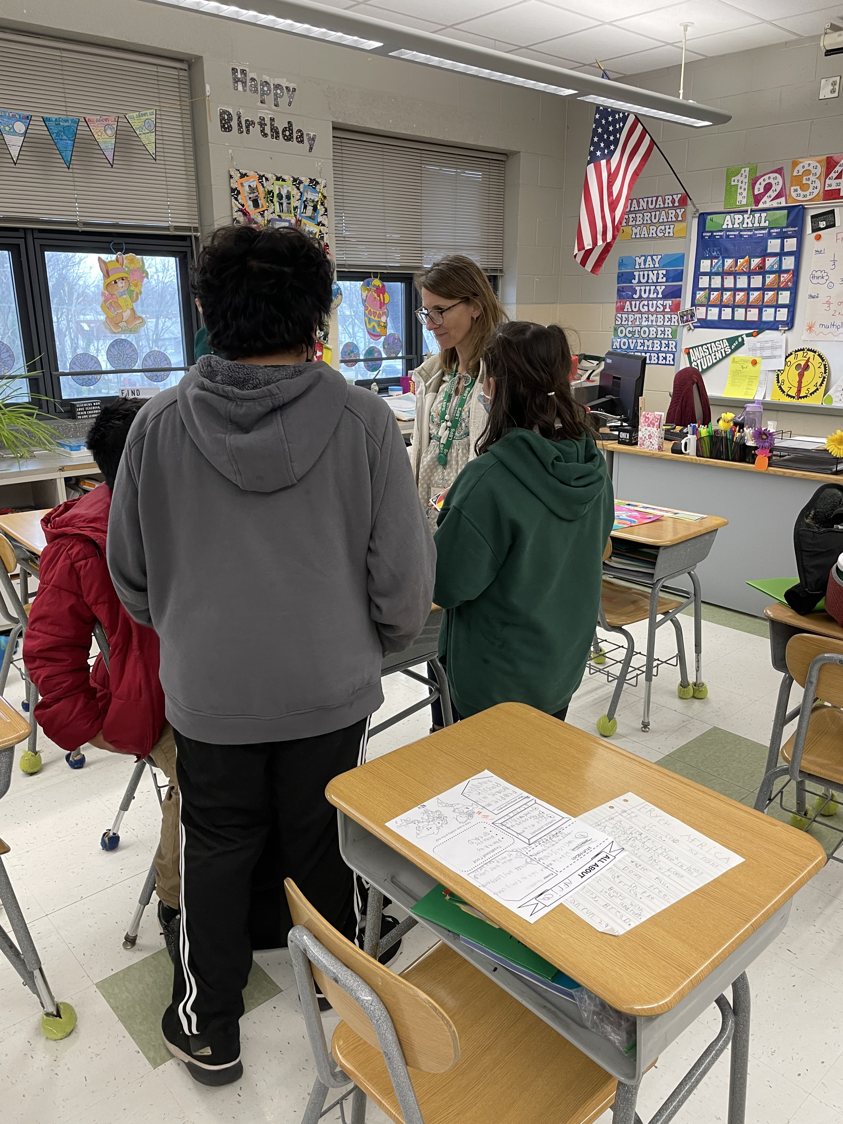
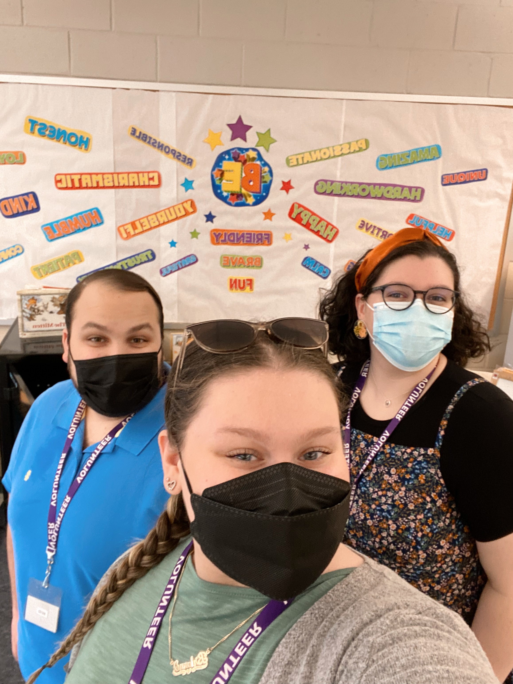
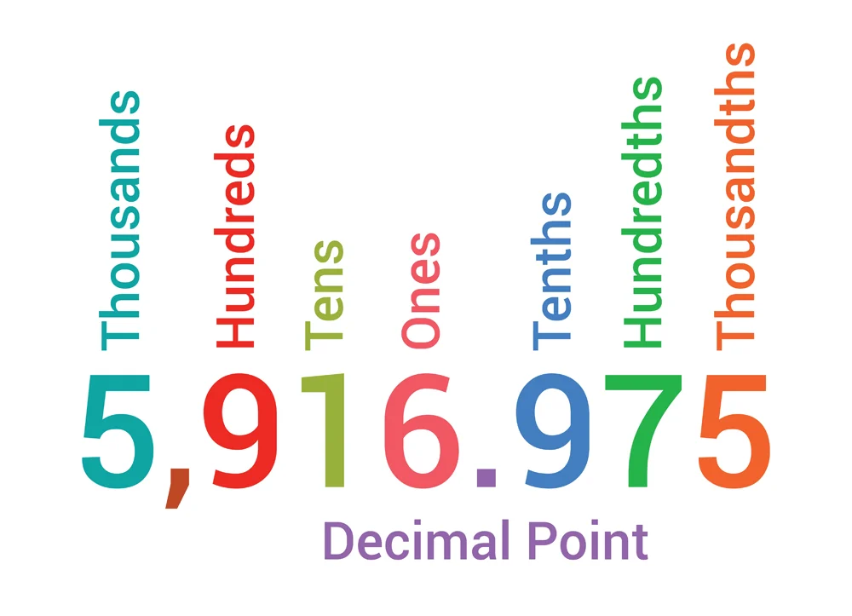
Clinical Practice/Service-Learning Experience-Michael Rue
Community
Understandings and
impacts
Long Branch, New Jersey. In Monmouth County
Approximately 31,000 Residents in the town
An 80.5% citizenship rate with an 18.2% poverty rate.
White population at a 66.98% followed by Blacks or African Americans at 15.99% and other races massing 12.75%
Course and Project
I learned how to be better understanding of what the child is going through.
I learned how to give praise to the student when necessary
My game impacted the students by giving them that sense of competition while also helping both their social skills and math skills.
I helped the students to create better friendships, while also learning.
15 hours for EDS 330
Made a game in which the students were to add or subtract decimals to get points for the round.
Object of the game was to get the most equations right to win.
Classroom and students
School-Life
In a fifth-grade class: twelve students in total with two female and 10 male students.
All twelve students have a disability, as this is a special education class. Includes, Tourette's, Speech impediments, and other learning disabilities.
Use iReady and Xtra Math and Read 180 on their chrome books.
Anastasia Elementary School
Grades K-5th
About 567 students with an 8:1 student teacher ratio. With an enrollment rate of majority Hispanic students at 71% of students.
Approximately 53% male students and 47% female students.
Role
Future Goals
Student Teacher Candidate
Observer
Help students and teacher with work
Test and homework grader
Classroom decorator
With this information, I plan to use the skills I have gained in my future classrooms.
My understanding of these students' disabilities has grown, but I plan to keep furthering my knowledge each day.

