Slide 1
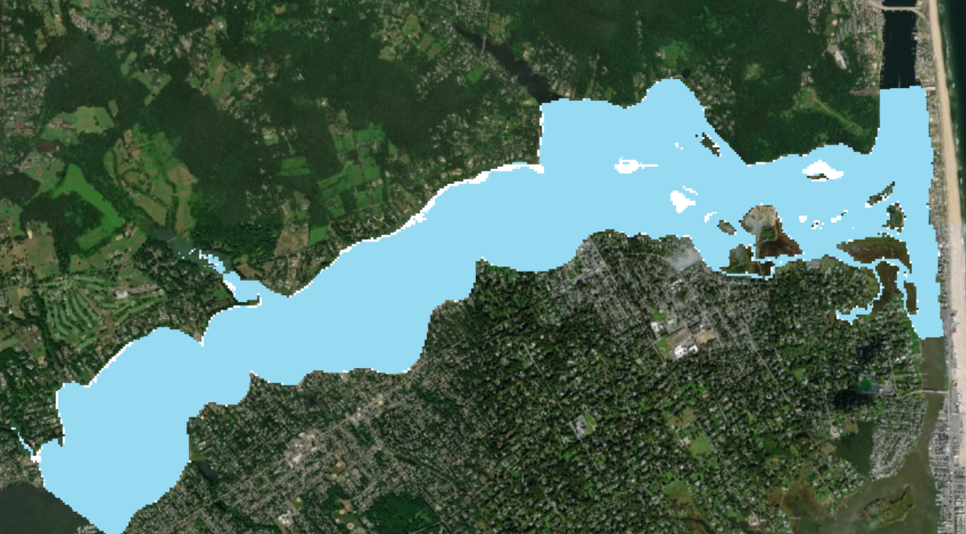
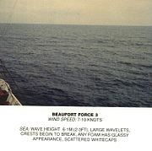
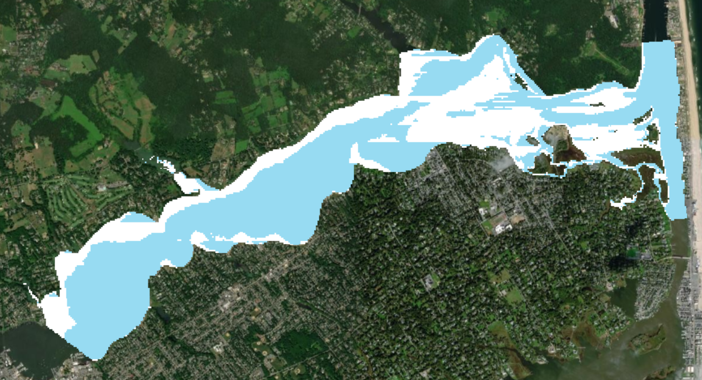
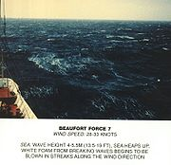
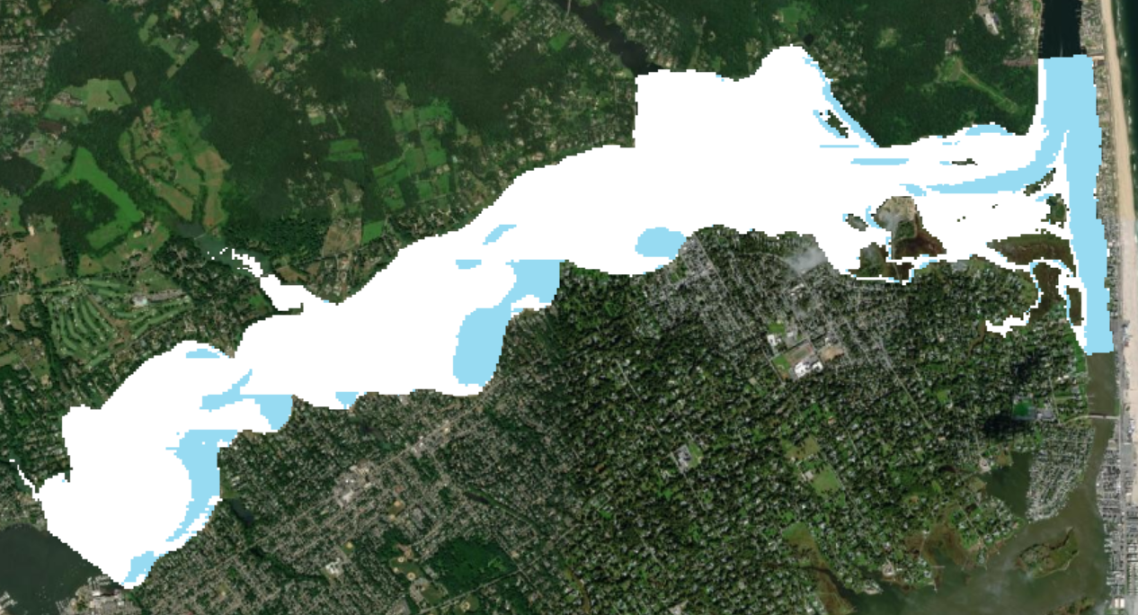
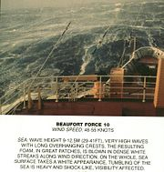
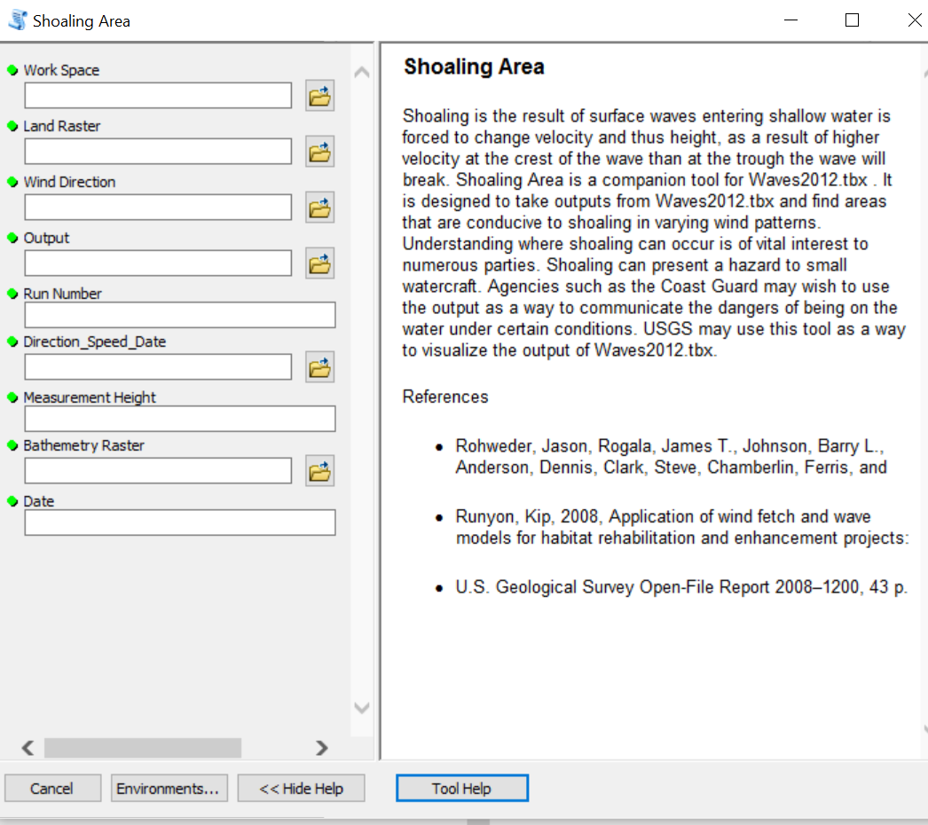
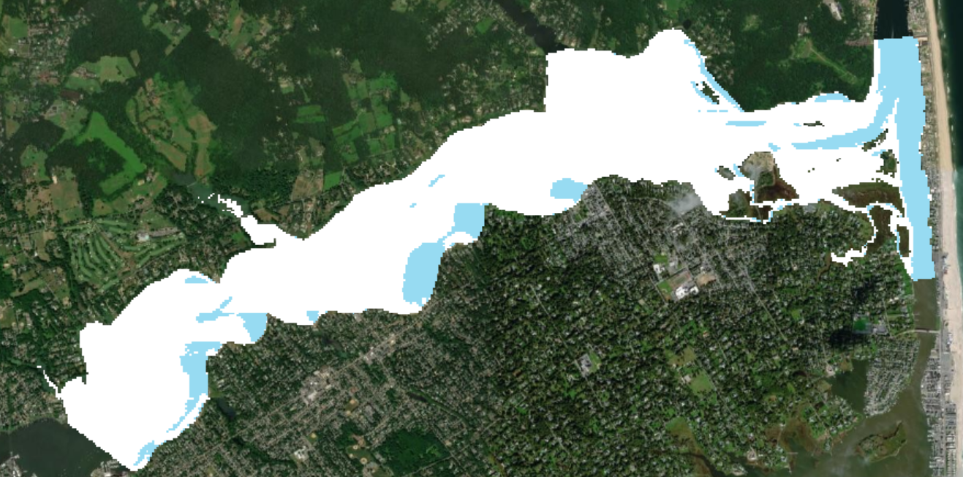
Development of a public tool to model shoaling areas in the Navesink River, New Jersey
Richard Kane
Monmouth University
April 1, 2021
How can existing wave modeling software be used to create a tool which will accurately model shoaling in the Navesink River?
Methods:
Existing wave modeling software was downloaded
Fetch was calculated using existing software
Wave height was calculated using existing software
Shoaling area calculation
Shoaling depth (Hb)
Negative Hb (0 - Hb)
Negative Hb ≥ Hb
Create Python script tool
Share to ArcGIS online
Purpose:
Create accurate shoaling model using available wave modeling
Make shoaling tool available to public
Lay groundwork for more complicated water safety analysis
Figure 2. Shoaling area when a light breeze (12 MPH) is blowing out of the East
Products Obtained for Maps:
Bathometry from National Oceanic and Atmospheric Administration
Wave model from US Geological Survey
Figure 3. Shoaling area when a near gale (38 MPH) is blowing out of the East
Figure 4. Shoaling area when a whole gale (68 MPH) is blowing out of the East
Outcomes:
A model for shoaling area was created
Shoaling Area Model is available at:
Shaoling_Area_Model
Figure 5. Shoaling when a
Hurricane Force (>78 MPH) is blowing out of the East.
Figure 1. Shoaling area script tool. Consists of nine mandatory inputs.
Contact Information:
Richard Kane: s1204678@monmouth.edu
Geoffrey Fouad: gfouad@monmouth.edu
Figures 2 – 5 depict output of shoaling area, as well as the Beaufort Scale wind speed to provide context for wind and sea state. White indicates where shoaling will occur, blue indicates non-shoaling area.

