Slide 1
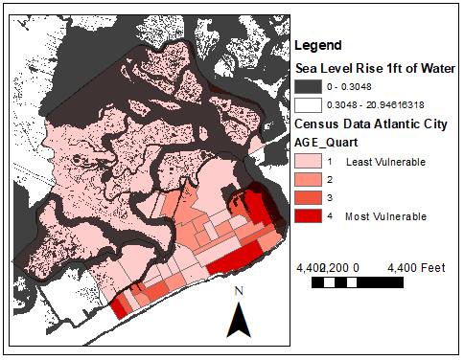
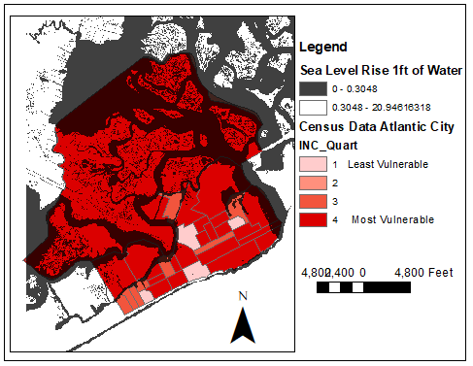
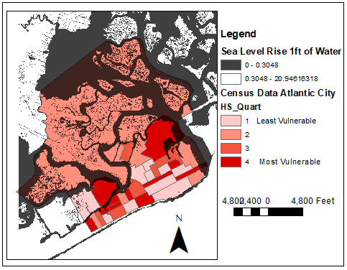
Sea level rise inundation mapping of vulnerable populations in Atlantic City, New Jersey
Jessica Wisowaty (s1205532@monmouth.edu) – Monmouth University – April 6th, 2021
Purpose
Assess one foot of sea level rise in Atlantic City, New Jersey
Map vulnerable populations in Atlantic City based on age, education, and income
Recognize areas of vulnerable populations who will be in need of assistance due to the effects of sea level rise
Data Obtained
Age, income, and education data from census demographic data and tracts, U.S. Census Bureau
Sea level rise inundation data based on National Elevation Dataset, U.S. Geological Survey
Figure 1 . Map of Atlantic City showing vulnerability based on age and one foot of sea level rise (black areas). U.S. Census tracts of older people are darker red (more vulnerable).
Figure 2. Map of Atlantic City showing vulnerability based on income and one foot of sea level rise (black areas). U.S. Census tracts of lower income residents are darker red (more vulnerable).
Outcomes
Established a ranking system for vulnerable populations in Atlantic City based on Census data and highlighted areas of vulnerable populations
Used elevation data to map areas in Atlantic City affected by a foot of sea level rise
Vulnerable populations are located in different areas of Atlantic City depending on the demographic attribute
Methods
Census demographic joined to tracts
Grouped demographic data by quantiles of one to four (larger numbers indicate greater vulnerability) for all Atlantic County
Colored maps to indicate vulnerability, where light red (1) is least vulnerable and dark red (4) is most vulnerable
Figure 3. Map of Atlantic City showing vulnerability based on education and one foot of sea level rise (black areas). U.S. Census tracts of fewer high school graduates are darker red (more vulnerable).

