Slide 1
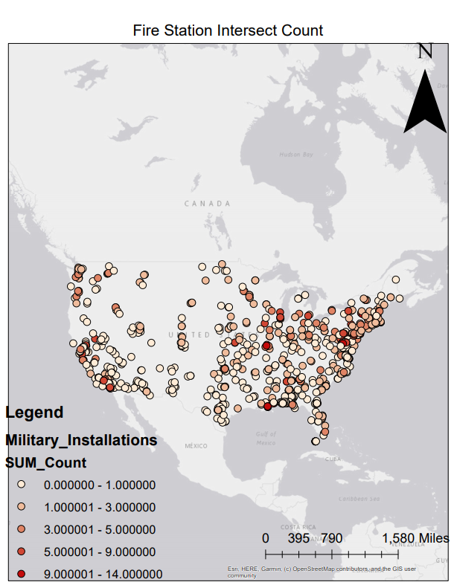
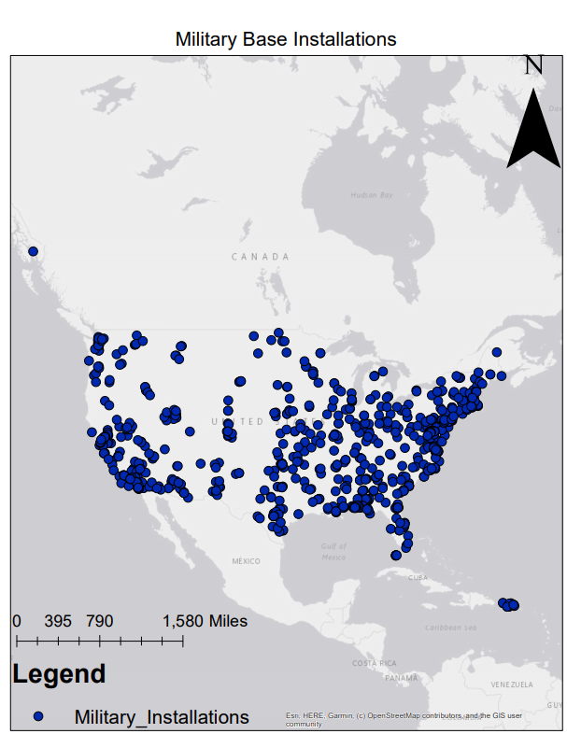
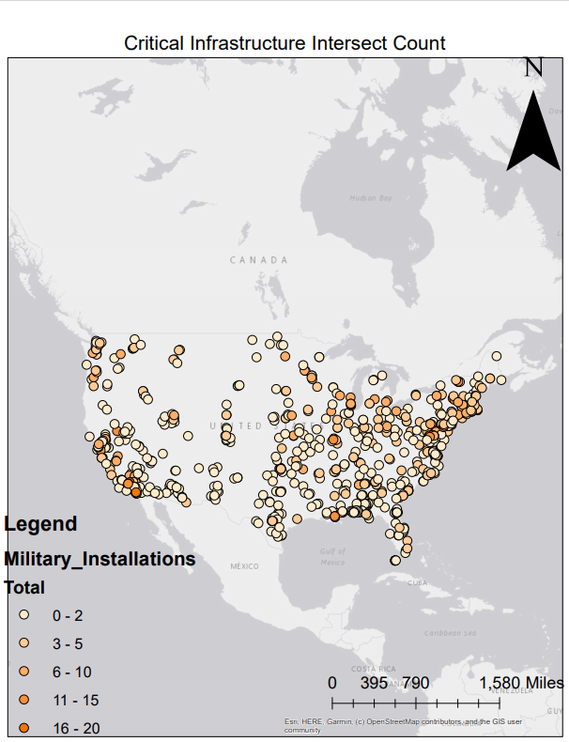
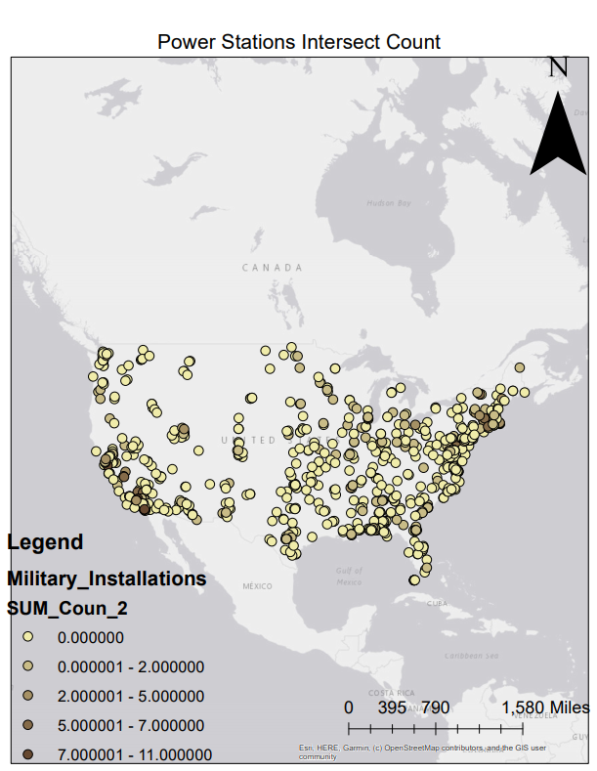
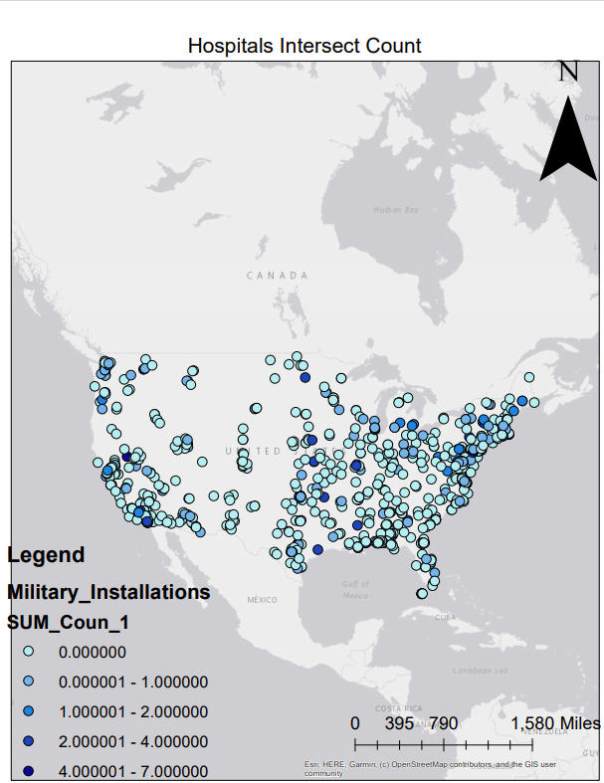
Military base security prioritization based on surrounding critical infrastructure in the contiguous United States
Pedro Sanchez
Monmouth University
8 April 2021
Purpose:
Assess the military bases across the contingent United States to prioritize security at military bases based on critical infrastructure in a proposed “blast zone”.
Do military bases need elevated security to protect critical infrastructures?
Methods:
Map the location of all military bases in the contingent United States
Map 3 sets of critical infrastructure across the contingent United States
Buffer Created around military bases for a 2.5-mile radius
Overlay critical infrastructure in the military base blast zone
Count the total number of critical infrastructure in the bast zone
Data Obtained for Maps:
All information gathered came from Homeland Infrastructure Foundation-Level Data
Outcome:
There are 846 military bases across the contiguous U.S.
Critical Infrastructure count demonstrates that threat of critical infrastructure increases as the color darkens. (Light-Dark)
Contact Information
Pedro Sanchez s1287079@monmuth.edu
Geoffrey Fouad
gfouad@monmouth.edu

