Slide 1
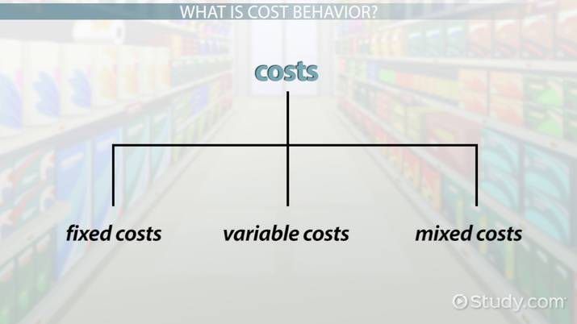
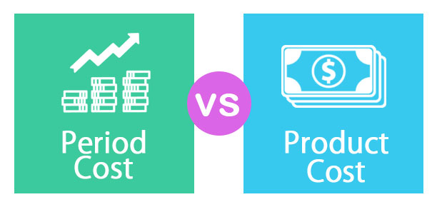
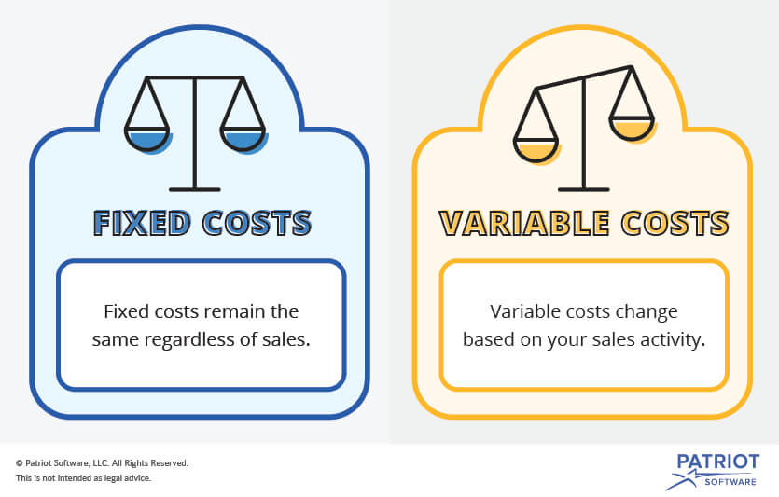
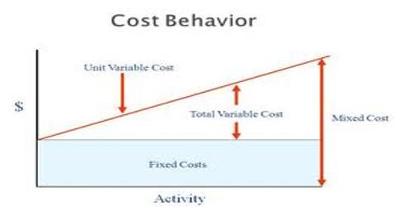
Medify Air: Cost Drivers of a Local Company
By Madeline Weber, Dana Terman, Dylan Fallis, Shaun Rausch, and Justen Samiljan
Monmouth University
Medify Air Purifiers
COSTS & MATERIALS
COST BEHAVIOR & METHODS
Cost Drivers
We selected the merchandising company Medify Air . The company products include purification units and filters
Costs Incurred:
Cost behavior is a measure of how the cost will change in total when there is a change in activity
These patterns change during changes in production and sale levels
Can also be described as time-related costs because they vary over time
Cost behavior is influenced by fixed, variable, and mixed costs
How to determine:
Fixed costs = (Total cost – variable cost) x # of units produced
Fixed costs are constant with whatever quantity of units produced
Variable costs = the cost to make a product x # of units produced
Variable costs vary with the number of units produced
Mixed Costs is expressed as y= a + bx
Where “y” is total cost
“a” is fixed cost
“b” is variable per unit rate
“x” is the number of units
Medify Air uses the high-low method which consists of the total dollars of mixed costs at the highest or lowest volume of activity.
Cost Drivers drive up the costs. In this section we will show the potential cost drivers for mixed and Variable costs.
Variable Costs:
LDP
- Manufacturing costs
Freight Cost
- Maintenance costs
Operating Costs
- Production Costs, # of machine hours used
Purchase goods from factories
- Units Purchased
Advertising and Marketing
- How many advertisements are created and distributed
Mixed
Employee Wages
- Number of hours employee worked per day
Sales Team Development
- Labor Costs
LDP
Freight Cost
Operating Expense
Design/ R&D Development
Purchase goods from factories
Warehouse Cost
Sales Team Development
Employee Wages
Advertising and Marketing
Insurance
PERIOD COST VS PRODUCT COSTS
What The Company Provides
Air filter units that purify the air and removes toxins and particles from the air
Aim to reduce symptoms that allergy sufferers go through
Filters are designed with HEPA H13 aero filters
Mission : a better and cleaner air for customers in order for them to live longer and cleaner lives
1. LDP → PRODUCT
2. Freight Cost → PRODUCT
3. Operating Expenses → PRODUCT
4. Design/ R&D Development → PRODUCT
5. Purchase goods from factories → PRODUCT
6. Warehouse Cost → PERIOD
7. Sales Team Development → PRODUCT
8. Employee Wages → PERIOD
Advertising and Marketing → PERIOD
10. Insurance → PERIOD
References
BA-320-01 Managerial Cost Analysis with Professor Yu
Medify Air Co.
https://www.wallstreetmojo.com/cost-drivers/
https://efinancemanagement.com/costing-terms/cost-drivers
http://www.hkiaat.org/images/uploads/articles/AAT_Paper_3_Cost_drivers_and_company_activities.pdf
FIXED, VARIABLE OR MIXED COSTS?
CUSTOMER BASE
LDP → VARIABLE
Freight Cost→ VARIABLE
Operating Expenses → VARIABLE
Design/ R&D Development → FIXED
Purchase goods from factories → VARIABLE
Warehouse Cost → FIXED
Sales Team Development → VARIABLE
Employee Wages → MIXED
Advertising and Marketing → VARIABLE
Insurance → FIXED
The company sells directly to businesses, schools, government entities and individuals
Each purifier is sold through personal website as well as third party sites like Amazon.
Acknowledgments and Contacts
Thank you to Professor Yu for providing our class with information on Cost Drivers!!!
Another big thank you to Kevin Weber, Medify Air CFO for taking the time to meet and provide the group with all the information directly related to the company
Contact info@medifyair.com for more information!

