Slide 1
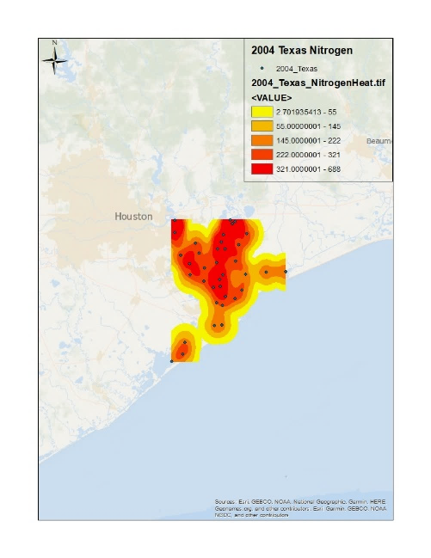
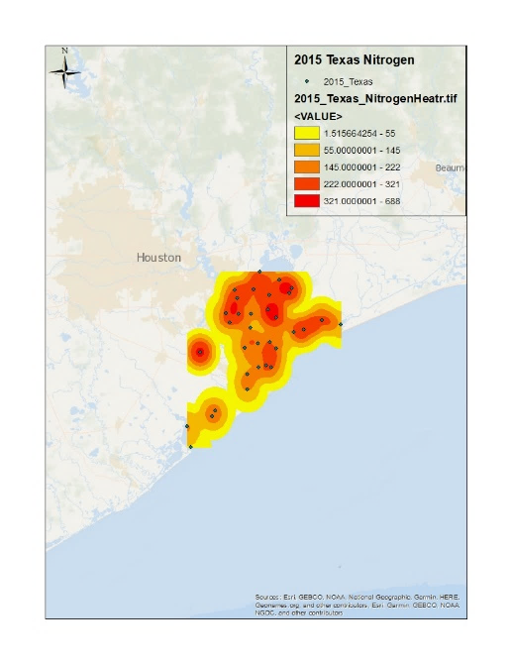
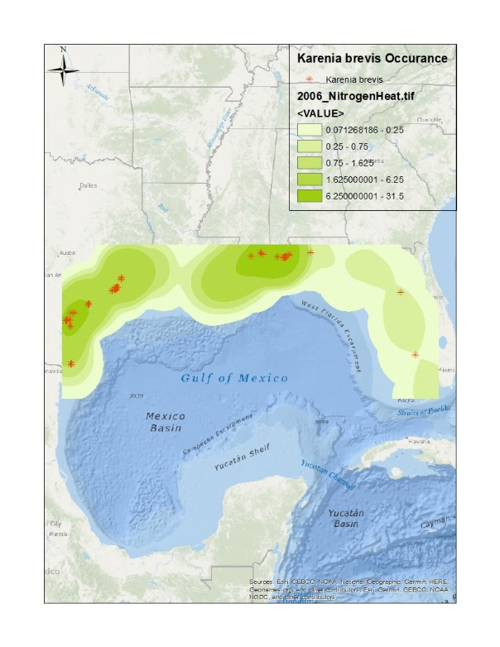
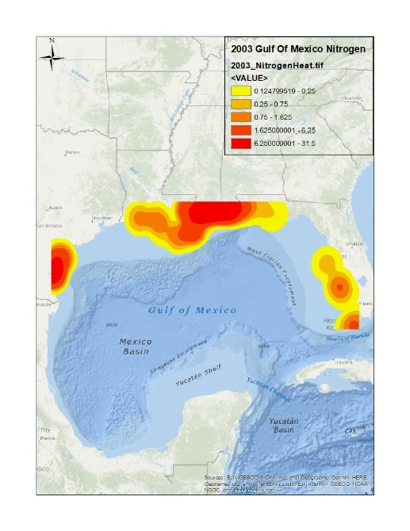
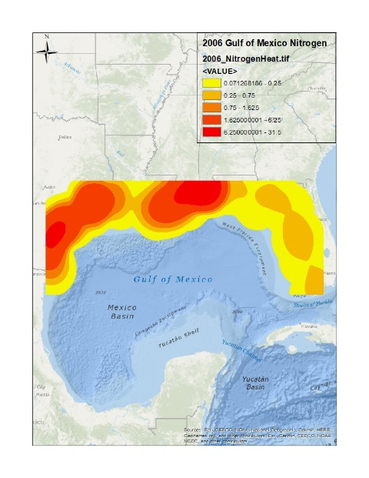
Mapping water quality parameters related to red tide events in the Gulf of Mexico
Logan Murphy^{1,2} and Geoffrey Fouad²
¹Marine and Environmental Biology and Policy Program, ²Geographic Information Systems Program
Red Tide
Red tide is a term used for a nutrient enrichment event which feeds harmful algal blooms. These blooms can cause fish kills, marine mammal kills, and severe ailments in humans
Purpose
Examine effects of progressive nutrient enrichment and red tide on nitrogen levels in the Gulf of Mexico
Observe how nutrient enrichment may impact red tide occurrences
Methods
Data gathered from EPA and NOAA
Points displayed using kernel density “heat map”
Data analyzed using a t-test in Microsoft Excel
Nitrogen concentrations presented along side of harmful dinoflagellate Karenia brevis occurrences
Results
Nitrogen levels in Galveston Bay rose by an average of 36% from 2004 to 2015 and 19% from 2003 to 2006
Results of t-test showed significant increases in average nitrogen with p-values of 0.0075 and 0.0024
Future Work
Implement more frequent and distributed water quality data in both the Gulf and adjacent estuaries
Use this data to predict future red tide events based on water quality and atmospheric forecasts
Figure 1: 2004 nitrogen concentrations in mg/L in Galveston Bay, Texas gathered by EPA National Aquatic Resources Survey in the form of a heat map.
Figure 2: 2015 nitrogen concentrations in mg/L in Galveston Bay, Texas gathered by EPA National Aquatic Resources Survey in the form of a heat map.
Figure 3: 2003 nitrogen concentrations in mg/L in the Gulf of Mexico along coastal areas collected by the Texas Commission on Environmental Quality and National Aquatic Resources Survey arranged into a heat map.
Figure 4: 2006 nitrogen concentrations in mg/L in the Gulf of Mexico along coastal areas collected by the Texas Commission on Environmental Quality and National Aquatic Resources Survey arranged into a heat map.
Figure 5: Heat map of nitrogen levels in the Gulf of Mexico during a Karenia brevis occurrence.
Table 1: A table of the range in averages between the maps and the p-values of the t-tests.
 | 2004 Texas Nitrogen (mg/L) | 2015 Texas Nitrogen (mg/L) | 2003 Gulf Nitrogen (mg/L) | 2006 Gulf Nitrogen (mg/L)
Average | 0.81 | 1.1 | 0.68 | 0.81
p-value | 0.0075 |  | 0.0024
Contact info:
Logan Murphy – s1120236@monmouth.edu
Geoffrey Fouad – gfouad@monmouth.edu

