Slide 1
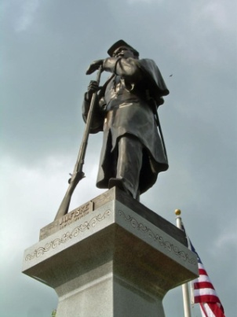
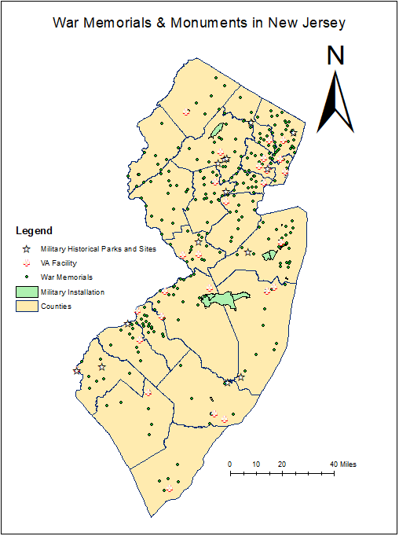
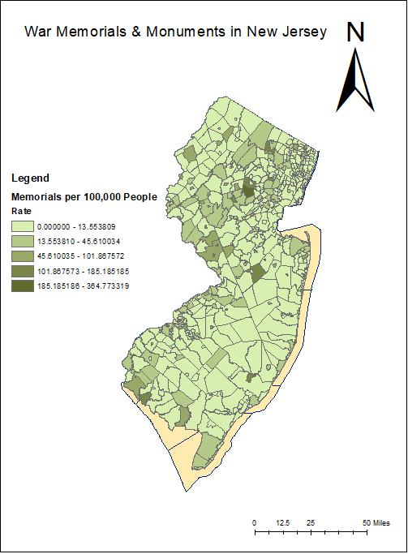
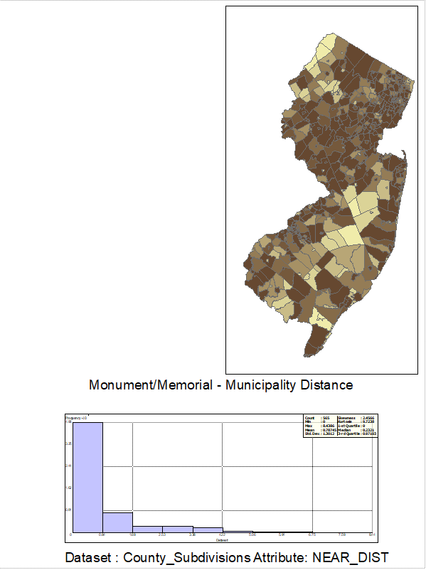
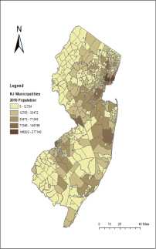
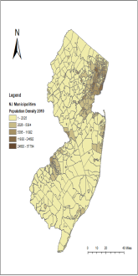
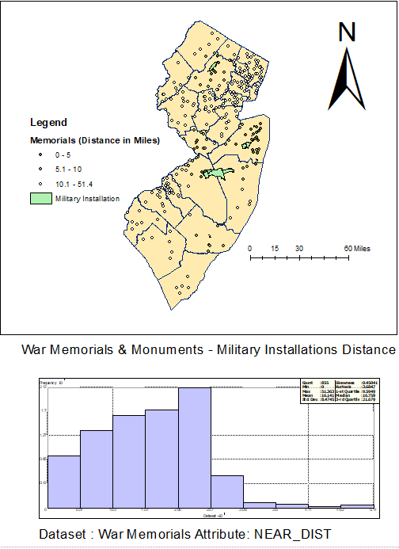
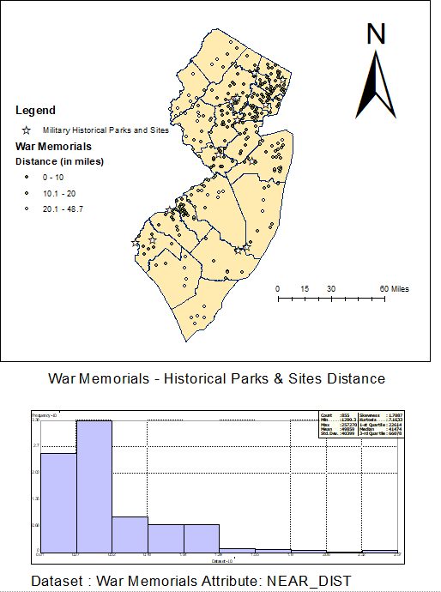
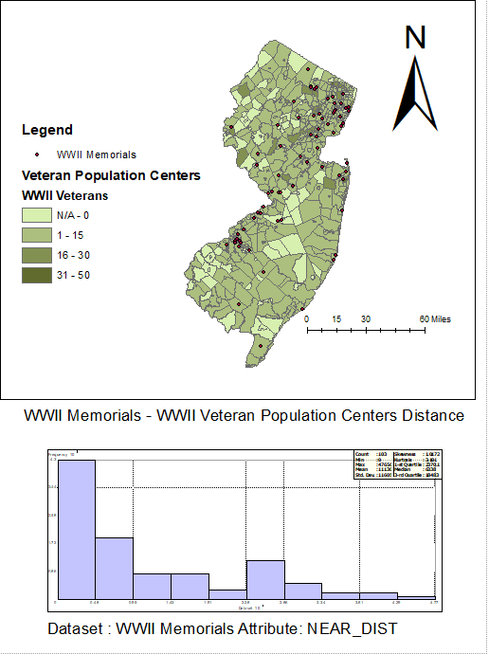
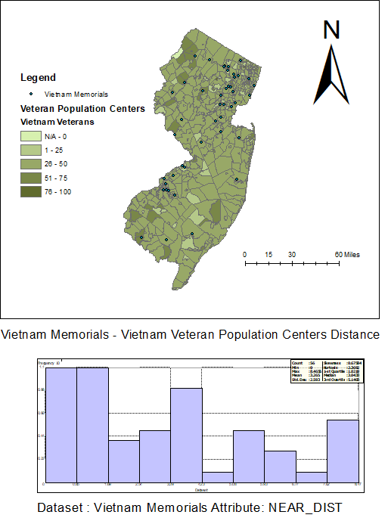
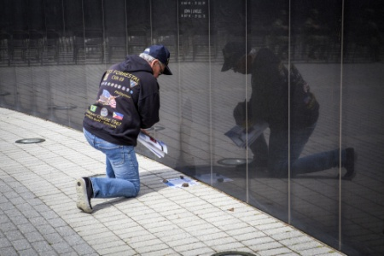
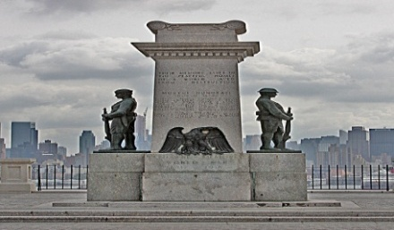
Mapping War Memorials & Monuments in New Jersey
Commemoration:
Monuments and memorials dedicated to our nation’s veterans and military history are an integral part of our cultural landscape.
Where are they found? What are the strongest factors that influence their location?
Mark Cianciosi, Richard Veit, and Geoffrey Fouad
Figure 4: Total population of cities (left), population density of cities (right), and distance of memorials to population centers (bottom).
Figure 1
Figure 2
Figure 4
Results:
Monuments tend to be located near urban areas (see Figure 4 histogram)
The same applies to historical military sites (see Figure 3b histogram)
Geographic distribution of monuments may be impacted by local populations of veterans of respective wars, but this is subject to change over time as veterans relocate (historical census data needed)
Discussion & Future Research:
Distance to population centers strongest factor influencing monument location
Further investigation into veteran population needed to assess changes over time and relation of that to monuments
Monument establishment year could be linked to historical events (anniversaries) and changing political sentiments
Economic factors also need to be related to monuments
Future questions: How do changes in economic factors, voting, and veteran populations relate to war commemoration?
Objectives:
Map key features and datasets relevant to war monuments/memorials identified in New Jersey
Identify trends in monument locations in relation to other relevant features and data
Assess strongest possible factors that influence where monuments/ memorials are established
Figure 5a and 5b
Data Sources
Monument data acquired in research project conducted by Veit, Cianciosi,& Butchko.
US Census data (2010) for counties and county subdivisions (cities) estimating total population and veteran population by war
Department of Veterans Affairs open source data for VA facilities and veteran statistics
Department of Transportation data for military bases in the US
National Park Service and state data for parks and historical sites
Figure 3a and 3b
Maps and Statistics
Figure 1: Map of all war memorials/monuments in New Jersey, as well as military installations, VA facilities, and major historical military sites/state parks.
Figure 2: Rate of war memorials per 100,000 people in census units similar to cities.
Figure 3a: War memorials/monuments in relation to military installations, by distance.
Figure 3b: War memorials/monuments in relation to historical sites/parks, by distance.
Figure 5a and 5b: WWII/Vietnam veteran population centers in relation to WWII/Vietnam war memorials.
Contact Information:
Mark Cianciosi: macianciosi@gmail.com
Dr. Richard Veit: rveit@monmouth.edu
Dr. Geoffrey Fouad: gfouad@monmouth.edu

