Slide 1
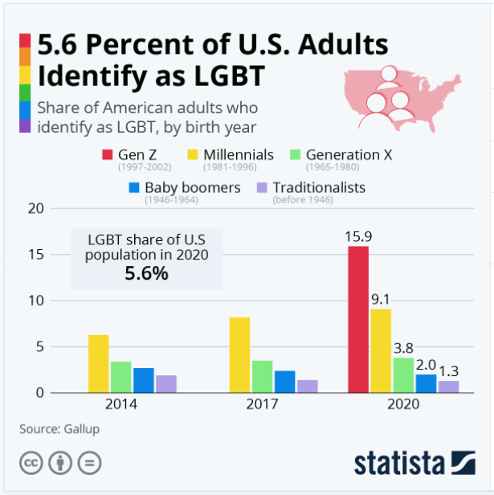
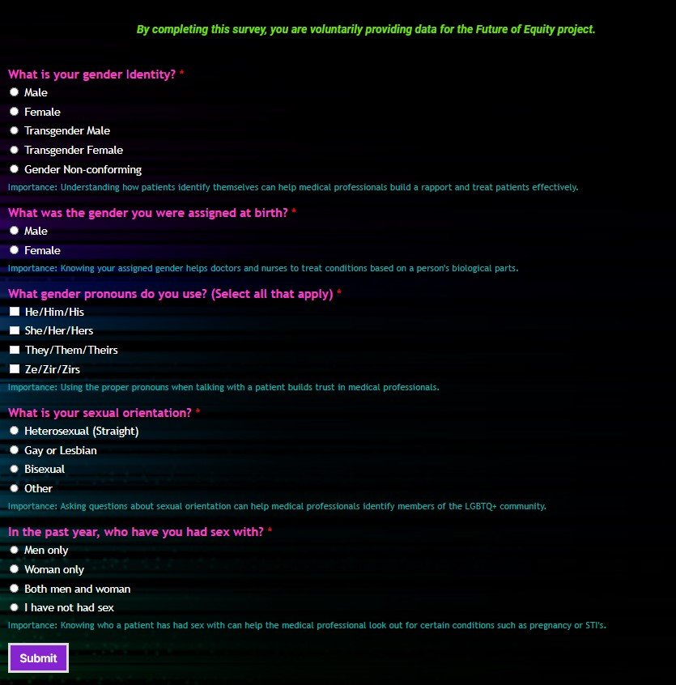
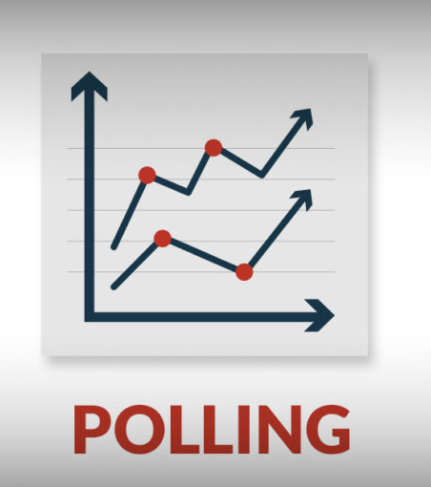
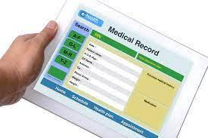
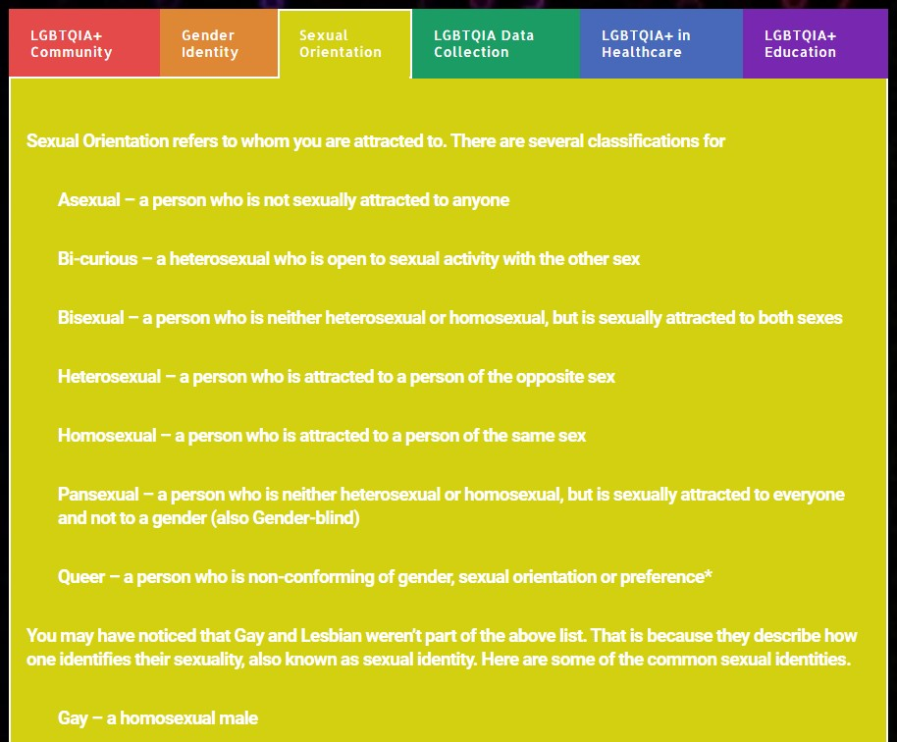
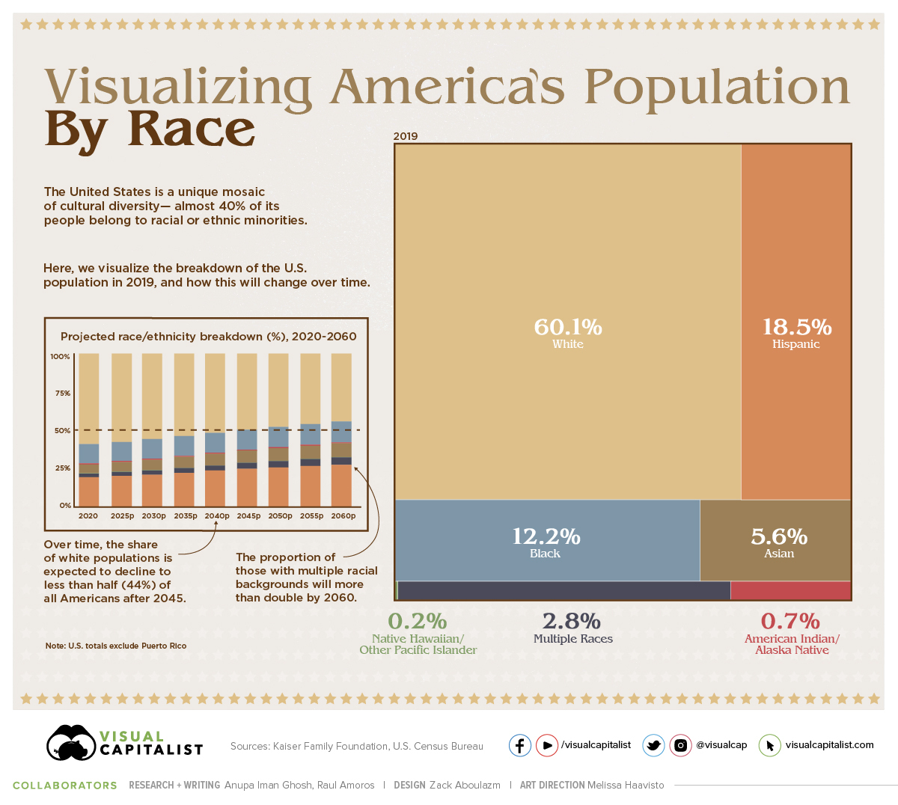
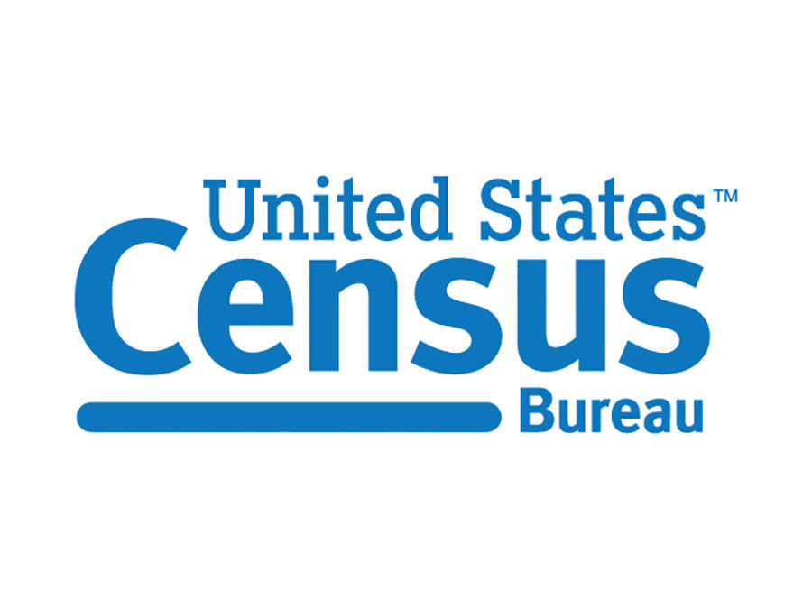
Inequity in Data Collection of the LGBTQIA+ Community
By: Darci Santella – Graduate Student
Department of Communication - Interactive Digital Media Concentration
LGBTQIA+ Data
Survey Instrument w/Explanations
Myths of SOGI Data Collection
Below are the 5 questions I believe should be asked on any form, poll or survey along with other demographic questions such as name, age, relationship status and ethnicity.
Below each question is a selection that defines a person based on gender identity, gender assigned at birth (also known as 'sex'), pronouns preferred, sexual orientation and sexual relationships.
After each question, there is a statement of importance; this references the importance of a person as a patient in a healthcare setting. Though there are many reasons these questions are an important part of data collection, it is especially important in healthcare because there are different health risks based on sexual orientation and gender identity.
1. PARTICIPANTS WILL REFUSE TO ANSWER QUESTIONS ABOUT THEIR SEXUAL ORIENTATION AND GENDER IDENTITY.
FALSE: Actually, the refusal to answer any question on a survey is completely random. There is no statistical proof that people will refuse to answer a survey question just because it is about their sexual orientation or gender identity.
2. BECAUSE THE LGBTQIA POPULATION IS SO SMALL THE SAMPLE SIZE WILL NOT HAVE ANY STATISTICAL POWER
FALSE: Statistical Power is how likely a study is to represent a population. Since we cannot survey the entire population (similar to the Census) we must take a sample of the population to test instead. The smallest sample size statisticians like to work with is around 100 people.
For the LGBTQIA population, this means randomly sampling Americans, but at least 100 of them must be LGBTQIA. Since the current LGBT population is recognized as 5.6%, that would only be 56 people out of 1000. They would have to sample 1000 more people to get close to 100 people identifying as LGBTQIA. This process is called oversampling and it will cost twice as much to collect the data.
This is the popup that is seen on my Future of Equity page, asking users to participate in a survey of only SOGI questions. The survey instrument is also presented on this poster (black box to the right).
In 2020, Gallop conducted a LGBT poll and found an increase in number of Americans that identify as LGBT. The number increased to 5.6%. The most interesting part of this survey is the dramatic increase of identity within different generations, especially Gen Z [1].
3. THERE IS NO VALID AND RELIABLE MEASUREMENT TOOL TO COLLECT DATA ON SEXUAL ORIENTATION & GENDER IDENTITY.
Objective
Where SOGI questions be asked?
FALSE: The survey instrument to the left (black box) is a reliable measurement tool. It asks the 5 most important questions, according to Sell (4): 1) sexual orientation, 2) current gender identity, 3) sex assigned at birth, 4) preferred name, and 5) preferred gender pronoun
My research on the Inequities of Data Collection in the LGBTQIA+ community were part of a larger project: The Future of Equity.
Statistics of the LGBTQIA+ Community show that they only make up 5% of Americans. I researched why this number was so low, and it turns out there haven’t been many studies conducted for this community, nor are they being represented in everyday polling, forms in the US Census.
In order to effectively and accurately count for the members of the LGBTQIA+ community, demographic questions about Sexual Orientation and Gender Identity (SOGI) need to be included with other demographic questions.
Demographic Questions
The images above are taken from the website I created for the Inequity of Data Collection in LGBTQIA+ community. These highlight some of the terms that are used within the community and explain what they mean in terms of sexual orientation and gender identity.
Research
References
As part of my research in data collection in Healthcare, I reached out to the Director of Diversity & Inclusion and Babs Siperstein PROUD Center, Paula Gutierrez, about how her center/hospital is incorporating SOGI questions into healthcare forms. I was surprised to find out that though NJ is part of the SOGI Law, it is only suggested SOGI questions be asked on intake forms. RWJBarnabas is only collecting information on gender identity through their electronic form format and are looking to add sexual orientation questions soon.
Ms. Gutierrez stated the most important thing for the healthcare system to do is train those who collect the information for data intake and those who are most visible with patients, not the nurses or doctors.
I also reached out to Monmouth University's Polling Director, Patrick Murray to find out whether pollsters ask SOGI questions when conducting polls. He told me that pollsters do not ask SOGI questions because approximately 5% of the population identifies as LGBTQIA+ and that is not a large enough sample size to have statistically relevant data.
Though I understand not having a large enough sample size, who better to see the trends in LGBTQIA+ representation than those who ask demographic questions every day?
In 2019, the LGBTQ Data Inclusion Act, which would require federal agencies to collect SOGI data was introduced in Congress. It has yet to be acted on.[2]
[1] Buchholz, K. (2021, March 1). 5.6 Percent of U.S. Adults Identify as LGBT. Statista Infographics. https://www.statista.com/chart/18228/share-of-americans-identifying-as-lgbt/
[2] H.R.3509 - 116th Congress (2019–2020): LGBTQ Data Inclusion Act. (2019a, June 23). Congress. Gov | Library of Congress. https://www.congress.gov/bill/116th-congress/house-bill/3509?s=1&r=4
[3] Sell, R. L. (2017a). Challenges and Solutions to Collecting Sexual Orientation and Gender Identity Data. Am J Public Health: LGBT Surveillance, 107(8), 1212–1214. https://doi.org/10.2105/AJPH.2017.303917
More Information
To learn more about the Future of Equity Project please visit:
http://idmresearchlab.com/index.php/projects/future-of-equity/

