Slide 1
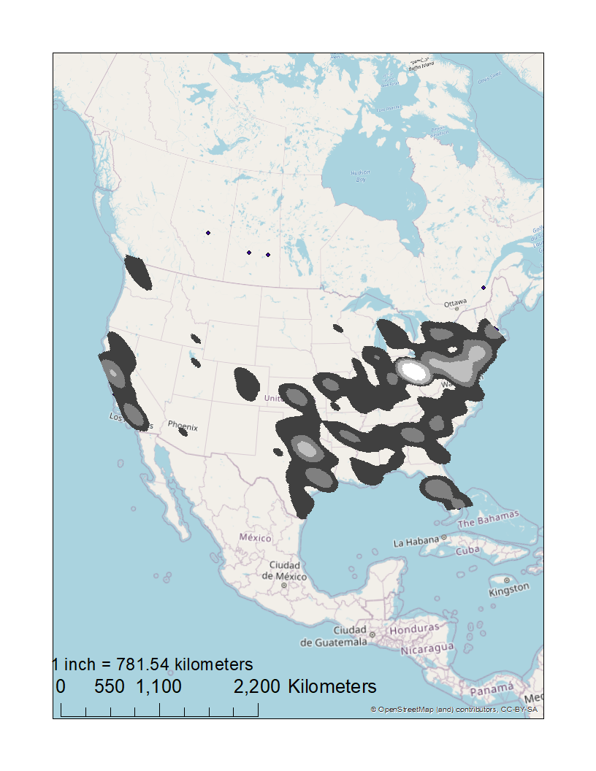
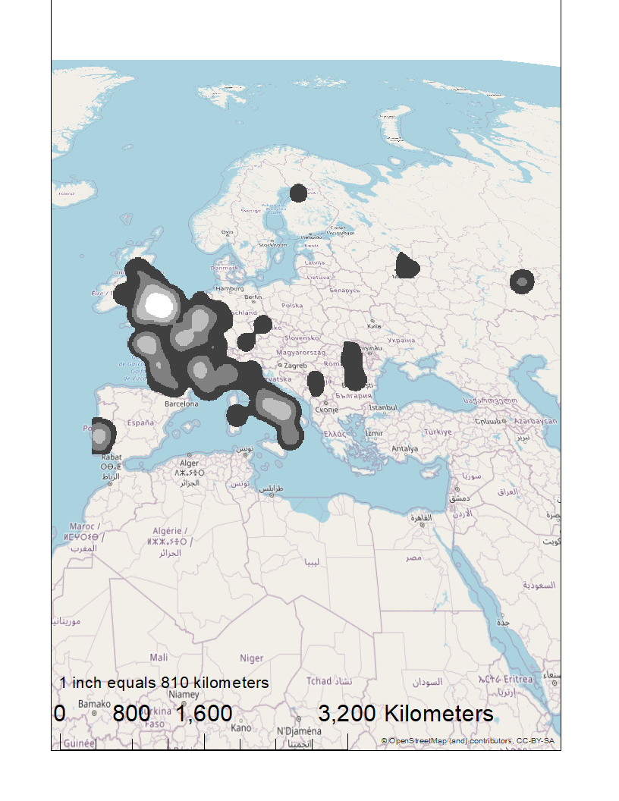
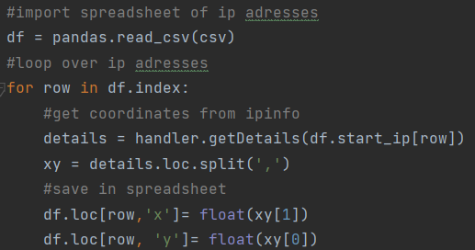
Geographic patterns of fraudulent internet protocol addresses
Justin Vunic (s1314118@monmouth.edu), Geoffrey Fouad (gfouad@monmouth.edu)
Computer Science Program and Geographic Information Systems Program
Are fraudulent IP addresses clustered geographically?
Purpose
Cyberspace poses a growing threat. Internet protocol (IP) addresses are identifiers of internet activity that can be mapped geographically. This includes IP addresses committing fraud, which are mapped here
Results
1,000 fraudulent IP addresses mapped
High density clusters of fraudulent IP addresses found in US and Europe
Primarily clustered around major cities, such as London
Methods
Fraudulent IP address sample (MaxMind)
“IPInfo” Python library for mapping IP addresses
Loop over IP addresses in Python
Kernel density (heat) map of fraudulent IP addresses
Discussion
Unexpected results
Largest cluster in US in Columbus, Ohio
A rural region of France (Brittany) has a cluster
Signs of data centers or the use of private networks for masking locations
Fraudulent IP address density
Extreme
High
Moderate
Low

