Slide 1
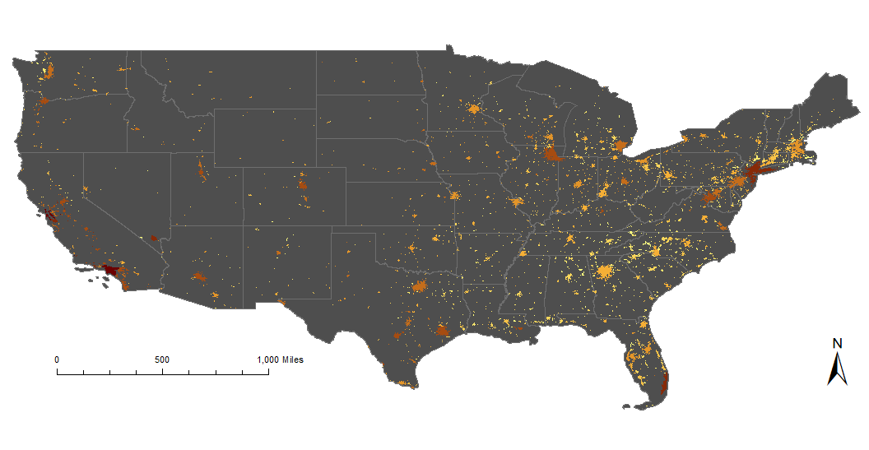
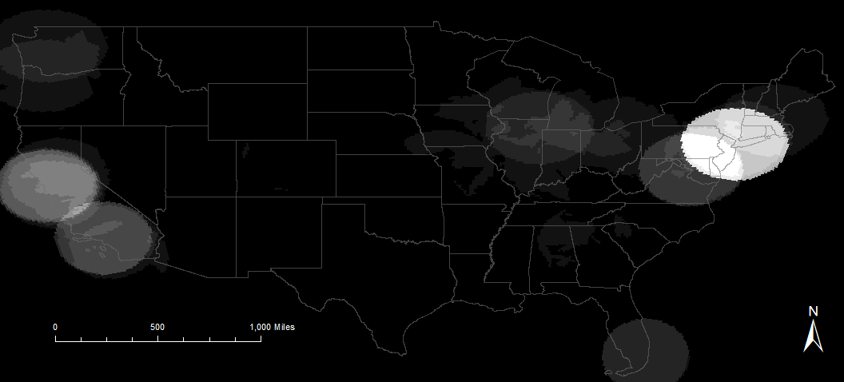
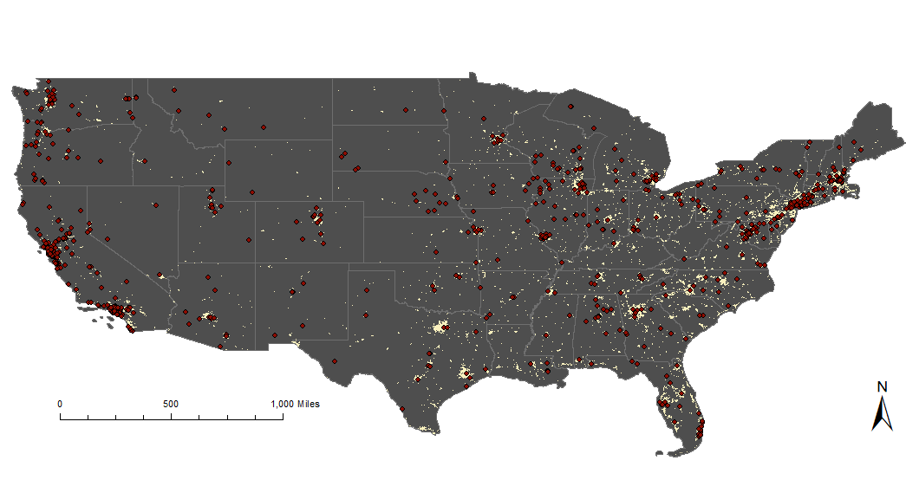
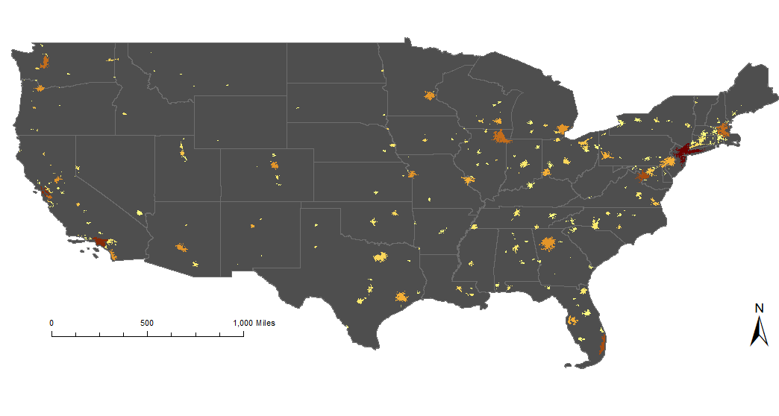
Geographic risk assessment of terrorist attacks in the United States (US)
Rob Merten
Monmouth University
April 8, 2021
Purpose:
Assess terrorism risk geographically
Map risk of terrorist attack as the probability and possible losses of an attack
Knowledge of where terrorism has occurred in the past may inform future decisions of where to deploy preventative measures nationwide
Is population density positively correlated to terrorism?
Methods:
Map population density based on the estimated population of an Urbanized Area ÷ square miles (Figure 2)
Map probability of a terrorist attack based on the number of attacks in the area ÷ 41 years (time frame of terrorism data) (Figure 3)
Point density heat map of terrorist attacks in the US (Figure 4)
Figure 2: Map of population density in Urbanized Areas. Population density was measured by calculating the estimated population per square mile of an Urbanized Area. Darker colors indicate a greater population density.
Data Obtained for Maps:
Population and Urbanized Areas from US Census
Terrorism data from University of Maryland Global Terrorism Database
Figure 4: Point density heat map of terrorist attacks with a radius representative of metropolitan areas (see the New York City area). Lighter colors represent greater attack risk.
Figure 3: Map of probability of a terrorist attack in Urbanized Areas calculated as the number of attacks divided by 41 years (period of record) in which darker areas have a higher probability of an attack.
Outcomes:
Population density generally varies with terrorist attack probability
Expected losses are high where terrorist attack probability is high
Coastal areas, which tend to be more densely populated, display a more dense distribution of attacks than any other areas
Figure 1: Map of US Urbanized Areas and terrorist attacks. The beige areas represent urban areas, and the red dots are terrorist attacks that have been attempted or conducted.
Contact Information:
Rob Merten: s1205159@monmouth.edu
Geoff Fouad: gfouad@monmouth.edu

