Slide 1
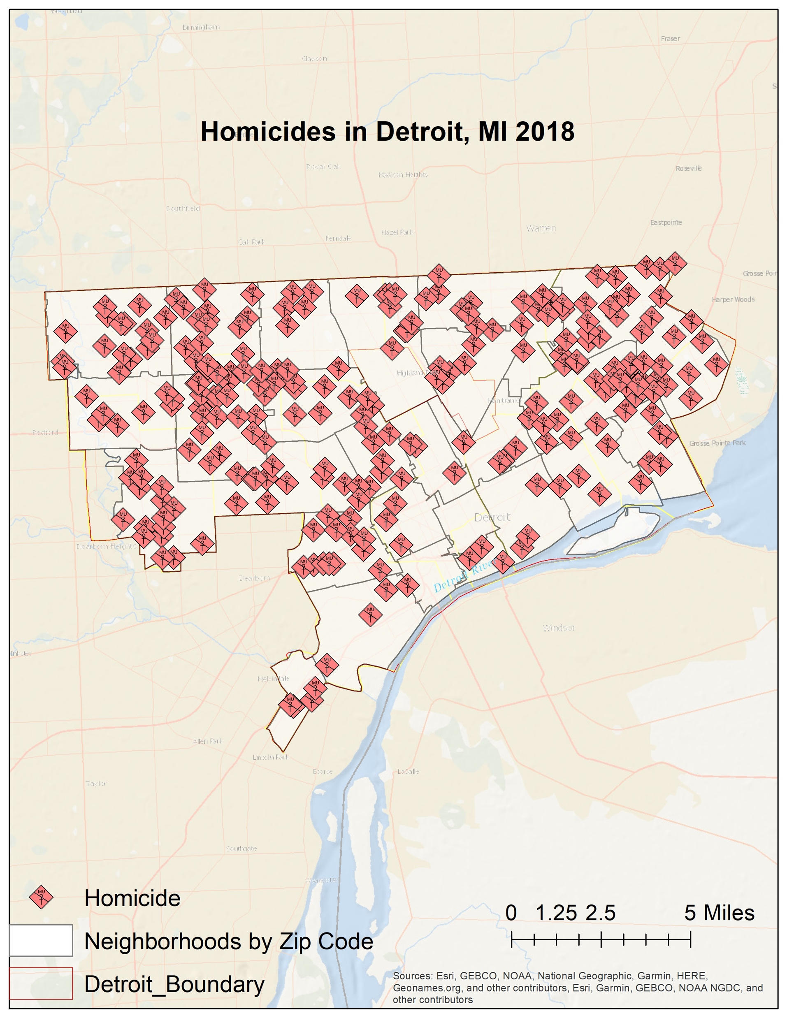
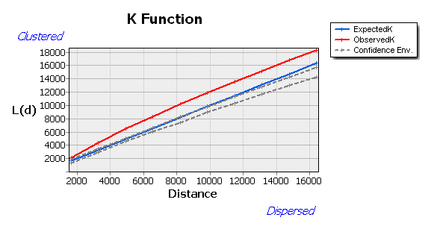
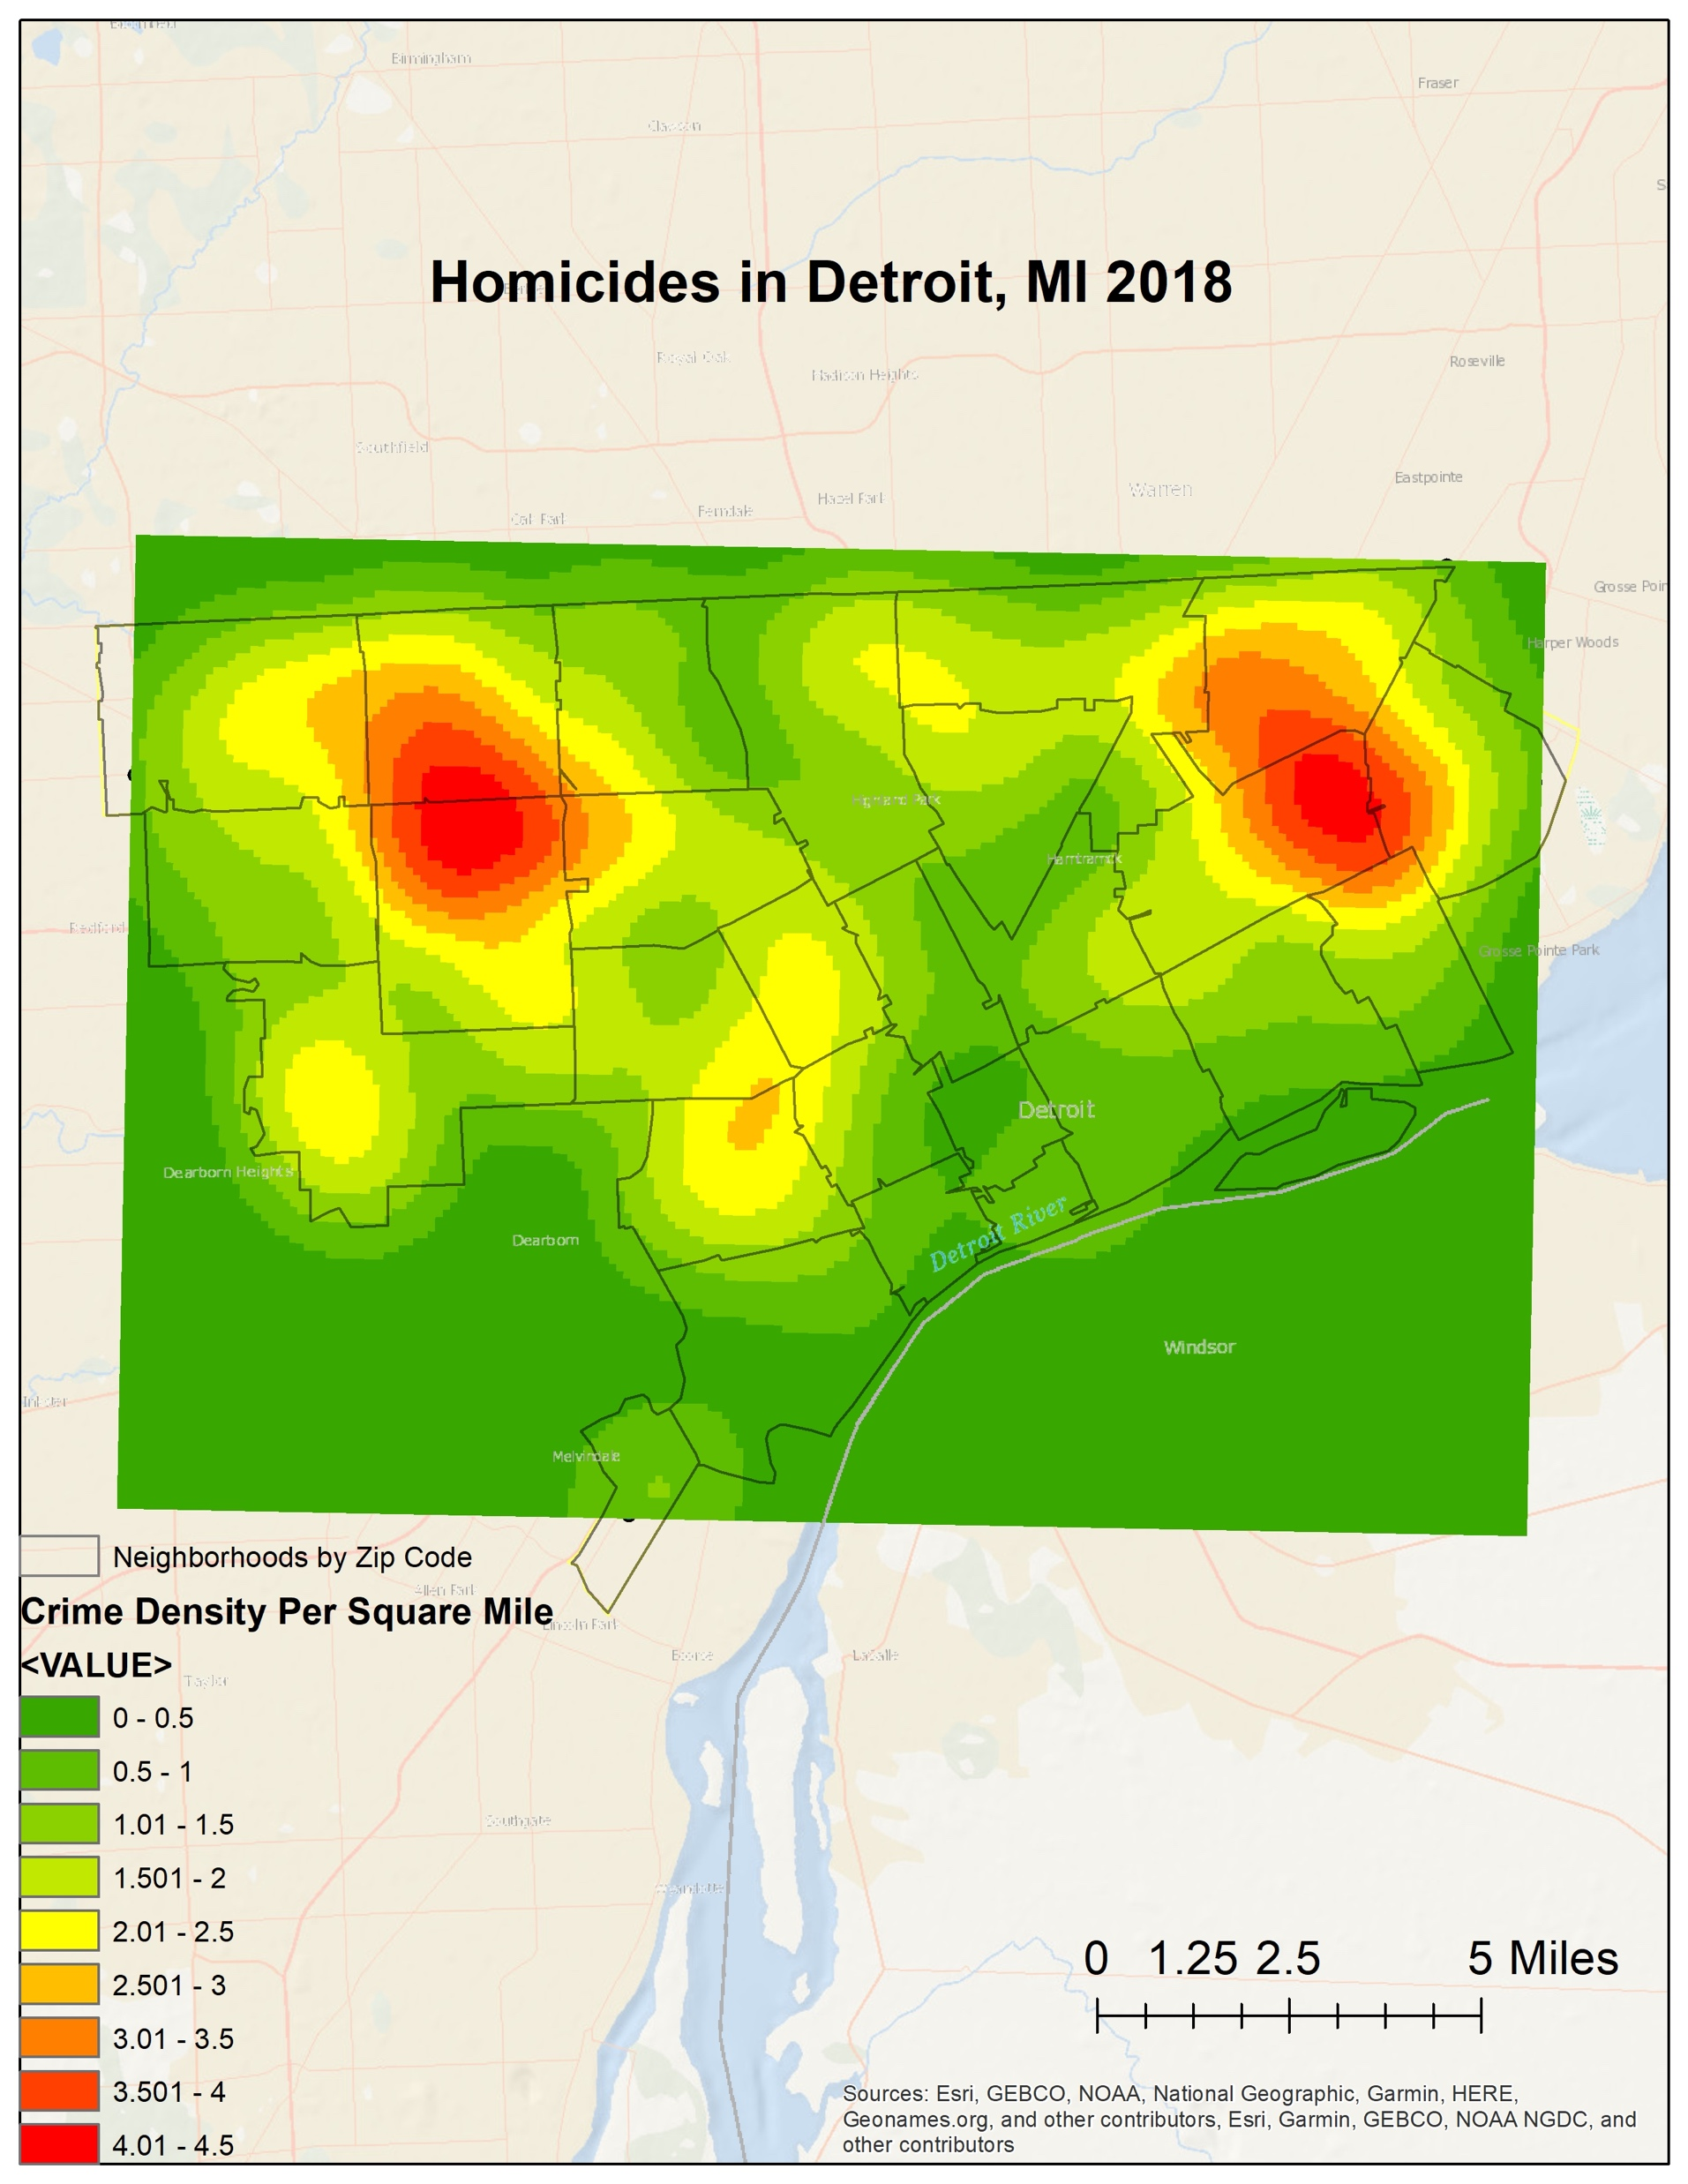
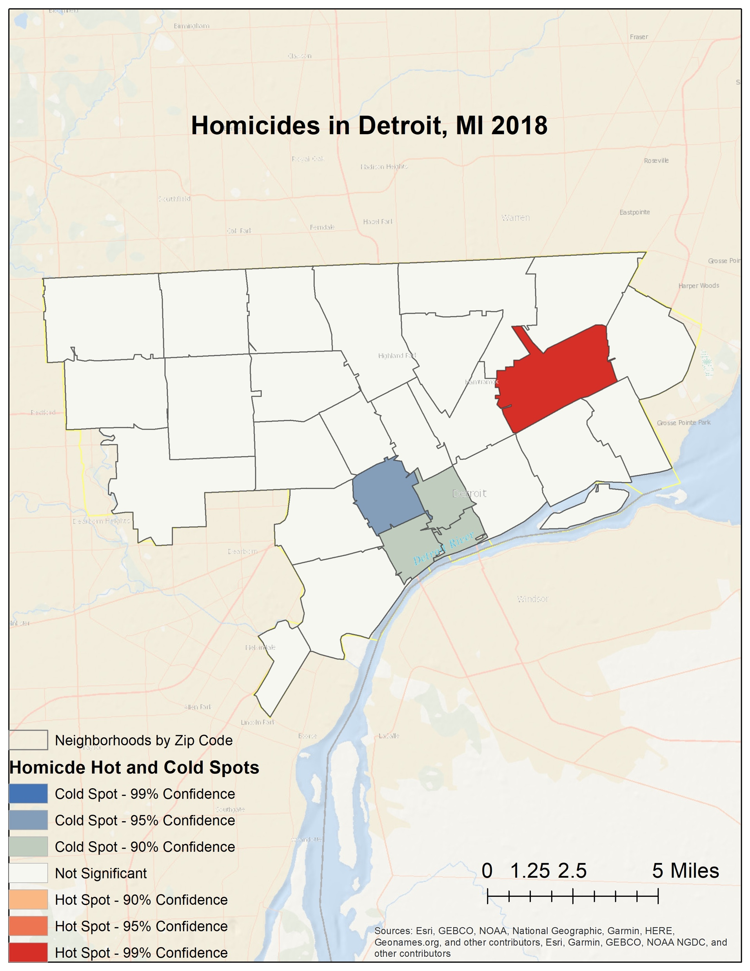
Alyssa M. Dowd
2021
Geographic Cluster Analysis of Violent Crimes in Detroit, Michigan
Are homicides in Detroit geographically clustered in economically disadvantaged neighborhoods?
Monmouth University, Geographic Information Systems (GIS) Program
Purpose
Methods
Assess location of homicides in Detroit in 2018
Map the crimes and neighborhoods
Assess whether the clusters show if high homicide rates relate to economically disadvantaged neighborhoods
Detroit is noted as one of the most violent cities within the United States, so if we can identify clusters of crime, we can assess mitigation efforts
Map homicide points and homicide rates in Detroit zip code areas
Assess clustering by distance (Ripley’s K Function)
Heat map of homicides per square mile using distance from Ripley’s K
Hot spot analysis of homicide clusters by zip code areas using distance from Ripley's K
Compare homicide clusters of heat map and hot spot analysis
Assess where the clusters are within Detroit zip code areas
Data Obtained for Maps
Outcome
Crime data from Open Data Detroit
Detroit Boundary from Open Data Detroit
Zip code areas and population data from the US Census Bureau
Homicides are clustered in some zip code areas, with both clusters of high and low crime
Clusters of high and low crime were unexpectedly close (see hot and cold spots)
The hypothesis is correct for certain areas, as the hot spot is located in the 4th poorest neighborhood in MI
The cold spot in NW Goldberg has a lower median income, but also a lower population
This shows that economic disadvantage is not the only factor related to high homicide rates

