Slide 1
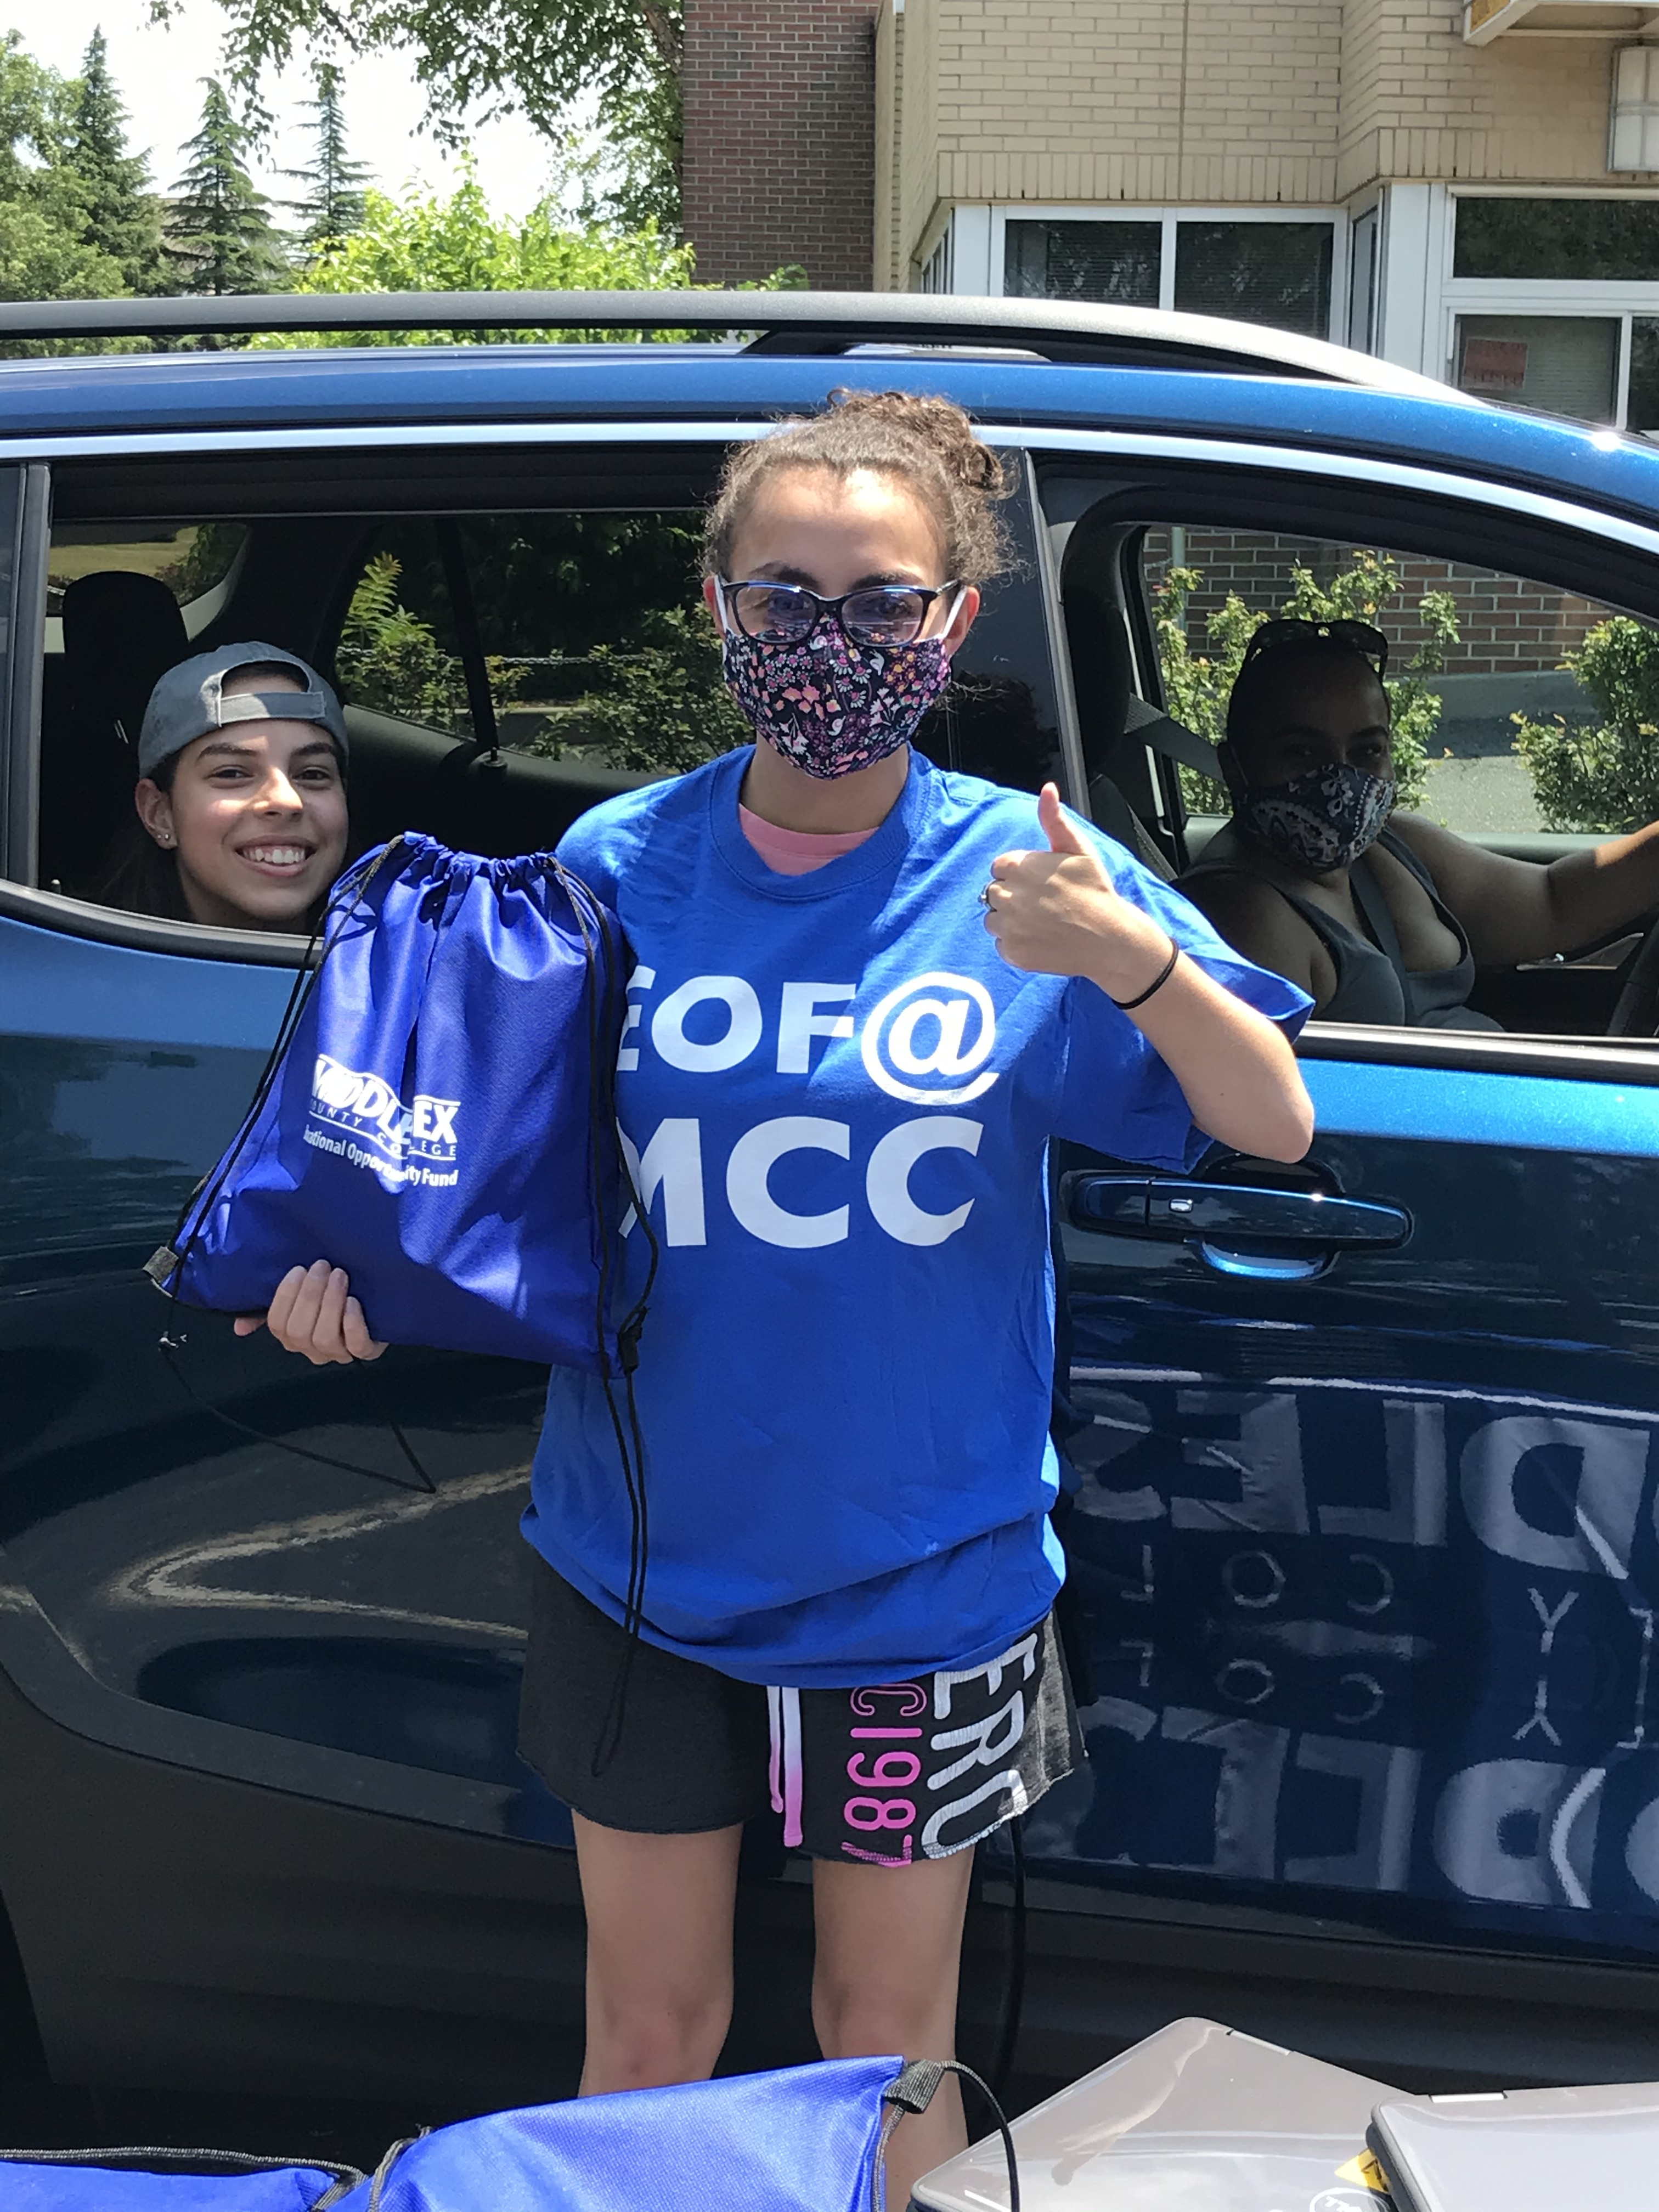
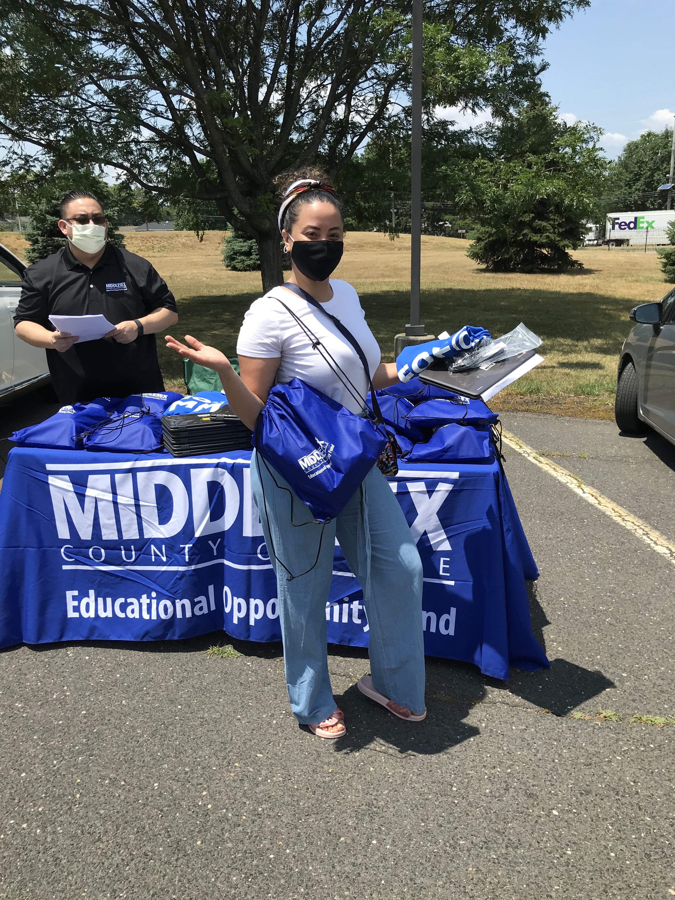
EOF Scholars: Resiliency & Excellence in a Virtual World
Romina Generali| Faculty Advisor: Alyson Pompeo-Fargnoli Ph.D
Introduction to EOF at Middlesex College
EOF Operations in a Virtual Setting
EOF as a Champion of Social Justice
The Educational Opportunity Fund program is a state-funded program that seeks to transform students’ lives. Our Services:
Personal, academic, and professional counseling with an assigned EOF Counselor
The Passport Program - student developmental workshops
Leadership and networking opportunities
Tuition grants
The Summer Scholar Institute:
A 5-week non-residential summer bridge program that includes an Orientation to college, free summer courses, stipends and meal vouchers, and resources to help incoming first-year students succeed at Middlesex College
I began working for the EOF office at Middlesex College a couple of weeks before the COVID-19 pandemic caused us to rely solely on virtual operations. I had the privilege of assisting the office in transforming our services to a new and unfamiliar virtual world. As we adapted to meet both the traditional and new and constantly evolving needs of our students, our students adapted as well. Our scholars were asked to transition to fully online courses in less than two weeks and had to balance their work and family obligations. Many of our students were essential, frontline workers and felt the full magnitude of the panic and uncertainty that dominated the first wave of COVID-19. To support our students in this new, uncharted environment we had to be creative and compassionate.
Virtual EOF initiatives:
All counseling services were moved online:
Pro: Students who were previously missing meetings had more flexibility because they didn’t have to commute to campus.
Con: Not all students had the privacy that is optimal for counseling sessions. Counselors did their best to meet with students when they felt the most comfortable.
All student engagement programs, such as the Passport Program workshops and the Summer Scholar institute were moved online:
Pro: Students could choose to attend a variety of programming within their preferred schedule. Again, many students who were previously not engaged were able to connect.
EOF programs are a direct result of the Newark rebellions of 1966. The year after the rebellions ended, the idea for EOF programs was created by the Chancellor of Higher Education, Ralph A. Dungan. The goal of the program would be to provide students in New Jersey from economically disadvantaged backgrounds with access to a college education. 50+ years later, EOF programs across the state have developed to an academic enrichment program that financially supports its students.
First-Generation EOF Students
Many EOF students are the first in their family to attend college. Therefore, EOF provides them with the guidance and nurturing space to begin exploring all that college has to offer. EOF counselors advocate for their first-gen students to receive the proper resources they need, and answer a variety of academic and financial aid questions that other students may already know.
Racially & Ethnically Diverse EOF Students
EOF is a home to highly diverse group of students. EOF counselors and staff are committed to supporting the cultural identity development of Students of Color and address their unique experience at college campuses across the state. EOF scholars are empowered to seek leadership opportunities and to speak up against injustices they see or face. The EOF office serves as a safe space for students to seek help and grow.
My Title & Role
EOF Retention Specialist at Middlesex College
February 2020 - present
I work with students in a variety of roles to support their academic, professional, and personal development. This includes:
Individual counseling sessions with students
Major & career exploration
Academic planning & registration
Transfer planning & assistance
Personal development
Addressing issues & barriers
Hosting leadership development workshops
How to Combat Zoom Fatigue
Learning Styles
Learning from Home 101, and more!
Designing and implementing on-going initiatives, such as our new virtual New & Transfer Student Orientations
In all of my work at EOF, I strive to advocate for historically underrepresented students to have the access and support they deserve to thrive and succeed in their education.
Con: Students were getting the academic and professional content they needed, but lacked the social engagement piece. To address this, additional initiatives were formed -
Social Engagement:
How do we engage students virtually?
Through increased social medial activity and interactions
Through intentionally social & fun events such as our “Let’s Talk About It” series, virtual recognition ceremonies, trivia nights, DJs, and more
My Takeaways & Contributions
Future Implications: Post-COVID-19
I joined the EOF team eager to contribute my counseling training, multicultural competency, and passion to advocate for historically underrepresented students.
When I leave my role, I will be taking with me so many invaluable experienced and lessons learned. I have seen first-hand the amazing achievements of our scholars, as well as the challenges and barriers they are facing. I have met with students who work multiple jobs to support their families and are persisting through their college courses during a global pandemic. This is the experience I needed to further fuel my motivation to work within EOF and similar offices to support our resilient scholars.
Like most offices and institutions, EOF at Middlesex went virtual during the COVID-19 pandemic. However, there are many initiatives and practices that have the potential to keep helping our students after the pandemic.
We should continue offering virtual services, including virtual counseling sessions and workshops to address the needs of our students and provide them with access that was not always in place pre-COVID-19.

