Slide 1
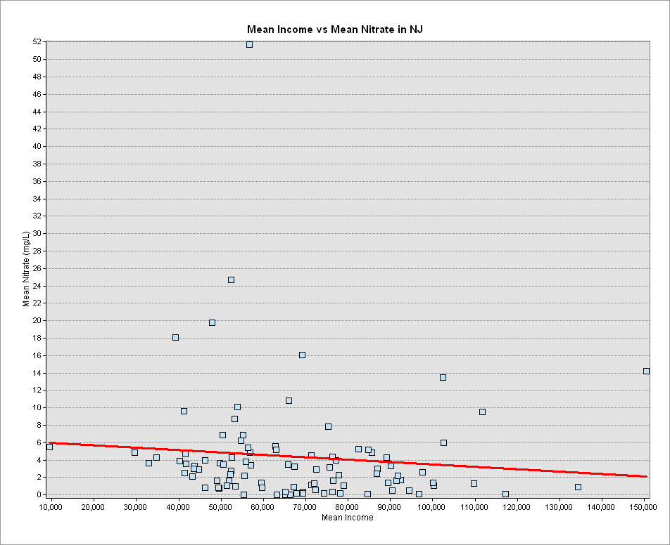
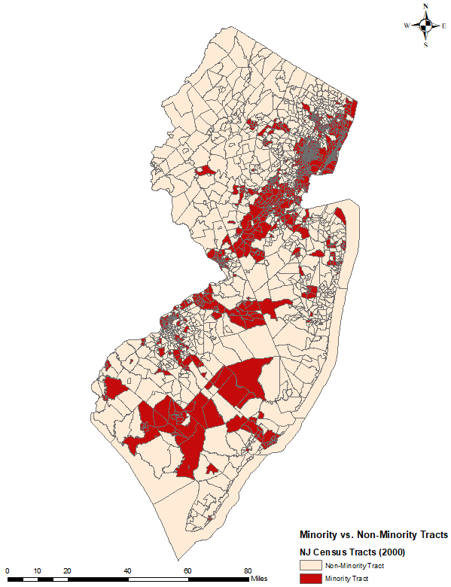
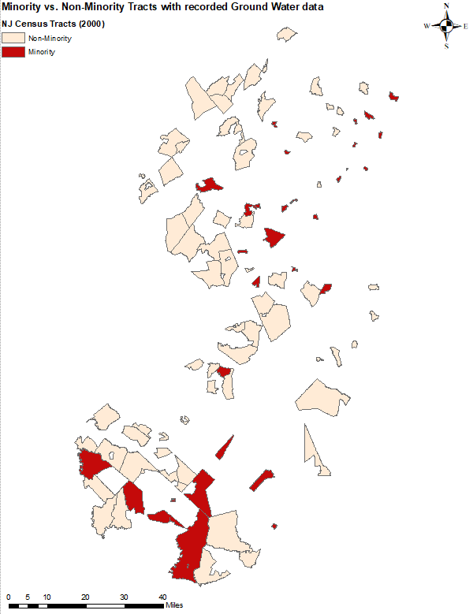
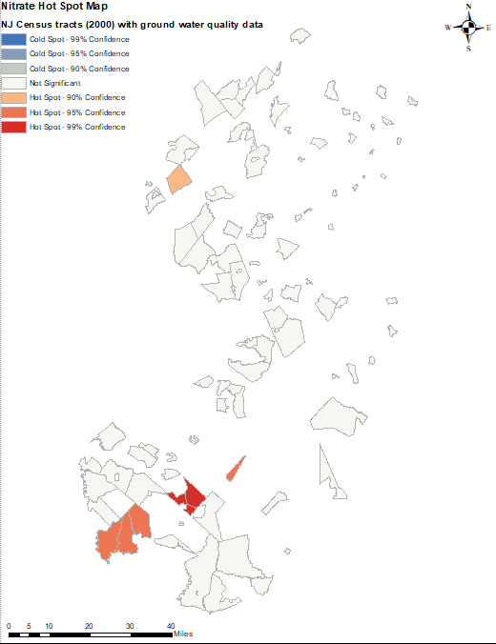
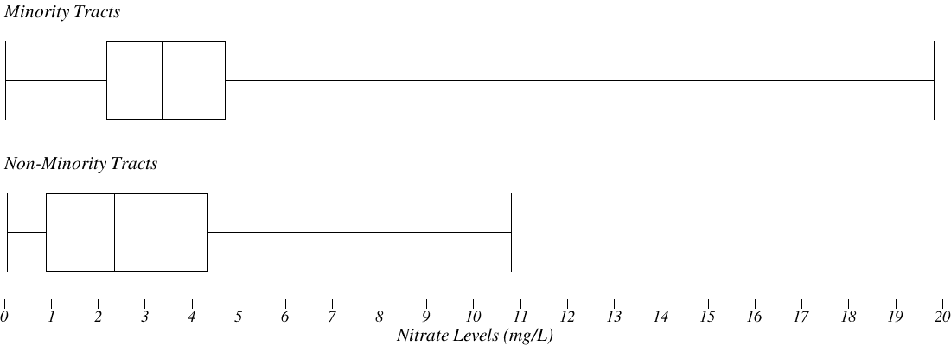
Nitrate level analysis in groundwater by mean income and minority groups in New Jersey (NJ)
James Allan
Monmouth University
April 8, 2021
Purpose:
Assess groundwater quality in NJ and determine hot spots of high nitrate
Analyze the relation between lower income and minority areas with nitrate levels in local groundwater sources
Higher nitrate concentrations in groundwater is often due to fertilizer runoff, wastewater, landfills, septic systems, or urban drainage
Any water containing more than 10 mg/L is dangerous to consume
Do lower income and minority populations live disproportionally in areas of higher nitrate concentrations in groundwater sources?
Methods:
Mean nitrate measurements in tracts
Compare mean nitrate to mean income (Figure 1)
Tracts with total minority population > 25% classified as “minority” (Figure 2)
Compare mean nitrate levels in minority tracts vs non-minority tracts using a box plot and Mann-Whitney U test of difference in medians (Figure 4)
Hot spot analysis (Getis-Ord statistic) of nitrate levels in groundwater quality tracts (Figure 5)
Mean Income vs Mean Nitrate in NJ
Mean Nitrate (mg/L)
Data Obtained for Maps:
Water quality data from New Jersey Department of Environmental Protection (NJDEP)
Demographic data from United States Census Bureau
Mean Income (Dollars)
Outcomes:
Nitrate levels in local groundwater sources decrease as mean income increases in tracts (Figure 1)
The current sample indicates nitrate levels are higher in minority tracts versus non-minority tracts, but not at a statistically significant level according to the Mann-Whitney U test (Figure 4)
Nitrate hot spots with 95%-99% confidence located in Gloucester and Cumberland County, and are in minority and non-minority tracts
Figure 1: Graph of mean nitrate levels in applicable NJ census tracts, compared to mean income of the same tracts. The trend line suggests that mean nitrate levels in groundwater decreases with mean income.
Figure 2: Map of minority and non-minority tracts.
Figure 3: Tracts with groundwater data.
Minority Tracts
Non-Minority Tracts
Mann-Whitney U test statistic: 922
p-value: 0.17
Nitrate Levels (mg/L)
Figure 4: Box plot of the mean nitrate levels in groundwater sources located in minority census tracts compared to that of non-minority census tracts, and Mann-Whitney U test results of difference in the medians (central bars in the box plots).
Contact Information:
James Allan: s1032252@monmouth.edu
Geoffrey Fouad: gfouad@monmouth.edu
Figure 5: Map of mean nitrate hot spots in census tracts with ground water quality data.

