Slide 1
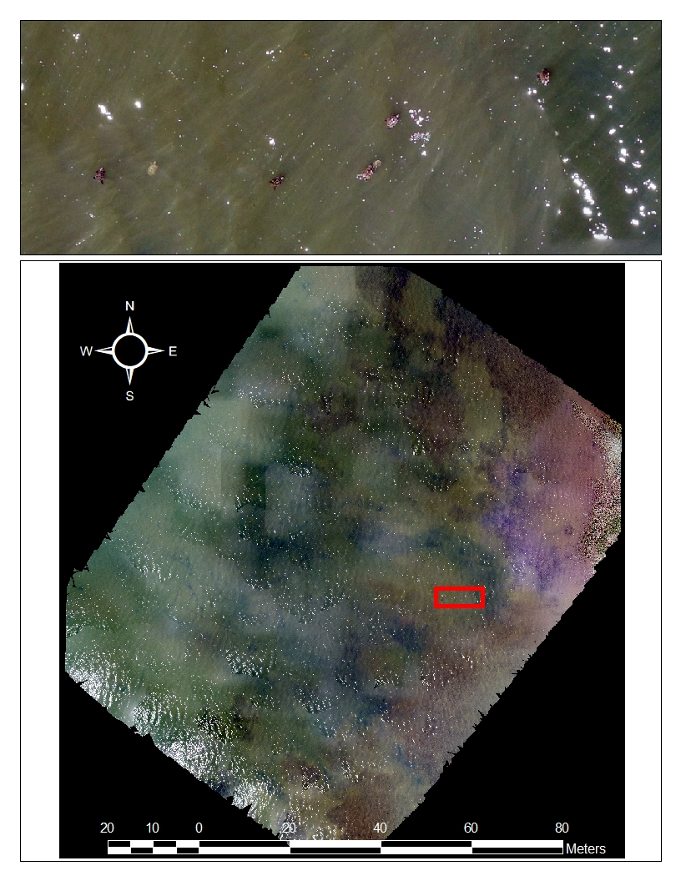
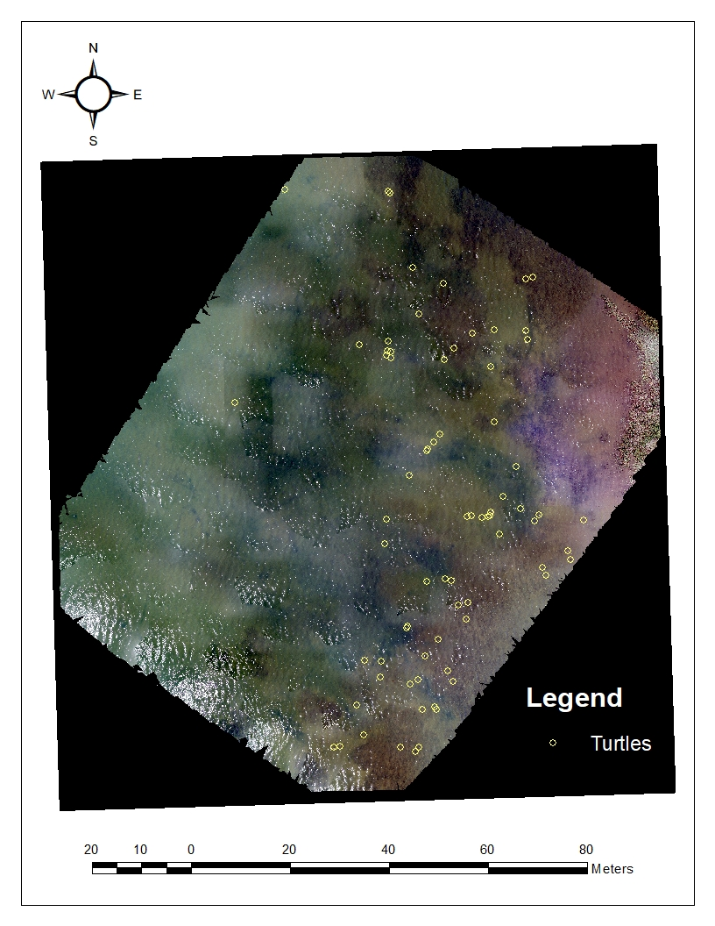
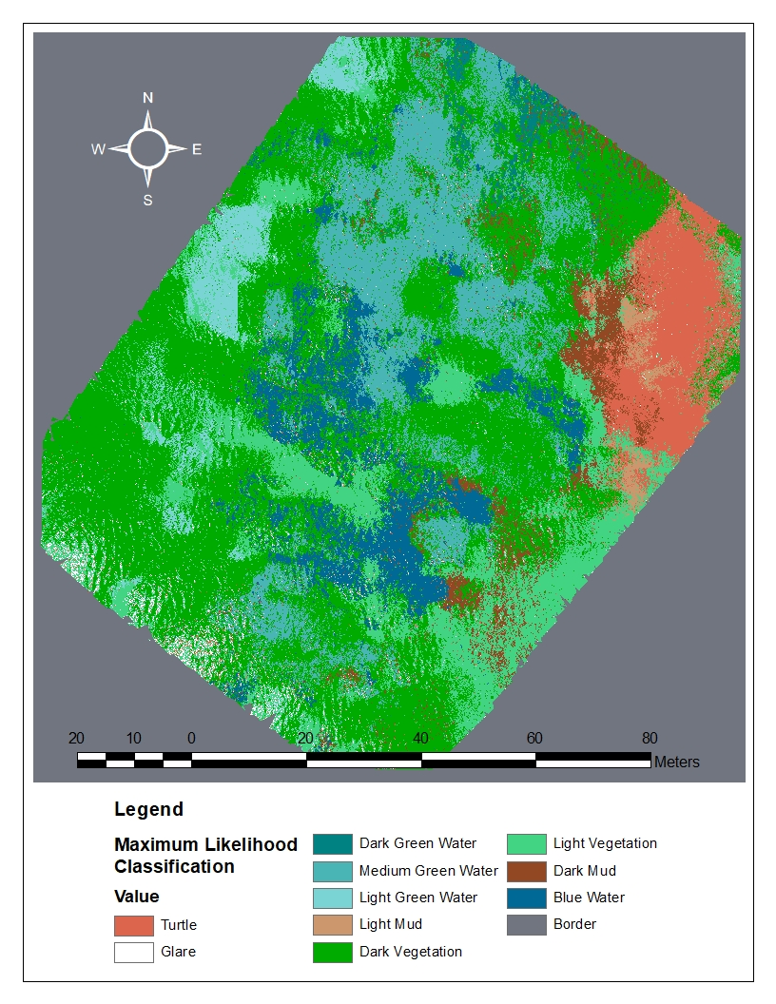
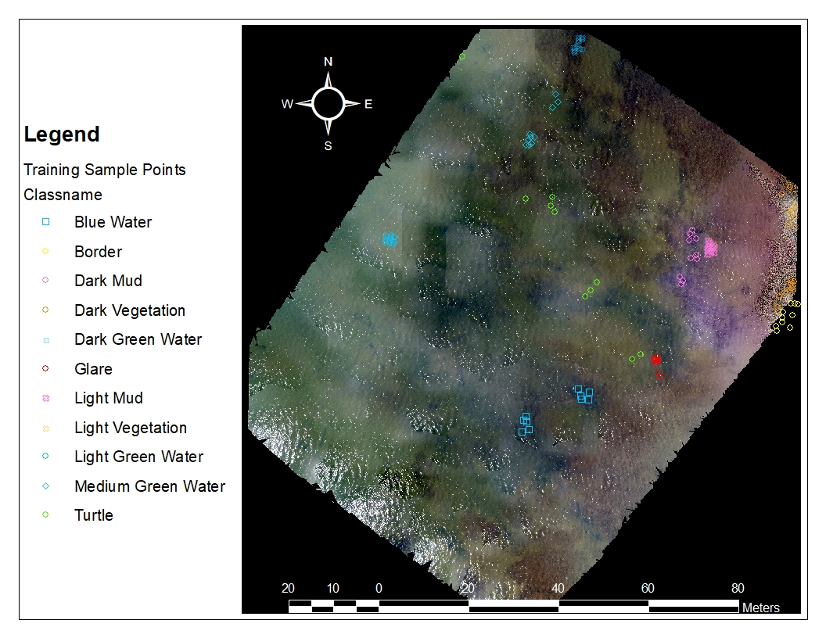
Counting diamondback terrapins (Malaclemys terrapin) in an aerial drone image over water using supervised image classification
Rebecca Berzins^{1, 2}, Sean Sterrett¹, Geoffrey Fouad²
¹Marine and Environmental Biology and Policy Program and ²Geographic Information Systems Program
Purpose:
Assess whether terrapins can be identified using supervised image classification
Terrapin identification can be converted to counts for wildlife management purposes
Methods:
Manual count of terrapins in image
Maximum likelihood classification to assign each pixel to a class
Ten training samples per class
Compare classified image to original image with manual terrapin count
Results:
Image stitching generates lines and different colors in water (artifacts of the stitching)
Green-colored water classified as vegetation
Terrapins classified as turtles
Mud misclassified as turtles (this prevents automated count of turtles)
74 turtles counted manually
Conclusions:
Image stitching issues may contribute to the many water colors
Makes creating a class for every possible category difficult
Water could be confused as vegetation because of green color and photosynthesis occurring in the water
Refine approach to distinguish between mud and turtles in order to count turtles
Top Left: The study photo with an inset showing some terrapins.
Top Right: Terrapins counted by hand.
Bottom: The training sample points
Above: The analyzed image classified by the maximum likelihood (probability) that a pixel belongs to a given class.
Contact Information
Rebecca Berzins s1170579@monmouth.edu
Sean Sterrett ssterret@monmouth.edu
Geoffrey Fouad gfouad@mnomouth.edu

