Slide 1


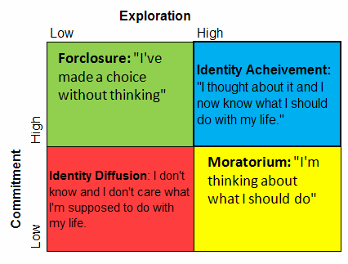

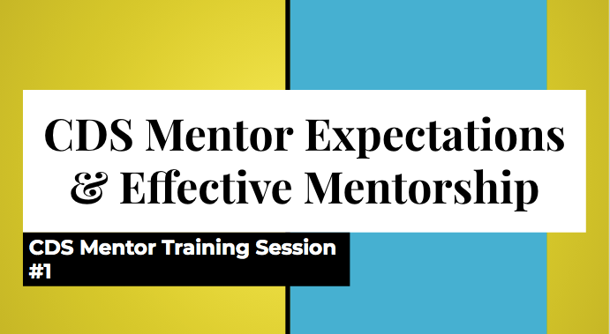
Career Advising Internship Reflections
Harry M. Termyna
Faculty Advisor: Dr. Alyson Pompeo-Fargnoli
Overview of Internship
Transferable Skills
Development Theory
Lessons Learned
Site: New Jersey Institute of Technology (fully remote)
Position: Career Development Services Graduate Intern
Students: Undergraduate and graduate science, technology, engineering and math (STEM) students
Assigned Duties and Tasks
  Advise between 5 and 10 STEM students per week on career exploration and the job search process
  Conduct resume/cover letter reviews, practice interviews and co-op/internship preparation meetings
  Co-manage our novel peer mentorship program which includes interviewing/hiring our undergraduate staff, pairing prospective mentees with an upperclass mentor based on program of study and professional interests/goals, creating and presenting mentor training sessions/workshops and overseeing the progression of the mentoring relationships (via group check in meetings and weekly email updates)
Benefits Students Gain:
  Confidence in navigating the oftentimes complex and overwhelming career development process
  Ability to present well polished and impressive professional documents to potential employers/supervisors
  Understanding of how the modern higher education experience should not solely center on academic coursework and grades
  The application of several employable skills including communication, professionalism, time management and critical thinking
National Association of Colleges and Employers Core Competencies
Critical Thinking/Problem Solving
Oral/Written Communication
Teamwork/Collaboration
Information Technology Application
Leadership
Professionalism/Work Ethic
Career Management
Additional Skills/Competencies
Counseling Microskills
  Active Listening/Understanding
  Checking in on the well being of the “holistic student” (personal, social, family life)
  Guiding students through the process of creating goals and activating desired change when it comes to possibly switching career paths or wanting to explore new internship/research opportunities
  Ensuring that the values, interests and cultural/familial influences of the students are being considered within their career exploration journeys
  Encouraging the incorporation of self-care
Social Justice Advocacy
  Understanding the wide range of lived experiences each individual student encounters and processes each and everyday
  Supporting students who may feel some sense of “Imposter Syndrome” due to their perceived defiance of social norms (ex. Students who identify as female sometimes mention their reluctance to enter the medical/technology fields. The apparent advancement of these students is used to refute any irrational beliefs surrounding their successes.)
  Providing students with accurate information regarding the status of their work authorization and advocating for their rights to attain practical hands on training; Many companies do not understand that F-1 students need to wait almost an extra month until their paperwork can be approved thus they are not always able to begin work as soon as the employer would like. Some students then assume that their offer is automatically revoked. This is not the case. Hence, students are advised on advocating for themselves during the hiring process. Career Services also trouble shoots when need be (ex. With timely communication, career directors can reach out to the hiring managers and alleviate any confusion.).
  Asking students if there is anything they need or expect to receive from the services provided (This question is used at the end of mentoring check in meetings to guarantee our mentors gain the most from serving within the role.)
Marcia’s Identity Statuses
Career development plays a crucial part in promoting student success during the college years
  University life is not just about attending classes and earning high grades.
  Employers care less about GPA and more about tangible, relevant on the job experiences (skill acquisition).
All higher education practitioners should be well versed in the underpinnings of basic professional development
  Any on campus position or program should help students build an impressive array of employable skills.
Student Affairs is more than fulfilling administrative and logistical obligations
  Advising students requires advanced interpersonal communication skills, genuine knowledge of student development as well as authentic compassion and multicultural sensitivity.
  Program planning and implementation require intentional creativity so that realistic learning objectives can be met by the target audience.
Counseling education is not just for counselors
  Any student affairs professional can benefit from applying key counseling skills within their communications with students.
  Always refer to counseling services when warranted.
Theory application is a must
  Evidence based practice can yield more effective results when acclimating students to their own career search. This idea applies beyond career services as well.
  Graduate interns are able to see the practicality of their coursework.
Virtual career fairs will never go out of style
  Students usually receive more time to network with employers one on one without long lines and background noise.
Students appreciate the initial “small talk”
  This demonstrates that the advisor cares about the student beyond the scope of the meeting and that while the advisor is in a position of authority, they are not a person to be intimidated by.
Never be afraid to say “I do not know”
  No advisor knows everything. Getting back to a student with accurate information is better than giving speedy yet possibly misleading answers immediately.
  Supervisors will also respect the honesty and will always be willing to help resolve any misunderstanding.
Most students advised through this experience fall under the Moratorium status.
  They have declared a major but are actively trying to explore their specific career options.
Few students are currently within the Achievement status. Even when so, they are still faced with the challenges of making specific choices on how they can eventually attain their desired roles.
  Ex. One peer mentor has decided she wants to become a doctor (High Commitment) however she is still deciding which medical school to attend and will eventually have to consider various specializations she can pursue for residency (High Exploration).
Schlossberg’s Transition Theory
Beginning to apply for field experiences can be a huge transition for many college students, especially F-1 students for this may be their first long term stay/work experience in the United States. All transitions are perceived differently by individuals based on the presence of the following components.
Components of Transition Theory
  Self: personal values and career interests/goals, personality traits and psychosocial abilities to welcome in and manage the transition process
  Situation: academic progress, readiness to apply coursework to a particular internship or co-op experience
  Strategies: meeting with a career advisor, understanding the entirety of the job search process before beginning to apply for work, valuing and practicing self-care, building a strong rapport with any new supervisor, being honest with colleagues and supervisors when it comes to stress and time management
  Support: career advisors, professors, fellow classmates, roommates, other on campus friends/campus leaders
    Colleagues who can assist with acclimating to the site culture, co-interns, trusted supervisors
    Family members even if home is further away, friends who may have worked in similar roles, local community partners (ex. Church) which the student is involved with
*Virtual workshop presented to our 1st peer mentoring staff back in December 2020; This initial group meeting focused on icebreakers, payroll procedures, position expectations and the mentoring process.
Other training topics focused on advising practices and career exploration resources.

