Slide 1


Artificial Intelligence
Applications to Business:
Social Security Privatization
Charles Willow, Ph.D., P.E.
March 6, 2026 (F)
LEON HESS BUSINESS SCHOOL

Slide 2
Contents
Introduction to Artificial Intelligence (AI)
AACSB Understanding of AI
Applications of AI
Social Security Privatization: TAI vs GAI
Future & Expectations

Slide 3
References
AACSB AI Conference [May, 2024 @ Santa Clara Univ., CA]
AI Policy Guide e-Book, ACUE
Business Artificial Intelligence, Charles Willow
[In Process, Pearson/ Prentice-Hall, 2025~27]

Slide 4
1. Introduction to Artificial Intelligence
Tri-Quarter Century (75-yr) History
Boom Factors
Mobility Revolution (Digital Big Data)
Technology Revolution (Chips, N/W, S/W)
End-User Interaction (2022~; Chat-GPT©)

Slide 5
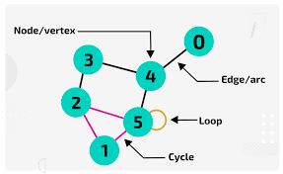
1.1 Mechanics of AI (Backend)
Real-Time Parallel Networks:
Nodes = Data
Arcs = Knowledge
Paths = Expertise
Graphs = Deep Learning

Slide 6
1.2 Machine Learning: Classification
Deterministic Outcomes
[e.g. Yes/ No]
Stochastic Outcomes (i.e. Open-Ended)
[e.g. Consumer Behavior]

Slide 7
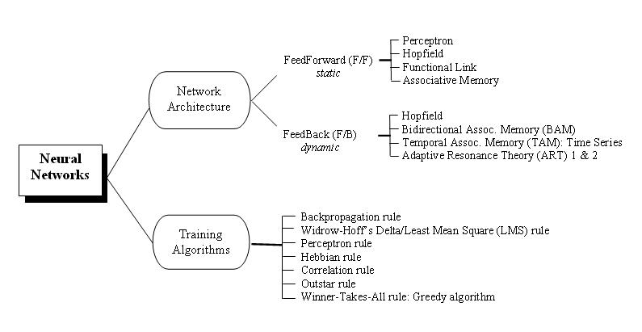
1.2.1 Taxonomy: Machine Learning
Neural Network
(taxonomy)
Willow, IJIIT, 1 (4),
25-51, 2005.

Slide 8
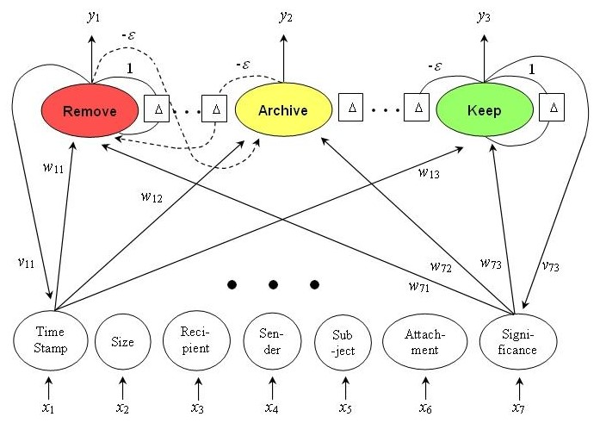
1.2.2 Example of Feed-Back Deterministic Learning
Neural Network
(application: A R T )
Willow, IJIIT, 1 (4),
25-51, 2005.

Slide 9
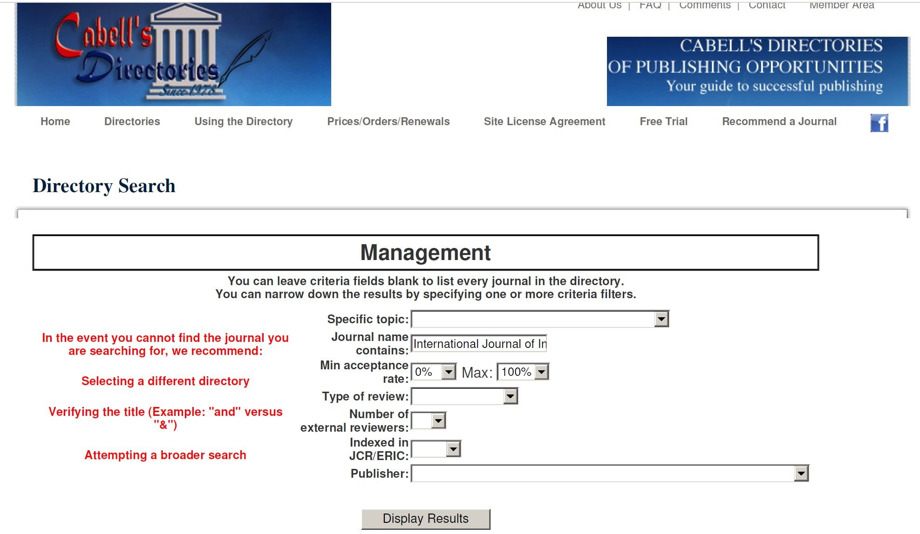
1.2.3 Int’l J. of Intelligent Info. Tech.: iGi – iDEA

Slide 10
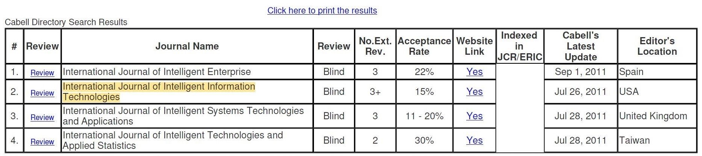
1.2.3 Int’l J. of Intelligent Info. Tech.: iGi – iDEA

Slide 11
1.3 Generative AI (G-AI)
Generative = “Interactive”!
Chat-GPT© by Open AI
Deep-Seek© by Chinese Research AI Lab
viz a viz Traditional AI (T-AI)

Slide 12
2. AACSB Understanding of AI
Limited to G-AI
Dispute = “Blessing or Curse?”
Consensus = need Local AI Strategy:
Faculty Development & Support
Curriculum Development & Enhancement
Student Engagement & Support

Slide 13
3. Applications of G-AI
Discipline-Specific
Student-Specific (i.e. UG vs Grad)
Research-Specific (e.g. Empirical vs Original)

Slide 14
4. Inflation Predictor Model
Traditional-AI: Special-Purpose
Generative-AI: General-Purpose

Slide 15
4.1 Inflation Predictor Model using Artificial Intelligence and
Deep Machine Learning
Outcomes (Y) = Acceptance of Social Security Privatization:
Sigmoid Function = {1, 0} = {Yes, No} = Boolean
Y = {y₁, y₂, y₃} = {1-year, 5-year, 10-year}
= { <y₁₁, y₁₂, y₁₃ > , . . . , < ... , y₃₃ >}

Slide 16
4.1 Inflation Predictor Model using Artificial Intelligence and
Deep Machine Learning
Input (X) = Big Data = {x_{i} | x₁, . . . , x_{n}}: Historical + TiAA-CREF!
Supply Chain for Commodities (unit = days)
Global Inflation Factor (0 ~ 1)
Global Price Index (Crude Oil, LNG/ LPG, Semi-Conductors, Corn, Wheat, Steel, etc.; unit = U.S. $)
Global/ Civil War (@ Time ZERO)
Global Pandemic (@ Time ZERO)
Average GDP pattern (+ / - / 0)

Slide 17
4.1 Inflation Predictor Model using Artificial Intelligence and
Deep Machine Learning
Research Methods :
Apparatus = Artificial Neural Network (Whole Set)
Instrument = F/B Deep Machine Learning (Sub Set)
Algorithms = {ART, BAM, TAM} (Instances, Comparative)

Slide 18

4.2 T-AI Performance
2030 = 78.2% YES
2040 = 85.8%
Google AutoML & ResNET

Slide 19

4.3 G-AI Performance (Inflation Timeline)
Post - WW II (Late 1940’s ~ Early 1950’s)
1970’s (Oil Crisis & Stagflation)
Global Financial Crisis (2008 ~ 2009)
COVID-19 Pandemic (2020 ~ Present)

Slide 20
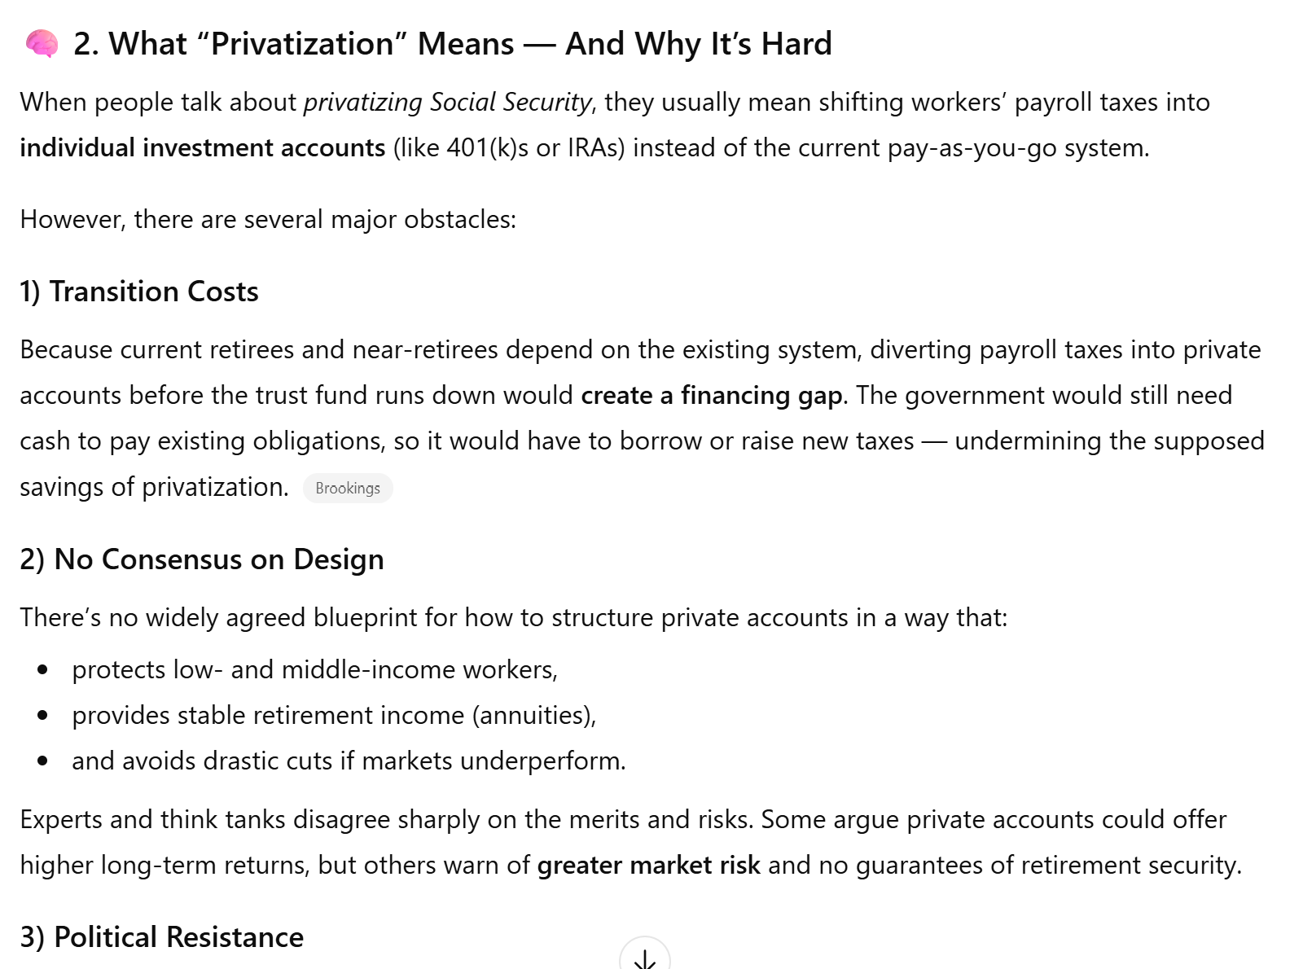
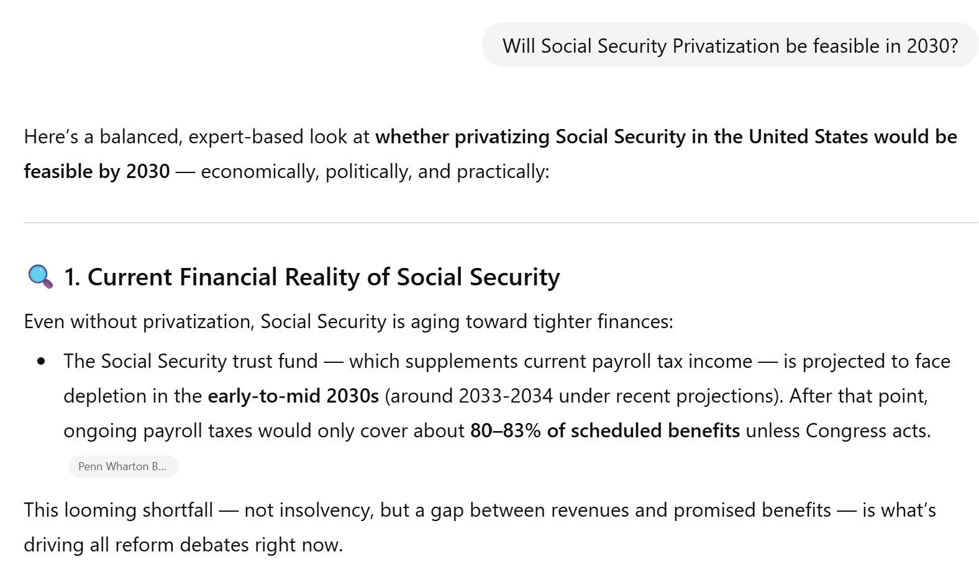
4.3 G-AI Performance (Privatization in 2030?)

Slide 21
5. Future Expectations
Standardization = {GPT-4, Copilot, SageMaker, Watson}
Human-Centered Business Models!
AI-Literacy as Business Requirement [exp. 2030]

Slide 22
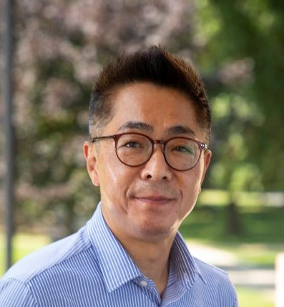
Contact:
Charles Willow, Ph. D., P.E.
E-mail: cwillow@monmouth.edu
URL : www.monmouth.edu/directory/profiles/charles-willow/
Voice: (732) 571 – 3664
Office: Leon Hess Biz School, Monmouth University
W. Long Branch, NJ 07764-1898

Slide 23
§. Appendix: G-AI Policies in Academe
Harvard Policies
STEM Policies
Humanities Policies

Slide 24
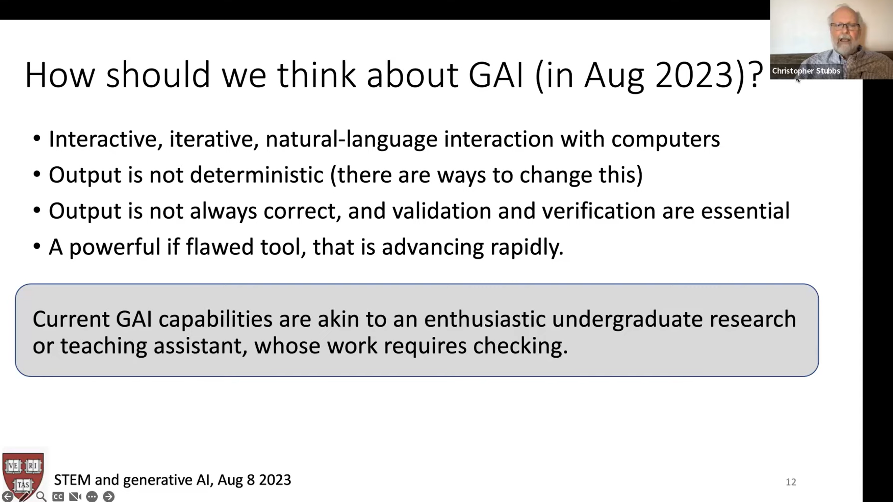
4. G-AI Strategies

Slide 25
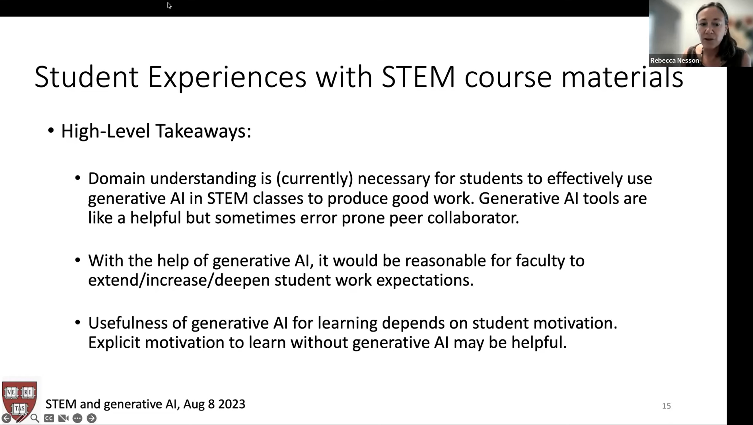
4. G-AI Strategies

Slide 26
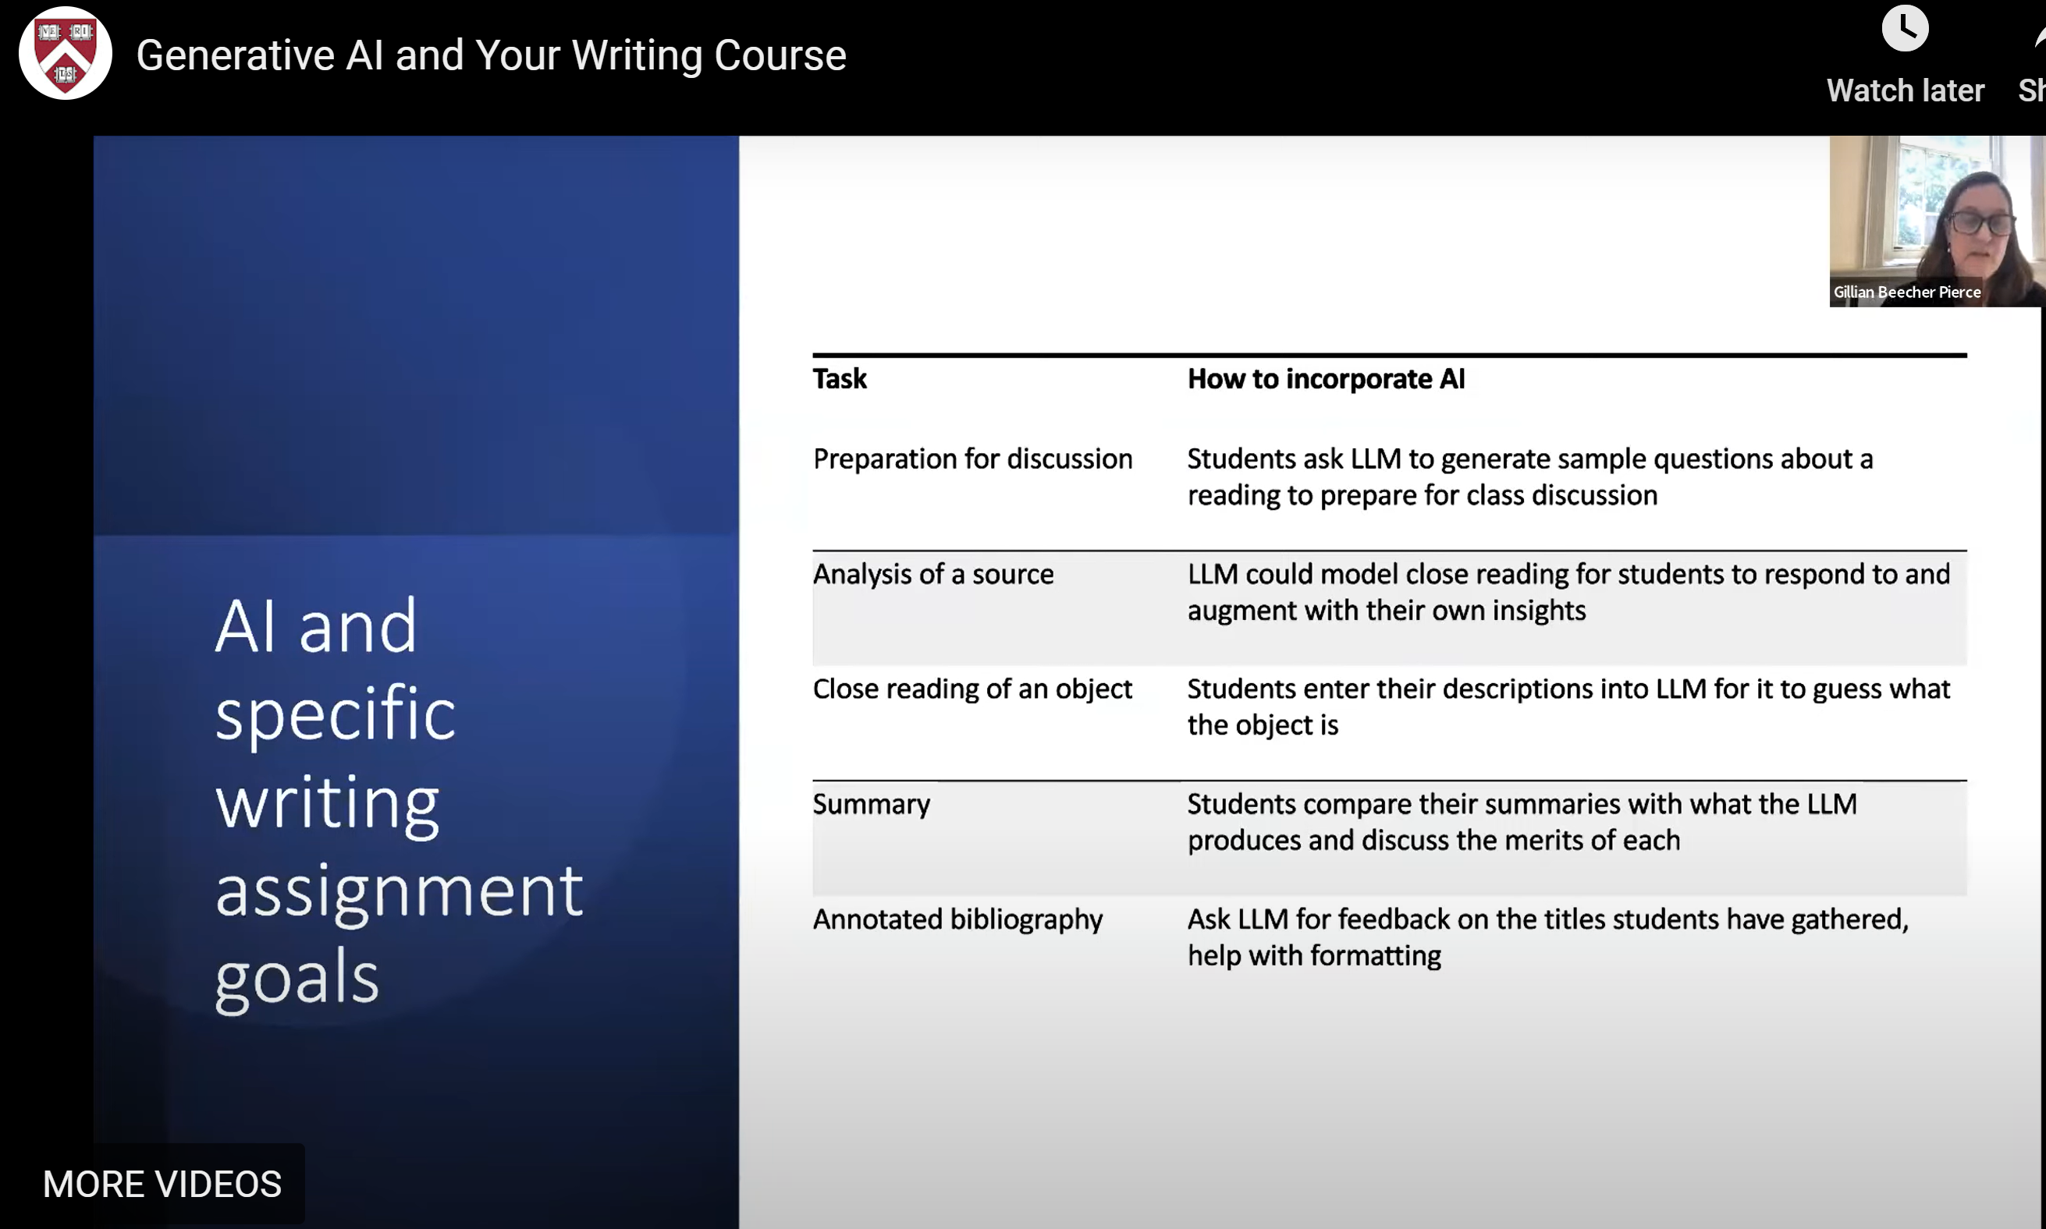

Slide 27
