Slide 1
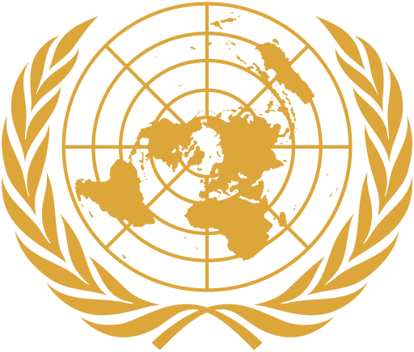
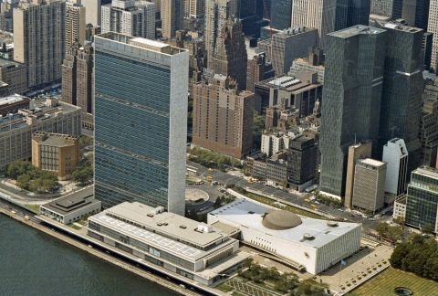
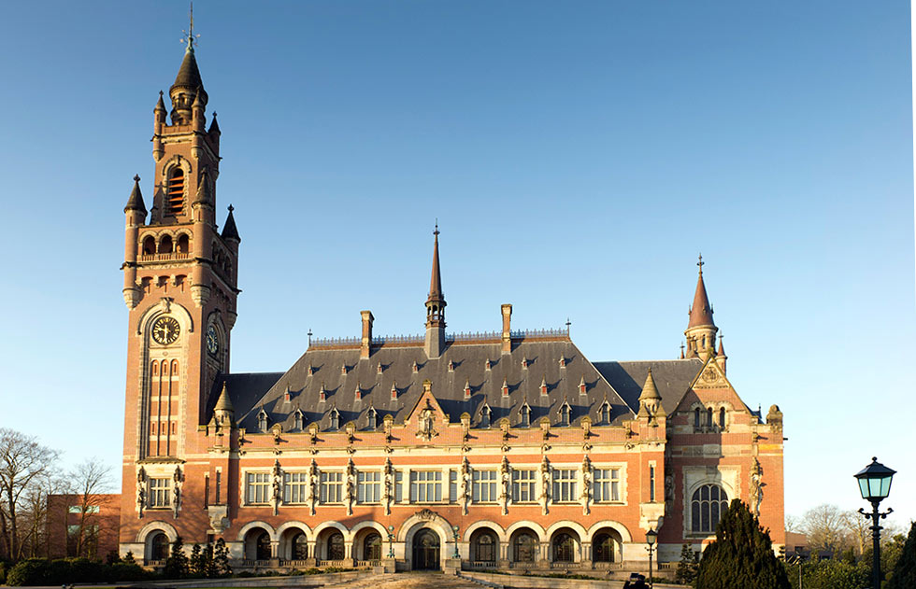
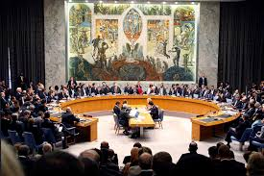
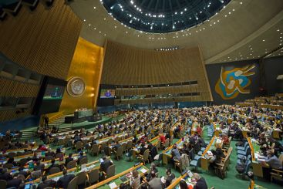
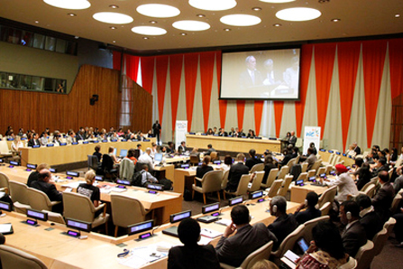
UNITED NATIONS
Source: un.org

Slide 2
UN Overview
The United Nations, with headquarters in New York City, is an international organization founded in 1945. It is currently made up of 193 Member States. The mission and work of the United Nations are guided by the purposes and principles contained in its founding Charter.
https://www.unmultimedia.org/avlibrary/asset/1288/1288630/
Due to the powers vested in its Charter and its unique international character, the United Nations can take action on the issues confronting humanity in the 21st century, such as peace and security, climate change, sustainable development, human rights, disarmament, terrorism, humanitarian and health emergencies, gender equality, governance, food production, and more.
The UN also provides a forum for its members to express their views in the General Assembly, the Security Council, the Economic and Social Council, and other bodies and committees. By enabling dialogue between its members, and by hosting negotiations, the Organization has become a mechanism for governments to find areas of agreement and solve problems together.
The UN's Chief Administrative Officer is the Secretary-General.
2020 marks the 75th anniversary of the United Nations.
https://www.youtube.com/watch?v=gCOkMWv5TB0

Slide 3
UN Membership—from 51 to 193
1945, Original 51 Members: Argentina, Australia, Belgium, Bolivia, Brazil, Byelorussian Soviet Socialist Republic, Canada, Chile, China, Colombia, Costa Rica, Cuba, Czechoslovakia, Denmark, Dominican Republic, Ecuador, Egypt, El Salvador, Ethiopia, France, Greece, Guatemala, Haiti, Honduras, India, Iran, Iraq, Lebanon, Liberia, Luxembourg, Mexico, Netherlands, New Zealand, Nicaragua, Norway, Panama, Paraguay, Peru, Philippine Republic, Poland, Saudi Arabia, Syria, Turkey, Ukrainian Soviet Socialist Republic, Union of South Africa, Union of Soviet Socialist Republics, United Kingdom, United States, Uruguay, Venezuela, Yugoslavia
1946, 55: Afghanistan, Iceland, Siam, Sweden
1947, 57: Pakistan, Yemen
1948, 58: Burma
1949, 59: Israel
1950, 60: Indonesia
1955, 76: Albania, Austria, Bulgaria, Cambodia, Ceylon, Finland, Hungary, Ireland, Italy, Jordan, Laos, Libya, Nepal, Portugal, Romania, Spain
1956, 80: Japan, Morocco, Sudan, Tunisia
1957, 82: Ghana, Federation of Malaya
1958, 83: Guinea
1960, 99: Cameroun, Central African Republic, Chad, Congo (Brazzaville), Congo (Leopoldville), Cyprus, Dahomey, Gabon, Ivory Coast, Malagasy Republic, Mali, Niger, Nigeria, Senegal, Somalia, Togo, Upper Volta

Slide 4
UN Membership—from 51 to 193
1961, 104: Mauritania, Mongolia, Sierra Leone, Tanganyika
1962, 110: Algeria, Burundi, Jamaica, Rwanda, Trinidad and Tobago, Uganda
1963, 113: Kenya, Kuwait, Zanzibar
1964, 115: Malawi, Malta, Zambia
1965, 117: The Gambia, Maldive Islands, Singapore
1966, 122: Barbados, Botswana, Guyana, Lesotho
1967, 123: Yemen
1968, 126: Equatorial Guinea, Mauritius, Swaziland
1970, 127: Fiji
1971, 132: Bahrain, Bhutan, Oman, Qatar, United Arab Emirates
1973, 135: Bahamas, Federal Republic of Germany, German Democratic Republic
1974, 138: Bangladesh, Grenada, Guinea-Bissau
1975, 144: Cape Verde, Comoros, Mozambique, Papua New Guinea, Sao Tome and Principe, Suriname
1976, 147: Angola, Samoa, Seychelles
1977, 149: Djibouti, Viet Nam
1978, 151: Dominica, Solomon Islands
1979, 152: Saint Lucia
1980, 154: Saint Vincent and the Grenadines, Zimbabwe

Slide 5
UN Membership—from 51 to 193
1981, 157: Antigua and Barbuda, Belize, Vanuatu
1983, 158: Saint Christopher and Nevis
1984, 159: Brunei Darussalam
1990, 159: Liechtenstein, Namibia
1991, 166: Democratic People's Republic of Korea, Estonia, Latvia, Lithuania, Marshall Islands, Federated States of Micronesia, Republic of Korea
1992, 179: Armenia, Azerbaijan, Bosnia and Herzegovina, Croatia, Georgia, Kazakhstan, Kyrgyzstan, Republic of Moldova, San Marino, Slovenia, Tajikistan, Turkmenistan, Uzbekistan
1993, 184: Andorra, Czech Republic, Eritrea, Monaco, Slovakia, The former Yugoslav Republic of Macedonia
1994, 185: Palau
1999, 188: Kiribati, Nauru, Tonga
2000, 189: Federal Republic of Yugoslavia, Tuvalu
2002, 191: Switzerland, Timor-Leste
2006, 192: Montenegro
2011, 193: South Sudan

Slide 6
UN Charter
The Charter of the United Nations was signed on 26 June 1945, in San Francisco, at the conclusion of the United Nations Conference on International Organization. It came into force on 24 October 1945. The Statute of the International Court of Justice is an integral part of the Charter.
Preamble
Chapter I: Purposes and Principles
Chapter II: Membership
Chapter III: Organs
Chapter IV: The General Assembly
Chapter V: The Security Council
Chapter VI: Pacific Settlement of Disputes
Chapter VII: Action with Respect to Threats to the Peace, Breaches of the Peace and Acts of Aggression
Chapter VIII: Regional Arrangements
Chapter IX: International Economic and Social Co-operation
Chapter XIX: Ratification and Signature

Slide 7
UN Charter
Chapter X: The Economic and Social Council
Chapter XI: Declaration regarding Non-Self-Governing Territories
Chapter XII: International Trusteeship System
Chapter XIII: The Trusteeship Council
Chapter XIV: The International Court of Justice
Chapter XV: The Secretariat
Chapter XVI: Miscellaneous Provisions
Chapter XVII: Transitional Security Arrangements
Chapter XVIII: Amendments

Slide 8
Preamble of the UN Charter
WE THE PEOPLES OF THE UNITED NATIONS DETERMINED
  to save succeeding generations from the scourge of war, which twice in our lifetime has brought untold sorrow to mankind, and
  to reaffirm faith in fundamental human rights, in the dignity and worth of the human person, in the equal rights of men and women and of nations large and small, and
  to establish conditions under which justice and respect for the obligations arising from treaties and other sources of international law can be maintained, and
  to promote social progress and better standards of life in larger freedom,
AND FOR THESE ENDS
  to practice tolerance and live together in peace with one another as good neighbors, and
  to unite our strength to maintain international peace and security, and
  to ensure, by the acceptance of principles and the institution of methods, that armed force shall not be used, save in the common interest, and
  to employ international machinery for the promotion of the economic and social advancement of all peoples,
HAVE RESOLVED TO COMBINE OUR EFFORTS TO ACCOMPLISH THESE AIMS
  Accordingly, our respective Governments, through representatives assembled in the city of San Francisco, who have exhibited their full powers found to be in good and due form, have agreed to the present Charter of the United Nations and do hereby establish an international organization to be known as the United Nations.

Slide 9
Purposes of the UN
Article 1
The Purposes of the United Nations are:
  To maintain international peace and security, and to that end: to take effective collective measures for the prevention and removal of threats to the peace, and for the suppression of acts of aggression or other breaches of the peace, and to bring about by peaceful means, and in conformity with the principles of justice and international law, adjustment or settlement of international disputes or situations which might lead to a breach of the peace;
  To develop friendly relations among nations based on respect for the principle of equal rights and self-determination of peoples, and to take other appropriate measures to strengthen universal peace;
  To achieve international co-operation in solving international problems of an economic, social, cultural, or humanitarian character, and in promoting and encouraging respect for human rights and for fundamental freedoms for all without distinction as to race, sex, language, or religion; and
  To be a center for harmonizing the actions of nations in the attainment of these common ends.

Slide 10
Principles of the United Nations
Article 2
The Organization and its Members, in pursuit of the Purposes stated in Article 1, shall act in accordance with the following Principles.
  The Organization is based on the principle of the sovereign equality of all its Members.
  All Members, in order to ensure to all of them the rights and benefits resulting from membership, shall fulfill in good faith the obligations assumed by them in accordance with the present Charter.
  All Members shall settle their international disputes by peaceful means in such a manner that international peace and security, and justice, are not endangered.
  All Members shall refrain in their international relations from the threat or use of force against the territorial integrity or political independence of any state, or in any other manner inconsistent with the Purposes of the United Nations.
  All Members shall give the United Nations every assistance in any action it takes in accordance with the present Charter, and shall refrain from giving assistance to any state against which the United Nations is taking preventive or enforcement action.
  The Organization shall ensure that states which are not Members of the United Nations act in accordance with these Principles so far as may be necessary for the maintenance of international peace and security.
  Nothing contained in the present Charter shall authorize the United Nations to intervene in matters which are essentially within the domestic jurisdiction of any state or shall require the Members to submit such matters to settlement under the present Charter; but this principle shall not prejudice the application of enforcement measures under Chapter Vll.

Slide 11
Amendments to the UN Charter
Amendments to Articles 23, 27 and 61 of the Charter were adopted by the General Assembly on December 17, 1963 and came into force on 31 August 1965. A further amendment to Article 61 was adopted by the General Assembly on December 20, 1971, and came into force on September 24, 1973. An amendment to Article 109, adopted by the General Assembly on December 20, 1965, came into force on June 12, 1968.
The amendment to Article 23 enlarges the membership of the Security Council from eleven to fifteen. The amended Article 27 provides that decisions of the Security Council on procedural matters shall be made by an affirmative vote of nine members (formerly seven) and on all other matters by an affirmative vote of nine members (formerly seven), including the concurring votes of the five permanent members of the Security Council.
The amendment to Article 61, which entered into force on August 31, 1965, enlarged the membership of the Economic and Social Council from eighteen to twenty-seven. The subsequent amendment to that Article, which entered into force on September 24, 1973, further increased the membership of the Council from twenty-seven to fifty-four.
The amendment to Article 109, which relates to the first paragraph of that Article, provides that a General Conference of Member States for the purpose of reviewing the Charter may be held at a date and place to be fixed by a two-thirds vote of the members of the General Assembly and by a vote of any nine members (formerly seven) of the Security Council. Paragraph 3 of Article 109, which deals with the consideration of a possible review conference during the tenth regular session of the General Assembly, has been retained in its original form in its reference to a "vote, of any seven members of the Security Council", the paragraph having been acted upon in 1955 by the General Assembly, at its tenth regular session, and by the Security Council.

Slide 12
Main Organs of the United Nations
Secretariat: The Secretariat, one of the main organs of the UN, is organized along departmental lines, with each department or office having a distinct area of action and responsibility. Offices and departments coordinate with each other to ensure cohesion as they carry out the daily work of the Organization in offices and duty stations around the world. At the head of the United Nations Secretariat is the Secretary-General.
General Assembly: The General Assembly is made up of 193 Member States, after the admission of South Sudan on July 14, 2011 as the 193rd Member of the United Nations.

Slide 13
Main Organs of the United Nations
Security Council: The Security Council has 15 members. The United Nations Charter designates five Member States as permanent members and the General Assembly elects ten other members for two-year terms. The term of office for each non-permanent member of the Council ends on December 31 of the year indicated in parentheses next to its name. Five permanent members: China, France, Russian Federation, the United Kingdom, and the United States, and ten non-permanent members elected for two-year terms by the General Assembly (with end of term date): Belgium (2020), Dominican Republic (2020), Estonia (2021) Germany (2020), Indonesia (2020), Niger (2021) Saint Vincent and the Grenadines (2021), South Africa (2020), Tunisia (2021), Viet Nam (2021).

Slide 14
Main Organs of the United Nations
Economic and Social Council: The Economic and Social Council has 54 members, elected for three-year terms by the General Assembly. The term of office for each member expires on December 31 of the third year of service.
Trusteeship Council: The Trusteeship Council is made up of the five permanent members of the Security Council -– China, France, Russian Federation, United Kingdom and the United States. With the independence of Palau, the last remaining United Nations Trust Territory, the Council formally suspended operations on November 1, 1994. The Council amended its rules of procedure to drop the obligation to meet annually and agreed to meet as the occasion required, by its decision or the decision of its President or at the request of a majority of its members or the General Assembly or the Security Council.
International Court of Justice: The International Court of Justice has 15 Judges, elected by both the General Assembly and the Security Council for nine-year terms. Current Members of International Court of Justice: Somalia, China, Japan, Slovakia, France, Morocco, Brazil, United States of America, Italy, Uganda, India, Jamaica, Australia, Russian Federation, Lebanon, Japan.

Slide 15
Secretaries General of the United Nations
António Guterres, Portugal, 2017-Present
Ban Ki-moon, Korea, 2007-2016
Kofi Annan, Ghana, 1997-2006
Boutros Boutros-Ghali, Egypt, 1992-1996
Javier Perez de Cuellar, Peru, 1982-1991
Kurt Waldheim, Austria, 1972-1981
U Thant, Myanmar, 1961-1971
Dag Hammarskjöld, Sweden, 1953-1961
Trygve Halvdan Lie, Norway, 1946-1952

Slide 16
Specialized Agencies of the United Nations
Food and Agriculture Organization (FAO)
International Civil Aviation Organization (ICAO)
International Fund for Agricultural Development (IFAD)
International Labor Organization (ILO)
International Maritime Organization (IMO)
International Monetary Fund (IMF)
International Telecommunication Union (ITU)
United Nations Educational, Scientific and Cultural Organization (UNESCO)
United Nations Industrial Development Organization (UNIDO)
Universal Postal Union (UPU)
World Bank Group (WBG): International Bank for Reconstruction and Development (IBRD),
International Finance Corporation (IFC), International Development Association (IDA)
12. World Health Organization (WHO)
13. World Intellectual Property Organization (WIPO)
14. World Meteorological Organization (WMO)
15. World Tourism Organization (UNWTO)

Slide 17
UN Related Organizations
Comprehensive Nuclear-Test-Ban Treaty Organization Preparatory Commission
International Atomic Energy Agency (IAEA)
International Organization for Migration (IOM)
Organization for the Prohibition of Chemical Weapons
World Trade Organization (WTO)

Slide 18
Millennium Development Goals
MDGs are eight goals with measurable targets and clear deadlines for improving the lives of the world's poorest people. To meet these goals and eradicate poverty, leaders of 189 countries signed the historic millennium declaration at the United Nations Millennium Summit in 2000. At that time, eight goals that range from providing universal primary education to avoiding child and maternal mortality were set with a target achievement date of 2015.
The MDGs are interdependent; all the MDG influence health, and health influences all the MDGs. For example, better health enables children to learn and adults to earn. Gender equality is essential to the achievement of better health. Reducing poverty, hunger and environmental degradation positively influences, but also depends on, better health.

Slide 19
Eight Millennium Development Goals 2015
Eradicate extreme poverty and hunger;
Achieve universal primary education;
Promote gender equality and empower women;
Reduce child mortality;
Improve maternal health;
Combat HIV/AIDS, malaria, and other diseases;
Ensure environmental sustainability; and
Develop a global partnership for development.

Slide 20
17 Sustainable Development Goals for 2015-2030
End poverty in all its forms everywhere
End hunger, achieve food security and improved nutrition, and promote sustainable agriculture
Ensure healthy lives and promote well-being for all at all ages
Ensure inclusive and equitable quality education and promote life-long learning opportunities for all
Achieve gender equality and empower all women and girls
Ensure availability and sustainable management of water and sanitation for all
Ensure access to affordable, reliable, sustainable, and modern energy for all
Promote sustained, inclusive and sustainable economic growth, full and productive employment and decent work for all
Build resilient infrastructure, promote inclusive and sustainable industrialization and foster innovation
Reduce inequality within and among countries

Slide 21
17 Sustainable Development Goals for 2015-2030
11. Make cities and human settlements inclusive, safe, resilient and sustainable
12. Ensure sustainable consumption and production patterns
13. Take urgent action to combat climate change and its impacts (in line with the United Nations Framework Convention on Climate Change)
14. Conserve and sustainably use the oceans, seas and marine resources for sustainable development
15. Protect, restore and promote sustainable use of terrestrial ecosystems, sustainably manage forests, combat desertification, and halt and reverse land degradation and halt biodiversity loss
16. Promote peaceful and inclusive societies for sustainable development, provide access to justice for all and build effective, accountable and inclusive institutions at all levels
17. Strengthen the means of implementation and revitalize the global partnership for sustainable development

