Slide 1
FALL 2022 CLONet data update: monitoring to restoration!
Jason E. Adolf^{1,2}, Tom Herrington^{1,2}, Erin Conlon^{1,2}
1. Monmouth University, Biology Dept., West Long Branch, NJ
2. Monmouth University Urban Coast Institute, West Long Branch, NJ
3. NJ Department of Environmental Protection
Contributing: Eric Ernst³, Geoffrey Fouad¹, Bill Heddendorf³, Sydney Lucas¹, Robert Newby³, Robert Schuster³, Ariel Zavala¹

Slide 2
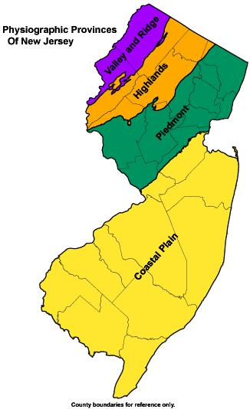
What is a coastal lake and why are they important?
https://mapmaker.rutgers.edu/MONMOUTH_COUNTY/OldMonmouthCounty.html

Slide 3
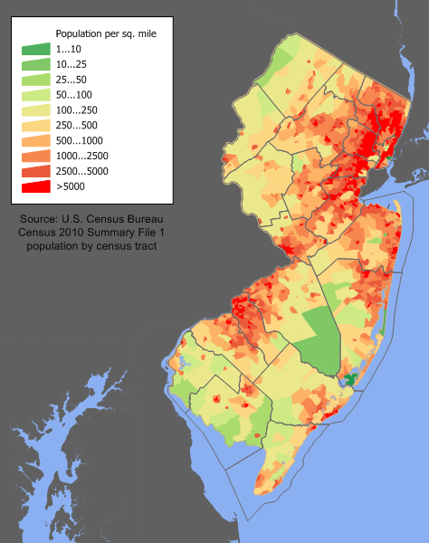
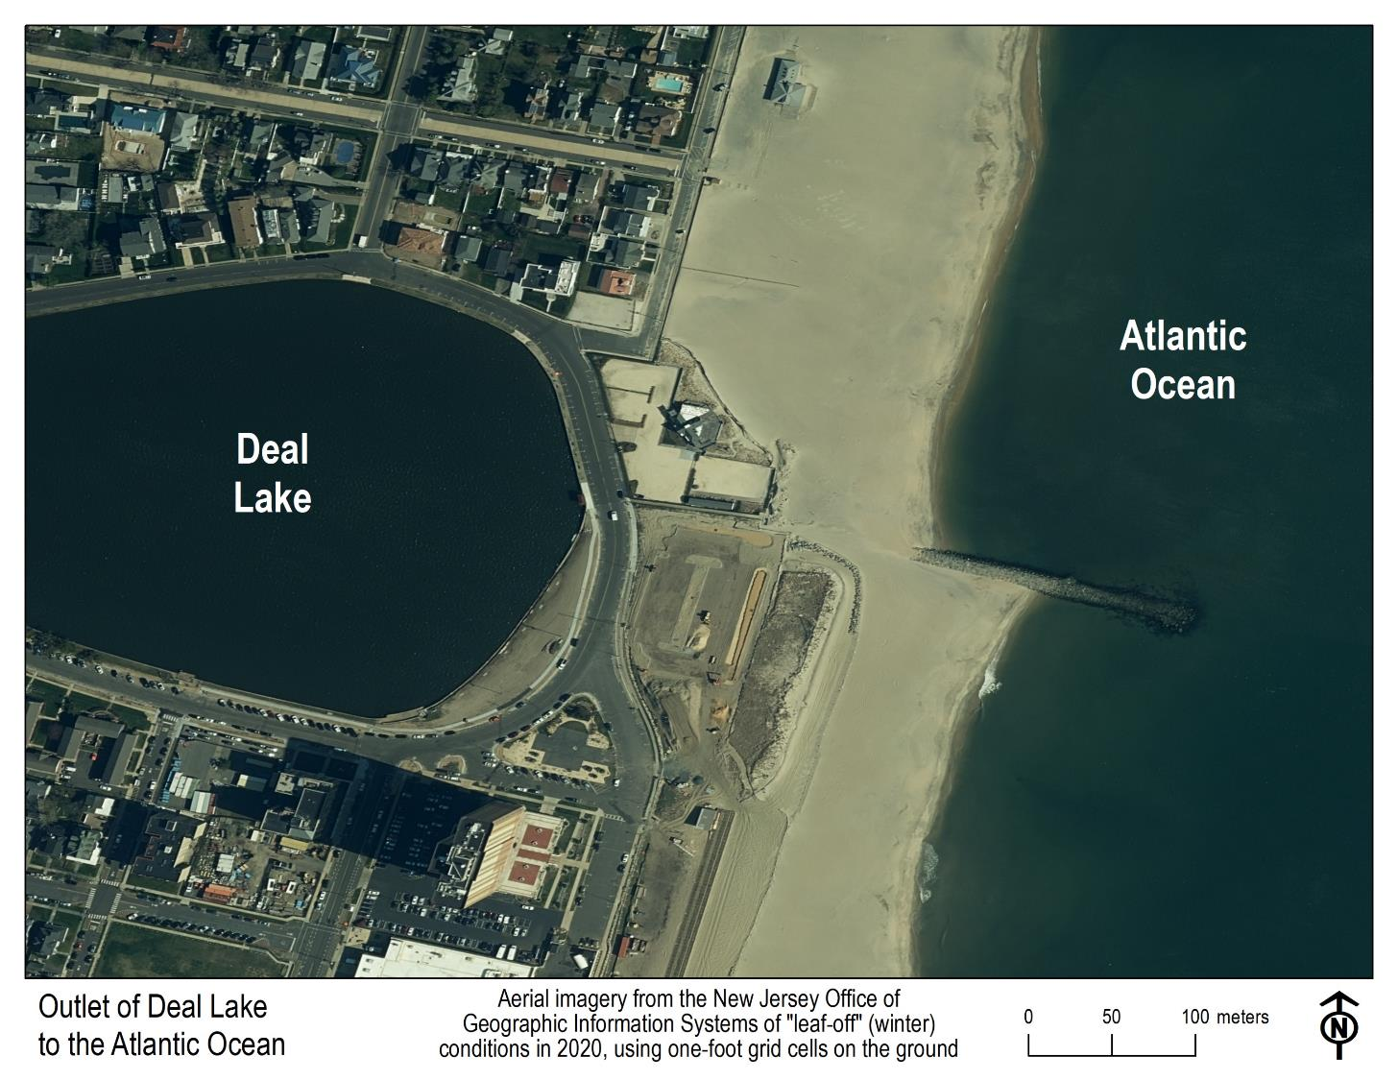
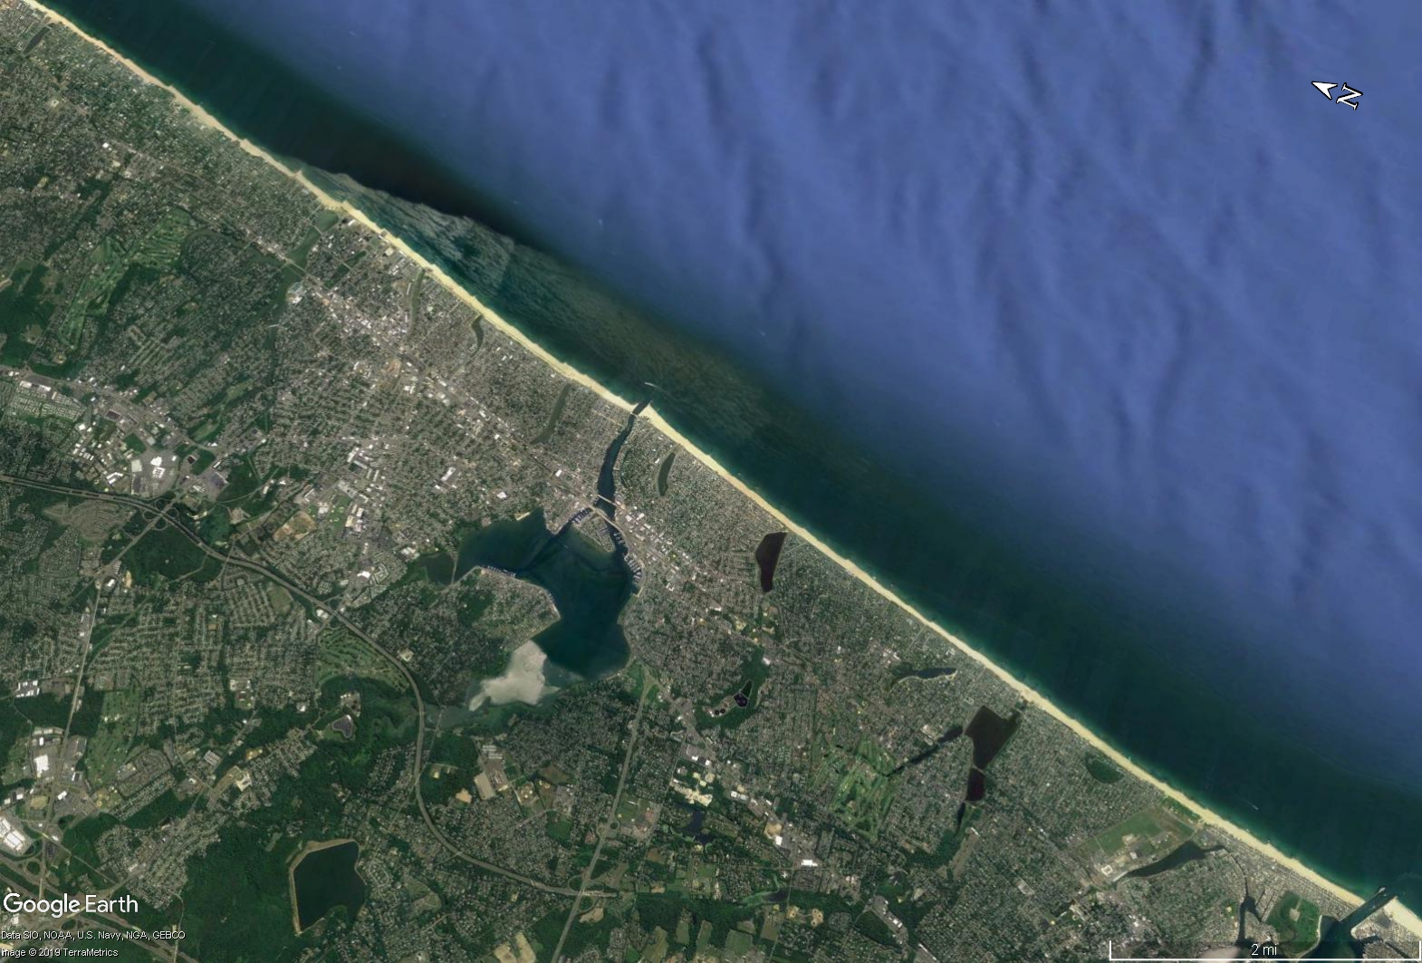
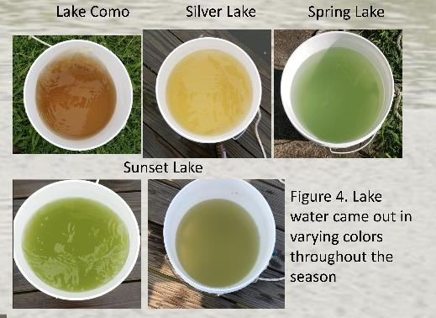
Lake Takanassee /
Whale Pond Brook
Coastal Lakes of Monmouth County, NJ
Deal Lake
Sunset Lake
Important features of Jersey shore communities
Wesley Lake
Fletcher Lake
Sylvan Lake
Silver Lake
Lake Como
Spring Lake
Wreck Pond

Slide 4
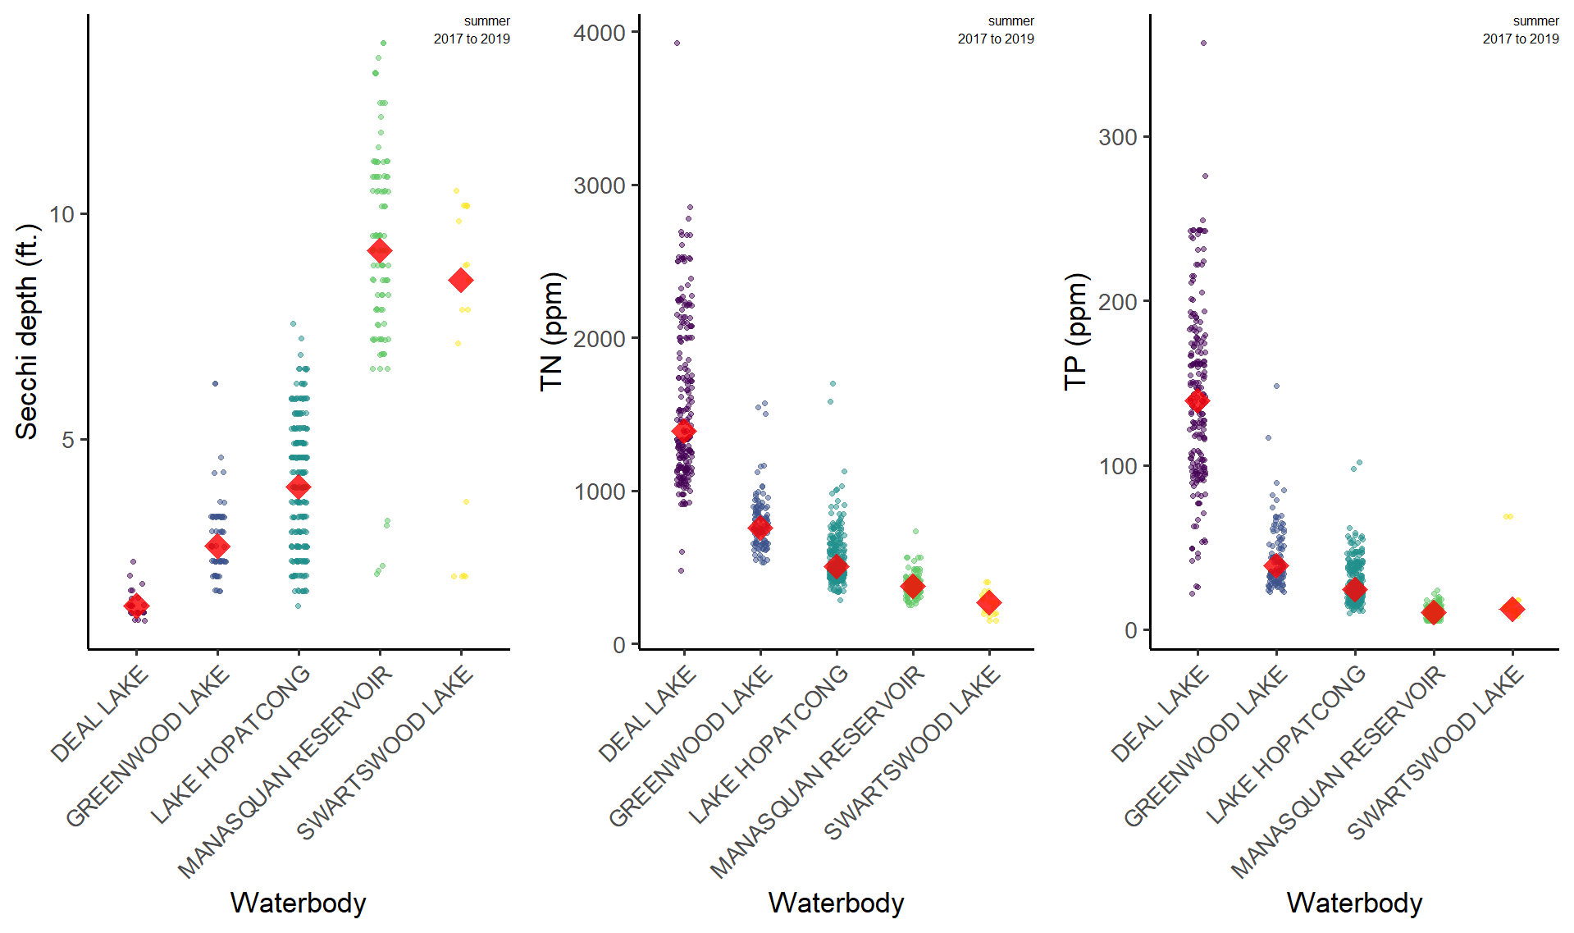
Coastal Lakes are eutrophic compared to other NJ lakes
Lower Secchi depth
Higher total nitrogen
Higher total phosphorus

Slide 5
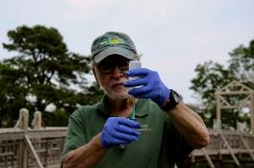
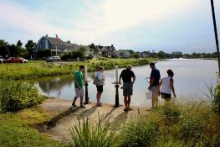
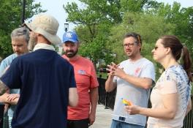
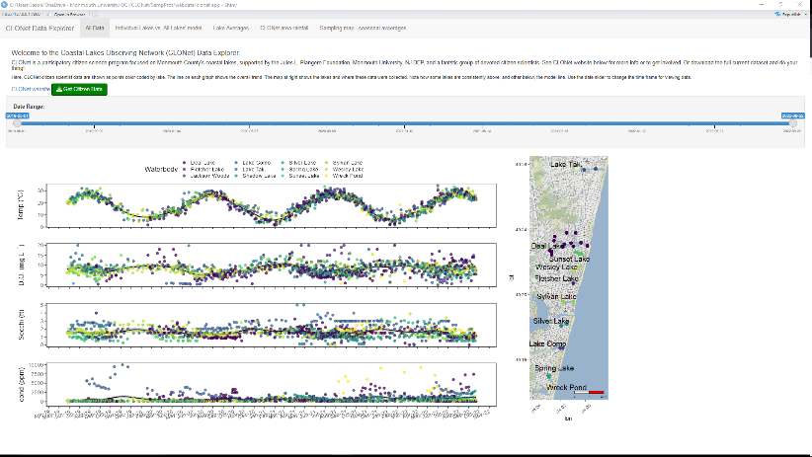
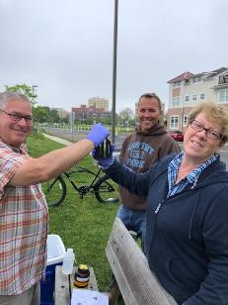
A community-based, participatory research and restoration group that will allow communities to address coastal lake issues based on their own knowledge and use of the underlying scientific data.
3+ years of citizen data have taught us a lot about these lakes and engaged the community
Lake
Lake
Lake
CLONet Shiny App displays citizen data
Monmouth University UCI
NJDEP
Community
Lake
Lake

Slide 6
Data Explorer App
https://jadolf-phab-apps.shinyapps.io/CLONet_data_explorer/
Key takeaways from citizen data:
Summer water temperatures commonly 25-30 °C, which is warmer than records we have from 1970’s
Dissolved oxygen is generally OK, but a number of lakes show low D.O. occasionally
What happens at night?
Secchi depths are generally low in all lakes – an important indicator of eutrophication / degradation
AND an important indicator to track improvements
Conductivity varies widely within and between lakes
Within lake, related to rainfall, underscoring the sensitivity of coastal lakes to stormwater runoff
Citizen data has shown road salt intrusion events

Slide 7
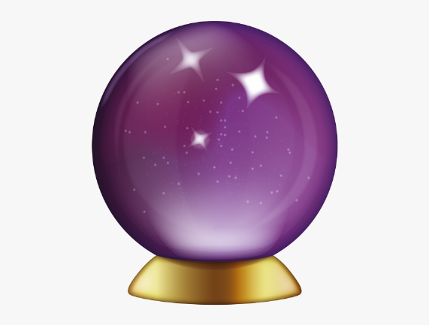
Key question: what’s the relationship between citizen measurements and lake characterization by the full dataset?
Citizen sampling is more resilient and scalable than lab sampling
$$$
COVID-19 pandemic
We (citizens, state, university) have collected a good amount of data to address this question rigorously

Slide 8
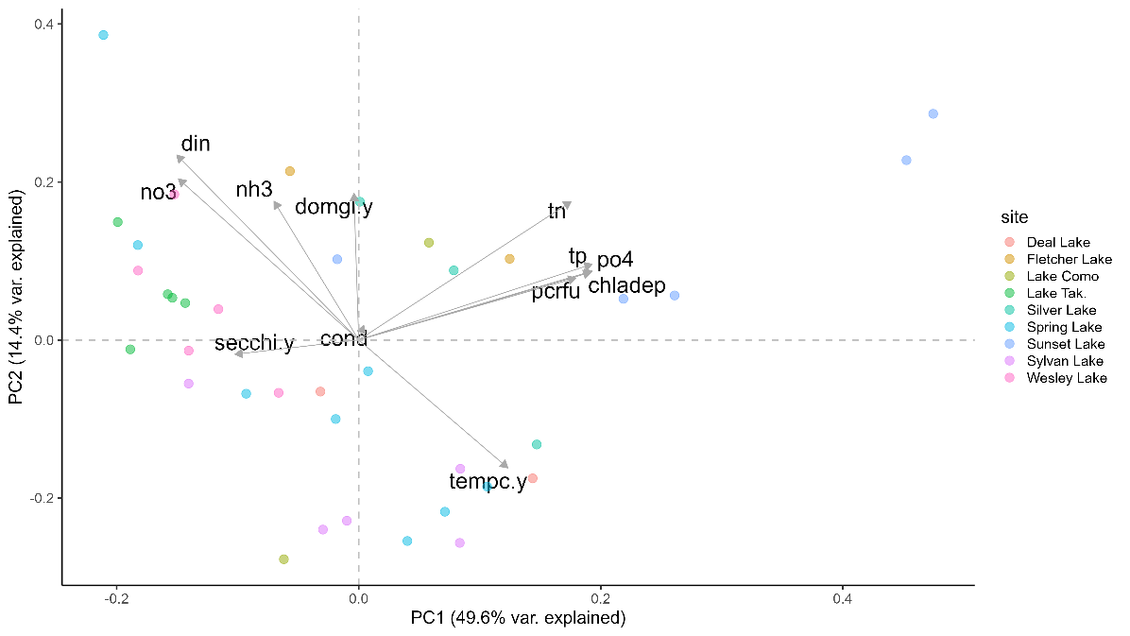
Key question: How does citizen data relate to lake nutrients and algal biomass (based on seasonal averages)?
Citizen Secchi depth is related to
TN and TP
Inorganic P (PO₄)
HAB / phytoplankton biomass
Citizen water temperature and D.O. are related to
Inorganic N
Captures seasonal nutrient inputs

Slide 9
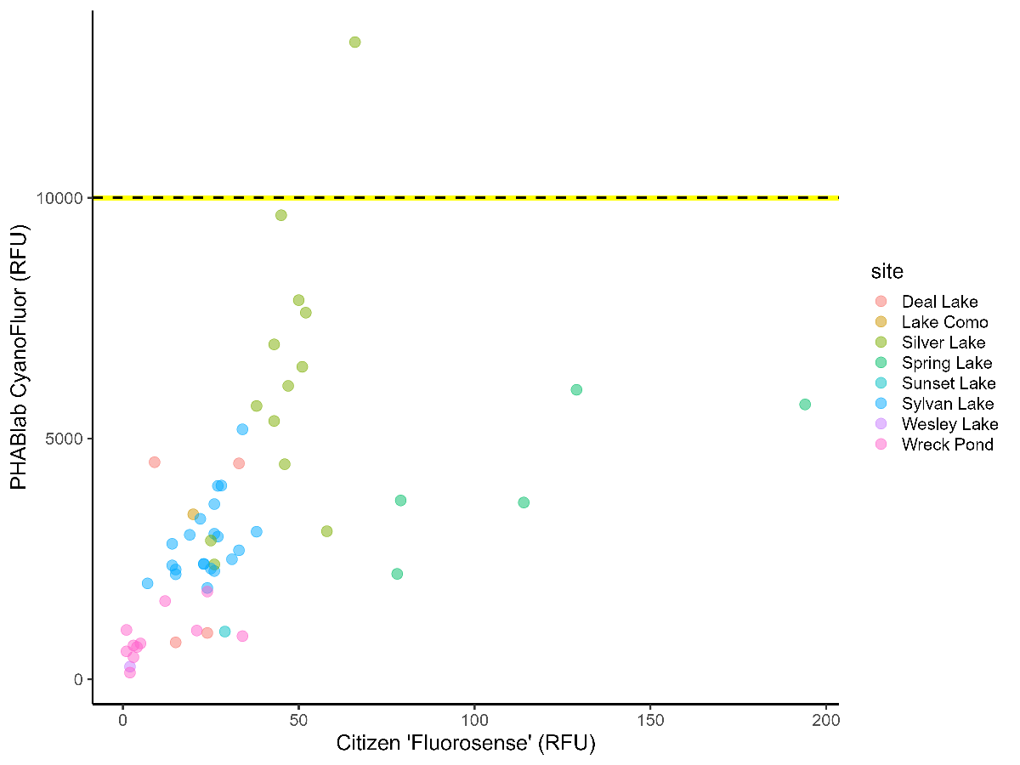
Citizens can reliably measure HAB index (PC fluorescence)
This strong comparison supports the idea that citizen scientists can monitor HABs in their own lakes
HABs are a major water quality issue in coastal lakes because of the public health issues they present

Slide 10
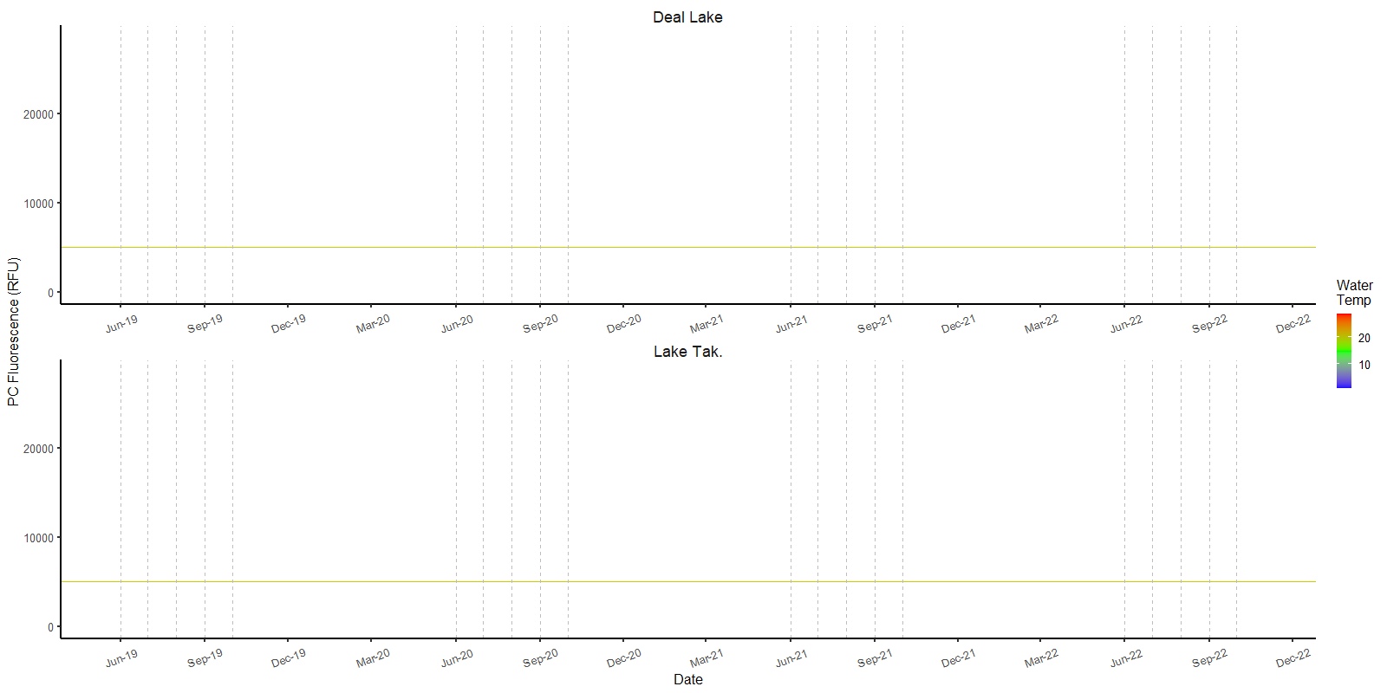
HAB (or not) time series in two coastal lakes
2022
2019
2020
2021
2019
2020
2021
2022

Slide 11
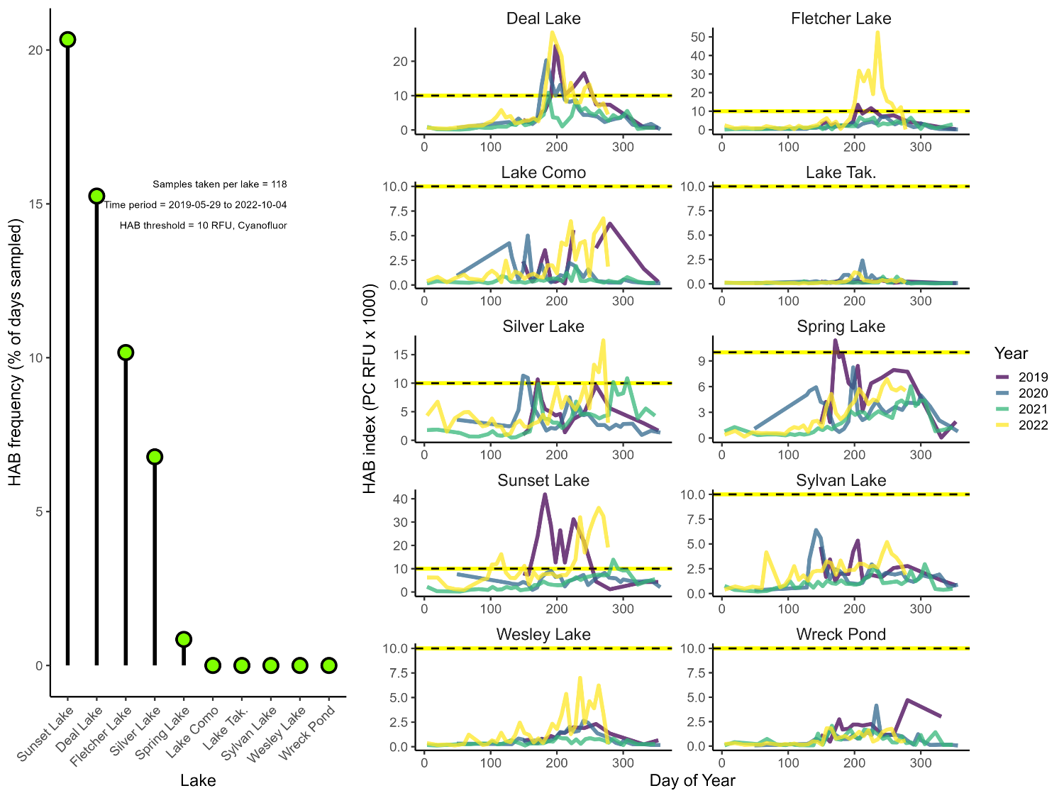
HABs – some lakes have them, some do not!

Slide 12
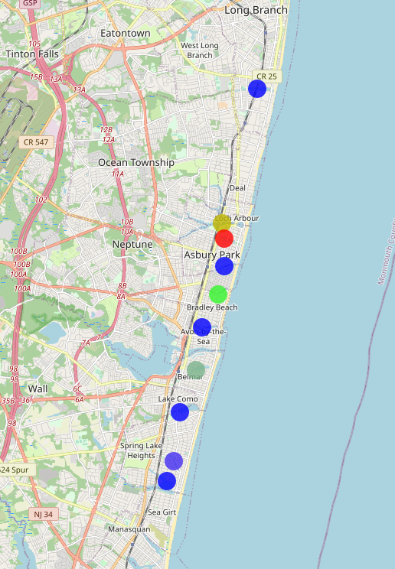
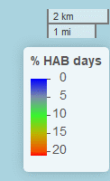
The two HAB-iest lakes are in Asbury Park
We have examined watershed characteristics of each lake to understand this
Does Rock `n Roll cause HABs?!?!
Statistically, HABs – elevated nutrients were associated with elevated population density and % urban watershed
Lakes with the least HABs had elevated % wetlands in their watershed
Please see my poster for details
The location and timing of coastal lakes’ HABs potentially exposes large numbers of people to public health issues and impacts an important natural resource

Slide 13
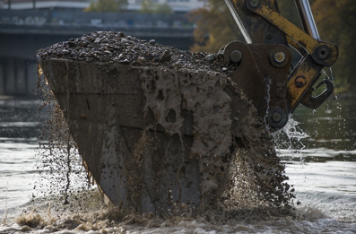
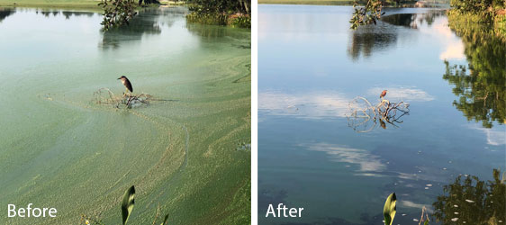
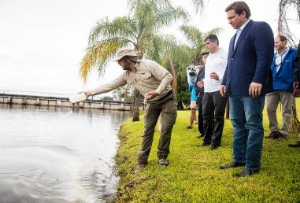
How do we use CLONet data for restoration?
Demonstrates commitment of the community to lake stewardship
Identifies the problems associated with different lakes
Shows existing monitoring infrastructure for determining efficacy of restoration activities
Ammendments?
Nanobubbles?
Dredging?

Slide 14
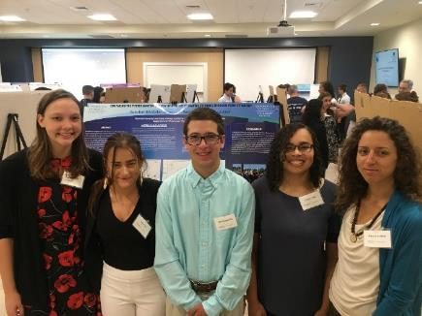
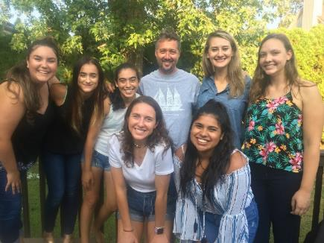
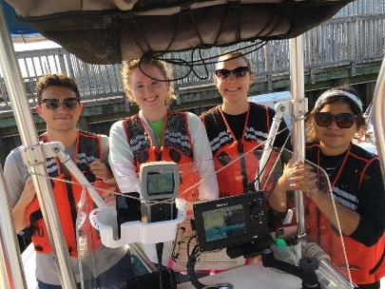
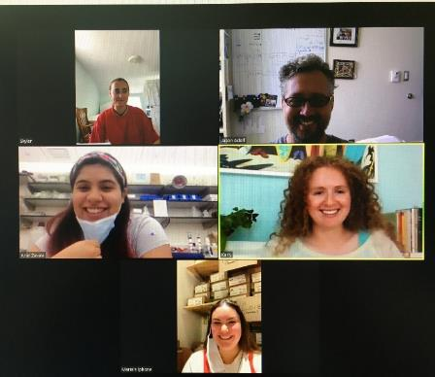
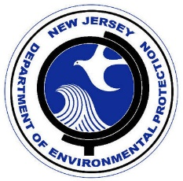
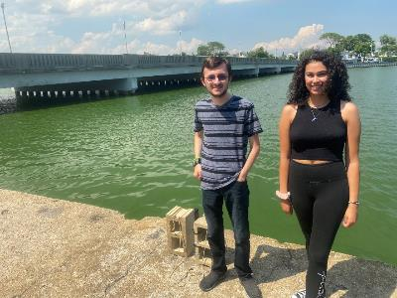
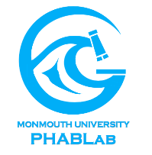
Thank you for your attention
Acknowledgements
2018
Jules Plangere Foundation
Erin Conlon, Skyler Post, Ariel Zavala, Maria Riley, Karly Nolan, Kelly Hanna, Tori Lohnes, Kaitlyn Saldutti, Sydney Lucas, Jack Campanella, Dr. J. Weisburg, Nicholas Box, Nicholas Occhiogrosso, Marie Mauro, Cora Hunt
Questions?
Jason Adolf, PhD
Monmouth University
Biology Department &
Urban Coast Institute
jadolf@monmouth.edu
732-263-5687
2019
2021
2022
Robert Schuster, Bill Heddendorf, Eric Ernst, Sherri Shifrin
monmouth_phab_lab
2020
https://jadolf.wixsite.com/phytoplankton

Slide 15
Funding for coastal lake restoration
https://nj.gov/dep/wlm/grants/lakestormwater.html
The contact for this would be Jennifer Noblejas. (jennifer.noblejas@dep.nj.gov)
https://nj.gov/dep/wlm/grants/swgrant.html
The contact for this would be Nancy Kempel. (nancy.kempel@dep.state.nj.us)

