Slide 1
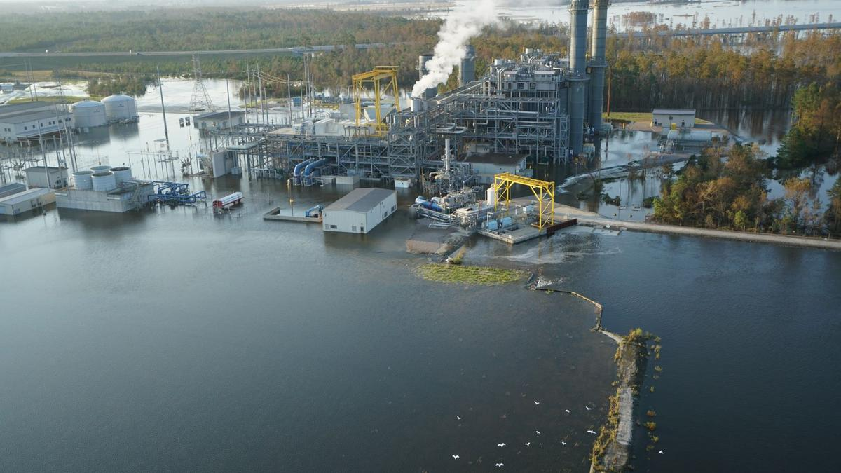

Future Inundation Frequency of Coastal Critical Facilities
Dr. Tom Herrington
Associate Director

Slide 2
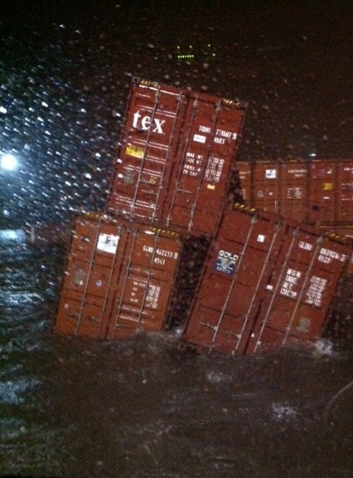
Introduction
Coastal Critical Facilities and Marine Dependent Industries are exposed to higher climate change risk due to their required proximity to coastal waters for:
  Maritime Transportation
  Cooling Waters
  Effluent Discharge
  Supply Chain & Transportation Networks

Slide 3
“Infrastructure currently designed for historical climate conditions is more vulnerable to future weather extremes and climate change.”
- 4th National Climate Assessment

Slide 4
Coastal Climate Change Risks
Sea Level Rise
  Nuisance Flooding
  Chronic Flooding
  Storm Surge
Saltwater Intrusion
Increasing Seawater Temperature
Increase in Precipitation Intensity & Frequency
Shoreline Erosion
Focus of today’s talk

Slide 5
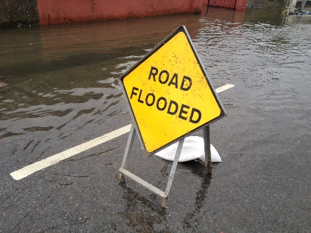
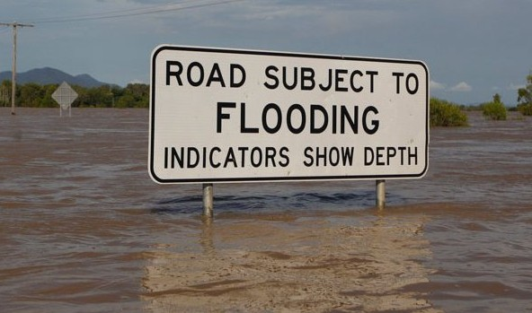
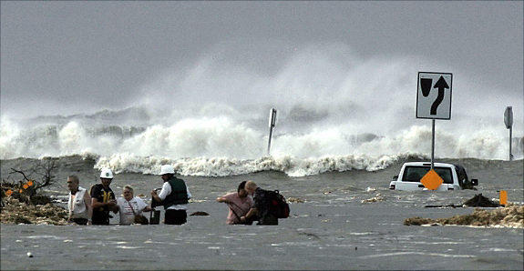
Flooding Terminology
-What are we really talking about?
Nuisance Flooding - flooding that
causes public inconveniences such
as frequent road closures (NOAA)
Chronic Flooding - flooding that
occurs more than 26 times per year
or every 2 weeks on average
(Union of Concerned Scientists)
Storm Surge – the abnormal rise in seawater level during a storm, measured as the height of the water above the normal predicted astronomical tide

Slide 6
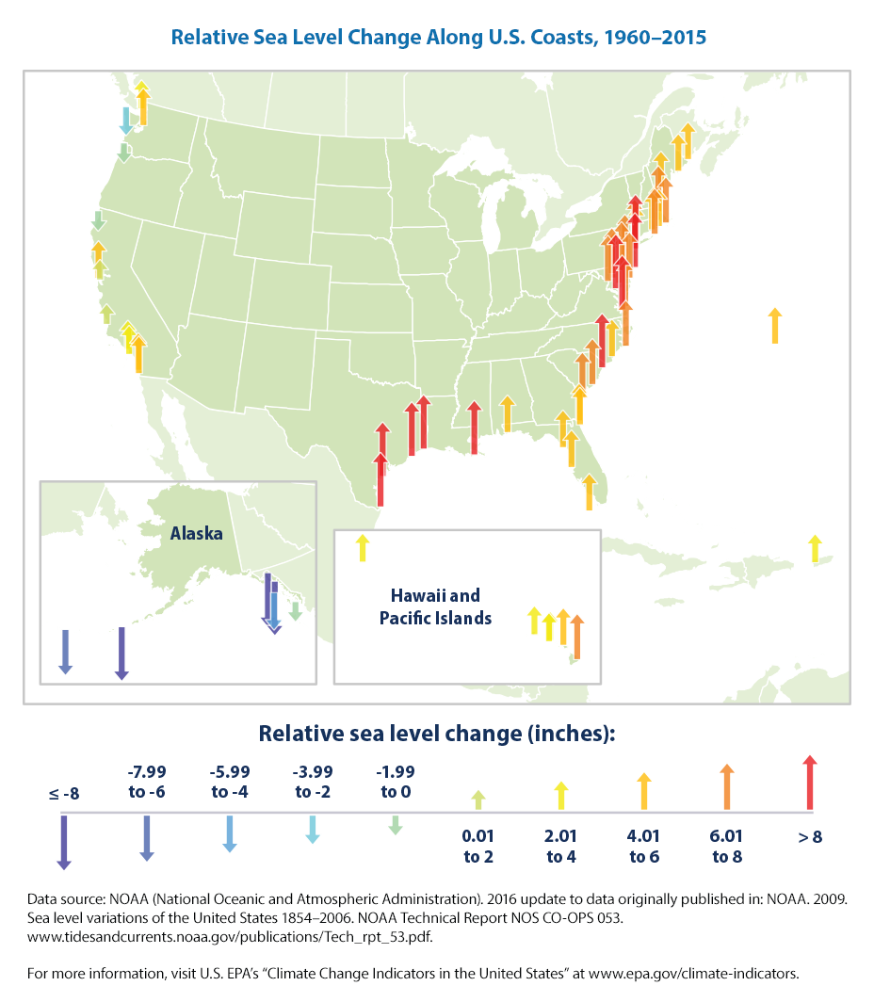
The Issue: Relative Sea Level Rise

Slide 7
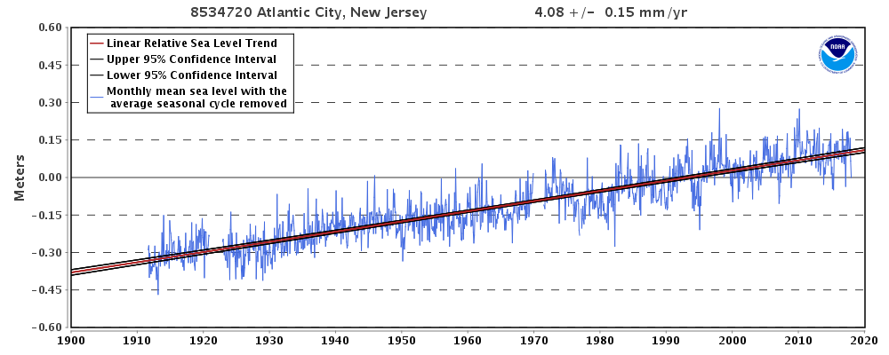
Relative Sea Level Rise at Atlantic City, NJ

Slide 8
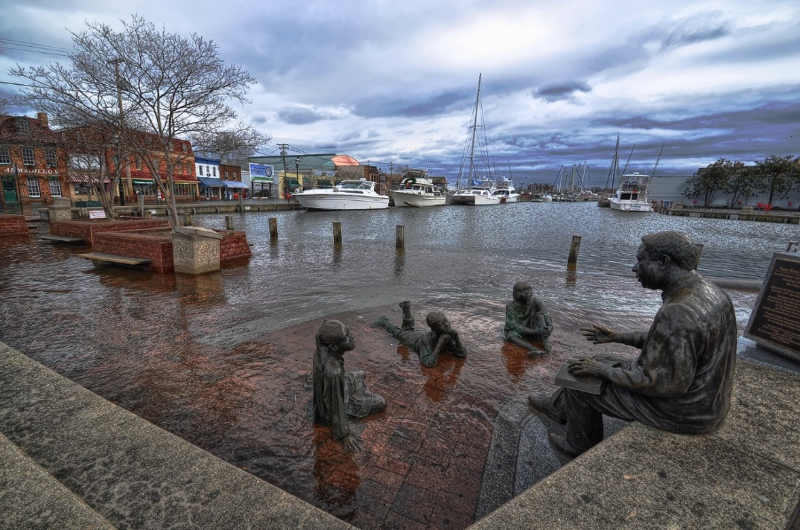
Result: More Days Like This
Annapolis, MD

Slide 9
Sea Level Rise Impact on Total Water Levels
Moderate
Flood
Minor
Flood

Slide 10
Future Impact: 2074
Major
Flood
Moderate
Flood
Minor
Flood

Slide 11
Sea Level Rise is projected to accelerate
Estimated, Observed and Projected Sea Level Rise (Melillo et al., 2014)

Slide 12
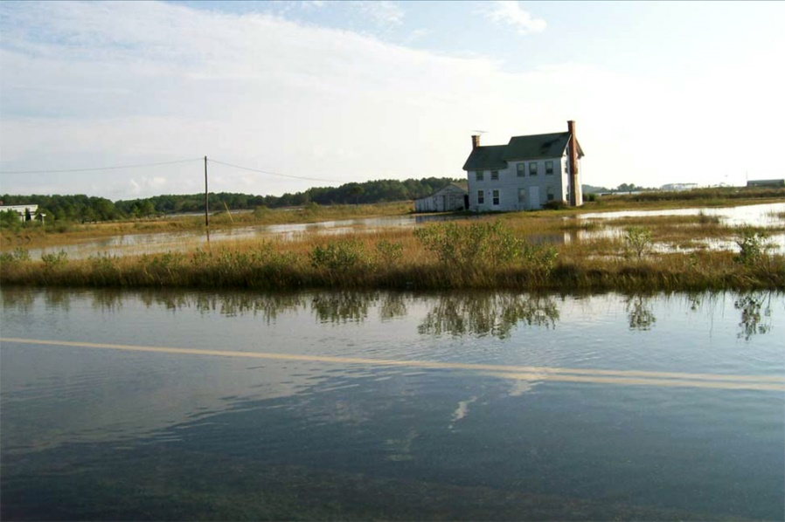
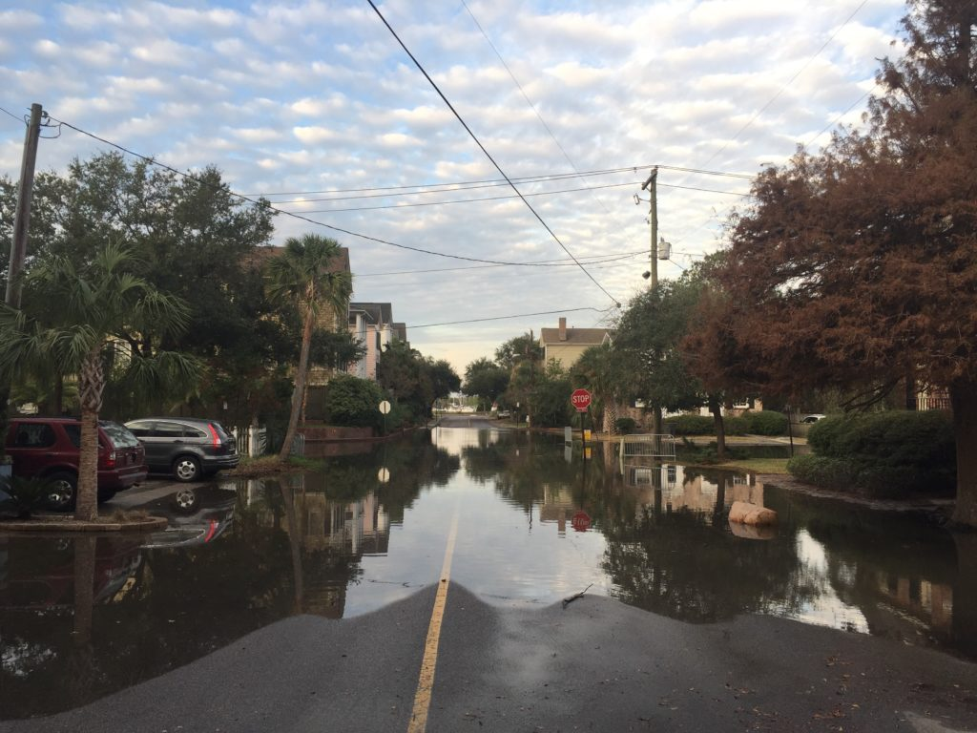
Concern
How frequently will low-lying roadways and infrastructure experience flooding in the future

Slide 13
DoE Sea Level Rise Impact on Energy Infrastructure (2014)
National Climate Assessment 2014
But this is just Sea Level
Rise. What about Total
Water Levels?

Slide 14
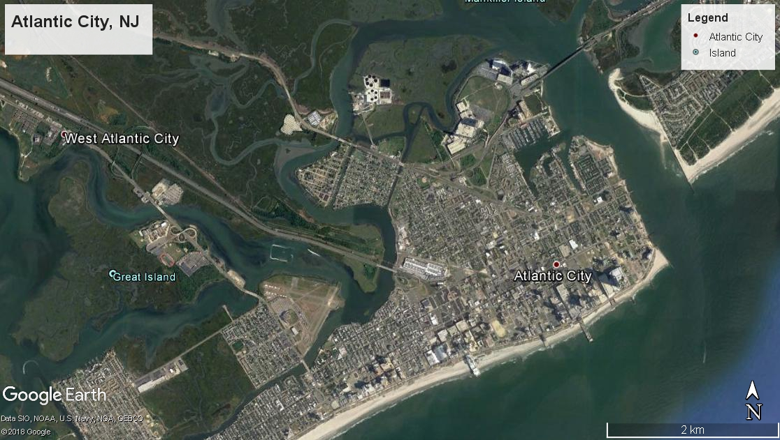
Down-scaling Climate Change Impacts

Slide 15
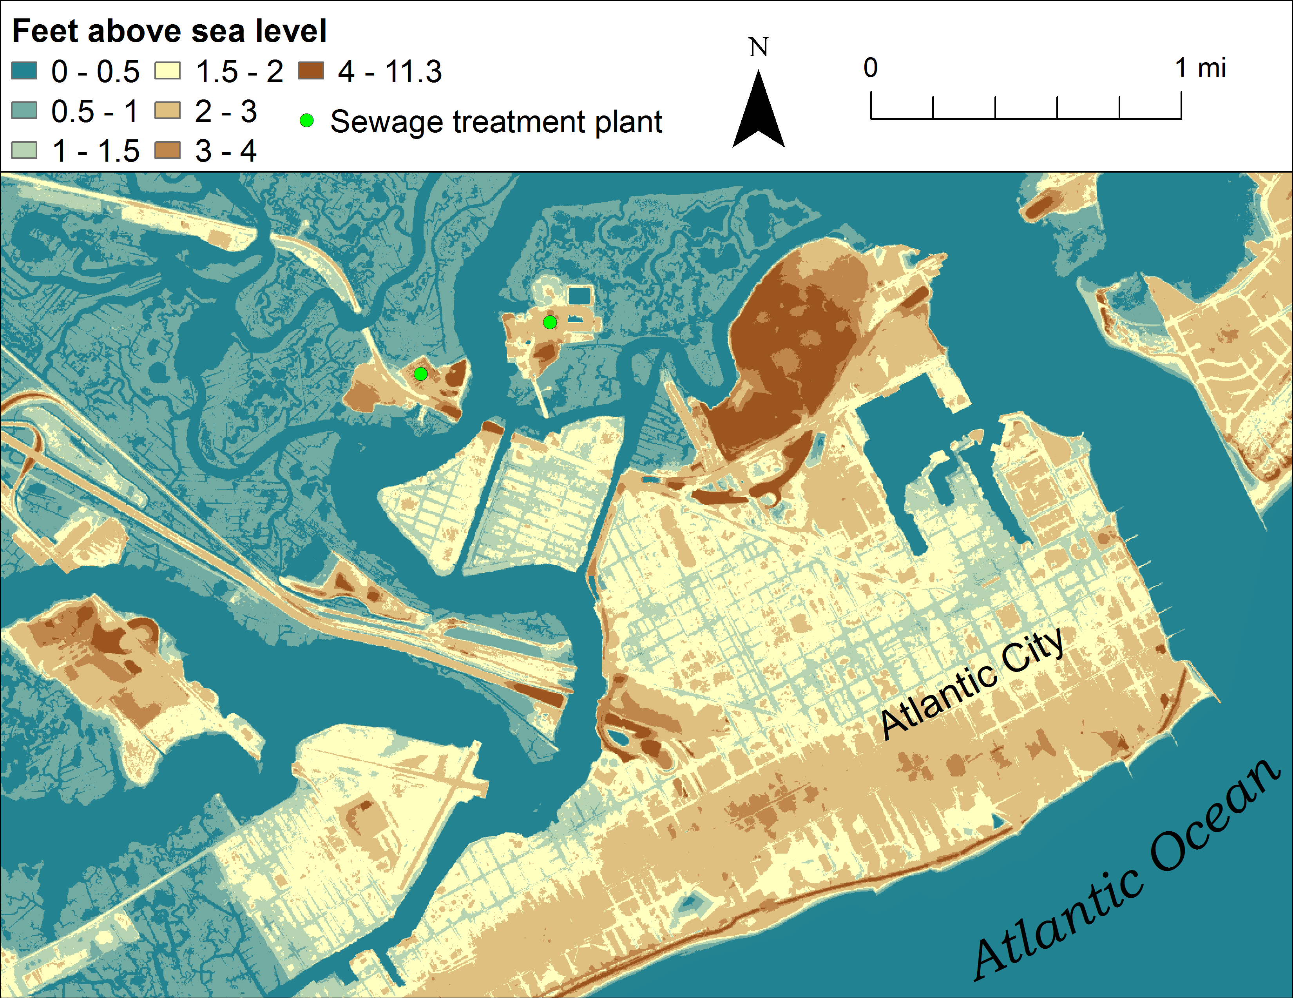
Digital Elevation Model
Land Elevation is mostly below 4 ft MSL

Slide 16
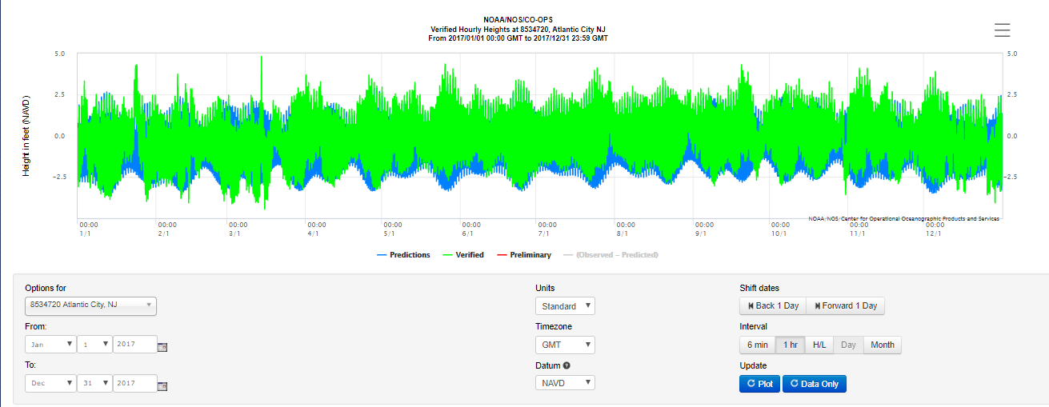
What about the Future?
https://tidesandcurrents.noaa.gov/waterlevels.html?id=8534720
We can look to what happen in the past as a proxy for future flooding

Slide 17
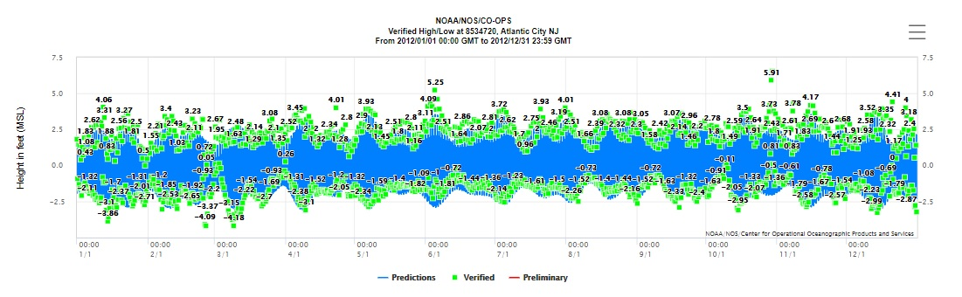
Processing
Start with hourly water levels from Atlantic City
  Use 20 years of observations to Identify high tide peaks and elevations in data set
  1997 – 2017
  De-trend data to remove sea level rise: Left only with high tide elev.
Sandy

Slide 18
Processing
Develop probability distribution of high tide amplitudes relative to Mean Sea Level
  Analyze data for exceedance probability of High Tides relative to Mean Sea Level
  Provides % time that High Tides were at or above specific elevations
  Assume same distribution will occur with sea level rise

Slide 20
Convert to # of High Tides per year
Easier to think in terms of how many high tides per year exceed a specific elevation
  Assume the high tides will continue to follow the 20-year distribution of high tides
  Two high tides per day
  730 total high tides per year

Slide 21
Local Sea Level Rise Projections
(relative to year 2000 water level)
Kopp et al., (2016) Assessing New Jersey's Exposure to Sea-Level Rise and Coastal Storms:
Report of the New Jersey Climate Adaptation Alliance Science and Technical Advisory Panel

Slide 22
Future Sea Level Rise Projections
2030 - 2100

Slide 23
Future Flood Events @ Roosevelt Blvd.
2030 - 2100
2100 Med
682

Slide 24
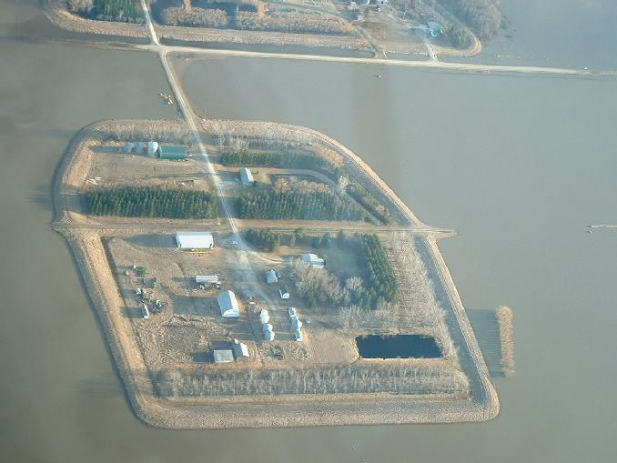
Our Future?

Slide 25
Our Future?

Slide 26
Conclusions
Number of flood events changes significantly with small changes in sea level
Daily flooding is likely if sea level rise accelerates at highest scenario rate
Engineering solutions to mitigate future flooding of critical facilities is feasible but surrounding area will likely be flooded.
Joint probability of increased rainfall and high tide flood events is not well understood at this time
  Increased frequency and intensity of rain events will increase frequency of high tide flood events

