Slide 1
“The Nonhuman Rights Project’s Struggle to Gain Legal Rights and Personhood for Nonhuman Animals”
Kevin Schneider, Esq.
Executive Director
The Nonhuman Rights Project
Climate Change, Coasts & Communities Symposium
Monmouth University – April 17, 2019

Slide 2
Founded in 1996 by attorney Steven M. Wise, the NhRP works to secure legally recognized fundamental rights for nonhuman animals through litigation, advocacy, and education. Our mission is to change the legal status of at least some nonhuman animals from mere “things,” which lack the capacity to possess any legal right, to “persons,” who possess such fundamental rights as bodily integrity and bodily liberty and those other legal rights to which evolving standards of morality, scientific discovery, and human experience entitle them. Our current plaintiffs are members of species who have been scientifically proven to be autonomous: currently, great apes, elephants, dolphins, and whales.

Slide 4
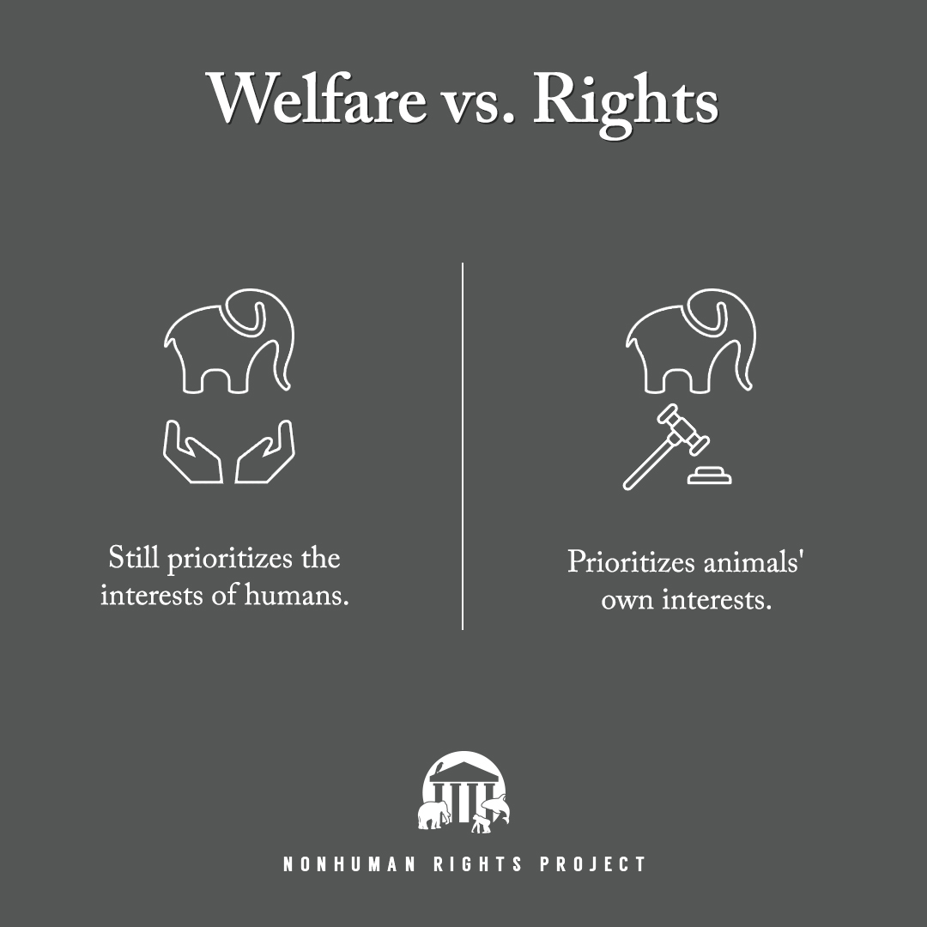

Slide 5
In December, 2013, the NhRP filed the world’s first common law habeas corpus petition on behalf of a nonhuman animal when we filed on behalf of Tommy, a chimpanzee we found alone in a cage in a shed on a trailer lot in upstate New York.

Slide 6
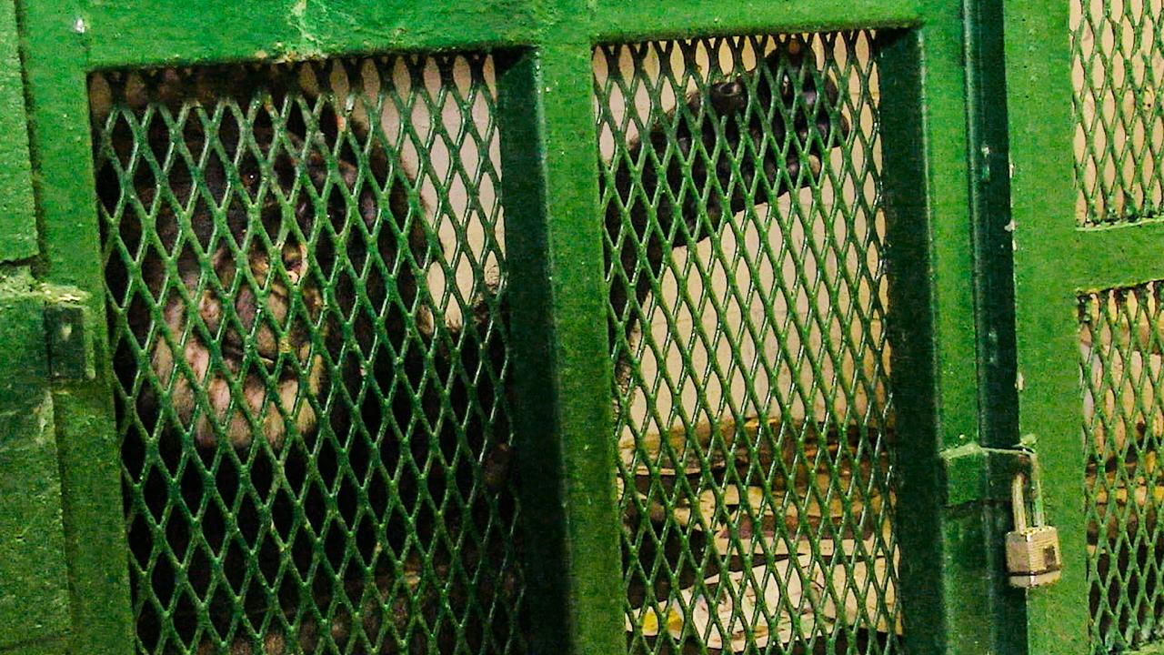
In December, 2013, the NhRP filed the world’s first common law habeas corpus petition on behalf of a nonhuman animal when we filed on behalf of Tommy, a chimpanzee we found alone in a cage in a shed on a trailer lot in upstate New York.

Slide 7
What is “common law habeas corpus”?
The “common law” is the law that judges make, as opposed to acts of legislatures, parliaments, or the executive.
At one time, the common law was the primary source of English law that judges used in deciding cases, and it still plays an important role in parts of the law.

Slide 8
Habeas corpus is one of the oldest “tools” in the common law, dating to near the time of the Magna Carta.
Habeas corpus was created to protect the autonomy of “persons” and historically was used to contest private and unlawful detention (i.e., it could be invoked to get the state involved in setting an innocent “person” free, including by force if necessary).

Slide 9
The key word is “person”: Who counts as one?
Why does it matter?

Slide 10
The law generally categorizes the world crudely into “things” or “persons.” We can also understand this distinction as “objects” and “subjects.”
In the eyes of the law, all that “person” means is the capacity for legal rights.

Slide 11
In the eyes of the law, “person” has never been and still is not a matter of biology; rather it’s a matter of public policy.
After hundreds of years of struggle, it is now the birthright of every human being to be a person.
For hundreds of years before that, corporations and ships, among other nonhuman entities, were already being treated as “persons.”

Slide 12
A “person” can have a theoretically infinite number of rights, while a “thing” is incapable of having any rights, even those which protect her most fundamental interests.
Currently, virtually every nonhuman animal in the world is a legal thing.
How can a legal thing become a legal person?

Slide 13
We build our cases around those principles that judges claim to believe in, including liberty, equality, and autonomy.
Autonomy is one of the most important principles in our court cases, and drives much of the scientific evidence we submit, including scientific affidavits from some of the world’s leading experts in nonhuman animal cognition.

Slide 14
Science shows beyond doubt that we are not the only species who have and value our autonomy.
A primary stated purpose of the law is to protect autonomy.
We argue autonony is a sufficient but not necessary basis for personhood and rights.

Slide 15
Elephant Experts:
Lucy Bates
Richard Byrne
Karen McComb
Cynthia Moss
Joyce Poole
Chimpanzee Experts:
James Anderson
Christophe Boesch
Mary Lee Jensvold
William McGrew
Sue Savage-Rumbaugh
Jane Goodall
Jennifer Fugate
James King
Tetsuro Matsuzawa
Mathias Osvath

Slide 17
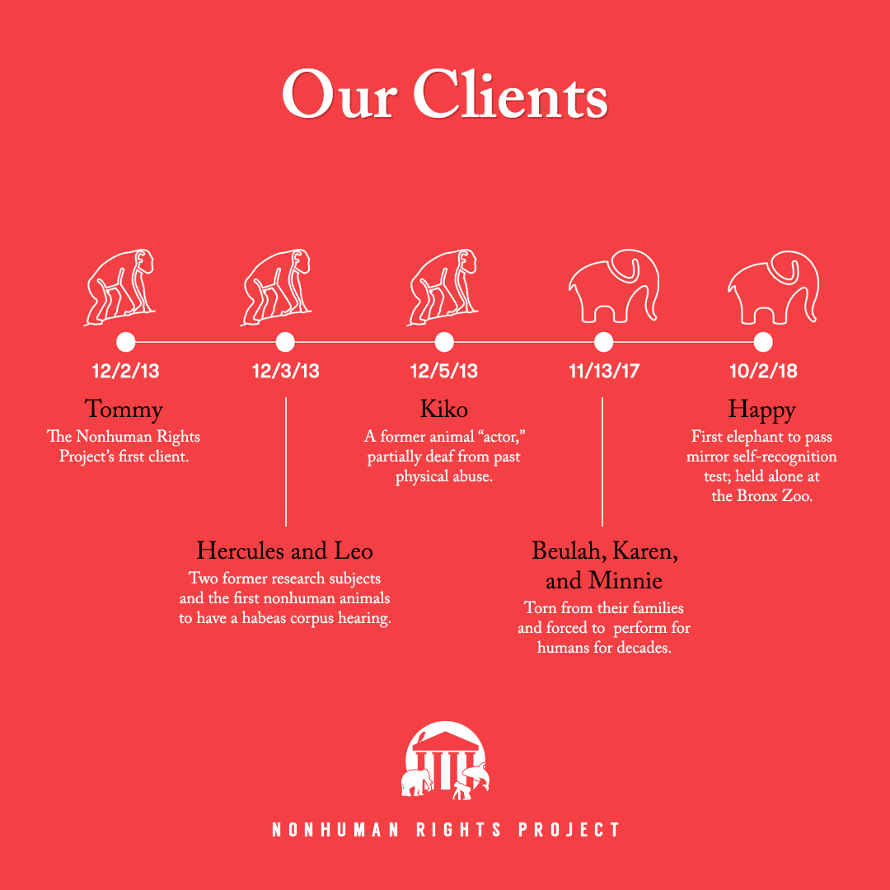

Slide 18
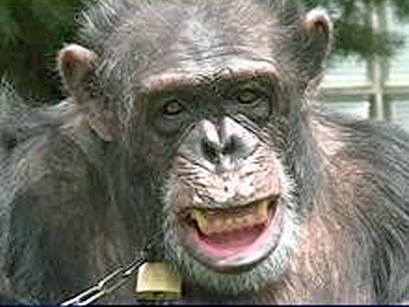

Slide 19
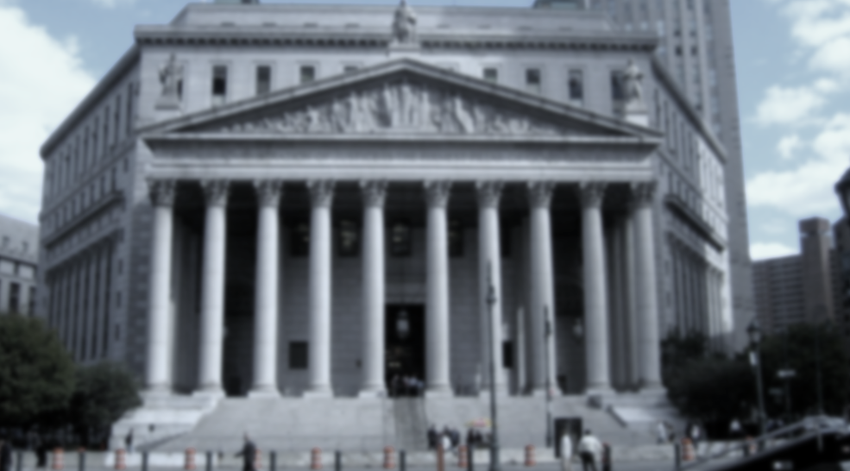
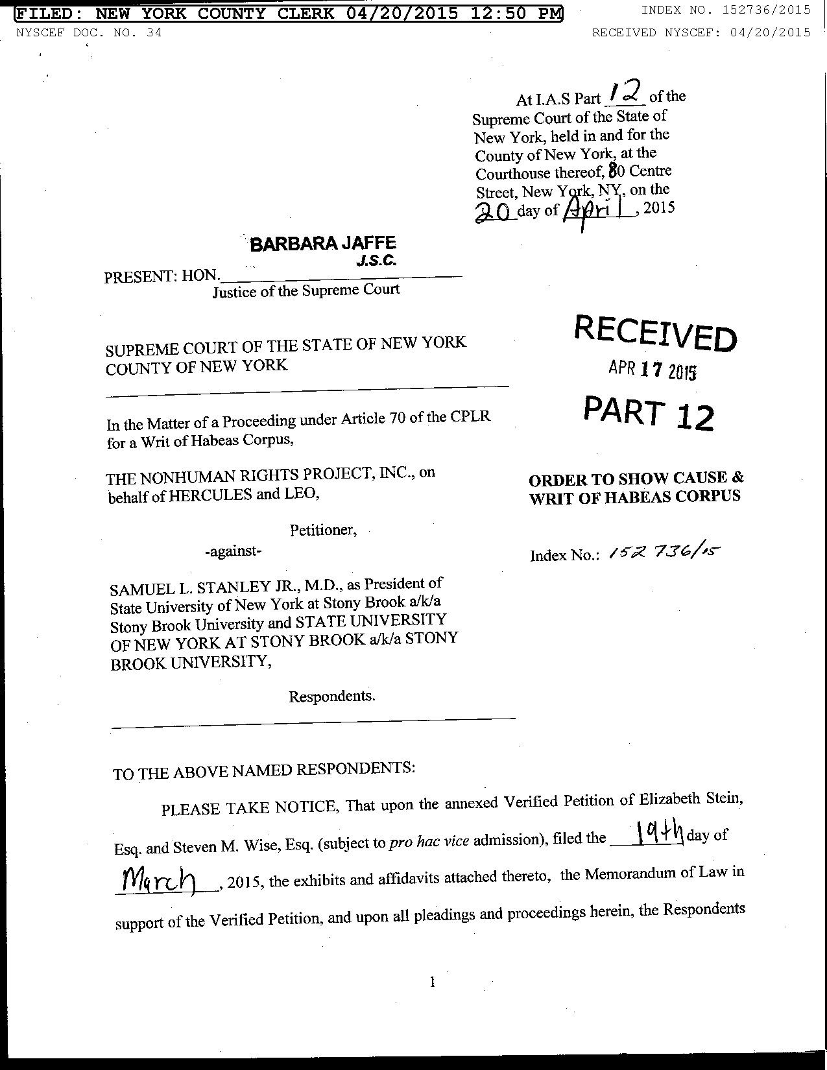
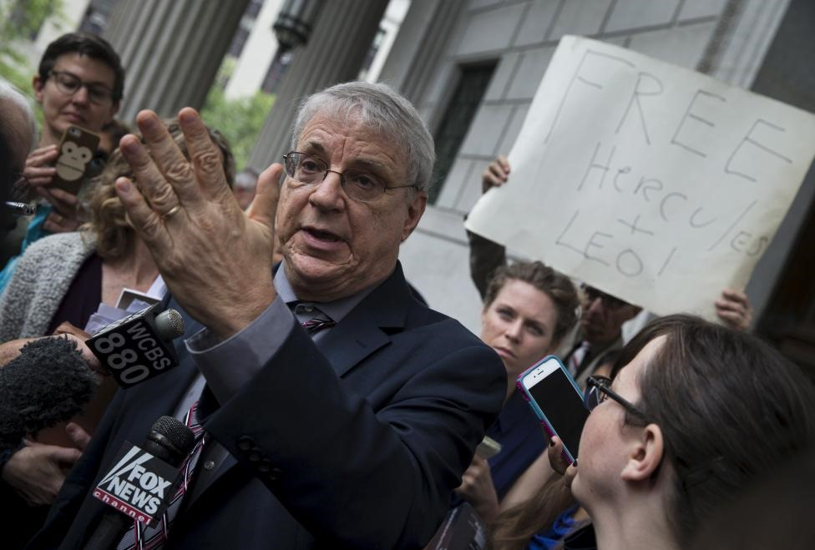

Slide 20
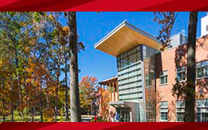
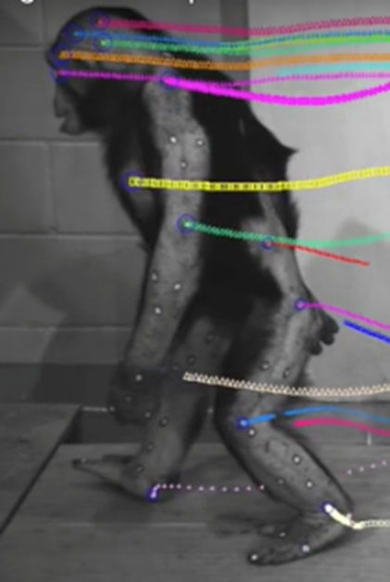
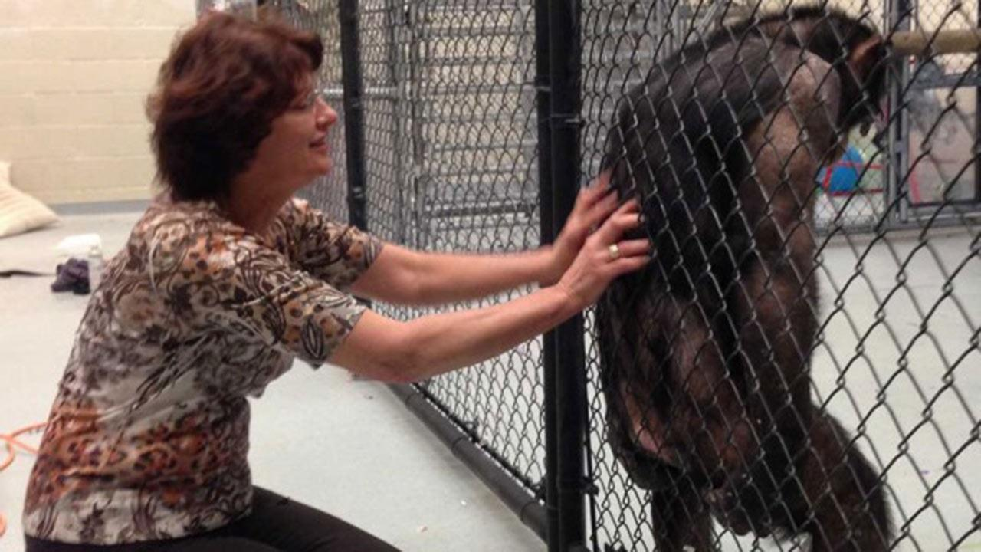

Slide 21
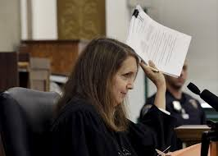
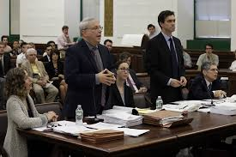
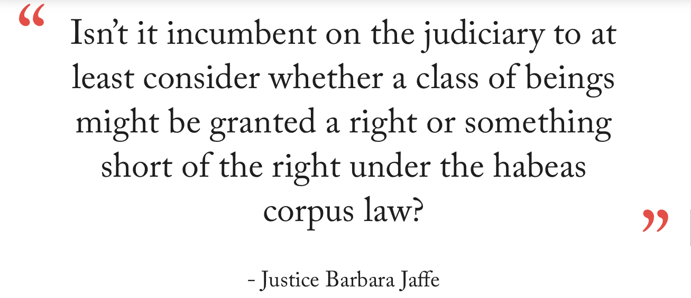

Slide 22
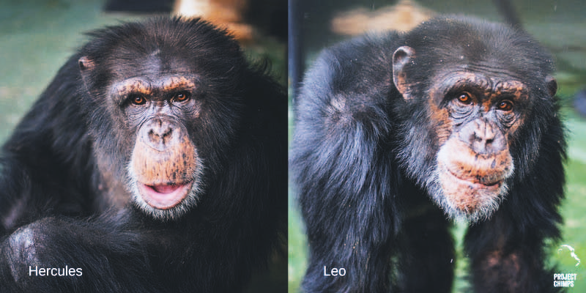

Slide 23
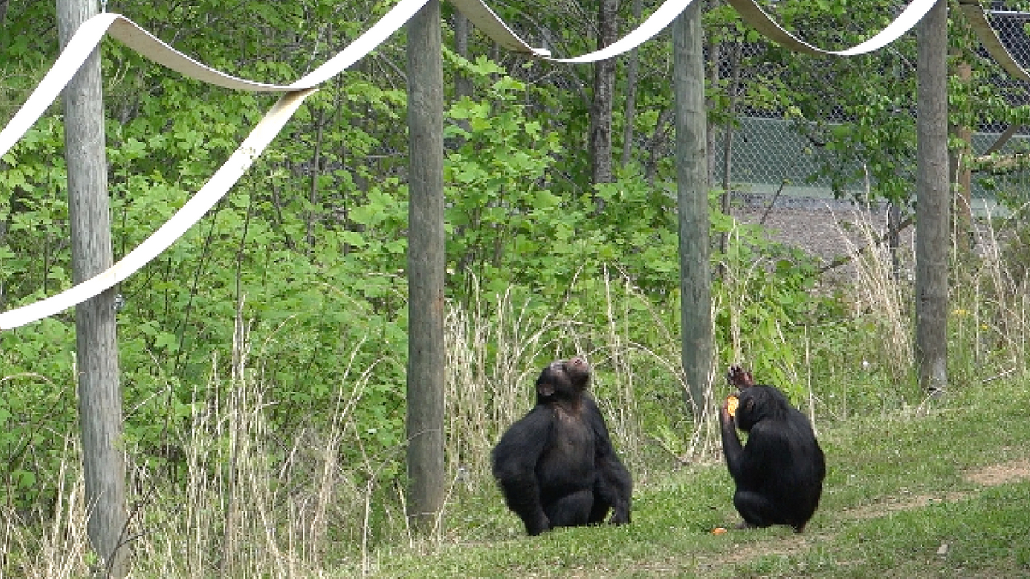

Slide 24
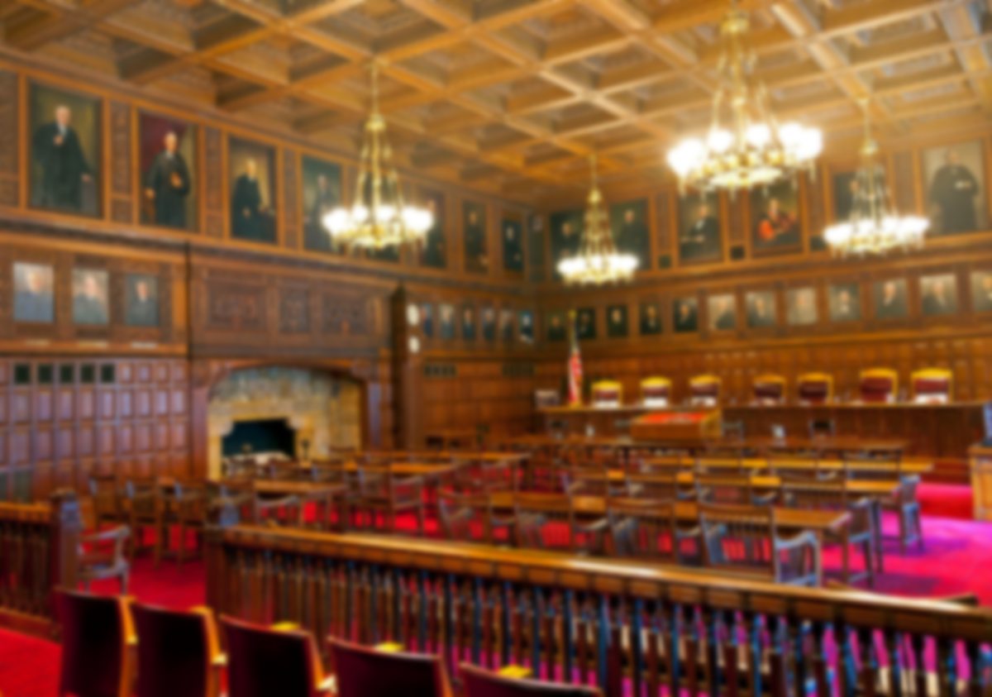
&
&
Tommy’s first case began in December 2013 and ended in an appeal decision in 2014 stating that rights require a correlative ability to bear “social duties and responsibilities,” and that chimpanzees lack it.
Kiko’s first case began in December 2013 and ended in an appeal decision in 2015 staing that seeking transfer to sanctuary was not an appropriate use of habeas corpus since we were not seeking “immediate release.”

Slide 25
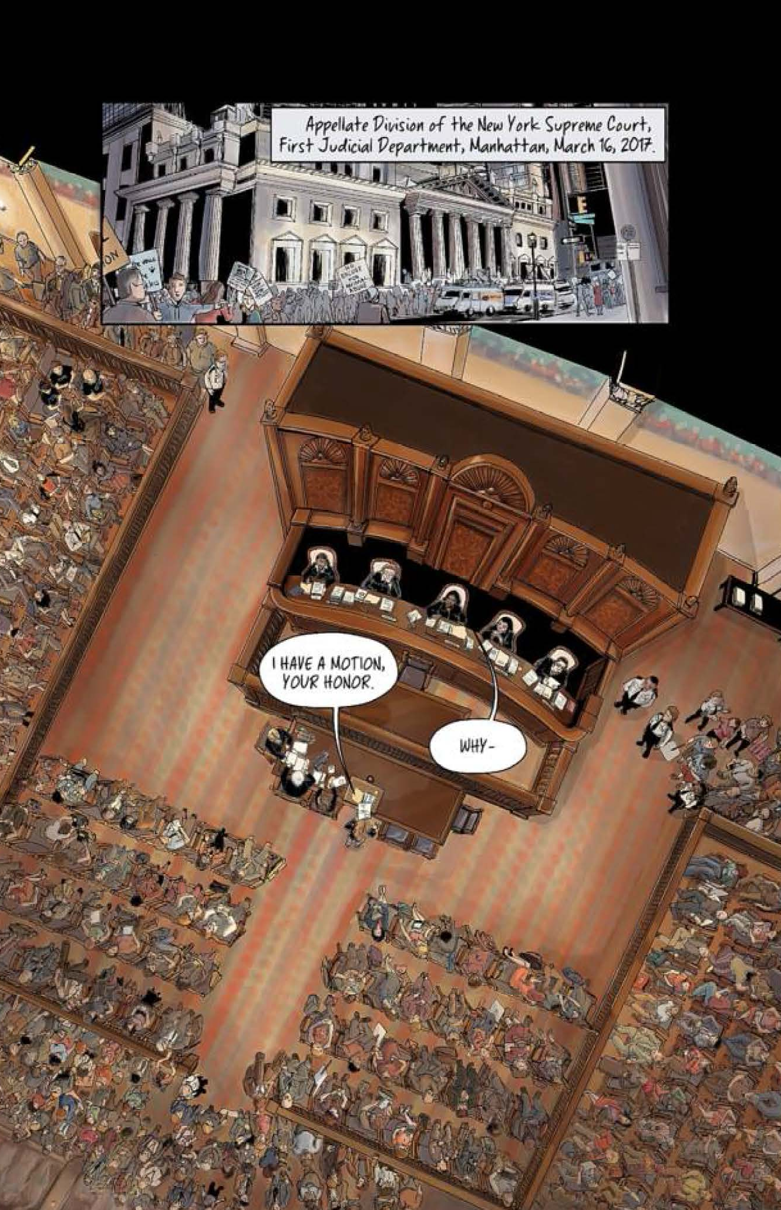
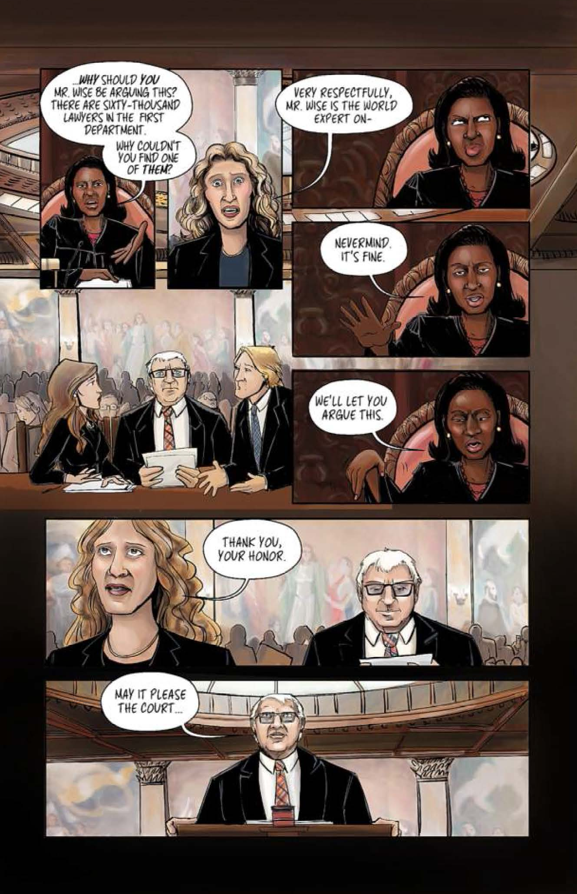
&

Slide 26
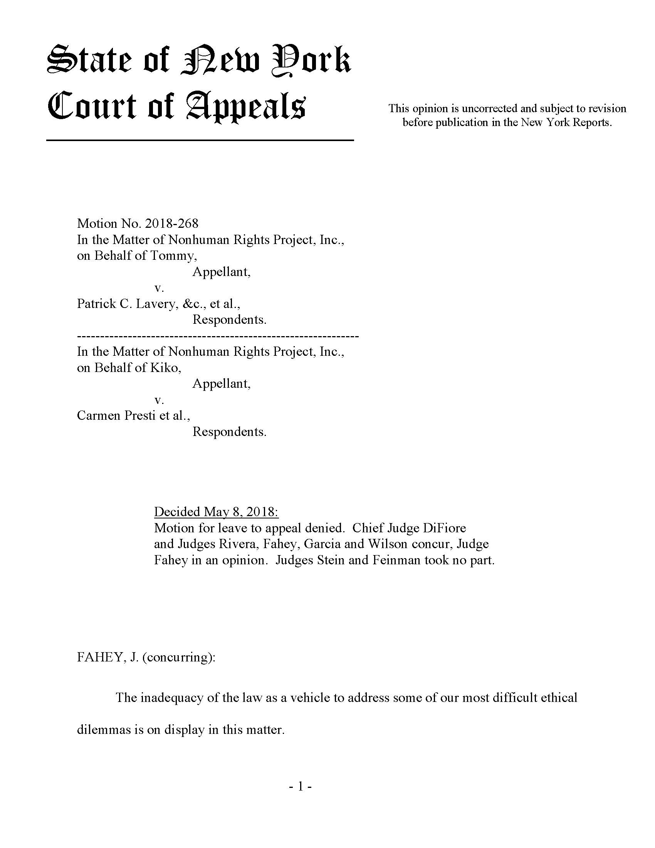
On May 8, 2018, Judge Eugene Fahey of the New York Court of Appeals issued an opinion in Nonhuman Rights Project v. Lavery, which begins:
“The inadequacy of the law as a vehicle to address some of the most difficult ethical dilemmas is on display in this matter.”

Slide 27
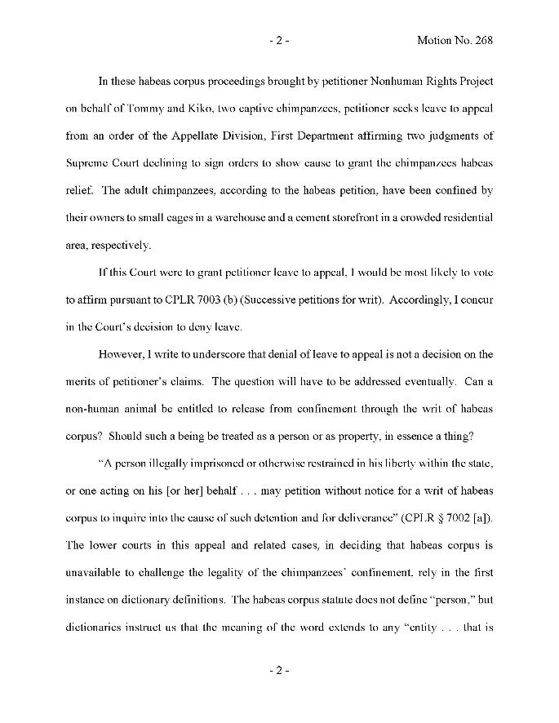
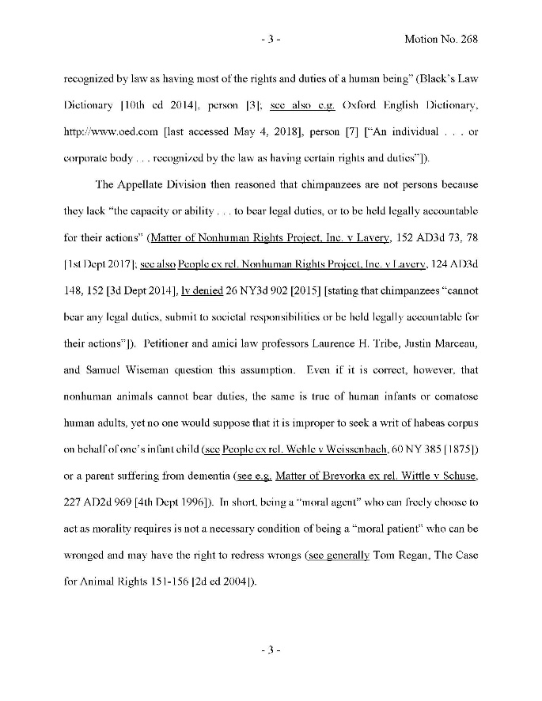
Nonhuman Rights Project, Inc., on Behalf of Tommy v. Lavery,
31 N.Y.3d 1054 (May 8, 2018) (“Tommy”) (Eugene Fahey, J., concurring)

Slide 28
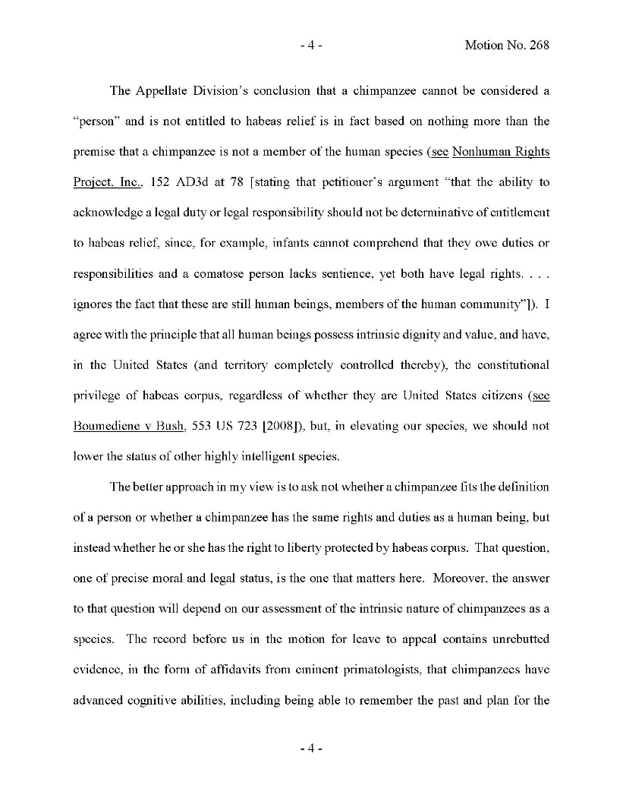
Nonhuman Rights Project, Inc., on Behalf of Tommy v. Lavery,
31 N.Y.3d 1054 (May 8, 2018) (“Tommy”) (Eugene Fahey, J., concurring)

Slide 29
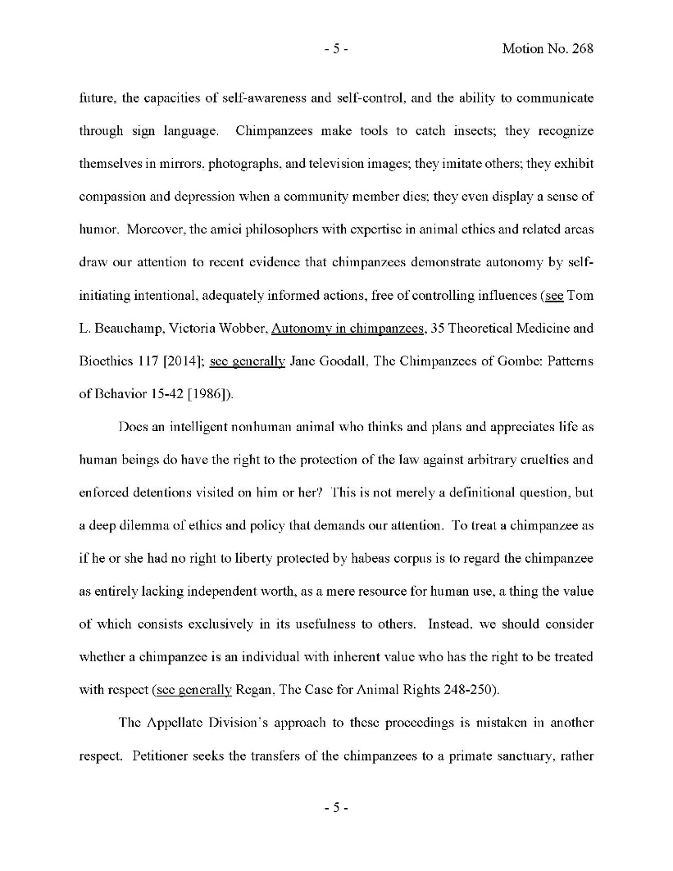
Nonhuman Rights Project, Inc., on Behalf of Tommy v. Lavery,
31 N.Y.3d 1054 (May 8, 2018) (“Tommy”) (Eugene Fahey, J., concurring)

Slide 30
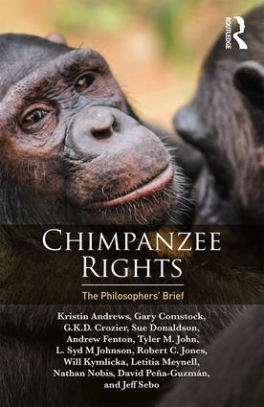
“We write as a diverse group of philosophers who share the conviction that if the concept of ‘personhood’ is being employed by the courts to determine whether to extend or deny the writs of habeas corpus, they should employ a consistent and reasonable definition of ‘personhood’ and ‘persons.’ We believe that the previous judgements offered by the Third, Fourth, and First Departments of the Appellate Division of the New York Supreme Court applied inconsistent definitions of ‘personhood.’”

Slide 31
Nonhuman Rights Project, Inc., on Behalf of Tommy v. Lavery,
31 N.Y.3d 1054 (May 8, 2018) (“Tommy”) (Eugene Fahey, J., concurring)

Slide 32
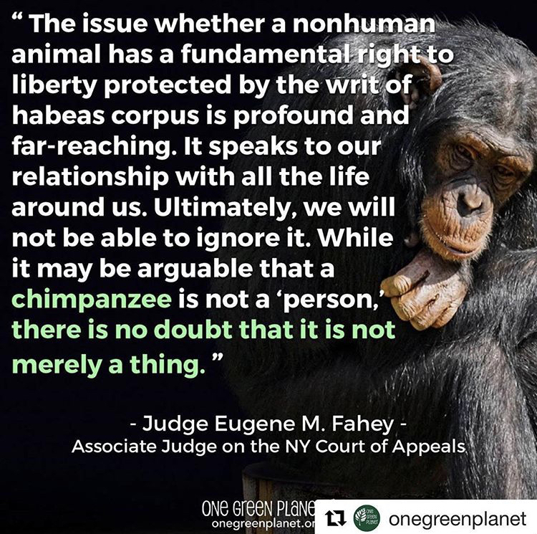

Slide 34
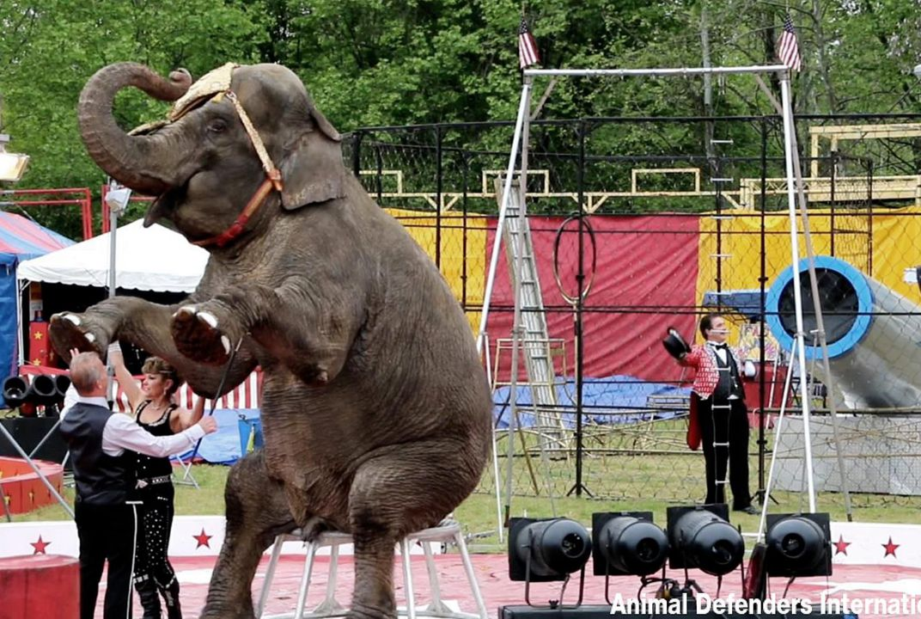
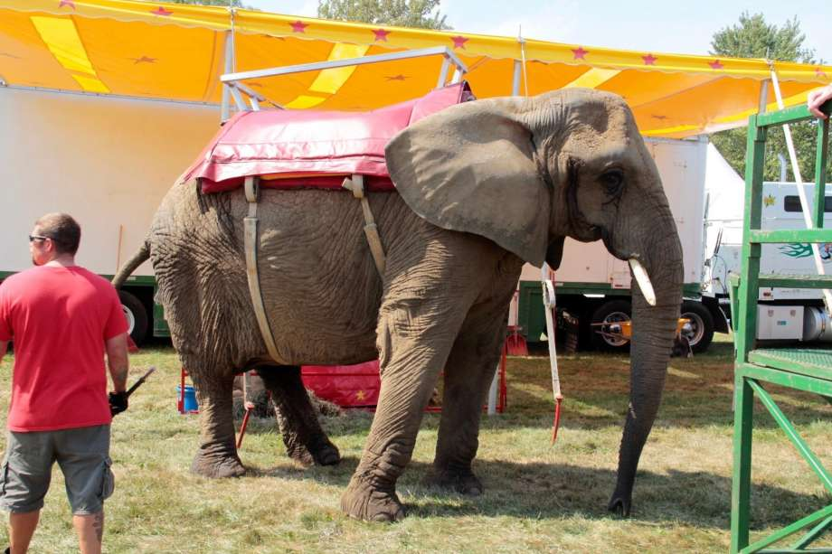

Slide 35
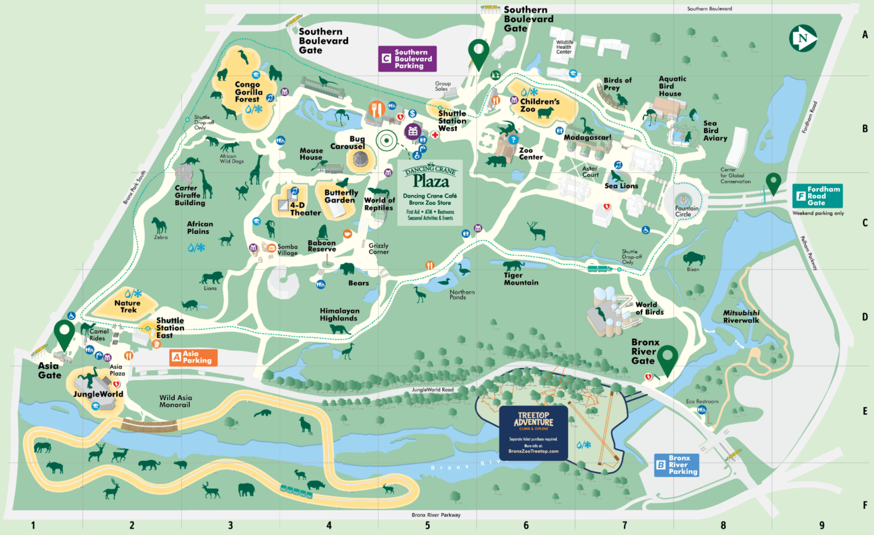
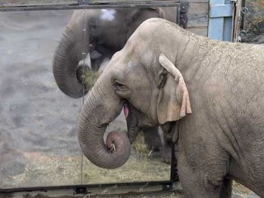

Slide 36
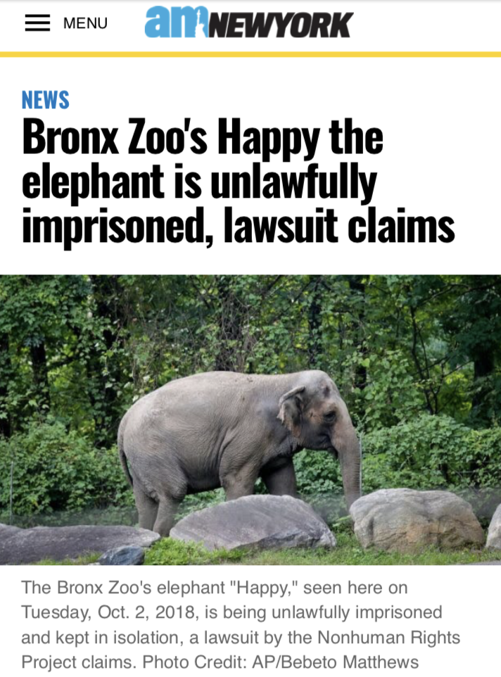
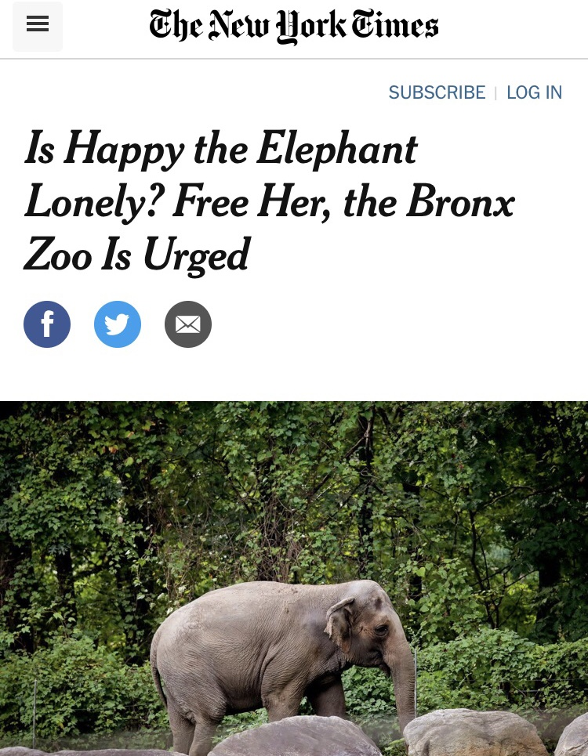
Armed with Judge Fahey’s concurring opinion, as well as another recent case from an upstate New York appellate court referring to the personhood of nonhuman animals as a matter of “common knowledge” (People v. Graves), the NhRP filed a habeas petition for Happy on October 2, 2018.

Slide 38
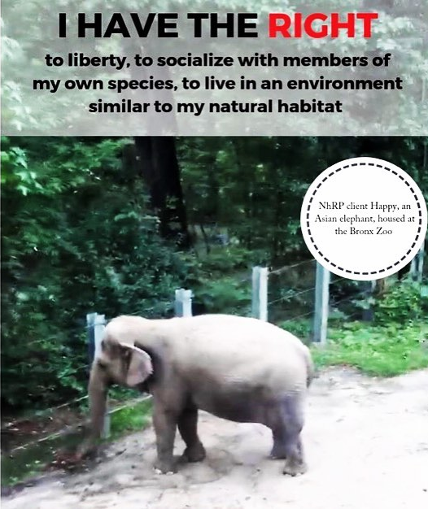
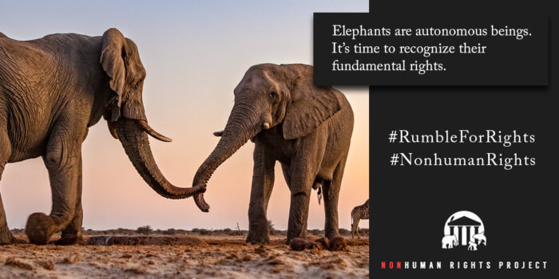

Slide 39
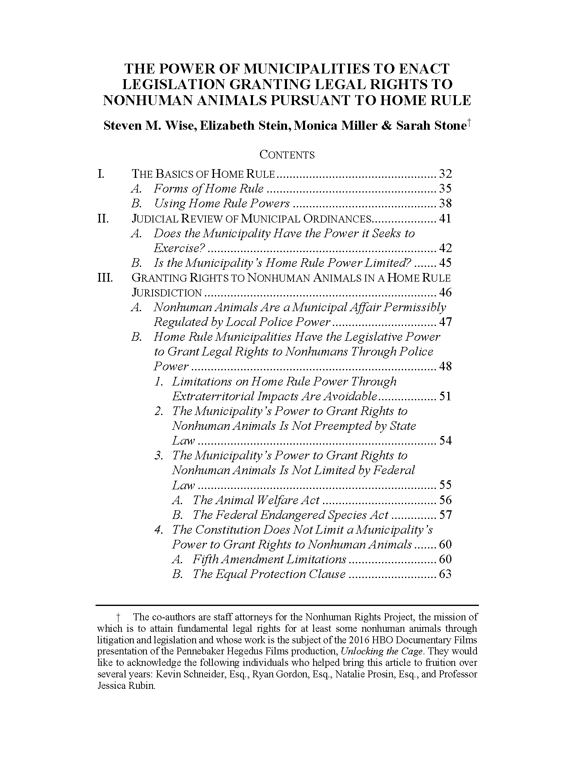
We will launch a campaign for the world’s first nonhuman animal rights ordinance in a major US city in 2019.
It will seek rights to bodily liberty and bodily integrity for chimpanzees and elephants, much the same we are seeking through our lawsuits.

Slide 40
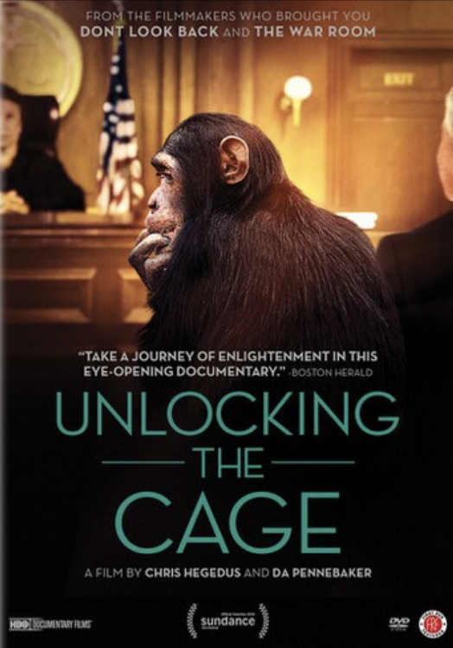
Our work is the subject of the 2016 Pennebaker Hegedus/HBO documentary film Unlocking the Cage, which has been seen by millions around the world.

Slide 41
We work with lawyers in over a dozen countries assisting them finding ways to work within their legal systems to create meaningful rights for nonhuman animals in their countries.
In Argentina in 2016, a court declared Cecilia, a chimpanzee, a “nonhuman legal person” and order her sent to a sanctuary.
In 2014, the Indian Supreme Court recognized the personhood (if not the rights) of all nonhuman animals in the country.
Around the world, rivers, national parks, and recently in Colombia the Amazon rainforest have been declared “legal persons” with rights.

Slide 42
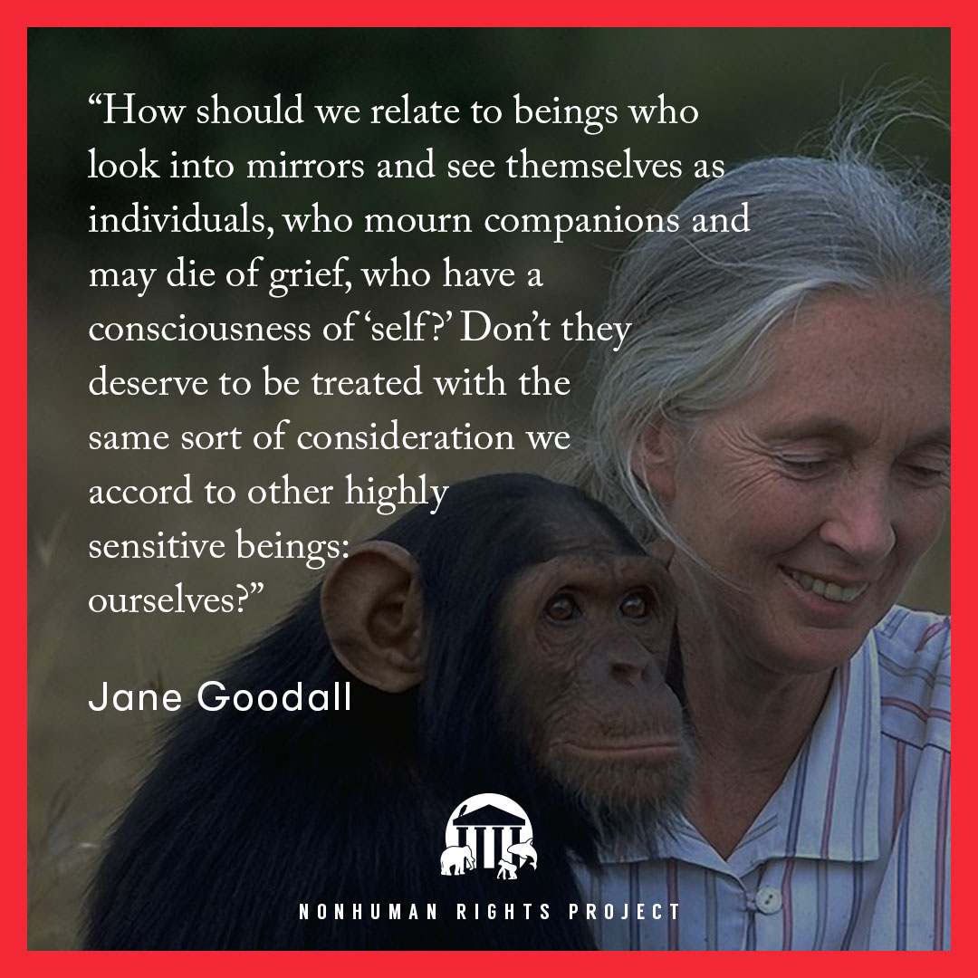

Slide 43
www.nonhumanrights.org
Kindly consider joining our email list and making a donation to support our work!
kschneider@nonhumanrights.org
@nonhumanlawyer

