Slide 1
Look Away
Water quality and a changing planet
By Keith W. Rizzardi

Slide 2
Look away (Limony Snicket/Netflix)
This show will wreck your evening,
your whole life and your day, every single episode is nothing but dismay…
Notes:
FOR PRESENTATION ONLY
Limony Snicket, in A Series of Unfortunate Events

Slide 3
Coastal adaptation?
The first step in problem solving is…
Recognition.

Slide 4
Storms are coming (Washington Post / NOAA)
Notes:
Bomb cyclone

Slide 5
Hurricanes are coming (abc-10)

Slide 6
Migration is coming (Pew Charitable Trusts)
Notes:
Biliana warned us that the oceans are changing

Slide 7
Extinction is coming (EPA)
Notes:
Reefs are habitat for 25% of ocean diversity

Slide 8
Algae is coming (RICHARD GRAULICH AP)
Notes:
FOR PRESENTATION ONLY

Slide 9
Int’l Law (WorldWaterDay 2018)

Slide 10
A human right (UN CESCR 2002)
Water is a limited natural resource and a public good fundamental for life and health.
The human right to water is indispensable for leading a life in human dignity.
Notes:
Committee on Economic, Social and Cultural Rights (2002). Right to Water, General Comment No. 15, 20 January 2003, E/C.12/2002/11 (Geneva: CESCR) at paragraph 1.

Slide 11
The right to clean H2o
The water required for each personal or domestic use must be safe…
…free from micro-organisms, chemical substances and radiological hazards that constitute a threat to a person’s health.

Slide 12
The right to know
To protect people from “unsafe and toxic” water conditions…
states should “monitor and combat situations where aquatic ecosystems serve as a habitat for vectors of diseases wherever they pose a risk to human living environments.”

Slide 13
USA: Look away (deny)
The United States does not share the view that a “right to water” exists under international human rights law.
Views of the United States of America on Human Rights and Access to Water Submitted to the Office of the United Nations High Commissioner for Human Rights (June 2007)

Slide 14
Yes, a human right!
We hereby recognize “the right to safe and clean drinking water and sanitation as a human right that is essential for the full enjoyment of life and all human rights”
Resolution 64/292, General Assembly, Sixty-fourth session, 108th plenary meeting (Wed., 28 July 2010, 10 a.m.)
Notes:
called upon the international community to “to scale up efforts to provide safe, clean, accessible and affordable drinking water and sanitation for all.”

Slide 15
USA: Look away (abstain)
“there is no right to water and sanitation in an international legal sense as described by the draft resolution.”
In notes of General Assembly, while abstaining from voting on the Resolution 64/292

Slide 16
Clean Water Act 33 U.S.C. §1251
The objective of this chapter is to restore and maintain the chemical, physical, and biological integrity of the Nation’s waters.
it is the national policy that the discharge of toxic pollutants in toxic amounts be prohibited

Slide 17
Water quality monitoring 33 U.S.C. §1254
States and federal agencies shall “establish, equip, and maintain a water quality surveillance system for the purpose of monitoring the quality of the navigable waters ...”

Slide 18
Water quality monitoring 33 U.S.C. §1256(e)
(e) Grants prohibited to States not establishing water quality monitoring procedures or adequate emergency and contingency plans…
Notes:
The Administrator shall not make any grant under this section to any State which has not provided or is not carrying out …
(1) … procedures necessary to monitor, and to compile and analyze data on… the quality of navigable waters…

Slide 19
EPA Guidance (2003)
Elements of a State Water Quality Monitoring and Assessment Program
Notes:
According to EPA, a water quality monitoring plan should focus on five questions:
1. What is the overall quality of waters in the State?
2. To what extent is water quality changing over time?
3. What are the problem areas and areas needing protection?
4. What level of protection is needed?
5. How effective are clean water projects and programs?

Slide 20
EPA: look away
“It is not EPA's intent to use the Elements document to withhold a State's Section 106 grant funds”
Transmittal Letter, Diane C. Regas, James A. Hanlan, Elements of a State Water Monitoring and Assessment Program, U.S. Environmental Protection Agency (Mar. 14, 2003).
Notes:
Avoiding enforcement

Slide 21
Florida Law (Ch. 373)
Water quality must be:
“considered”
“adequately and accurately monitored,”
“using methods determined by the applicable water management district”
that otherwise “ensure protection” of a resource
or are “appropriate.”

Slide 22
Florida Law (Ch. 373)
statewide program to manage total maximum daily loads is discretionary by must include monitoring that is
“sufficient”
to evaluate “reasonable progress”
and “as appropriate”

Slide 23
FDEP: look away
Implementation, in accordance with rules adopted under this paragraph, of practices that have been initially verified to be effective, or verified to be effective by monitoring at representative sites, by the department, shall provide a presumption of compliance with state water quality standards …
Sec. 403.067(7)(c)3., Fla. Stat.
Notes:
Intentional ignorance

Slide 24
Presume compliance
Implementation [of approved best management practices] shall provide a presumption of compliance with state water quality standards and release from the provisions of s. 376.307(5) for those pollutants addressed by the practices…
Sec. 403.067(7)(c)3., Fla. Stat.
Notes:
Intentional ignorance

Slide 25
Presume compliance
i. A landowner, discharger, or other responsible person who is implementing applicable management strategies specified in an adopted basin management action plan may not be required by permit, enforcement action, or otherwise to implement additional management strategies, including water quality credit trading, to reduce pollutant loads to attain the pollutant reductions established pursuant to subsection (6) and shall be deemed to be in compliance with this section.
Sec. 403.067(7)(c)3., Fla. Stat.
Notes:
Intentional ignorance

Slide 26
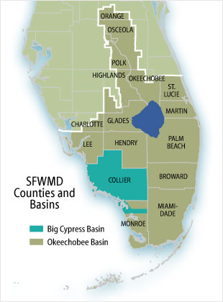
SFWMD: Look away

Slide 27
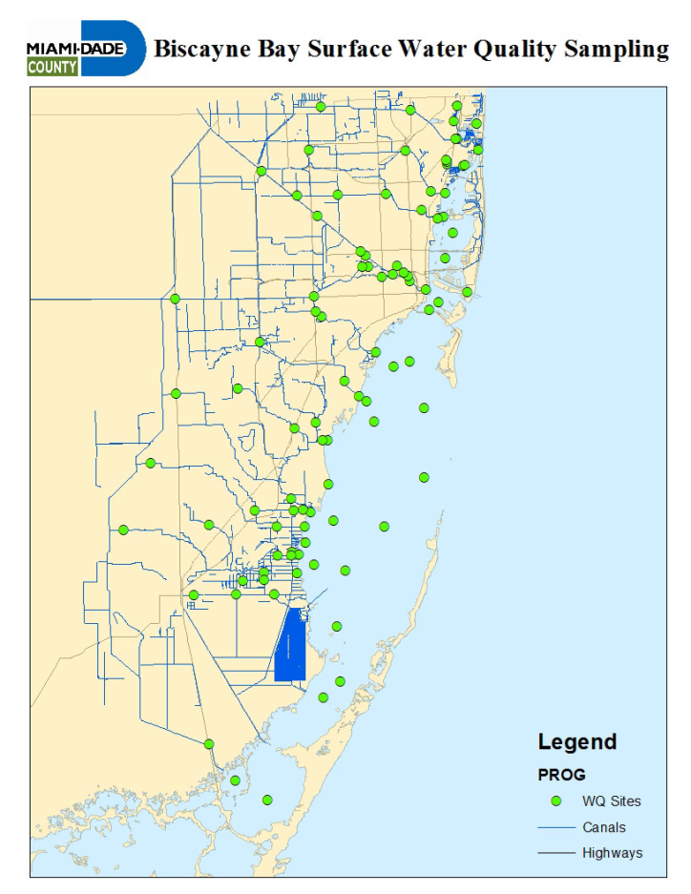
Fewer stations
Notes:
Major article by Miami Herald (2018)

Slide 28
Lower budgets

Slide 29
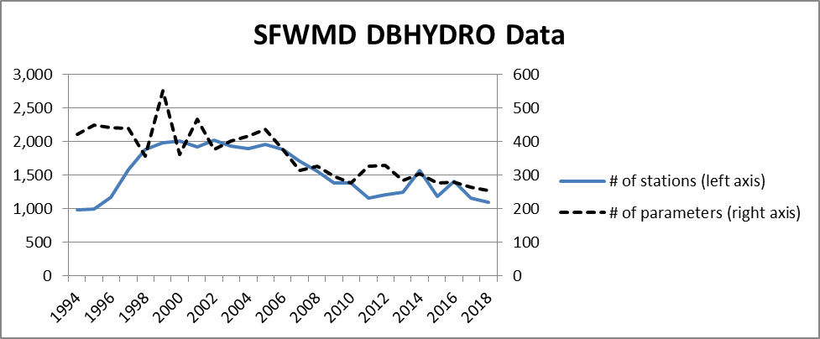
Less data

Slide 30
Citizen monitoring (Palm Beach Post / Angari Foundation)
Notes:
FOR PRESENTATION ONLY

Slide 31
Citizen monitoring (Minnesota Pollution Control Agency)

Slide 32
Virginia: Look away
“The results of such citizen monitoring shall not be used as evidence in any enforcement action.”
Virginia, VA Code Ann. § 62.1-44.19:11

Slide 33
Oregon: look away
“The State Marine Board shall not instruct a volunteer group or any member thereof participating in the Oregon Adopt-a-River Program in the measurement of water quality, encourage any participant to measure water quality or include the measuring of water quality in the duties of any participant.”
O.R.S. § 830.055(12)

Slide 34
Algae is coming (RICHARD GRAULICH AP)
Notes:
FOR PRESENTATION ONLY

Slide 35
Change is coming (Margo Robinson / WPBF)
Notes:
FOR PRESENTATION ONLY

Slide 36
Are we looking away?
Kelly Hanna
Michael Scognomillo
Kaitlyn Smith

Slide 37
Kelly: the pollution is coming (NASA)
Notes:
Pig farms

Slide 38
Michael: the insects are coming (EPA)
Notes:
mosquitos

Slide 39
Kaitlyn: the salt water is coming (Woods Hole)

Slide 40
Jan McDonald: the ocean is coming (Federation Press)

Slide 41
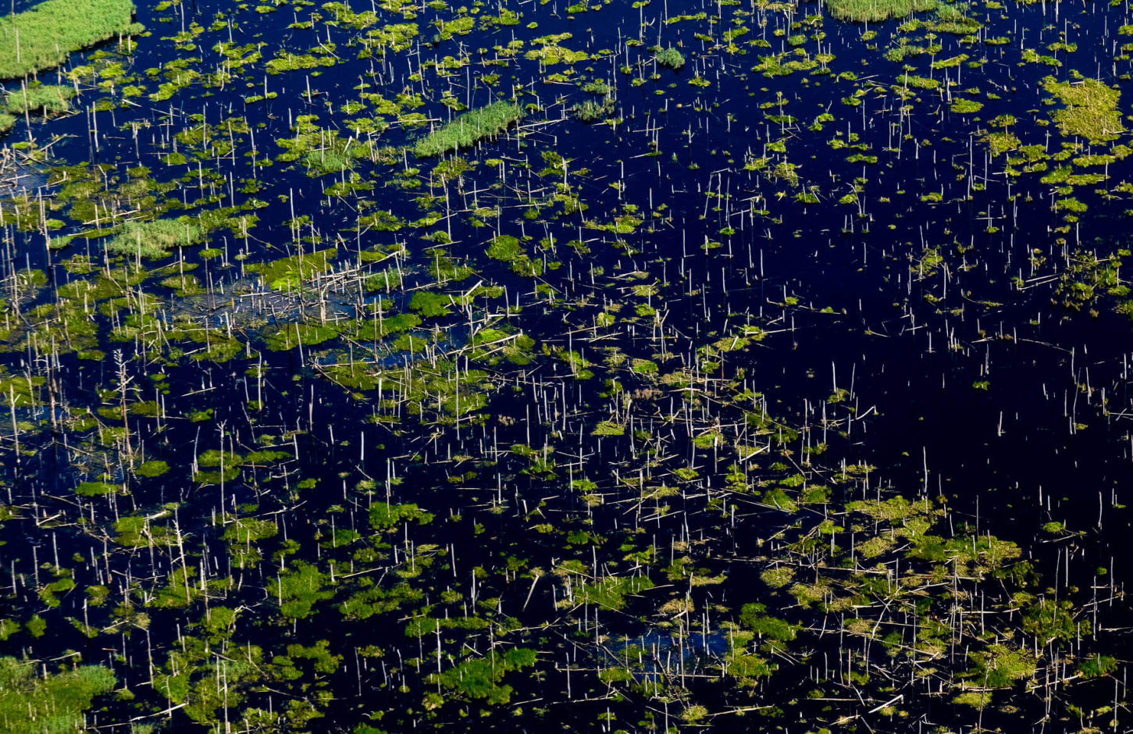
Change is coming

Slide 42
Change is coming (NOAA Lake Erie)

Slide 43
Climate change: THE series of unfortunate events (Limony Snicket/Netflix)
Notes:
FOR PRESENTATION ONLY
Limony Snicket, in A Series of Unfortunate Events

Slide 44
Look away?

Slide 45
We are the VFD
Participate & Educate
Insist on Investment
Don’t look away
Notes:
Participate in the process Know local needs
Educate, volunteer & vote
Insist on investment Don’t accept denial
don’t look away

Slide 46
Regional Climate Action Plan Building Codes Procurement Policies Summits and Workshops Unified Science Reports

Slide 47
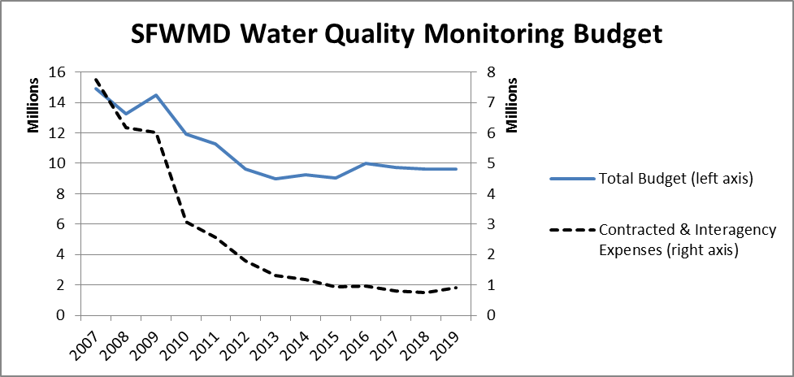
Bigger budgets

Slide 48
More data

Slide 49
A new model code?

Slide 50
We have a duty to look
Notes:
FOR PRESENTATION ONLY
We are the volunteer fire department.

Slide 51
@keithinking
WATER POLLUTION AND THE DUTY TO KNOW forthcoming in Sea Grant Law Journal (Fall 2019)

Slide 52
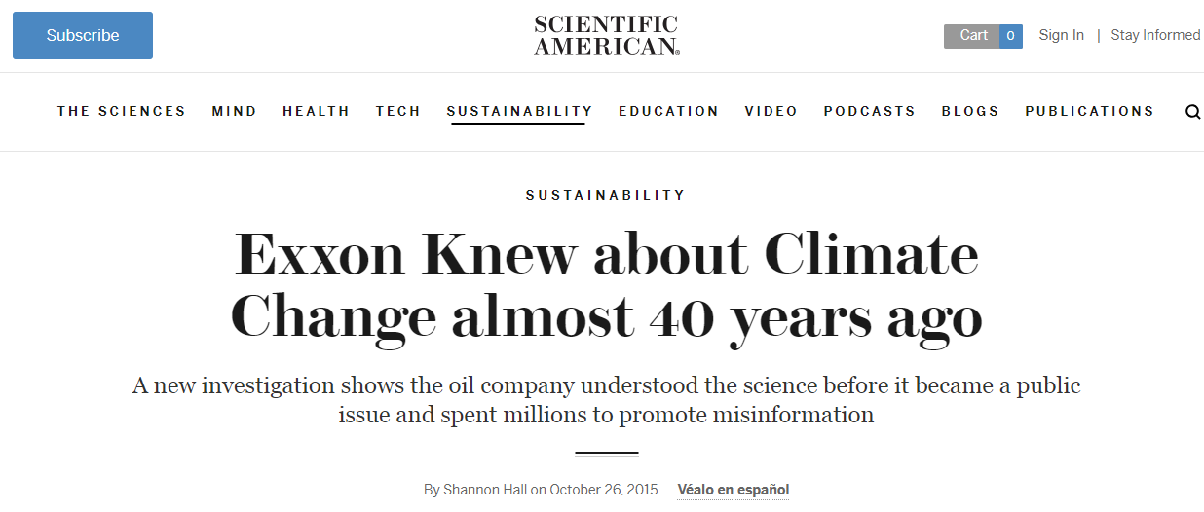

Slide 53
Look away

Slide 54
Winter is coming (Game of Thrones/HBO)
Notes:
FOR PRESENTATION ONLY

Slide 55
Look away? (Game of Thrones, HBO)
Notes:
FOR PRESENTATION ONLY

