Slide 2
Global responsible intergenerational leadership
Julia M. Puaschunder
10/5/2017

Slide 3
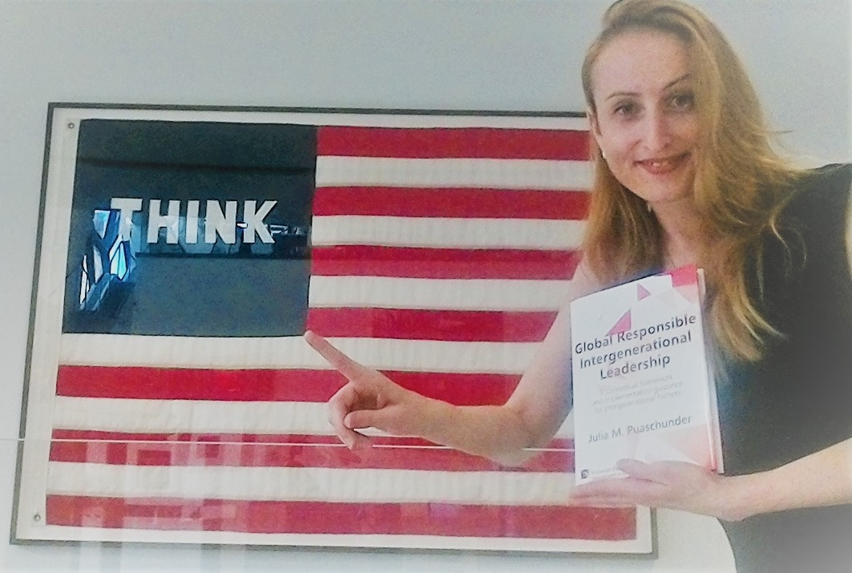
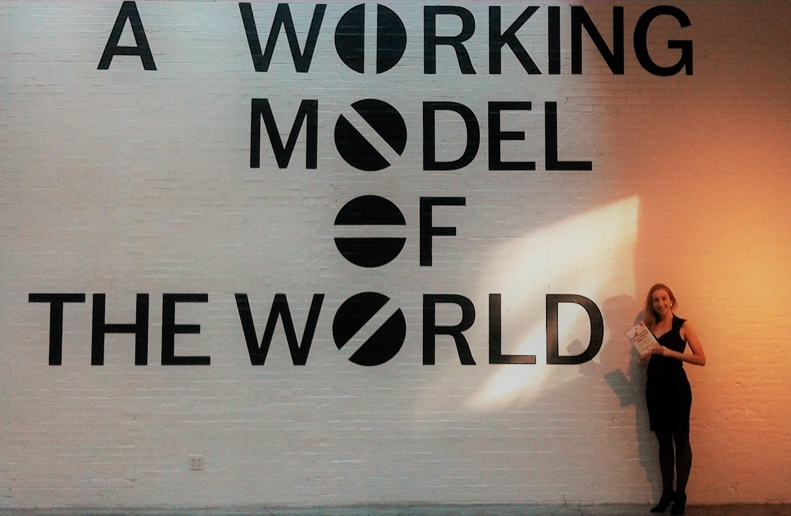

Slide 4
Intergenerational Equity as Natural Behavioral Law
Intergenerational equity
Future at least as favorable standard of living as today

Slide 5
Intergenerational Equity as Natural Behavioral Law
Intergenerational equity
Future at least as favorable standard of living as today
Intergenerational equity as natural behavioral law

Slide 6
Intergenerational Equity as Natural Behavioral Law
Intergenerational equity
Future at least as favorable standard of living as today
Intergenerational equity as natural behavioral law
Globalization: Emergent risks
Puaschunder, 2015

Slide 7
Social representations of intergenerational equity
External shocks’ impact on society
Kirchler, 2011; Moscovici, 1961, 1963, 1984; Puaschunder, 2015

Slide 8
Social representations of intergenerational equity
External shocks’ impact on society
Future conference: Justice: Responsibility for Future (2011)
(n=110 experts; 48,460 words)
Kirchler, 2011; Moscovici, 1961, 1963, 1984; Puaschunder, 2015

Slide 9
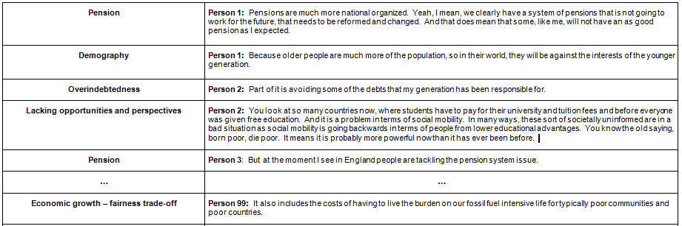
Social representations of intergenerational equity
External shocks’ impact on society
Future conference: Current intergenerational equity
constraints (n=110 experts; 48,460 words)
What do you think about ‘Intergenerational Equity’?
Kirchler, 2011; Moscovici, 1961, 1963, 1984; Puaschunder, 2012

Slide 10
n=110 experts, European Forum Alpbach Absolute frequencies of categories in speeches/interviews comprising 48,460 words

Slide 11
n=110 experts, European Forum Alpbach Absolute frequencies of categories mentioned in speeches/interviews comprising 48,460
http://www.usdebtclock.org/

Slide 12
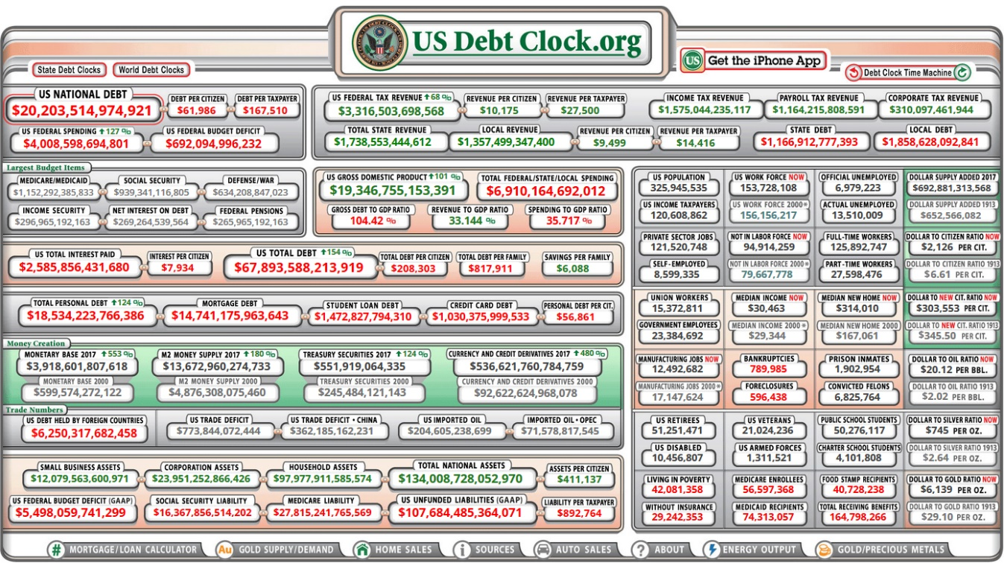
n=110 experts, European Forum Alpbach Absolute frequencies of categories mentioned in speeches/interviews comprising 48,460
http://www.usdebtclock.org/

Slide 13
n=110 experts, European Forum Alpbach Absolute frequencies of categories mentioned in speeches/interviews comprising 48,460

Slide 14
Social representations of intergenerational equity
Intergenerational equity constraints per stakeholder group
Kirchler, 2011; Moscovici, 1961, 1963, 1984

Slide 15
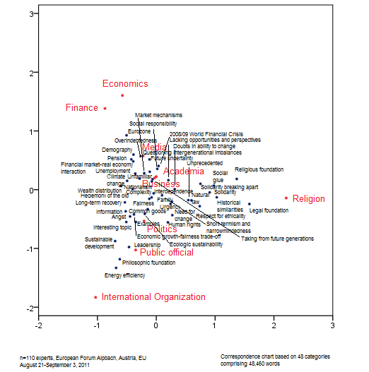
Current intergenerational equity constraints
Correspondence Chart

Slide 16
Intergenerational imbalances – Solution
Voice unborn
International solutions
→ global capitalism reform to form
Inclusive societies and stable economies
Top-down institutionalism
Bottom-up democracy-in-action
Academic & legal writing
Binder et al., 2014; Heldo & McGrew, 2007; Panitch & Gindin, 2012; Shaikh, 2016

Slide 17
Mapping Climate Justice

Slide 18
Mapping Climate Justice - Maps
Fairness within country
Progressive tax
Should we tax former world inhabitants?
inheritance tax to reap wealth built on past pollution

Slide 19
Mapping Climate Justice
Fairness within country
Progressive tax
Should we tax former world inhabitants?
inheritance tax to reap wealth built on past pollution
Fairness between country
Private property or common good
→ Public access to stable climate trumps
Corporate taxation justification
Governments with better ability to protection and conservation have higher responsibility to carry burden

Slide 20
Mapping Climate Justice
Fairness within country
Progressive tax
Should we tax former world inhabitants?
inheritance tax to reap wealth built on past pollution
Fairness between country
Private property or common good
→ Public access to stable climate trumps
Corporate taxation justification
Governments with better ability to protection and conservation have higher responsibility to carry burden
Fairness over time
Climate change burden sharing with bonds
Gestalt: Whole > Σ parts over time: tipping points & irreversible lock-ins

Slide 21
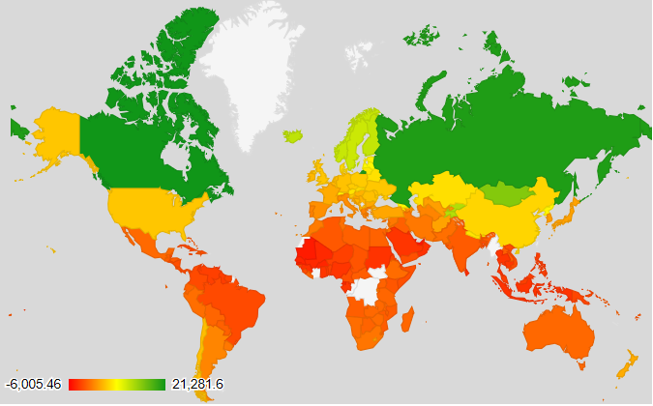
Climate change winners and losers web

Slide 22
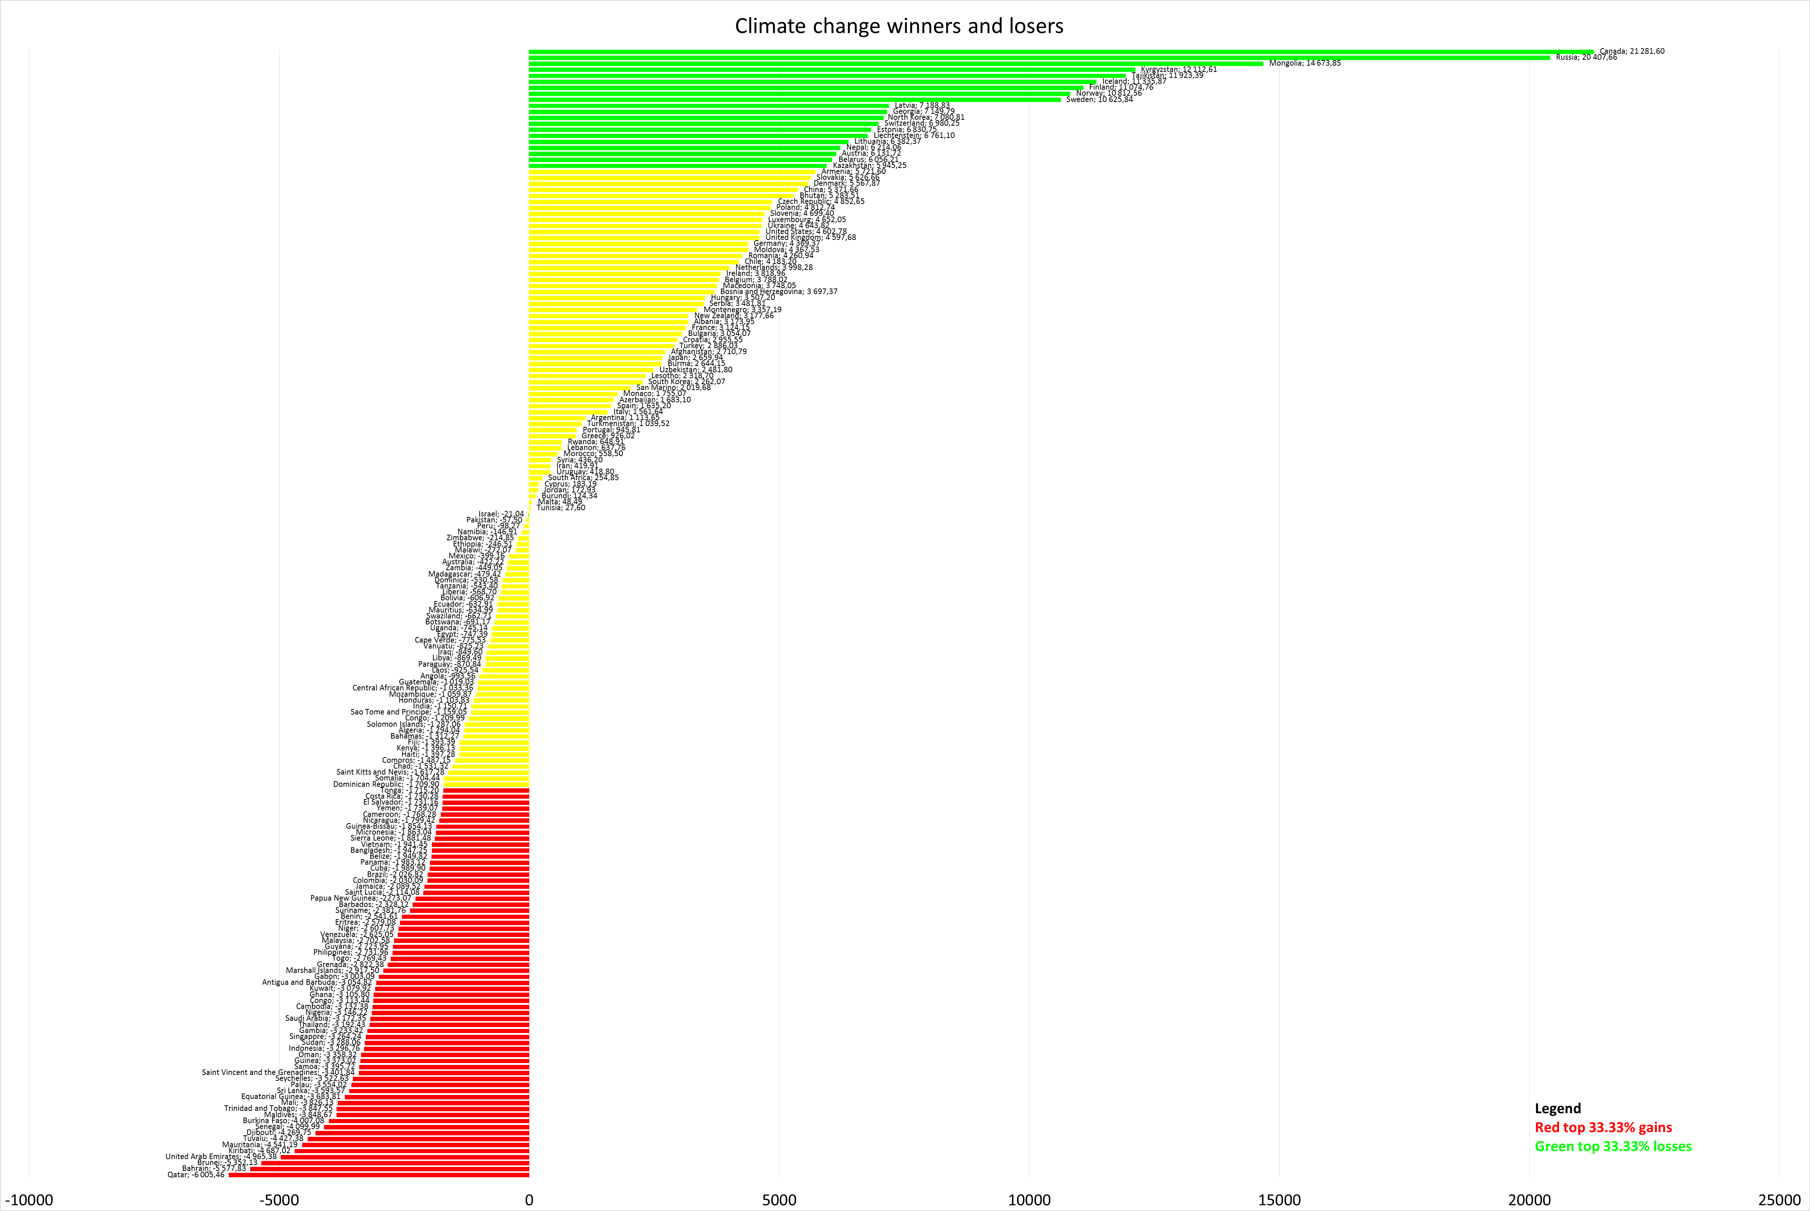
Climate change benefits

Slide 23
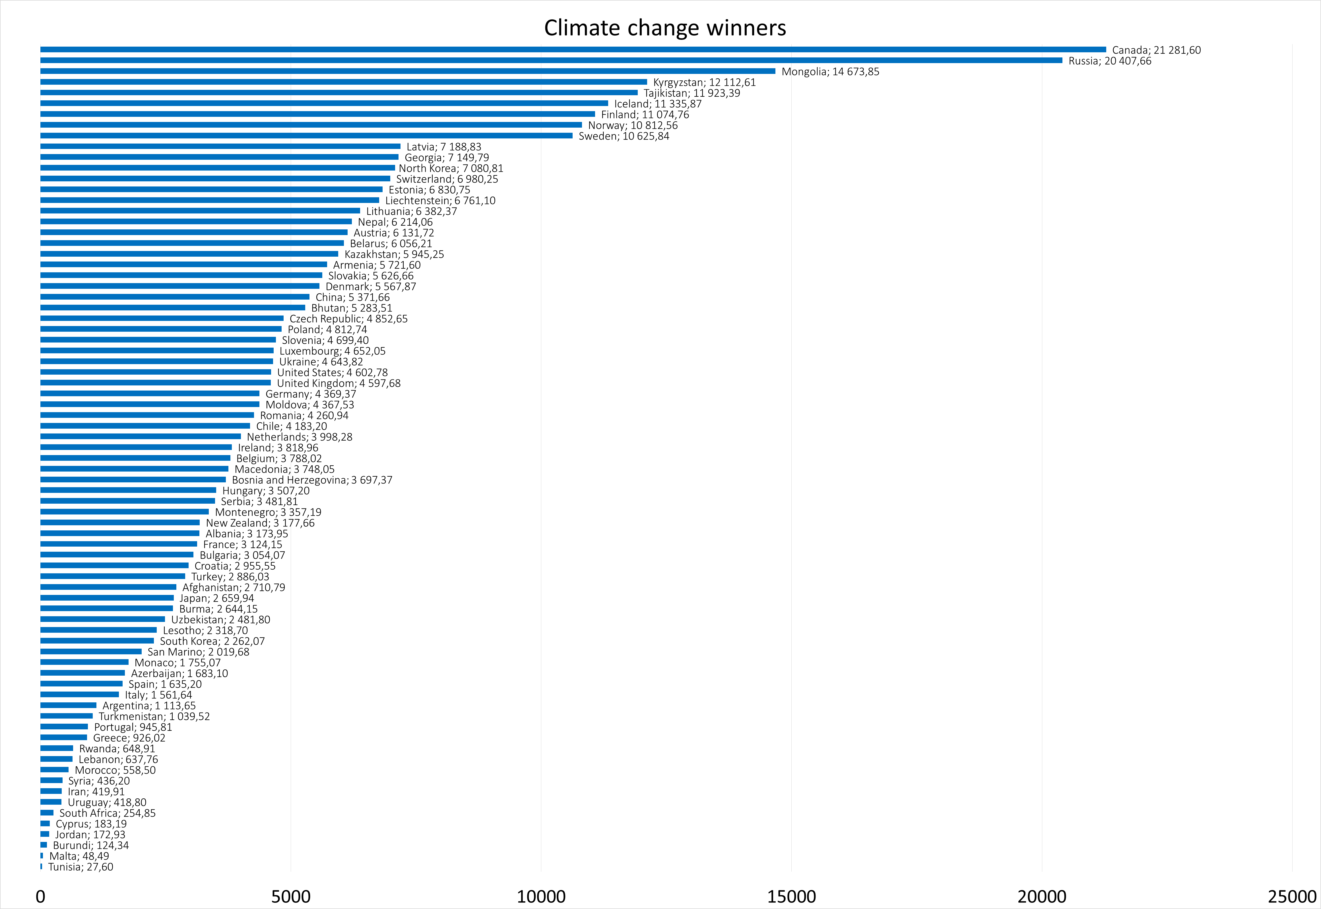
Climate change winners

Slide 24
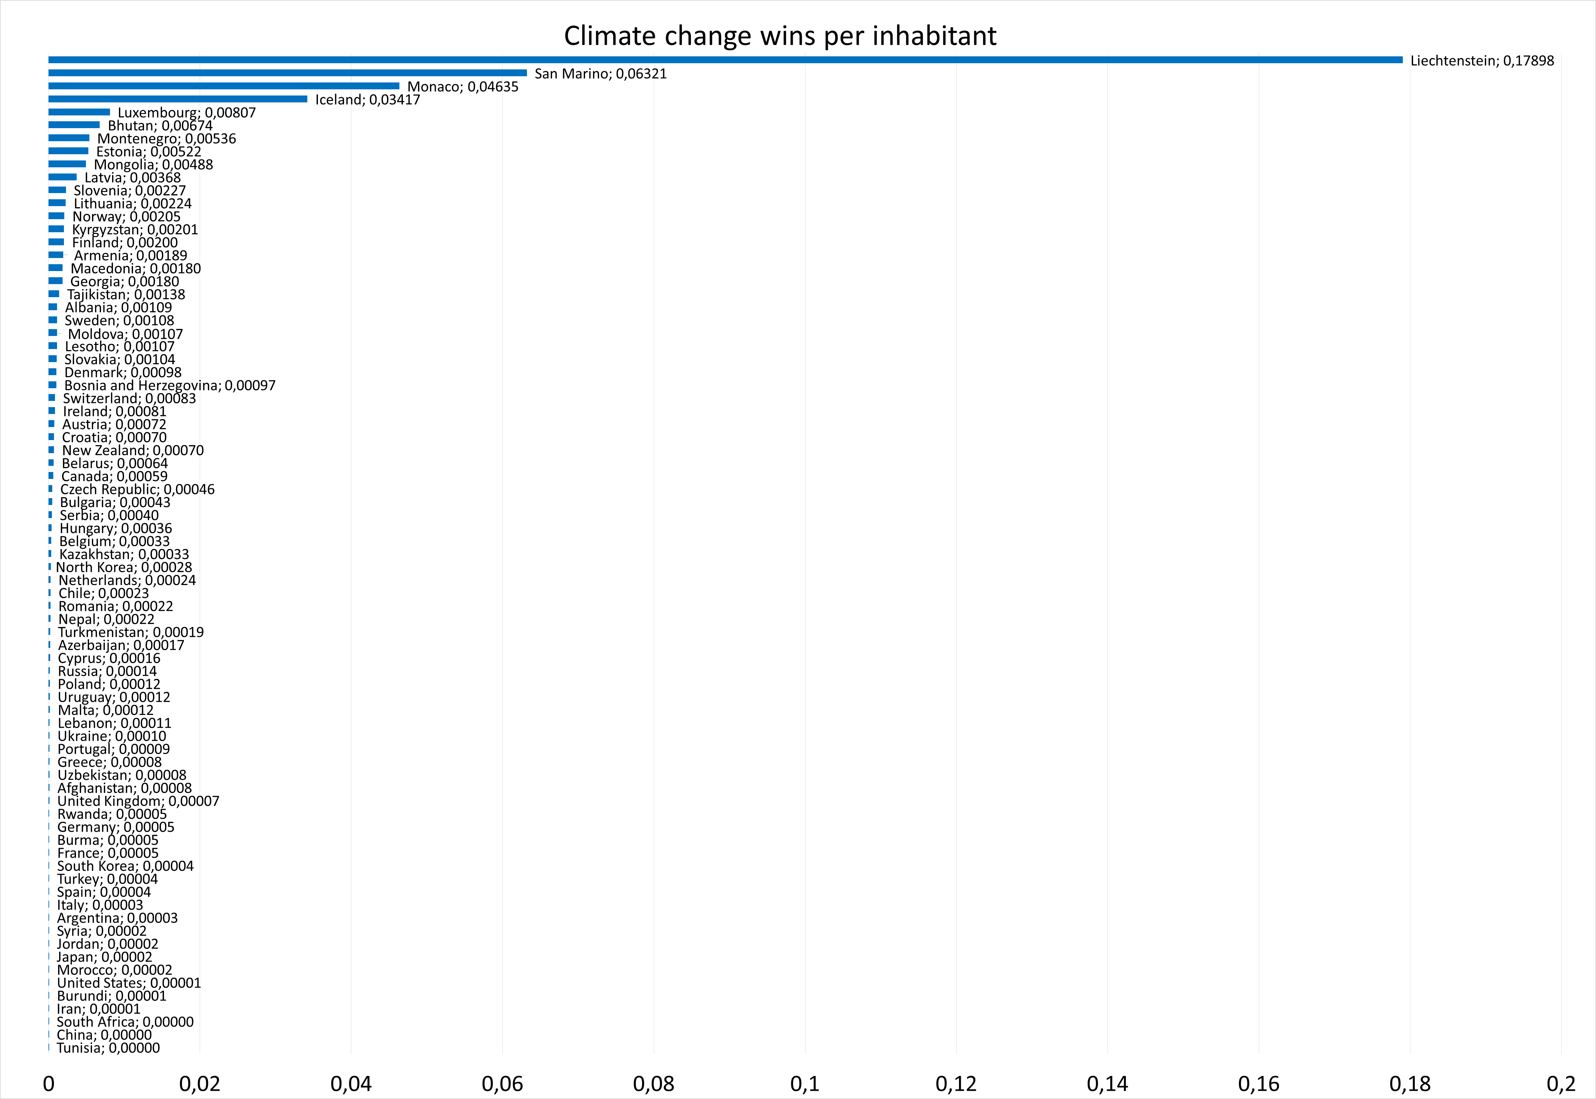
Climate change winners per capita

Slide 25
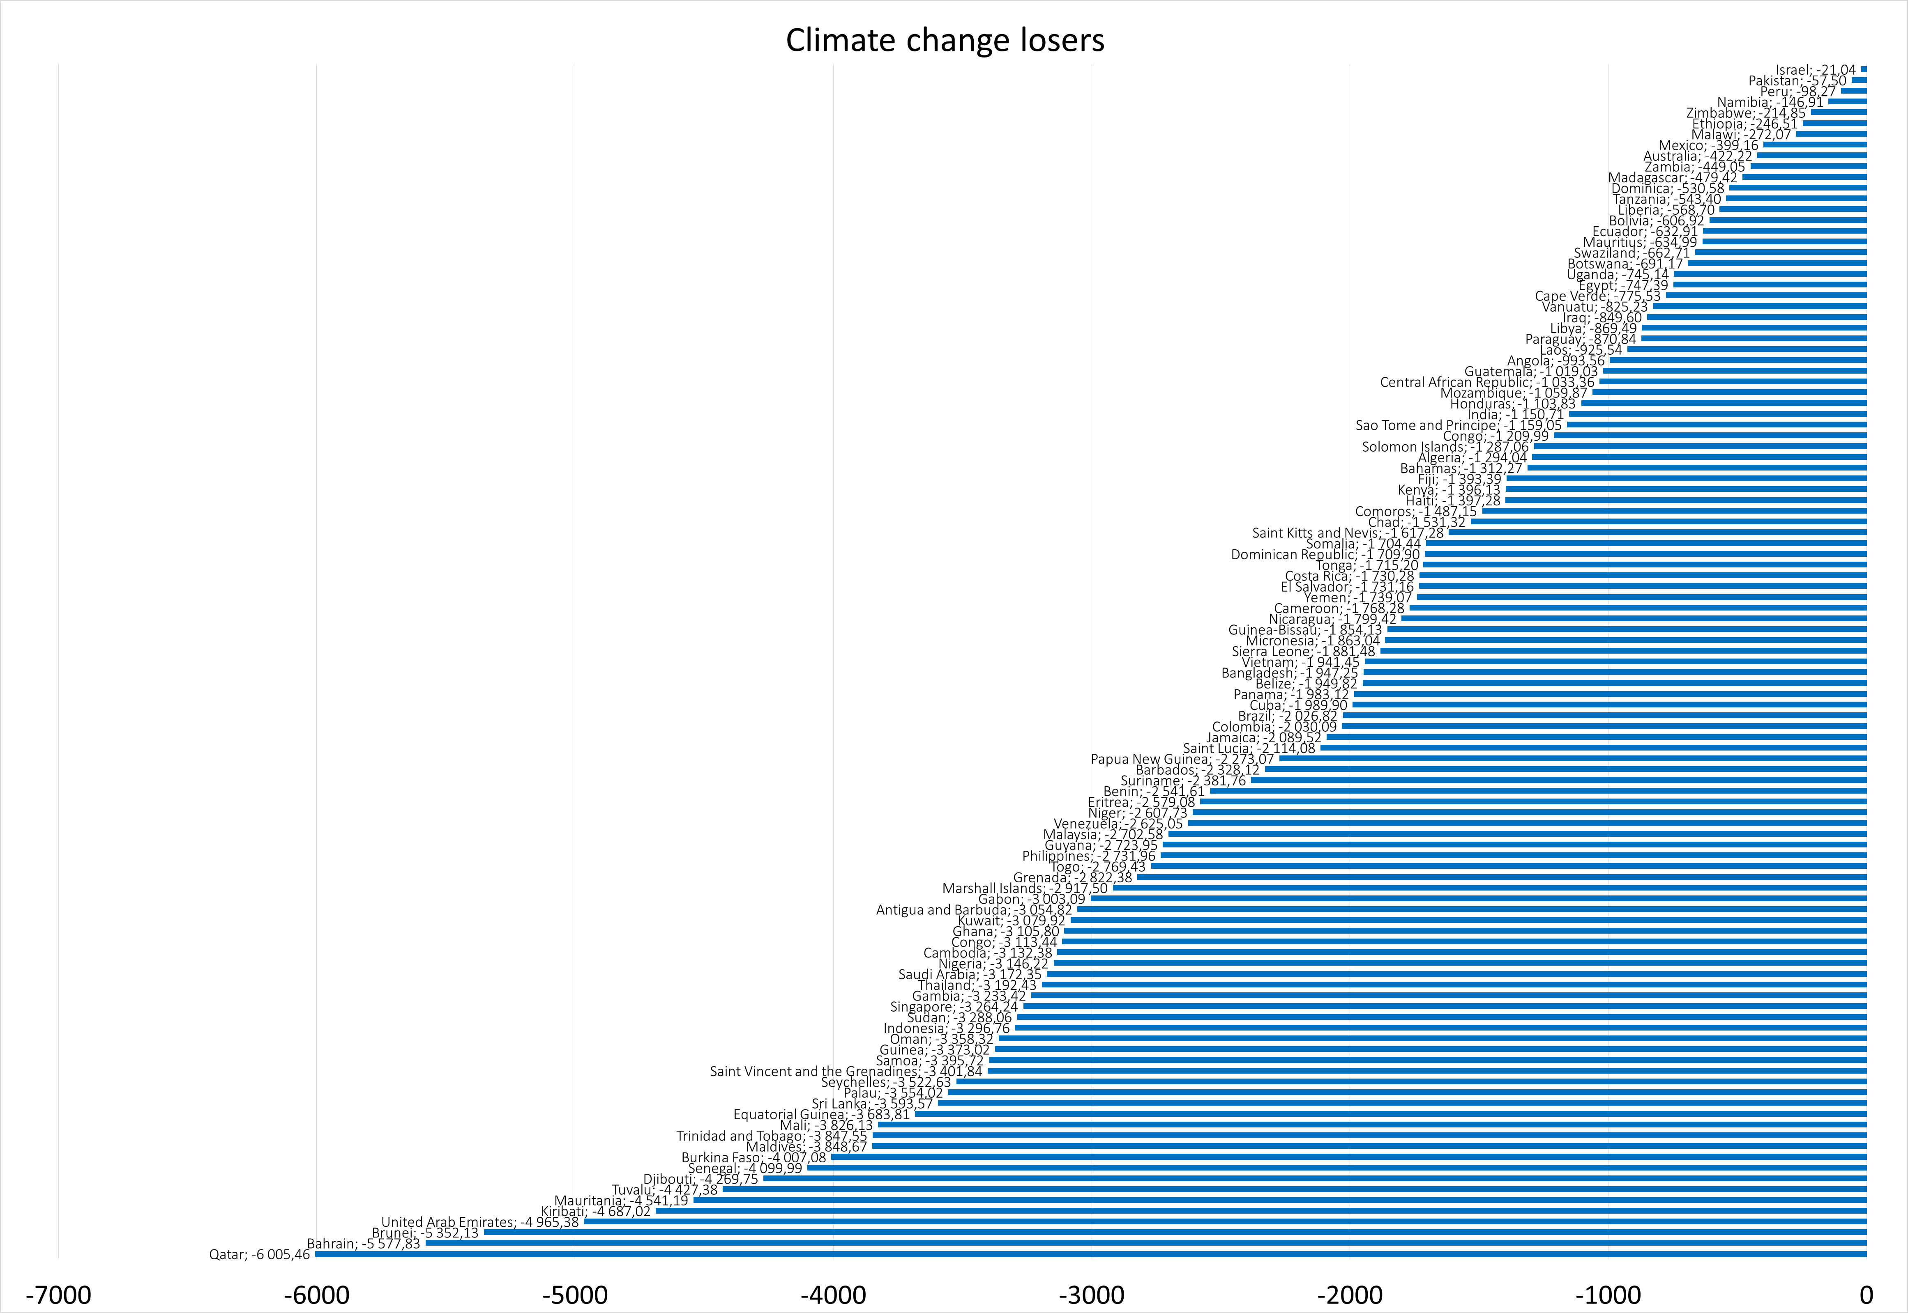
Climate change losers

Slide 26
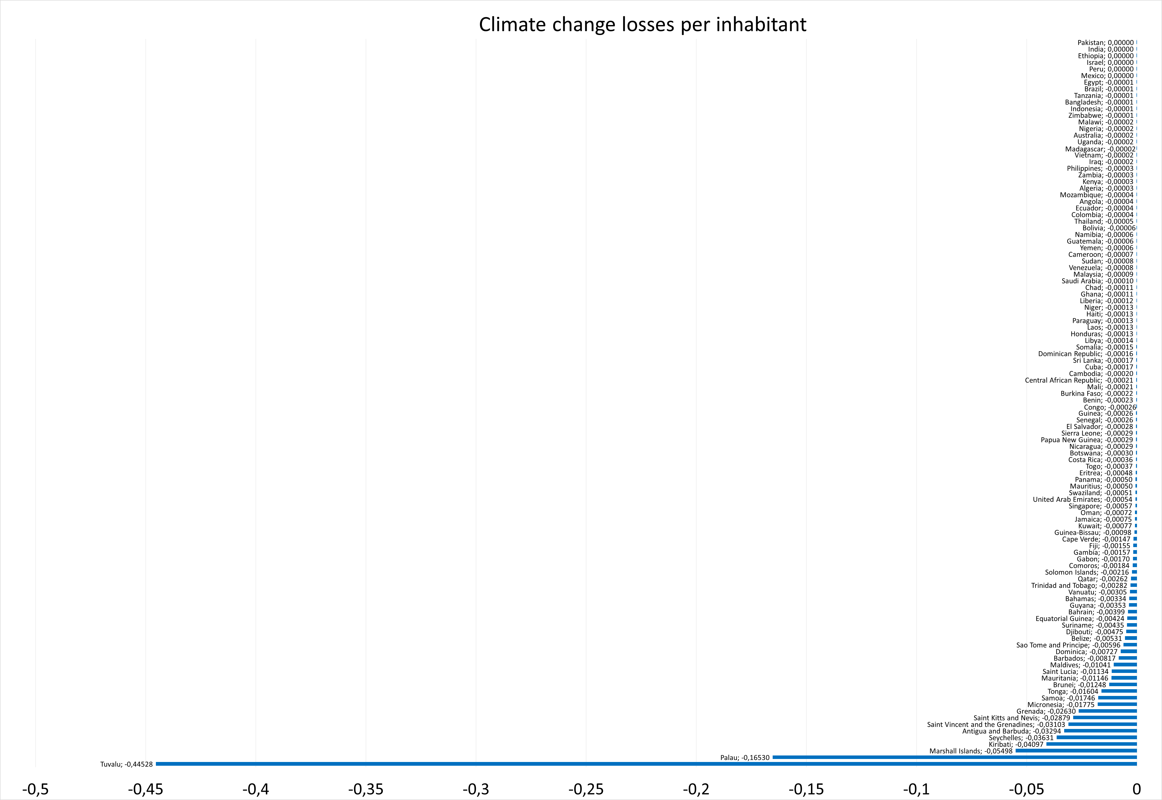
Climate change losses per capita

Slide 27
Climate gain loss perspective emission connection

Slide 28
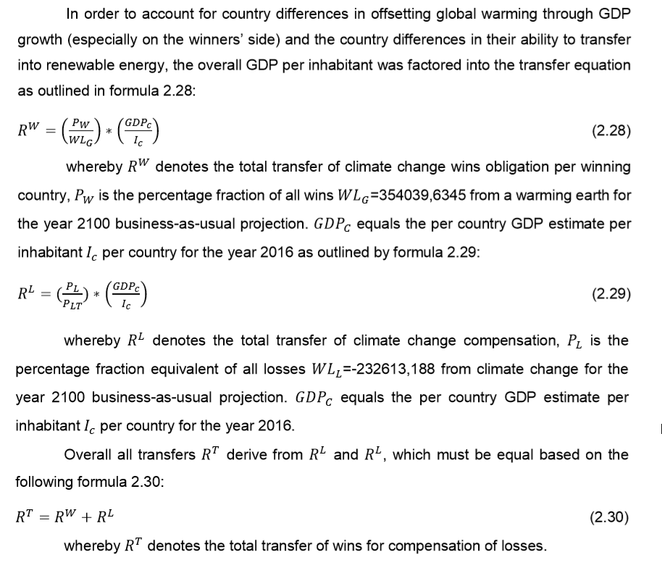
Climate change benefits transfers

Slide 29
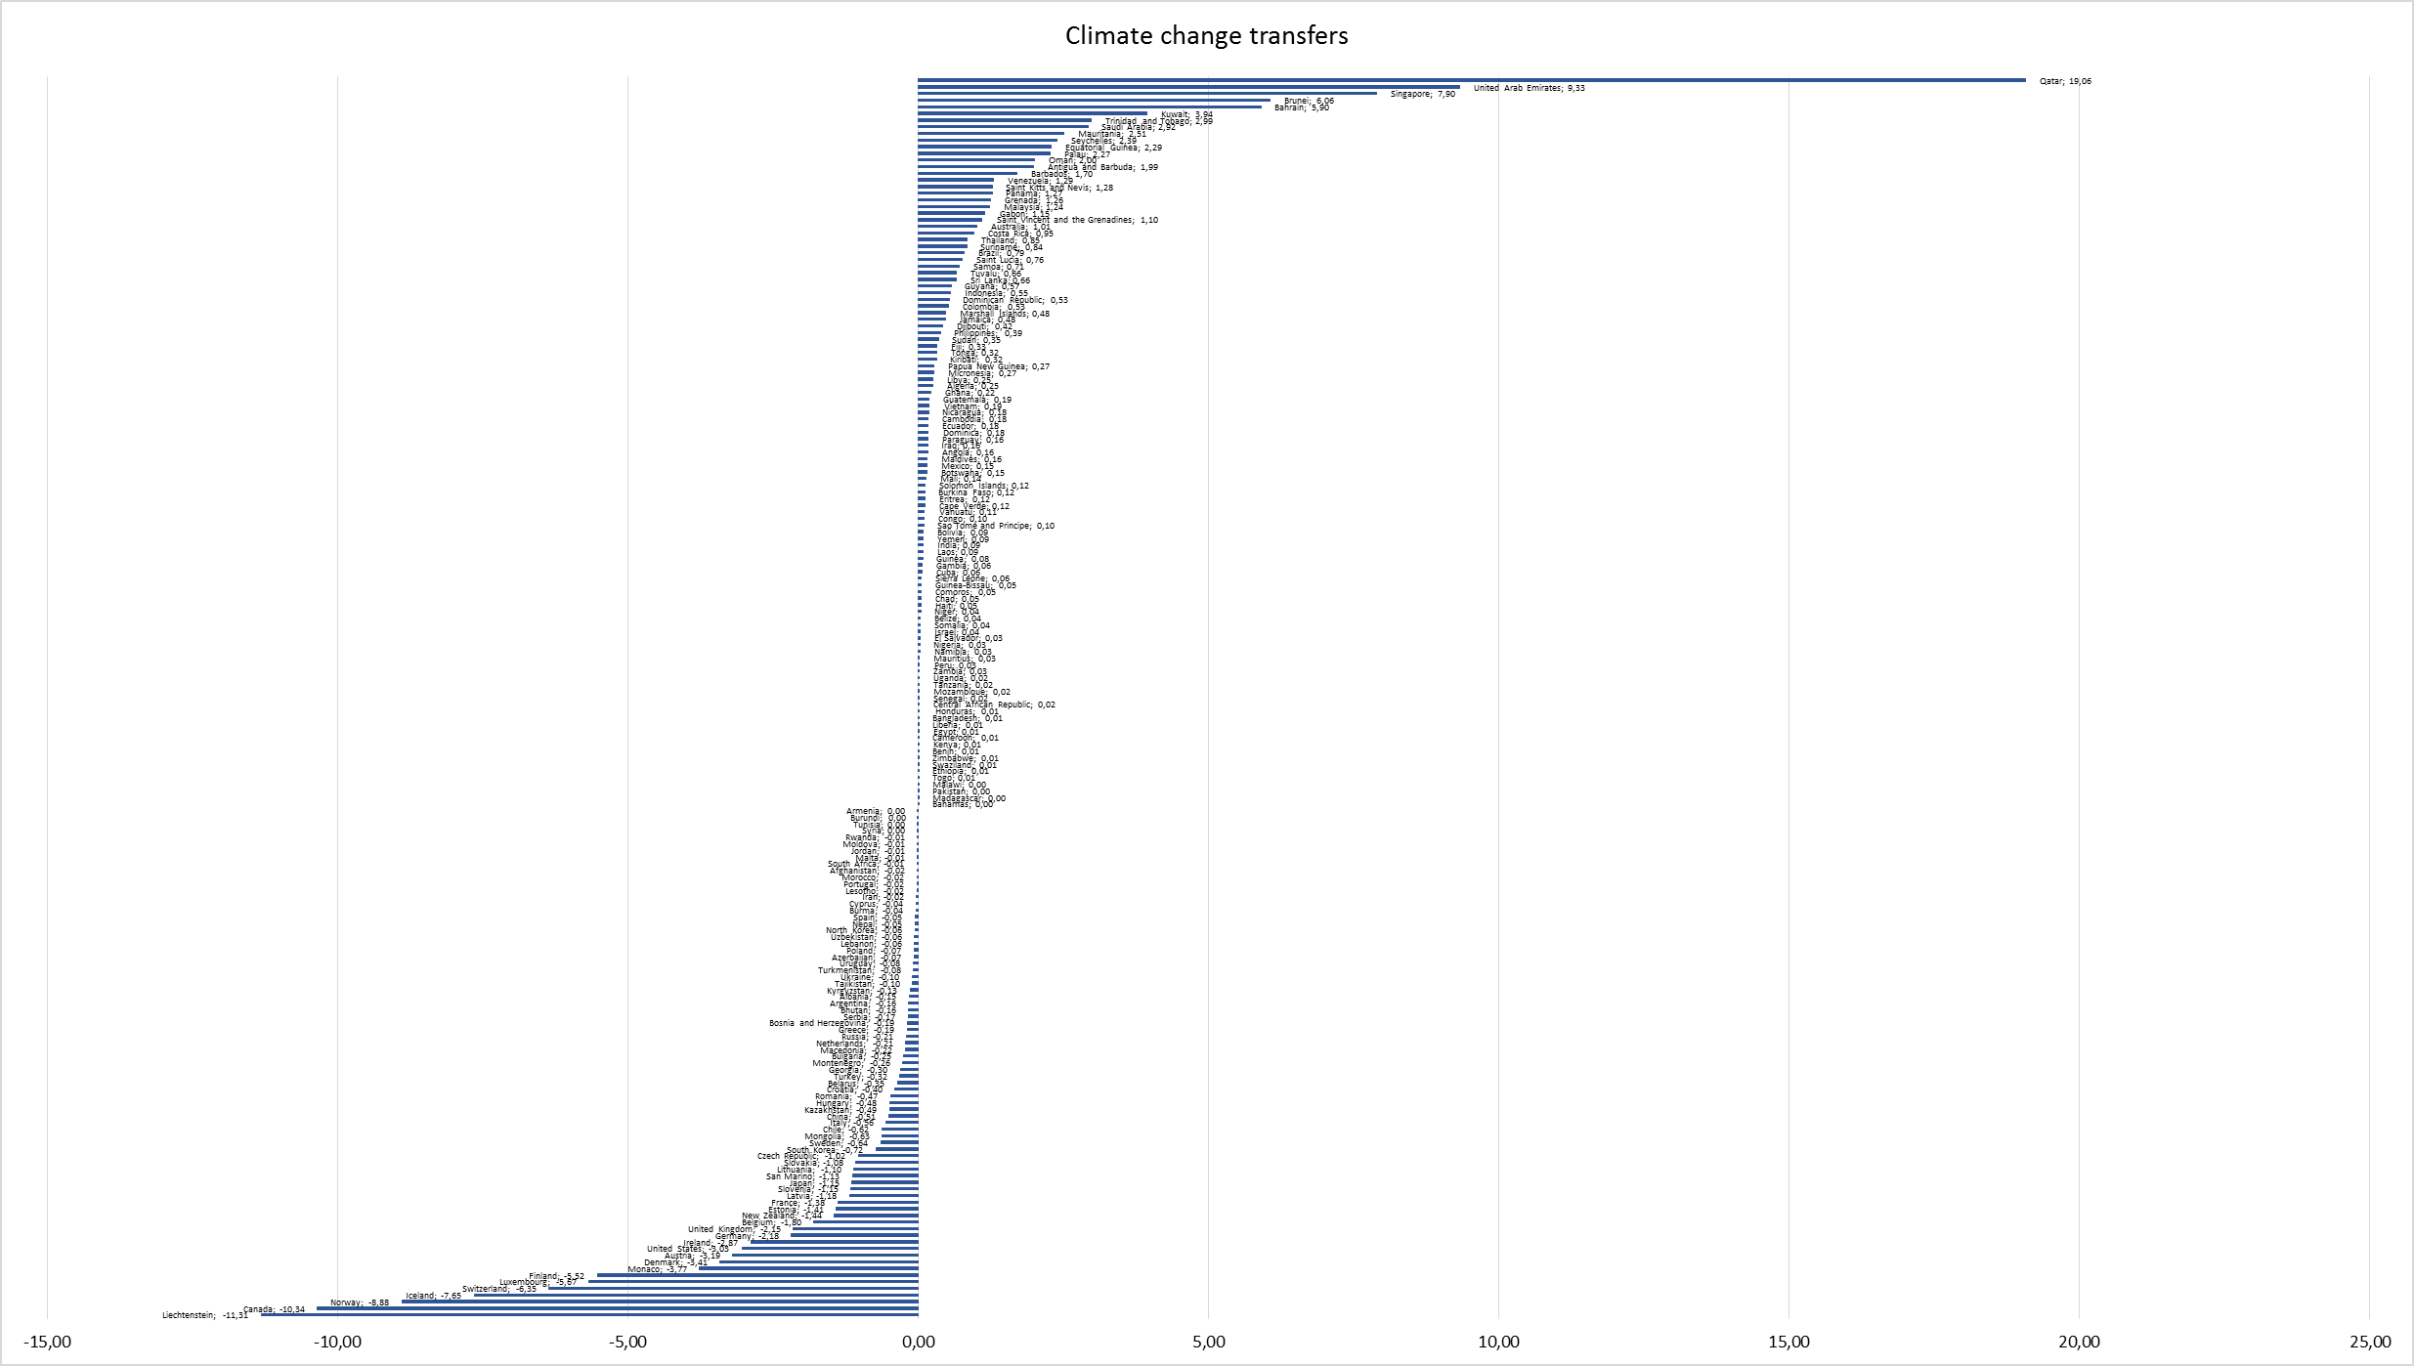
Climate change benefits transfers

Slide 30
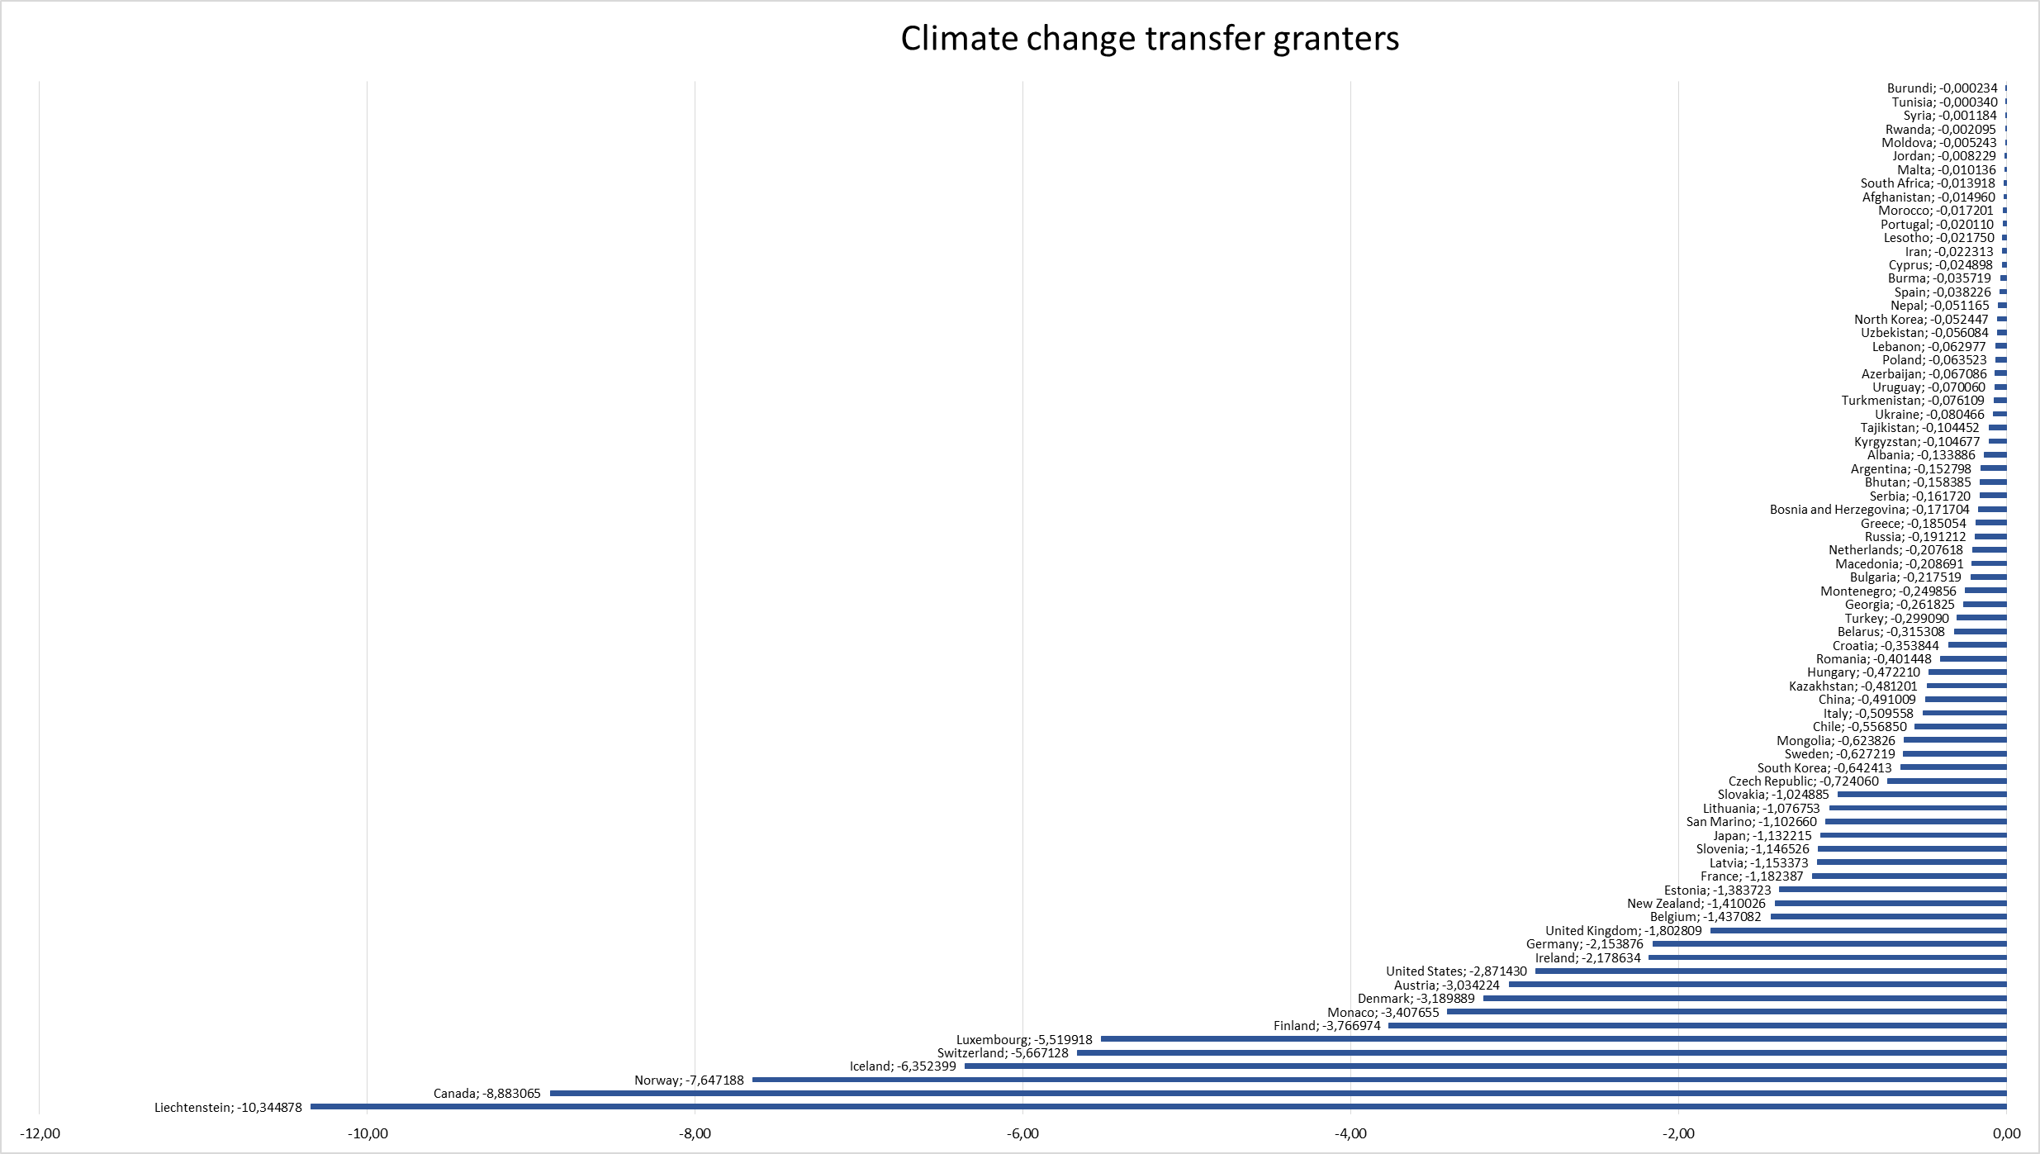
Transfer grantors weighted per GDP/inhabitant

Slide 31
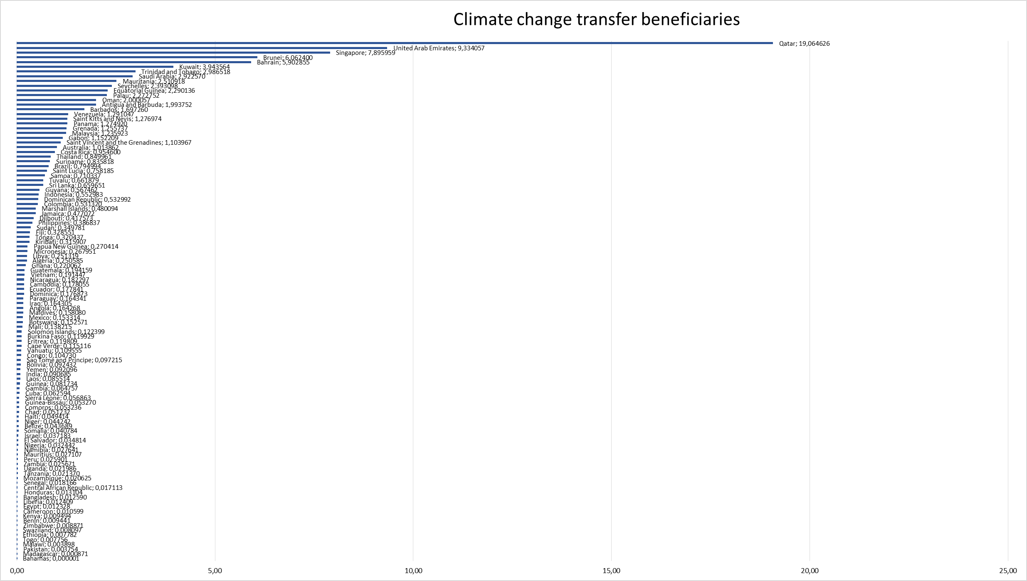
Transfer beneficiaries weighted per GDP/inhabitant

Slide 32
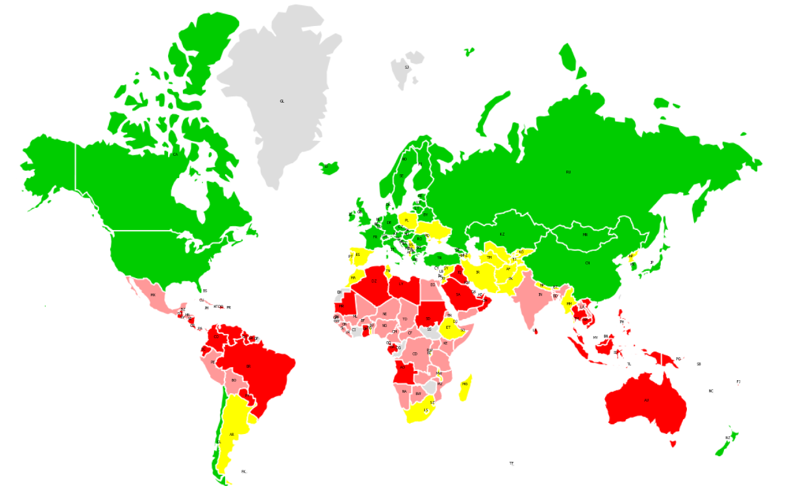
Climate change grantors and beneficiaries

Slide 33
Human capital & Finance streams: Migration
Climate induced migration
When investigating the relation of human migration and climate change winners and losers in 187 countries of the world, a highly significant correlation (rPearson(187)=.184, p < .006), is found between being climate change winner and human migration inflows.
A highly significant independent t-test with t(185)=-2.401, p=0.017 of 110 climate change loser and 77 winner countries consolidates the finding.

Slide 34
Human capital & Finance streams: Foreign Direct Investment
Financial inflows
When investigating the relation of financial inflows and climate change winners and losers including 181 countries of the world, a significant correlation (rPearson(181)=.180, p < .016), is found between being climate change winner and FDI inflows.
A highly significant independent t-test with t(179)=2.680, p=0.008 of 110 climate change loser and 77 winner countries consolidates the finding.
As a cross validation of lasting financial inflows into climate change winner countries, a non-significant correlation and non-significant independent t-tests are reported.

Slide 35
An inquiry into the nature and causes of Climate Wealth of Nations
Climate flexibility

Slide 36
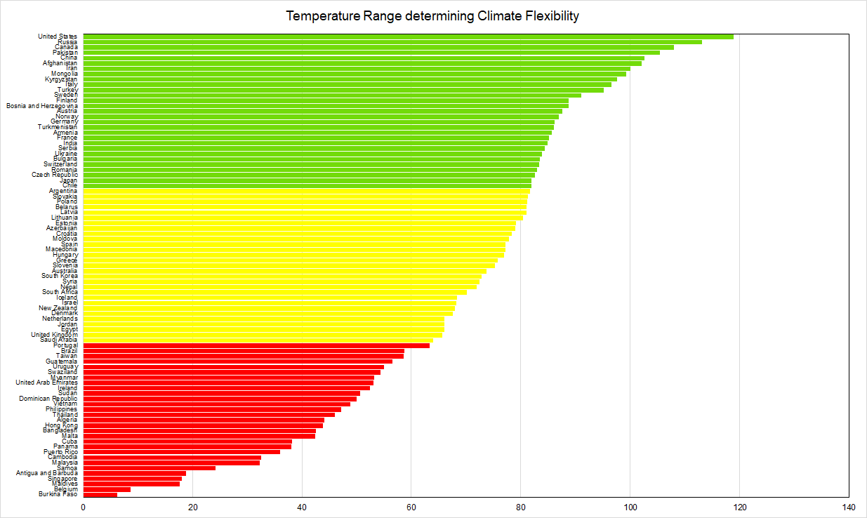
Climate Wealth of Nations: Climate Flexibility

Slide 37
An inquiry into the nature and causes of Climate Wealth of Nations
Climate change induced market flows

Slide 38
Human capital & Finance streams: Migration
Climate induced migration
When investigating the relation of human migration and climate change flexibility in 86 countries of the world, a highly significant correlation (rPearson(86)=.307, p <.002), is found between being climate flexibility and human migration inflows.

Slide 39
Mapping Climate Justice
Fairness within country
Progressive tax
Should we tax former world inhabitants?
inheritance tax to reap wealth built on past pollution
Fairness between country
Private property or common good
→ Public access to stable climate trumps
Corporate taxation justification
Governments with better ability to protection and conservation have higher responsibility to carry burden
Fairness over time
Climate change burden sharing with bonds
Gestalt: Whole > Σ parts over time: tipping points & irreversible lock-ins

Slide 40
Intergenerational equity 08-09/11
n=110 experts, European Forum Alpbach, Austria, EU Absolute frequencies of categories mentioned in speeches/interviews comprising 48,460

