Slide 1
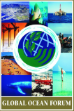
Addressing the Ocean and Climate Nexus: The Time to Act is Now
Biliana Cicin-Sain
President, Global Ocean Forum
Climate Change, Coasts and Communities Symposium
April 17, 2019, Monmouth University
With support from

Slide 2
The Ocean and Climate Nexus
The ocean plays a key role in regulating the climate system producing oxygen, storing carbon, and absorbing anthropogenic heat. In turn, changes in the climate have significant impacts on the ocean, including ocean warming, acidification, deoxygenation, sea level rise, and altering currents and oceanographic conditions, all of which have accelerated significantly in recent years, and all of which have significant impacts on peoples and economies.
The wide range of impacts arising from climate change on the oceans and on peoples and economies in 183 coastal and island nations demands urgent action and investment to protect marine environments and peoples and economies and should be addressed at all levels of policymaking both for the survival of planetary health and for human well-being.

Slide 3
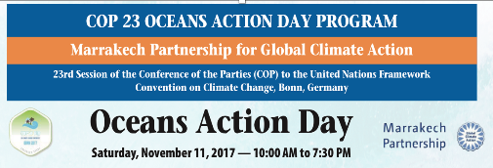
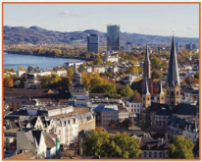
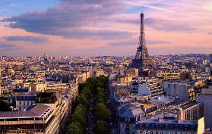

Slide 4
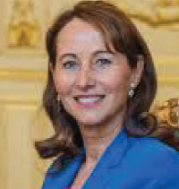
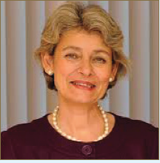
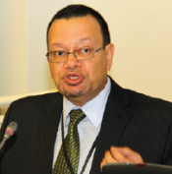
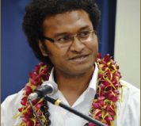
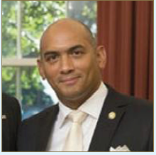
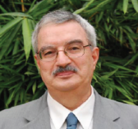
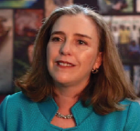
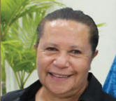
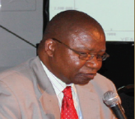
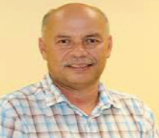
Examples of High Level Speakers at Oceans Action Days
H.S.H Prince Albert II, Sovereign Prince of Monaco
H.E. Minister Ségolène Royal, Minister of Ecology, Sustainable Development and Energy, France
Dr. Irina Bokova, Director-General, United Nations Educational, Scientific and Cultural Organization (UNESCO)
Ambassdor Ronald Jumeau
Seychelles
Mr. Luke Daunivalu, Ministry of Foreign Affairs, Fiji, Member, SIDS, UNFCCC Adaptation Committee
Dr. Angus Friday, Ambassador to the United States, Grenada
Dr. Braulio Ferreira de Souza Dias, Executive Secretary, Convention on Biological Diversity Secretariat
Mr. Karmenu Vella, Commissioner on Environment, Maritime Affairs and Fisheries, European Commission
Ms. Paula Caballero, Senior Director, Environment and Natural Resources Global Practice, World Bank
Dame Meg Taylor, Secretary-General, Pacific Islands Forum Secretariat
Dr. Hashali Hamukuaya, Executive Secretary, Benguela Current Commission, GEF/UNDP/UNEP African Large Marine Ecosystem Projects
Dr. Vladimir Ryabinin, Executive Secretary, Intergovernmental Oceanographic Commission/UNESCO
Dr. Colin Tukuitonga, Director General, Secretariat of the Pacific Community (SPC)

Slide 5
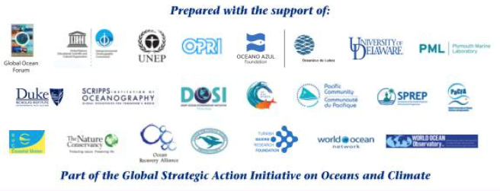

Slide 6
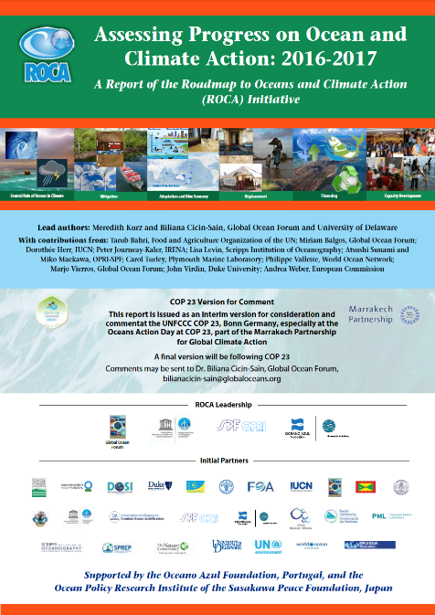
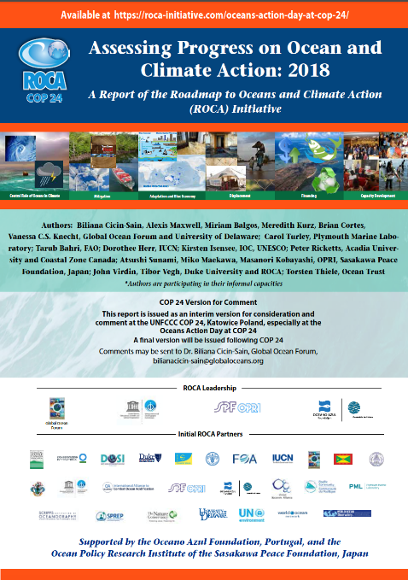

Slide 7
Agenda for Action
Approach the Oceans and Climate Issues in an Integrated Manner
Constantly Monitor and Assess the Impacts of Climate Change on the Oceans and on Coastal Areas and Peoples
Mobilize National and International Policy Responses to the Oceans and Climate Nexus

Slide 8
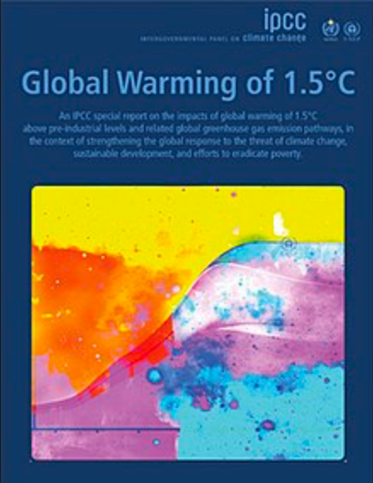
IPCC 1.5ºC Report
The IPCC Special Report on Global Warming of 1.5°C (2018)
--An outcome of the UNFCCC COP21, SIDS nations push for “1.5°C to stay alive”
--A landmark report with far reaching implications for all climate change action and with special relevance to oceans and coasts

Slide 9
IPCC 1.5ºC Report
The predicted impacts of climate change are coming much earlier than expected
--We will most likely reach a warming of 1.5°C as early as 2030 and no later than 2052, posing immediate threats to peoples and ecosystems around the world, especially in 183 coastal countries and SIDS
There is a marked difference between keeping to a 1.5℃ scenario versus a 2℃ scenario
--Under a 1.5°C scenario, very adverse impacts may be avoided (displacement of millions of people due to sea level rise, increased frequency and intensity of storms, death of coral reefs)
Limiting global warming to 1.5°C will require "rapid and far-reaching" transitions in land, energy, industry, buildings, transport, and cities

Slide 10
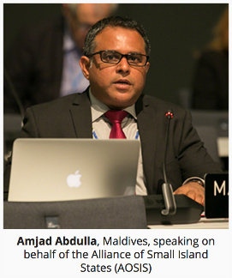
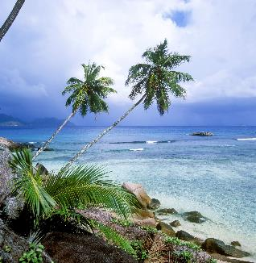
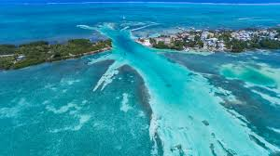
Implications of the IPCC 1.5ºC Report
Amjad Abdulla, Alliance of Small Island States and IPCC Board member noted: “….I have no doubt that historians will look back at these findings as one of the defining moments in the course of human affairs. I urge all civilized nations to take responsibility for it by dramatically increasing our efforts to cut the emissions responsible for the crisis and to do what is necessary to help vulnerable people respond to some of the devastating consequences we now know can no longer be avoided.”

Slide 11
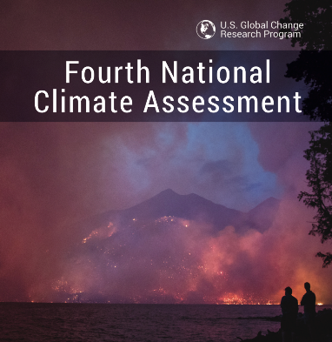
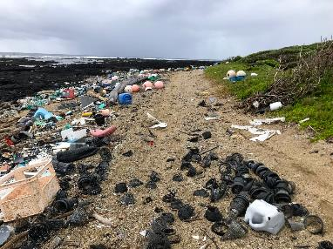
US 2018 Climate Change Report
--Other reports evoke a number of points raised in the IPCC 1.5°C report
--For example, the US Climate Change report (November 2018) examines developments at a national level in the United States
--The US Report underlines that negative impacts of climate change are not a hypothetical future scenario but are already causing damages to US lives and livelihoods ……through a combination of ocean warming, sea level rise, ocean acidification, coastal erosion, more intense storm surge, and an increased number of heavy precipitation events

Slide 12
Agenda for Action
Approach the Oceans and Climate Issues in an Integrated Manner
Constantly Monitor and Assess the Impacts of Climate Change on the Oceans and on Coastal Areas and Peoples
Mobilize National and International Policy Responses to the Oceans and Climate Nexus

Slide 13
1. Address the Ocean and Climate Nexus in an Integrated Manner
Ocean and climate issues should be addressed at all levels of policy (national, subnational, international) as an inter-related “package” of issues including inter alia:
--Recognizing the central role of oceans in climate
--Mitigation (e.g., ocean energy, Blue Carbon, reduce
air emissions from ships, carbon capture and storage)
--Adaptation
--Blue Economy
--Population displacement
--Financing
--Capacity development

Slide 14
2. Constantly Monitor and Assess the Impacts of Climate Change on the Oceans and on Coastal Areas and Peoples

Slide 16
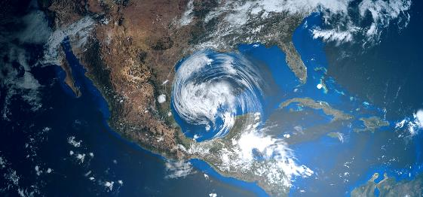
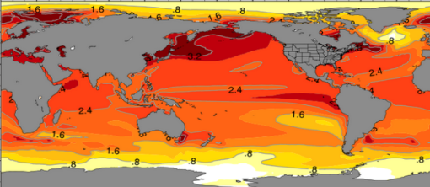
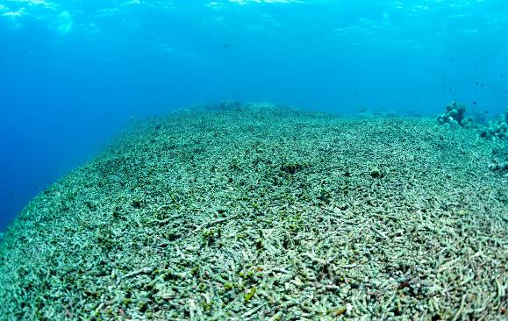
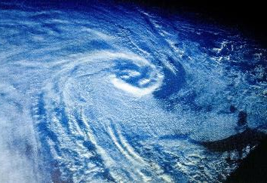
Troubling Trends
Ocean warming 2015, 2016, 2017 warmest years on record
Unprecedented tropical storms in 2017 and 2018
Tropical
coral reefs unlikely to survive at current emission rates
Weakening Atlantic circulation

Slide 17
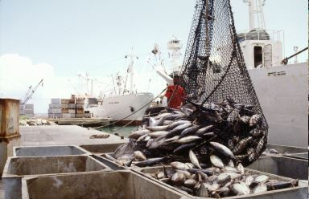
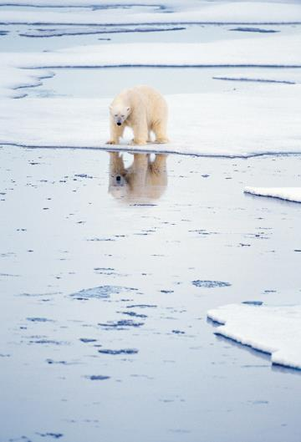
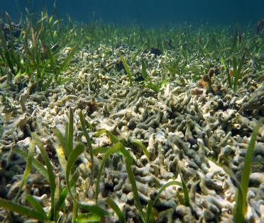
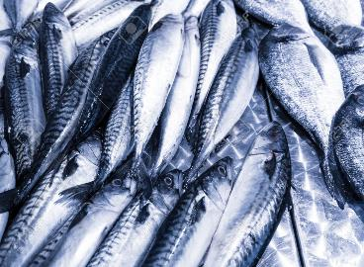
Troubling Trends Cont.
Continuing loss of Arctic
sea ice
Reduction in fish catch by 30% in tropics by 2050 with 1.4 billion people at risk
Acidity of the global ocean increasing 30% relative to pre-industrial times

Slide 18
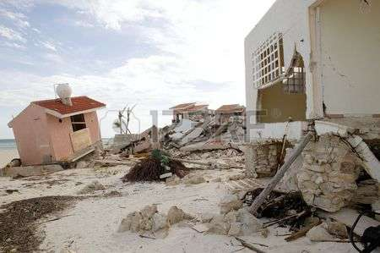
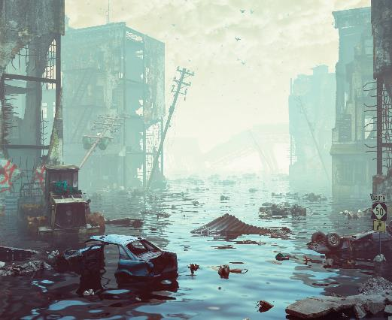
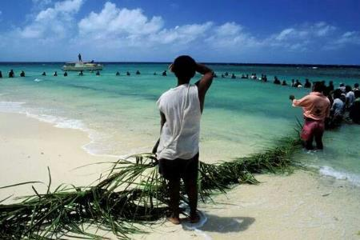
Troubling Trends Cont.
Damages to coastal infrastructure and peoples around the globe
For SIDS the threat of sea level rise is four times the global average. Some face submergence and trillions of dollars in losses
Increased population displacement due to environmental disasters and
climate change–140 million people could be displaced by 2050

Slide 19
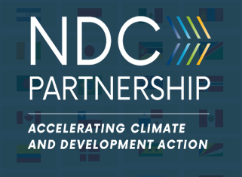
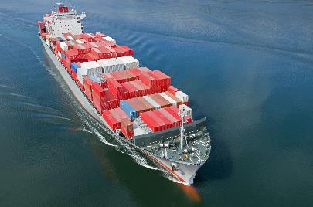
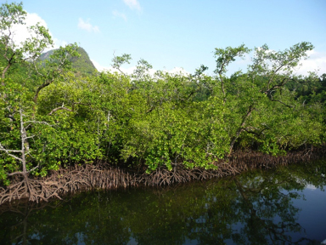
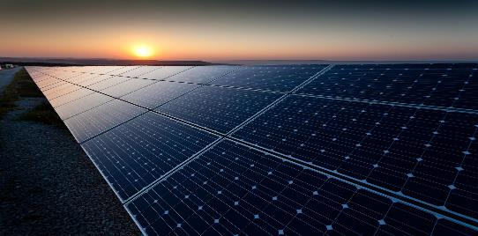
Encouraging Policy Responses
70% of Nationally Determined Contributions address ocean and coastal issues
Increased commitment by the International Maritime Organization (IMO) to reduce 50% of emissions from shipping by 2050
Increased effort of the Renewable Energy Agency (IRENA) in building energy independence for Small Island Developing States
Worldwide restoration of lost
Mangroves resulting in avoided emissions

Slide 20
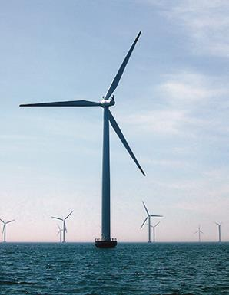
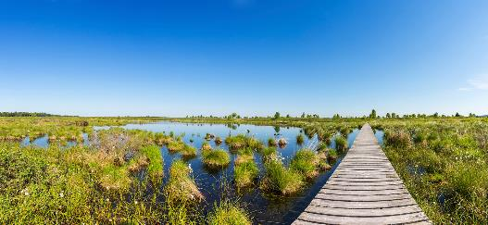
Encouraging Policy Responses Cont.
World Bank 1 billion USD commitment to advance the sustainable oceans and Blue Economy agenda in developing countries
World’s largest offshore wind facility in the United Kingdom
The Least Developed Countries Fund (LDCF) and the Special Climate Change Fund (SCCF) have increased adaptation projects and programs
New financing initiatives like the Blue Natural Capital Financing Facility (BNCFF) have emerged

Slide 21
Encouraging Policy Responses Cont.
The European Union has maintained investment supporting an All-Atlantic Ocean Research Alliance, with research teams from the Arctic to the Antarctic
Our Ocean Conference in Bali, Indonesia, resulted in 48 tangible and measurable commitments specifically regarding the blue economy
Emergence of private-sector finance, such as corporate climate bonds

Slide 22
3. Mobilize National and International Institutions on the Oceans and Climate Nexus
National level: Decarbonization of national economies, move to alternative sources of energy, address the impacts on coastal and island comunities and economies
International level:
Act within the UNFCCC and in other international fora
But difficult to advance the oceans and climate issues in UN fora given separate authorities on oceans, climate, biodiversity, etc.

Slide 23
Within the UNFCCC
A step by step approach was identified in 2018 to develop a vision and agenda related to the oceans and climate nexus for the period 2019-2021.
COP 25 Chile, the “Blue COP”?
1. Consider two IPCC Reports and their implications for mitigation and adaptation related to oceans and coastal and island populations
2. Consider points related to oceans and coasts in the Paris Rulebook and in the Global Stocktake
3. Support the ocean content and ambition of Nationally Determined Contributions (NDCs)
4. Ocean financing to support nations in addressing the multiple and difficult challenges they are facing, and systematic understanding of the existing patterns of financial flows

Slide 24
Within Other UN and International Fora
Work and discussions on the oceans and climate nexus taking place in the context of the UNFCCC must also be synchronized and coordinated with oceans and climate initiatives in other UN fora
--2019, G20 Summit, Osaka, Japan, June 28-29, preceded by S20 Science 20
--2019 UN Secretary General’s Climate Summit, September 23, 2019
--Release of the IPCC Report on Ocean and the Cryosphere, September 2019
--Work on the Decade of Ocean Science for Sustainable Development
--Implementation of Agenda 2030 (especially Goal 14 (oceans) and Goal 13 (climate change)
--Bringing the climate issues into the BBNJ negotiations (biodiversity in areas beyond national jurisdiction) (ongoing)
--2020 projected UN Ocean Conference
Increased informal efforts led by specific nations
--Our Ocean Conferences in Norway in 2019, and Palau in 2020

Slide 25
The IPCC Ocean and Cryosphere Report
The IPCC Report on the Ocean and Cryosphere, to be released September 19-23, 2019 in Monaco, will give us a key opportunity to focus the world’s attention on the effects of climate change on oceans and coasts and how we address these impacts
Efforts underway to bring key journalists and key scientists together to interpret and widely disseminate the findings

Slide 26
In Conclusion
We must do our work with a great sense of urgency. A changing climate and continued loss of biodiversity in our oceans and coasts, is a powerfully negative combination that threatens our planetary survival and our human well-being.
The time to act is now, not tomorrow. As the very young people exemplified by young Helga of Sweden have said—”Your lack of action is denying us our future.” This just cannot be.

Slide 27
Acknowledgements--COP 24 and 2018 Progress Report Support
COP 24 Oceans Action Day: Ocean Policy Research Institute of the Sasakawa Peace Foundation, Japan ; Oceano Azul Foundation, and the Government of Sweden, The Ocean Pathway (Governments of Fiji and Sweden), Intergovernmental Oceanographic Commission, UNESCO, Food and Agriculture Organization of the United Nations, International Union for the Conservation of Nature
Progress Report 2018 Contributors: Biliana Cicin-Sain, Alexis Maxwell, Miriam Balgos, Meredith Kurz, Brian Cortes, Vanessa C.S. Knecht, Global Ocean Forum and University of Delaware; Carol Turley, Plymouth Marine Laboratory; Tarub Bahri, FAO; Dorothee Herr, IUCN; Kirsten Isensee, IOC, UNESCO; Peter Ricketts, Acadia University and Coastal Zone Canada; Atsushi Sunami, Miko Maekawa, Masanori Kobayashi, OPRI, Sasakawa Peace Foundation, Japan; John Virdin, Tibor Vegh, Duke University and ROCA; Torsten Thiele, Ocean Trust

